Slide 1
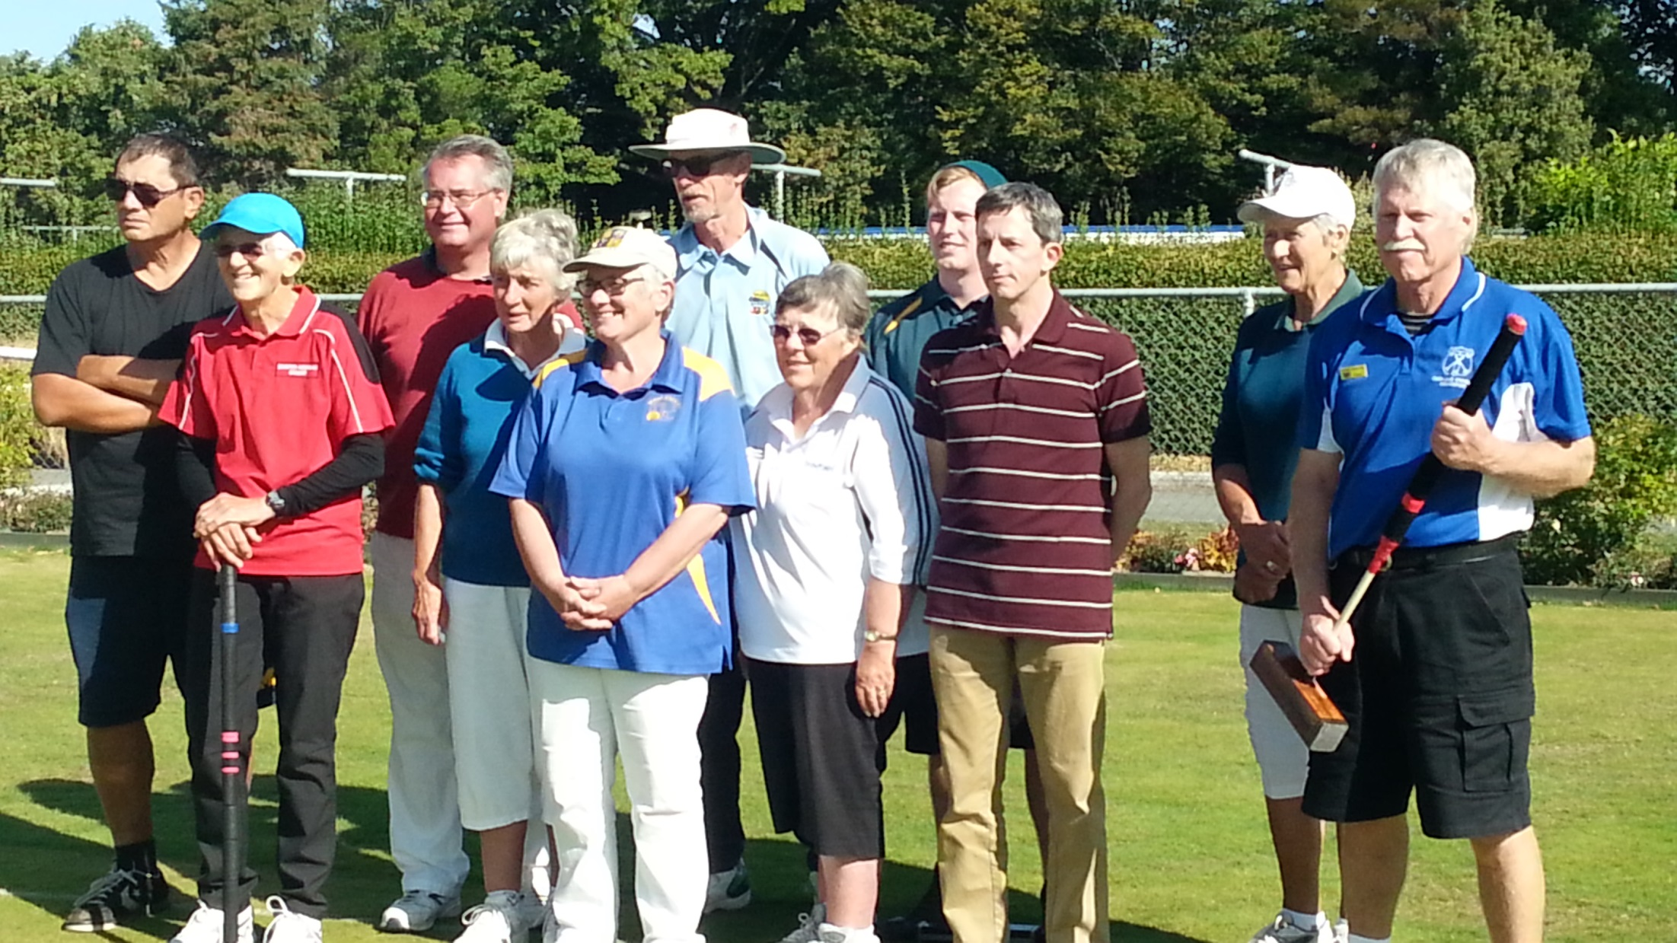
Teaching older athletes new tricks – coaching croquet through Game Sense Dr Jenny Clarke, University of Canterbury

Slide 2
A different context, and a different demographic

Slide 3
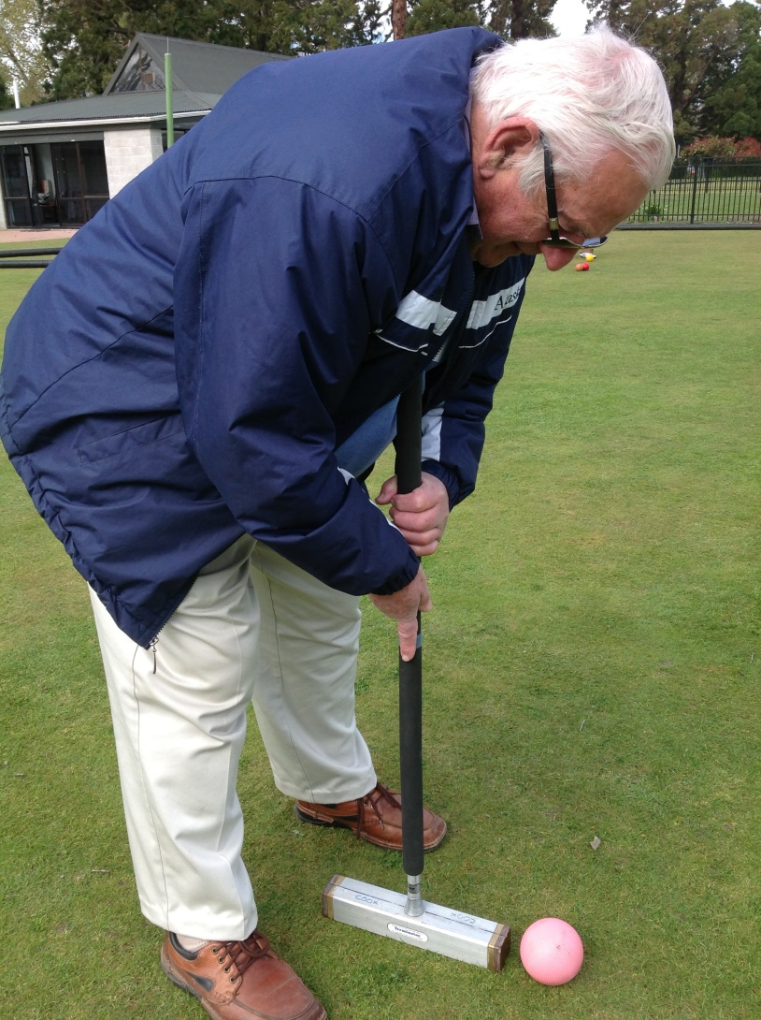
Historical approaches

Slide 4
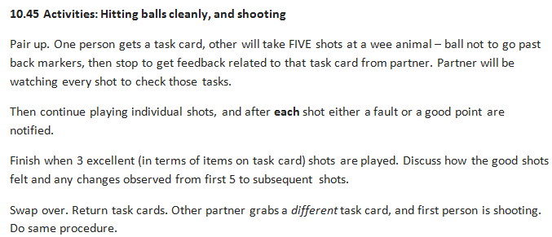
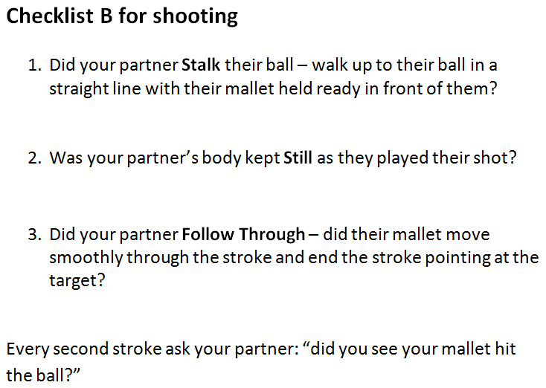
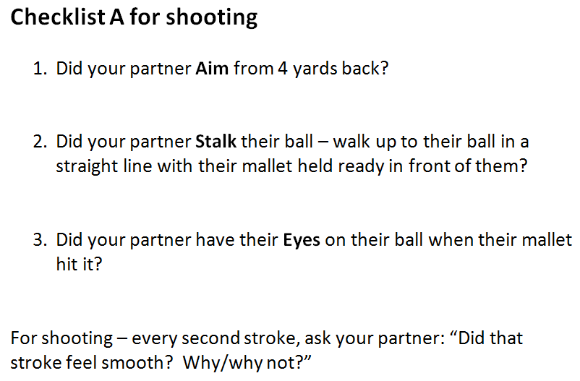
Taking an athlete-centred approach

Slide 5
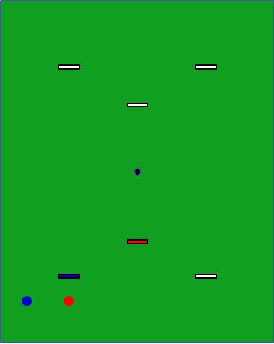
Game Sense croquet
Session 2: 12.55-2
12.55 Tactical session: 1-ball hoop games
Played in pairs. Red v Blue.
Start with red 1 yard directly in front of a hoop, blue 2 yards directly to the side of red. Blue to play. Compete until someone has won that hoop. Think about the tactics used.
Reset and play again- total of 5 games. Then swap roles - Both players should have turns at being red and being blue. 5 games starting as blue, and 5 starting as red.
Discussion (for coaches with players as they finish individual games): what have we learned here?, what were the choices you had, and why did you make them?
Hope to have participants comment on use of clearing mid-pace rather than fast, the importance of a central contact, estimating oppo probability of running hoop. No need to tell players anything – will have group discussion after some time and will give opportunities for players from other pairs to come up with ideas. Group discussion about game follows

Slide 6
What happened?
Coach observations:
More discussion
More enthusiasm
Depth of understanding

Slide 7
Observations 2: CCA President
comments a lot more positive and heartfelt than usual

Slide 8
Observations 3: the athletes
“I really enjoyed myself…while I had come along today, I had been thinking of not playing any more… the two sessions I had with a friend had been very confusing. …I am understand what I am doing”
“I had a huge amount of fun”
“I really got the _feel_ for using a followthrough in my swing” (her emphasis).
She said last year she had a followthrough with her swing because I told her to, but this year she really understood it, and was thrilled at how it worked.

Slide 9
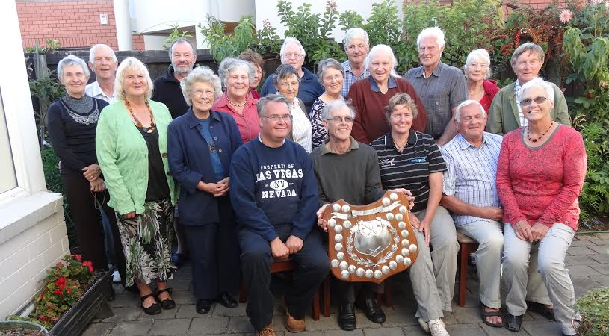
References
Light, R. L. (2013). Game Sense: Pedagogy for performance, participation and enjoyment. London & New York: Routledge.
Light, R. L. (2014) ‘Learner-centred pedagogy for swim coaching: A complex learning theory informed approach’. Asia-Pacific Journal of Health, Sport and Physical Education, 5(2), 167-180.

