Slide 1
2015 Games Sense for teaching and coaching conference
University of Canterbury
Christchurch
New Zealand

Slide 2
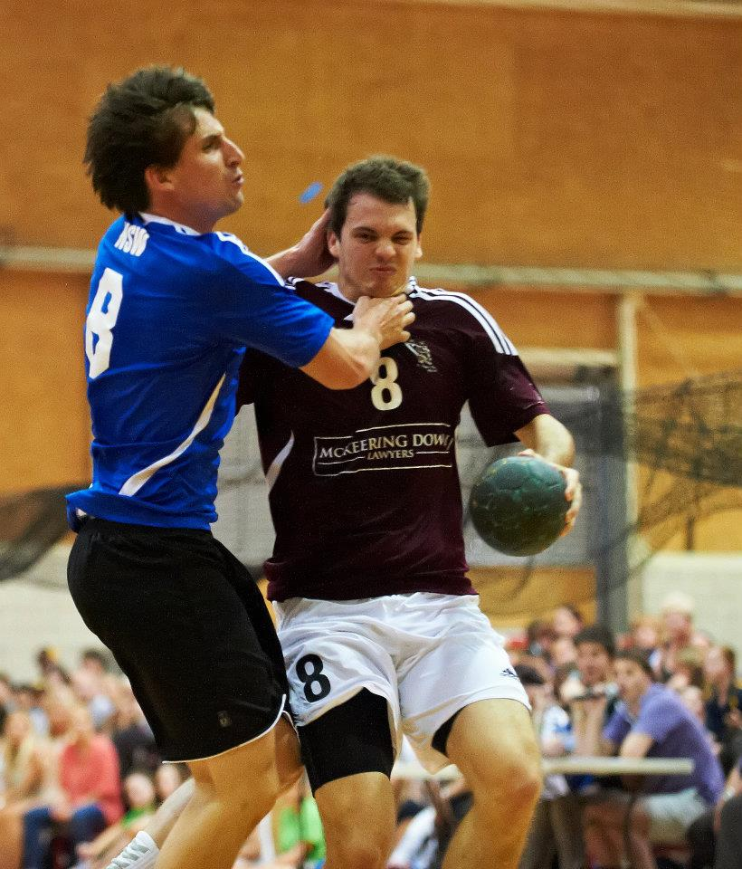
Games Sense meets Inquiry meets Mosston and Ashworth in the Olympic sport of Handball
The Olympic sport of Handball is a dynamic, fun and challenging. HPE teachers in Oceania are becoming more switched on to the possibilities of this fast paced, exciting and user friendly team sport that is enormously popular around the world.

Slide 3
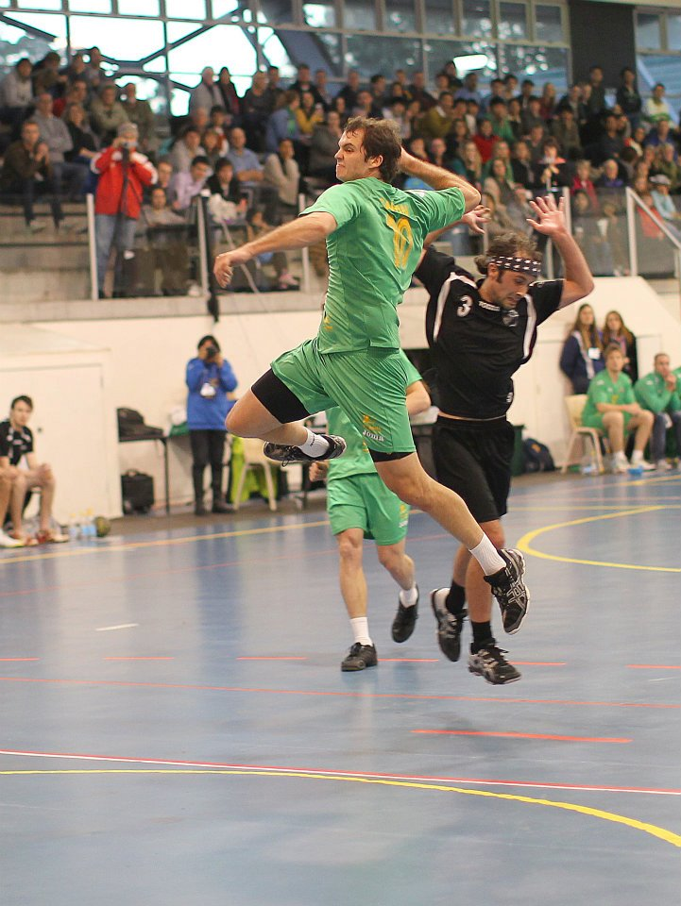
Utilising Handball in HPE classes
Can we use Games Sense, Inquiry and Mosston and Ashworth’s production teaching styles in a unit of work discovering the inclusive and diverse possibilities of Handball?
I contend that we can.

Slide 4
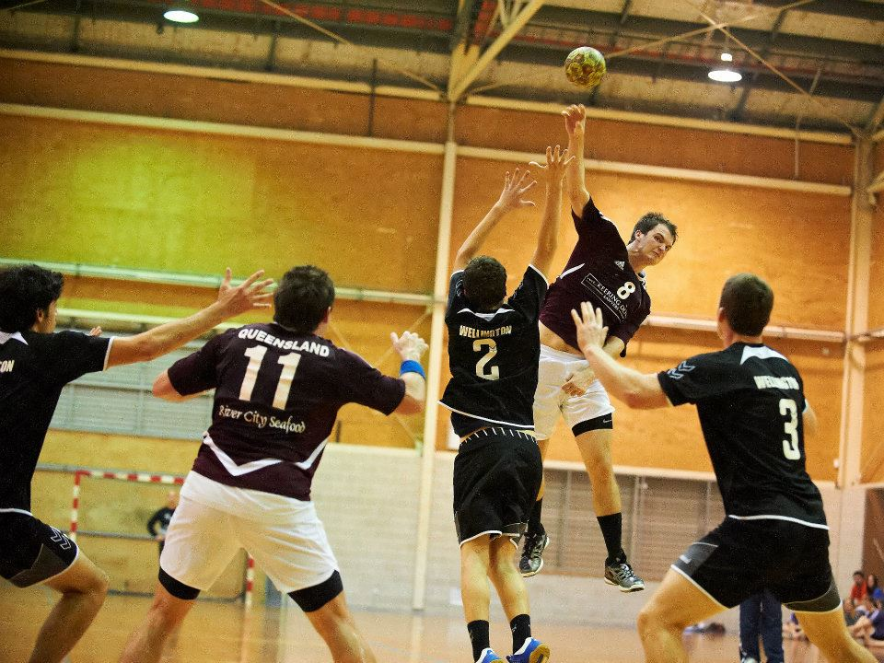
What are the commonalities between Games Sense, Inquiry and the Production Teaching Styles?

Slide 5
Inquiry style of teaching
characterised by students being provided with learning experiences where processes of learning outcomes are arrived at with gentle guidance by the teacher.
teacher acts as a facilitator by presenting a combination of structured and framed questions, problems, examples and learning activities.
‘process-oriented’ - focus is more on the learning process than the final product or outcome.
environment that is free of fear of failure as students experience learning situations that require them to inquire, speculate, reflect, analyse and discover answers on their own.
students have the opportunity to think and be creative and develop a greater understanding of the subject matter, thereby strengthening their self-concept.
Notes:
In the case where the subject matter appears to have specific solutions (for example, motor skills), critics of this approach indicate that too much time is spent on one topic when one ‘best’ way to perform has been established and as such this is too time-consuming an approach. However, there is overall agreement that students need to be involved in their learning process and, along with the inquiry style, the guided discovery and problem-solving styles provide students with more control over the direction and content of the learning process.

Slide 6
Invasion Games
In Invasion games the aim is to score more points within the time limit than the opposing team, while endeavouring to keep their score to a minimum.
A variety of sporting patterns is evident: Handball is an example - the ball can be thrown or shot into a target

Slide 7
Games Sense or
Teaching Games for Understanding (TGfU) (Bunker & Thorpe),
Game Sense uses games as the focus of the session rather than technique practice,
Players are encouraged to:
1. become more tactically aware and make better decisions during the game
2. begin to think strategically about game concepts whilst developing skills within a realistic context and most importantly,
3. have fun.
By focusing on the game (not necessarily the 'full' game), players are encouraged to develop a greater understanding of the game being played.
Students are more tactically aware and therefore able to make better decisions during the game.
Skills are being developed within a realistic and enjoyable context rather than practiced in isolation
http://www.activehealth.uow.edu.au/gamesense/index.html

Slide 8
The spectrum of teaching styles
Began in 1966 when Muska Mosston developed the Spectrum of Teaching Styles.
The Spectrum of Teaching Styles was based on the premise that teaching is a chain of decision making, i.e., who makes the decisions and when and what are the intentions or purpose.
Mosston - health and physical education lessons could be conducted using a variety of ‘styles’.
The styles are contingent upon:
    the purposes of the lesson
    the lines of communication
    proposed channels of development
At no time did Mosston suggest that one style is better than another.
Notes:
8

Slide 9
A Teaching Style
A plan of action that defines the specific decision interaction of the teacher and the learner for the purpose of leading to the development of specific objectives in subject matter and behaviour.
Notes:
9

Slide 10
Spectrum of Teaching Styles
Reproduction:
Style A – Command
Style B – Practice
Style C – Reciprocal
Style D – Self Check
Style E – Inclusion
Production:
Style F – Guided Discovery
Style G – Convergent Discovery
Style H – Divergent Discovery
Style I – Learner Designed Individual Program
Style J – Learner Initiated Program
Style K – Self Teaching

Slide 11
Self-Teaching style – Most activities where skills or tasks can be done on an individual basis. (More child centered)
Inclusion style – Perhaps more of a philosophical position than a style – the principle though is one were everyone can participate.
Guided Discovery – Using a series of steps to allow children to ‘discover the correct response’ – games particularly well suited. (Child centered)
Convergent Style – Using a series of steps to allow students to ‘discover the correct response’ for a new problem where the response is not previously known to students – games particularly well suited. (Child centered)
Divergent Style – Allows students to design own responses to tasks – well suited to games of all kinds. (Very child centered)

Slide 12

The logical and sequential design of a series of questions that lead a person to discover a predetermined concept, principle, relationship or rule that was not previously known.
The teacher asks one student a series of specific questions;* each question has only one correct answer. The questions are logically sequenced so that each answer leads the student step by step to discover the answer– the idea, concept or solution—that is anticipated.
Content appropriate for Guided Discover includes principles, rules, concepts, and relationships.
*Note: There are cognitive liabilities when this style is used in a large group. The discovery process is interrupted per student in a group setting; therefore, the content acquisition cannot be guaranteed for each student.

Slide 13

To produce the anticipated/target answer to a question not experienced before.
A stimulus in the form of a question, situation or problem to solve, is provided that invites reshuffling of known information to produce new or novel cognitive links and patterns that rely on logic, and perhaps trial and error, to produce the anticipated/target answer.
If the learner has been exposed to the question-answer previously, then the teaching style and its objectives are no longer Convergent Discovery but Practice Style-B.
The teacher designs a situation or question that has one specific correct response—the situation or question is new and the response is not previously known to students. The learners are given individual and private time to use their thinking and questioning skills, reasoning, and logic to discover the anticipated answer.

Slide 14

Each learner produces-discovers divergent (multiple) responses to a single question, situation or problem within a specific cognitive operation.
The teacher designs a single or series of problems, situations or questions that seek multiple solutions to the same problem. The task is new to the students; therefore, each student is invited to discover new possibilities, as they produce multiple (divergent) responses to the specific problem.

Slide 15
What Does Research Tell Us?
Seidentop “over 90 percent of all the lessons observed in teaching research in health and physical education fit the teacher directed format” (1983)
Cothran et al. (2005) found that the Command and Practice style were the 2 most commonly occurring styles used by QLD teachers of HPE
Teachers spend “most of their time using direct styles of teaching” (Curtner-Smith, Todorovich, McCaughtry & Lacon, 2001, p177).
“Teachers spent the greatest percentage of time (55.97%) utilising the practice style, style B” (Hasty, 1997, p52.)

Slide 16
What does this mean in teaching a game like Handball?
What do the students need to know to be able to play the game?
Purposeful, structured and framed questions which require open ended responses allow the students to discover what they need to be able to play.
Which skills and strategies transfer from other games?
When do we need to introduce rules like stepping, one handed throw, 9m line, and contact rules?
What reasons would we have for introducing all rules?
Handball is a new activity for most students… they can draw on prior learning of other games and apply strategies and skills from a variety of games.
Unknown or unfamiliar games provide the best opportunity to experiment with Games Sense .

Slide 17
https://www.youtube.com/watch?v=fTWchrII8cw

