Slide 1
High Performance Coaching:
Comparison between a highly successful coaches' approach and Game Sense
Pimenta, R. M. & Light, R. L.

Slide 2
Research Question
What are the influences of game based coaching on a highly successful coach’s approach?
  What are the influences of a highly successful coach’s approach on girls experiences in basketball?
Notes:
Compare the highly successful coach’s approach to the Game Sense approach in an exploration of the influence of game based coaching on his practice and of Light’s (2006) suggestion that Game Sense coaching can be seen as just good coaching.

Slide 3
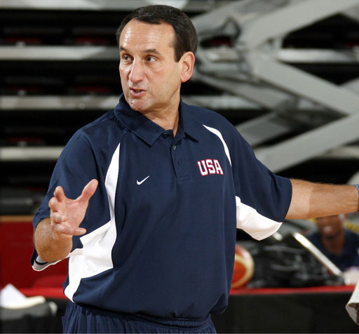
Lit Review
NOTE:
To change images on this slide, select a picture and delete it. Then click the Insert Picture icon
in the placeholder to insert your own image.
Buttler (1997) - Coaches enable athlete learning, athletes develop their knowledge when involved in problem solving situations for themselves.
Light (2013) stayed with the relatively loose approach to propose a pedagogical framework for Game Sense structured by four pedagogical features and suggesting that there is great variation in regard to the emphasis coaches’ place on these four features
Coaches base their coaching in games and some use questioning but few completely adopt the ‘authentic’ approach of Game Sense or TGfU
Notes:
(BFORE 1ST POINT) There has been a considerable amount of research done on tactical approaches to teaching games such as Game Sense (GS) and Teaching Games for Understanding (TGfU).
(BFORE 2ND POINT) den Duyn, 1997) proposed a loose guide to coaching that emphasized using practice games, questioning and encouraging players to think and talk about the tactical aspects of team sport.
(2ND POINT) Indeed, research suggests quite different interpretations of Game Sense with many coaches using some features of this framework while ignoring others (see Light & Evans, 2010).

Slide 4
Game Based Approaches
Game Sense Model (Light, 2013)
Traditional Model (Blomquist et. Al, 2001)
Locates learning within modified games to give it meaning and relevance to the full game and develop skills at the same time as understanding
The use of language and reflection of the experiences are the main aspect of learning in GS
Techniques and skills as fundamental to successful play
These skills are trained until they are performed well enough to allow a game to be played
Notes:
Several approaches based on games teaching have been developed over the past thirty years as responses to problems identified within the traditional teaching methods
Few people suggest that there is a clear difference between the two models. Light (2004) suggested that the coaches in his study usually saw an overlap between the two models, and much of what is advocated by GS would be seen as ‘good coaching’.
Light, Evans, Harvey and Hassanin (2015) suggest that coaches operate across a spectrum from a direct instruction, technical approach at one end to an athlete-centred, holistic approach at the other end.
Game Sense teaching is inquiry-based, athlete-centred approach where the coach acts as a facilitator of learning. Games taught using this approach give athletes opportunities to develop problem solving abilities and social skills that they can use in life.

Slide 5
Game Sense Core Features
Designing a learning environment
Emphasizing question to generate dialogue
Providing opportunities for collaborative formulation of ideas/solutions that are tested and evaluated
Developing a supportive socio-moral environment

Slide 6
Coaching style
Peter
  “These (practice) games put them under the same pressure as the game on Friday night so they learn to work together and deal with decision making under pressure”.
  “I mean it is a little bit of both, you want them to have fun, you want them to learn, you want them to learn to play hard, you want them to learn to play as a team because they are life lessons not only there, but you know I’m a teacher so I try to teach them things about life and I just want to see them progress as human beings.”
Notes:
Light (2013) defined four core features for GS to offer a framework for its implementation
Peter’s coaching style, we noticed, through the observations, that he uses some of the features of GS, namely creating a learning environment and developing a supportive environment(BEFORE
(BEFORE 1ST POINT) The observations of Sunday training sessions and competition games Peter would try to create game-like situation where they would try to have similar pressure and intensity to that of a real game but which he managed according to how the girls responded.

Slide 7
Intensity
Jackie
  “I like the intensity in training because it keeps you on the edge and keeps you focused on being your best and is never boring because you have to focus and do your best all the time”
Rachel
  “…everyone comes to training they are prepared to go hard out there.”
  “…the team is training out there and it’s training hard and you are part of that team even if the girls are injured. Like sometimes they’ll pull back but they’ll push themselves until they can’t anymore, they honestly can’t do it anymore they just want to get better for everyone.”
Notes:
In our observations of competition games on Friday nights the team demonstrated good tactical understanding, decision making and composure under pressure
All of the girls nominated intensity as the biggest factor required to make training and playing enjoyable for them as Jackie explains:
Rachel on what she likes (about this team) is when

Slide 8
Supportive environment
Peter
  “I try making it enjoyable. I make it hard for them, there’s no doubt about it, I’m a ‘my way or the highway’ guy and I’m intense but they also know that”.
  “I tell them that it’s about the act. I always tell them, ‘I don’t mean you it’s what you just did’”
  “There has to be a bond of trust between the coaches and the team and the team with the coach. And they have to trust each other. Trust each other and know that each other one cares”.
Notes:
(After 1st POINT) This seems to contradict the more even relationships promoted in GS and other GBA (Evans, 2013) but there was a warm, trusting and respectful relationship between the coach and players with him always encouraging them to be calm under pressure.
(Before 2nd POINT) Peter had a close relationship with all the girls in his team who had immense respect for him. He also respected them but at times, during games and training, he would shout at one of them when she made a mistake. This was, however, never intended to be, or taken as being, personal. During timeouts in game or between/during the exercises he would tell them why he shouted and also give an explanation,
(After 3rd POINT) This demonstrates that not only that he was showing them the correct way of playing but also creating a supportive environment where he could correct anyone without any fear of losing that players engagement

Slide 9
Conclusion
Approximately half of Peter’s practice sessions that we watched based learning in games
He also used some questioning as well as offering some opportunities for the girls to discuss tactics and skill execution in the context of a game.
Peter coached in a way that is very similar to GS as defined in the literature from den Duyn (1997) to Light (2013) and which, despite some differences with the GS approach, seemed to be driven by the same underpinning principles and philosophy.
Notes:
The study was focused on the nature of the girls’ experiences in basketball which meant that the study focused on how Peter’s coaching approach influenced this rather than focusing on the influence of GS on his coaching.
A maneira dele influenciava as experiencias das miudas e que msm nao sabendo o que era GS os core features estavam presentes e esses influenciaram as experiencias das miudas
(After 3rd POINT) Our focus on Peter’s coaching also supports Rod Thorpe’s suggestion that good coaches have long used games in their training with his contribution to GS being the emphasis he placed on questioning and providing some structure for improving and developing the use of training games (Light, 2004).

Slide 10
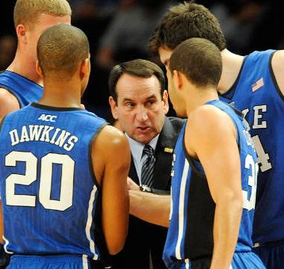
Thank you for listening
Any Questions?

