Slide 1
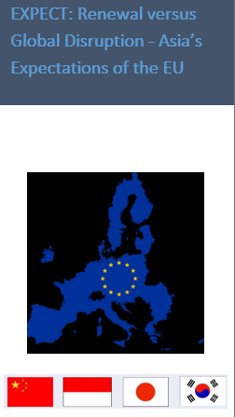

Jean Monnet Network, EXPECT (No. 611168-EPP-1-2019-1-NZ-EPP-JMO-NETWORK)
Martin Holland, Professor & Director
National Centre for Research on Europe
University of Canterbury
2023 EXPECT Grant Findings

Slide 2
EXPECT Network Research Motivations
2020 presented a watershed in how the EU is perceived globally.
Prior to Covid19 global disruption had become a contemporary EU phenomenon.
-- BREXIT challenged integration and EU effectiveness as a global actor.
-- Trump Presidency undermined the TransAtlantic consensus on norms/ values.
-- Russia had re-emerged as a disruptor for Europe.
Together these affect 3rd country expectations of the EU and the continued utility of the EU Global Strategy (EUGS).
EXPECT traces the impact of this new context on expectations towards the EU from the perspective of four key EU Asian partners – China, Indonesia, Japan and Korea
EXPECT’s conceptual innovation is from “perceptions” to “expectations” and will trace how the EU’s international role is being redefined through internal (the EUGS and leadership renewal) and external (the global disruption of Trump, Brexit, Russia and latterly Covid19) drivers.

Slide 3




Research Methods
 | Traditional Media Analysis | Social Media Analysis | Key-informant interviews
Time | March-June 2020 & March-June 2021 |  | 2022
Countries
Data | Qualitative & Quantitative |  | Qualitative

Slide 4
Media Analysis (19 Print media)
 | China | Indonesia | Japan | South Korea
Popular Daily | People's Daily | Kompas | Yomiuri Shimbun | Chosun Ilbo
 | - | Republika | Asahi Shimbun | -
 |  | Tempo
Business Daily | Economic Daily | Bisnis Indonesia | Nihon Keizai Shimbun | Maeil Kyungje Shinmun
English-language Daily | China Daily | Jakarta Post | Japan News | Korean Herald
Periodical | Liao Wang (weekly) | Tempo Weekly | Sekai (monthly) | Weekly Donga (weekly)

Slide 5
Social Media Analysis (11 accounts)
 | China | Indonesia | Japan | South Korea
1 | EU Delegation to China’s Weibo (EUinChina) | EU Delegation to Indonesia’s Twitter (EUinIndonesia) | EU Delegation to Japan’s Twitter (EUinJapan) | EU Delegation to Korea’s Facebook (EUinKorea)
2 | Weibo of Department of European Affairs of China’s MOFA | Twitter of Embassy of Indonesia in Brussels (2021 only) | Twitter of Mission of Japan to EU | Facebook of Embassy of South Korea in Brussels
3 | Weibo of KeysToEurope (2021 only) | Twitter of EU Delegation to ASEAN | - | Facebook of ECCK

Slide 6
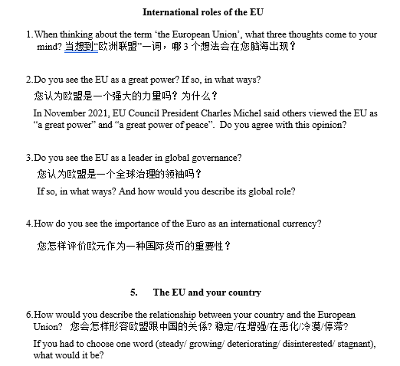

In-depth interviews (20/country)

Slide 7
Database (2020-2022)
 | Traditional Media Analysis | Social Media Analysis | Key-informant interviews
2020 | 2194 news items | 1397 posts | -
2021 | 3240 news items | 2059 posts | -
2022 | - | - | 20 in-depth interviews in each country
Total | 5434 news items | 3456 posts | 80 interviews

Slide 8
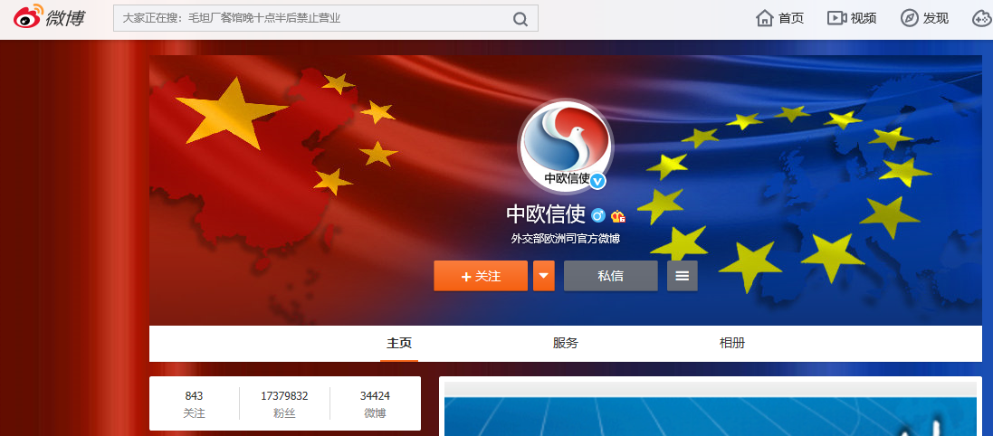
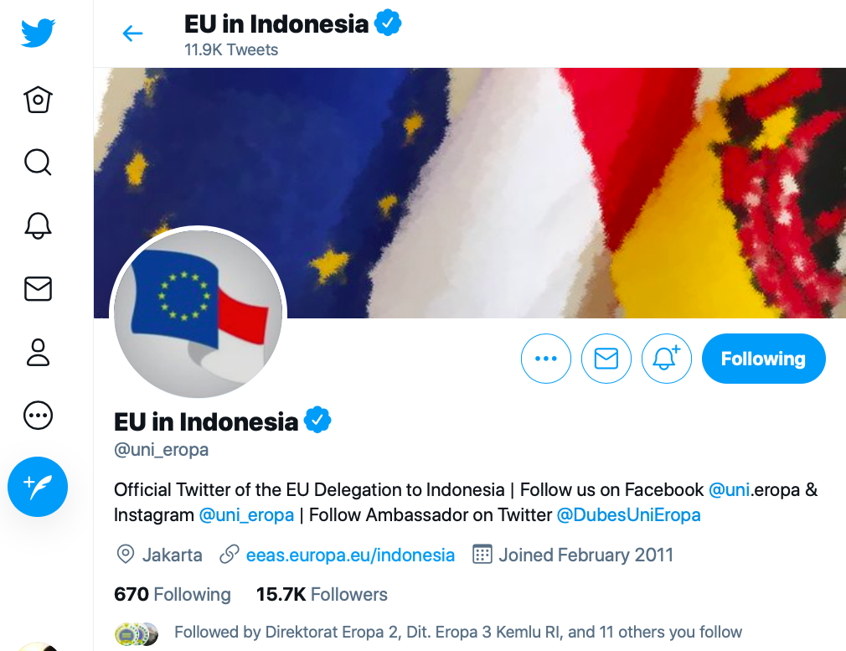
Messages from the EU Delegations in Asia

Slide 9
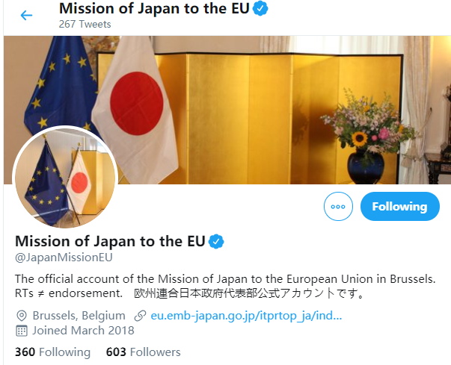
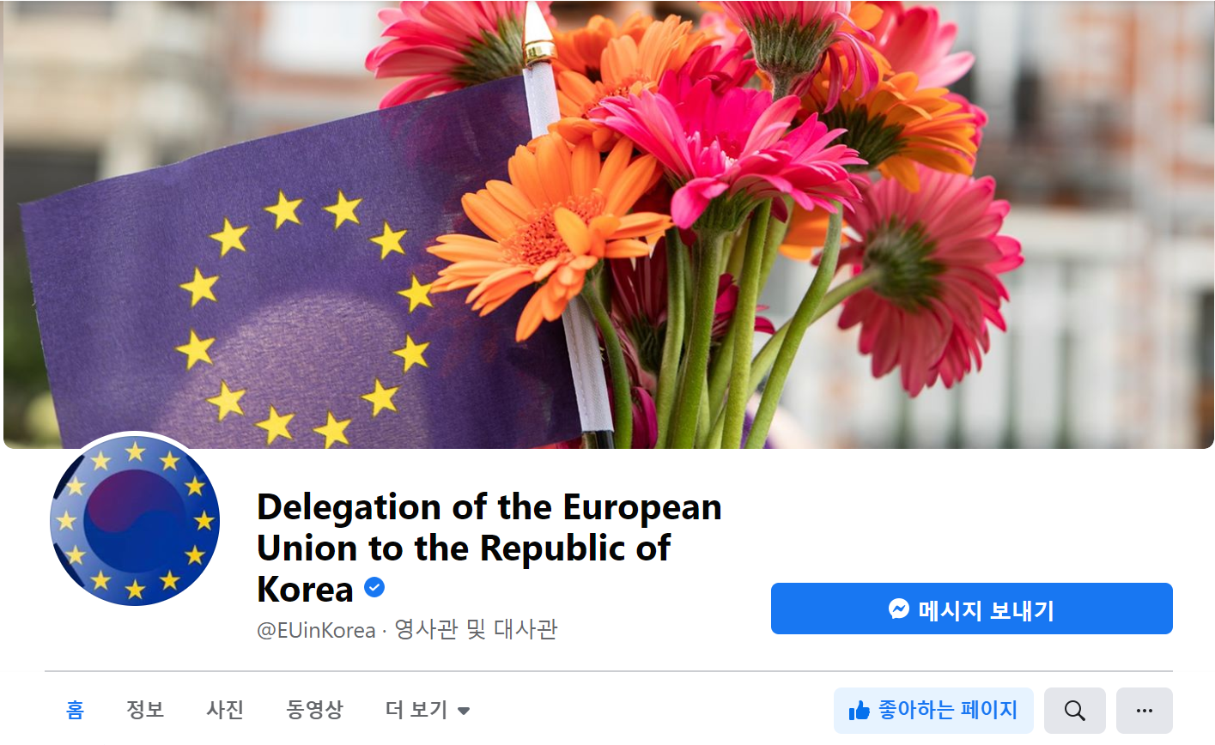

Slide 10
Activeness of the EUD accounts

Slide 11
Actions of EU

Slide 12
Presentation of EU

Slide 13
Reactions from Asia

Slide 14
Netizens’ Responses (2020)
 | Most liked | Most commented | Most shared
EU@China | EU HRVP Borrell’s statement on One country, two system of Hong Kong
EU@Indonesia | International Day Against Homophobia | Celebration of Europe Day | EU assist Indonesia in fight against Covid19
EU@ASEAN | Celebration of Europe Day | - | EU assist ASEAN in fight against Covid19
EU@Japan | National Day of Sweden | EU Biodiversity Strategy | National Day of Sweden
EU@Korea | Celebration of Europe Day

Slide 15
Netizens’ Responses (2021)
 | Most liked | Most commented | Most shared | Most shared
EU@China | EU announced sanctions on Russia, China, North Korea, Libya, South Sudan, Eritrea, for violation of human rights
EU@Indonesia | Europe Day activities | - | EU is a co-initiator & contributor to COVAX which donate vaccine to Indonesia | EU is a co-initiator & contributor to COVAX which donate vaccine to Indonesia
EU@ASEAN | EU HRVP Borrell met EU Permanent representatives to ASEAN
EU@Japan | EU approved export of Covid19 vaccine to Japan |  |  | Int’l Women Day
EU@Korea | Celebration of Europe Day

Slide 16
Asian MFA accounts featured of EU
(2020 vs. 2021)

Slide 17
Asian MFA’s View of EU

Slide 18
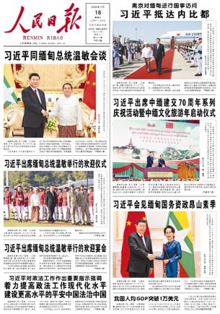
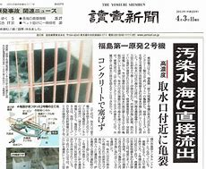
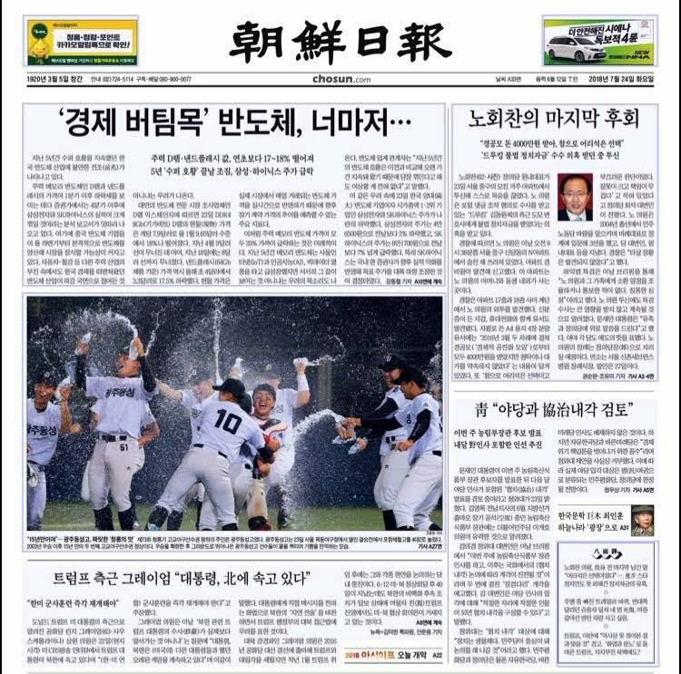
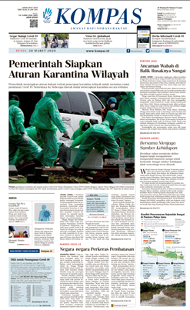
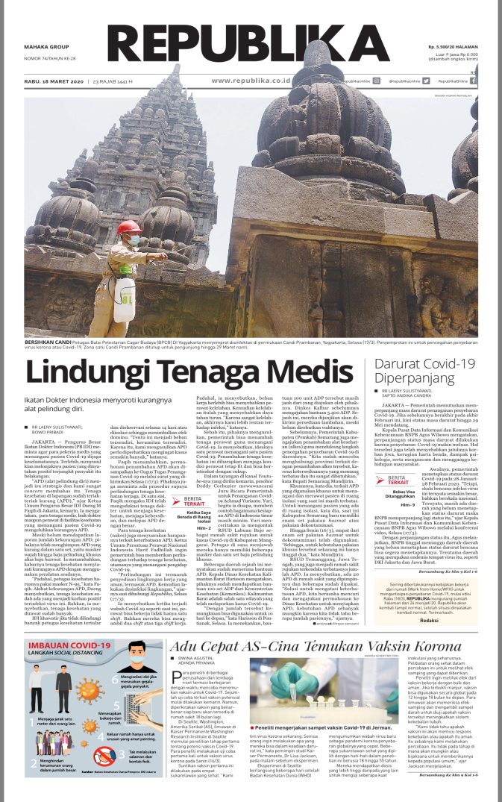
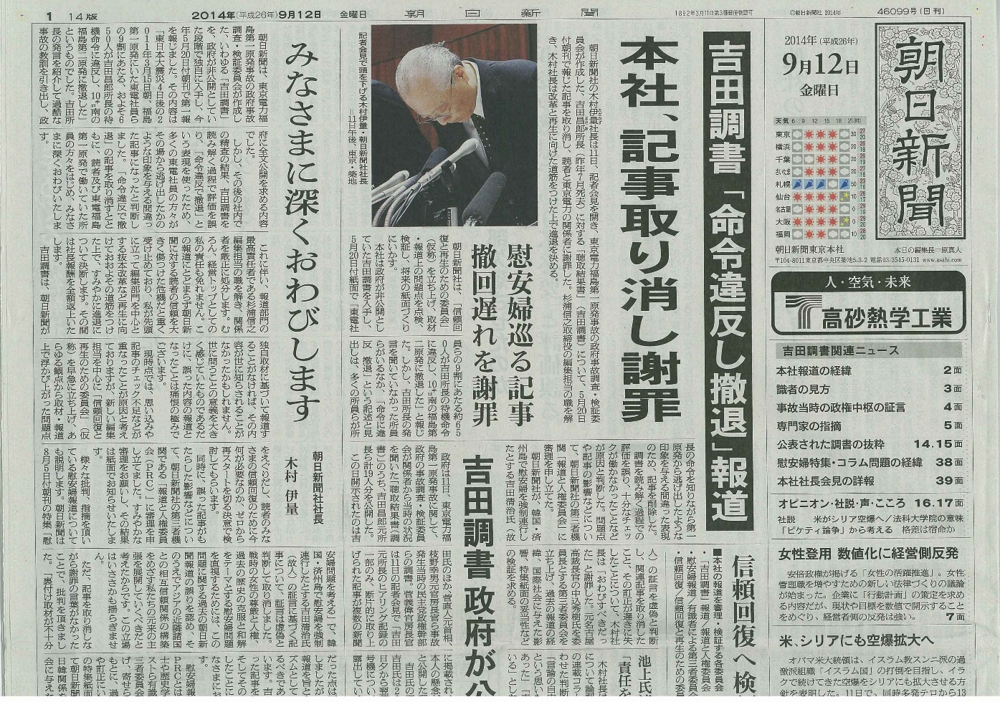

Slide 22
Centrality of EU in Popular dailies

Slide 23
Evaluation of EU (Main/2nd focus)

Slide 24
Evaluation of EU (continue)
Media | Year | Positive stories | Negative stories
People's Daily | 2020 | China-EU partnership | Problems with refugees
 | 2021 |  | EU sanctioned China
Kompas | 2020 | EU as a aid donor; EU Covid recovery fund | Trade disputes with Indonesia Problems with refugees
 | 2021 | EU as a aid donor | Problems with Covid vaccines
Republika | 2020 | Donor of Covid vaccine | Disunity
 | 2021 | - | Problems with Covid vaccines

Slide 25
Media | Year | Positive stories | Negative stories
Yomiuri | 2020 | Recovery from Covid19 Japan-EU cooperation | Covid-hit economy
 | 2021 | EU & US settled trade disputes | Problems with Covid vaccines
Asahi | 2020 | EU led international cooperation | Covid-related travel ban
 | 2021 | Recovery from Covid19 | Problems with Covid vaccines
Chosun Ilbo | 2020 | EU Covid recovery fund | Covid-hot economy
 | 2021 | Success with Covid vaccine | Problems with Covid vaccine

Slide 26
Asia’s Expectation (Popular dailies)
 |  | China | Indonesia (2 dailies) | Japan (2 dailies) | S. Korea
General |  | High | Low | Medium | Low
2020 | no. of news | 15 | 2 | 12 | 0
 | no. of expectation | 52 | 2 | 19 | 0
 | TOP expect | strengthen China-EU partnership | (diverse) | unite to manage Covid19 | -
2021 | no. of news | 14 | 4 | 12 | 2
 | no. of expectation | 36 | 5 | 16 | 2
 | TOP expect | focus on +ve side of China-EU relations | fairly treat Indonesian palm oil | cooperate with Japan in Indo-Pacific | (diverse)

Slide 27
Elite interviews (2022)

Slide 28
Elite interviews (2022)
Country | China | Indonesia | Japan | S.Korea
No. of Interviewees | 20 | 20 | 20 | 20
Awareness of EU | High | Low | Very high | Modest
Knowledge of EU | Fairly high | Low | High | Fairly high
Attitude towards EU | Neutral | Favourable | Favourable | Favourable, with some criticism
Expectations toward EU | Raise strategic autonomy | NOT to hold double-standard | Play a stronger security actor role | Equal partnership with shared values

Slide 29
 | China | Indonesia | Japan | S. Korea
Is EU a Great power? | 74% agreed with a partial YES | 71% agreed, referred more to economic power | 85% agreed with a partial YES | 45% agreed + 45% disagreed
EU’s role to your country | 65% said stakeholder | 100% called it partner | 85% called it partner, some added “like-minded” | 45% said partner; 35% called it friend
Prominence of EU to your country* | 4.1 (US got 4.8) | 4.2 (US got 4.6) | 4.1 (US got 5) | 3.5 (US got 4.9)
* all ratings are based on a scale of 1 to 5

Slide 30
Conclusions
There is an obvious gap between the image promoted by the EU and the perception received by its Asian partners.
  EUD, including the EU Delegation to the ASEAN based in Jakarta, made efforts to convey positive images and highlight achievements of the Union. On the contrary, the Asian MOFA accounts did not show high interest in the EU.
  The EU Delegations have projected a rather normative role for the EU, while the four Asian countries expected more pragmatic actions.
  Reaction (number of likes, comments, and shares) received by the EU delegations in their social media accounts were far from enthusiastic.

Slide 31
Conclusions (2)
From 2020, visibility (and relevancy) of the EU has been increasing, expect in the case of China.
Chinese press appeared to be the most favourable in tone when reporting the EU, while the Korean ones were relatively the most critical.
Japan was the most interested in the EU, while Indonesia was the least. While limited, Japan expressed the most concern over Brexit.
Negative impacts of Covid19 were prominent.

Slide 32
https://www.canterbury.ac.nz/ncre/research/expect/

