Slide 1
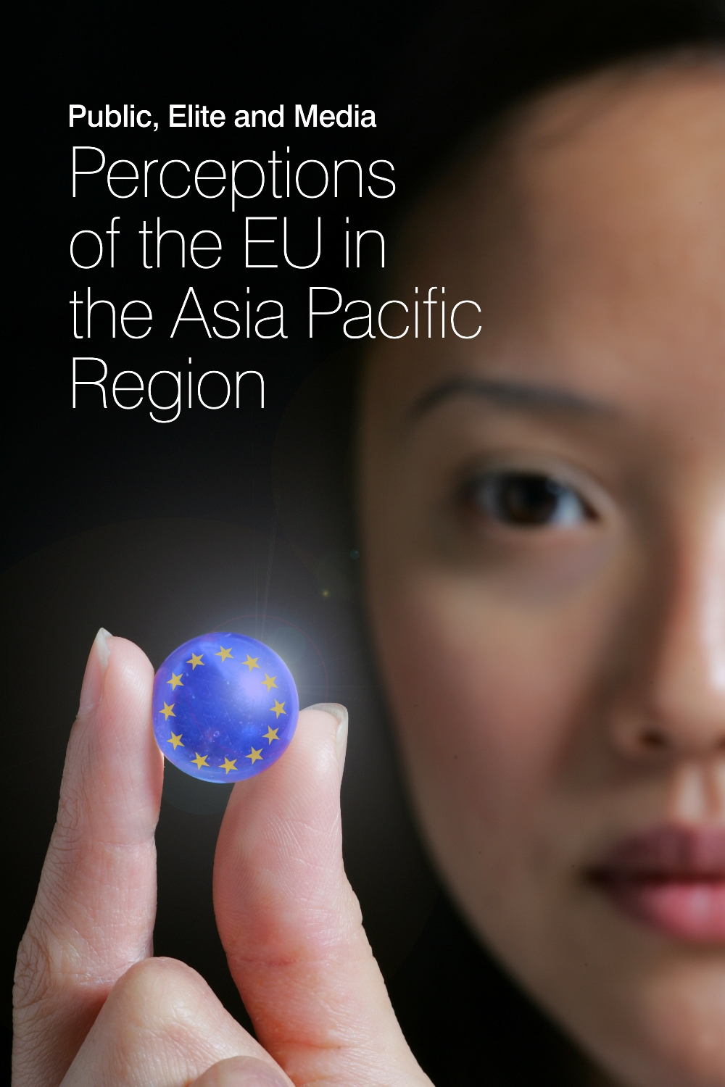
EXPECT: China’s Perception of and Expectation on EU
The case of Printed media
HUANG Yijia (Joey)
National University of Singapore
September 2022

Slide 2
Content
1 | Bilateral relations with EU
2 | Monitored outlets
3 | Visibility of EU & Hot issues
4 | Sources of EU news
5 | Centrality
6 | Domesticity
7 | Action frames
8 | Bilateral relations
9 | Evaluation
10 | Expectations
11 | Visual images
12 | Conclusions

Slide 3
1. Bilateral relations with EU
Diplomatic relations was established in | 1975
First bilateral agreement was signed in | China-EEC Trade Agreement in May 1978
EU Delegation Office opened in | 1988 (Beijing)
Annul summit began in | 1998
Strategic partnership was established in | 2003
EU as trade partner | No.2 (after ASEAN)
EU as investor | 3rd (2020 data)
Problems | EU arm embargo on China since 1989; trade disputes; mutual sanction in 2021

Slide 4
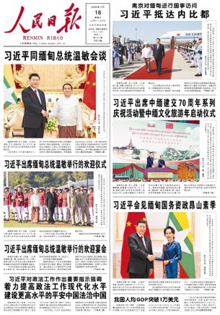
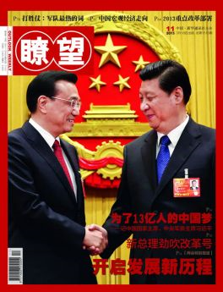
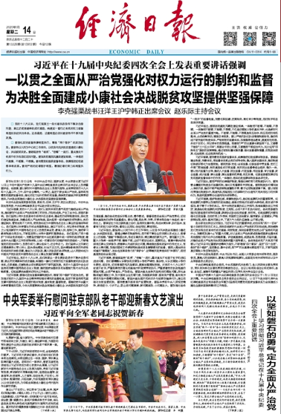
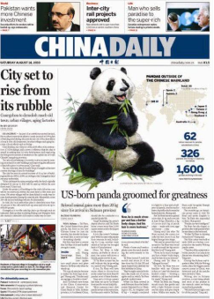
2. Monitored Press in China
Notes:
In both years, we monitor People Daily, Economic Daily, China Daily and Liaowang

Slide 5
Type | Selected outlets | Ownership | Founding year, online Presence | Circulation
Popular daily | People’s Daily | People’s Daily Group (owned by China Communist Party) | 1948 www.people.com.cn | 3.46 million
Business daily | Economic Daily | The Economic Daily Group | 1983 http://www.ce.cn/ | 1.15 million
English-language daily | China Daily | China Daily Group | 1981 https://www.chinadaily.com.cn/ | 0.7 million
Weekly | Liaowang | Xinhua | 1981 http://lw.xinhuanet.com/ | 0.9 million
Notes:
The statistics for Liaowang is very old but this is what we can find on its website/post office’s website.
People’s Daily has the largest circulation in China and Economic Daily ranks 5th (2020).

Slide 6
3. Visibility of the EU (n=1254)
Notes:
n=1254=645 in 2020 +609 in 2021
From 2020 to 2021, we captured more than one thousand pieces of news about the EU in the four outlets. The number for 2020 is 646 and for 2021 is 610, slightly less than the 2020s. China Daily reports most, and Liaowang Reports the least. Except for China daily, we see a decrease in visibility of the EU in the rest three outlets.

Slide 7
Visibility of the US, Russia, Japan and EU
Notes:
n=1254=605 in 2020 +609 in 2021
EU is the fourth most important actor in People’s Daily in both 2021 and 2021. In Economic Daily, it is the third most important actor in 2020 and fourth in 2021 with the rising visibility of Russia in 2021. The rising visibility of Russia may attribute to the negative economic impact induced by the Russia-Ukraine crisis, such as surging energy prices, food supply chain and so on.

Slide 8
EU’s appearance on Front Page
Notes:
EU not usually appears on Front Page, only 10% of EU news was on Front Page, most on China daily. The appearance on front page is quite stable between the two years.

Slide 9
Average length of EU-news (major/2nd)
Notes:
Liaowang only has 1 piece with the centrality of major/2nd in 2021.
For the average length of EU news, with the centrality of major & secondary, the longest are in Liaowang but Liaowang actually don’t have many reports on the EU, so the average length may not be as accurate as PD, ED & CD. For people’s daily, it is around 1300 -1400 words, the length in Economic daily increase significantly, from 1100 to around 2000 words. If we take translation into consideration, the average length of EU-news in PD and CD was quite similar and in ED was longer.

Slide 10
Notes:
Covid is a hot topic in EU news, but its visibility decrease a lot from 2020 to 2021.

Slide 11
Notes:
China’s attention to the EU remained at a stable and low level. The interest further decreased in 2021.

Slide 12
The Belt and Road Initiative in EU-related news (n=1254)
Notes:
The visibility of BRI in EU-related news=42+36=78 (only behind the COVID)
In EU-related news, the Belt and Road initiative is the hottest topic in 2020, but the attention to it slightly decrease in 2021(42->36).

Slide 13
Other hot issues in EU-related news (n=1254)
Notes:
For other hot topics, reports about the Xinjiang Issue greatly increase in 2021 and it is the hottest topic in 2021, 47 items mentioned the Xinjiang issue and 31 of them mentioned sanctions. There are some reports about the Xinjiang issue in 2020 but not many. Refugee crisis is a hot topic in 2020, but in 2021, the interest in it was low.
In China, most news about Iran is Iran nuclear deal so I adjusted the issue
Exceptions are that in 2020, we have some news about Iran, but they were about Chinese officials sharing pandemic prevention experience with Iran.
In 2020, news about Myanmar was about garment factories there and China-Myanmar natural gas trade. I don’t think it’s relevant to what we mean “Myanmar” here, so I did not count them into hot issues.
In 2021, the Hong Kong issue, mainly about human rights is also a hot issue in China. 21 items mentioned the issues, but it is not on our hot issue list so I did not put it on the graph.

Slide 14
4. Sources (n=1254)
Notes:
Local resources dominate the EU reports in both years and all outlets. China Daily has more reports from foreign resources, as it is an English daily and has some foreign freelancers. However, even in China daily, the reports from foreign resources dropped from between the two years.

Slide 15
Sources of EU news
 | Writers |  | News wires
 | 2020 | 2021 | 2020 | 2021
1st | Julia Shea (Freelance journalist for China Daily, 24) | Chen Weihua (The chief of Brussels, 25) | Xinhua (105) | Xinhua (114)
2nd | 张朋辉 (Zhang Penghui, People’s Daily, 23) | Julia Shea (Freelance journalist for China Daily, 19)
3rd | Jonathan Powell (Freelance journalist for China Daily, 17) | Earle Gale (Freelance journalist for China Daily, London 16)
Editorial | 13 | 38
Notes:
Julia, Jonathan and Earle are based in London. Zhang and Chen are based in Brussels.
The number of editorials doubled from 2020 to 2021.

Slide 16
Editorials
 |  | 2020 | 2021
Source |  | China Daily
Centrality | Major | 1 | 11
 | Secondary | 2 | 8
 | Minor | 9 | 19
Policy framework & Sub frame |  | A Stronger Europe in the World – CFSP (3) | A Stronger Europe in the World – CFSP (17)
Evaluation (Major/2nd) | Positive | 1 | 2
 | Neutral | 1 | 2
 | Negative | 1 | 15
Expectations |  | 1 The role of the EU: A strategic partner of China, mediator of China-US conflicts | 53 The role of the EU: A partner of China (reliable, fair, unprejudiced, economic, strategic, cooperation, 32) An actor with strategic autonomy (11)
Notes:
It is worth noting that 10 out of 19 editorials with EU as a major/2nd actor expressed expectations in the titles.
11 of the 38 editorials mentioned the Xinjiang issue.

Slide 17
5. Centrality (n=1254)
Notes:
EU is a minor actor in most news. The reports with a secondary centrality increased while both major and minor decreased.
In terms of outlets, the largest share of reports with EU as a major actor was in China Daily (23%), followed by the People’s daily(18%) and Economic daily had the least (14%)

Slide 18
6. Domesticity (n=1254)
Notes:
Overall, most news appeared in local background, followed by EU or Europe. The number is quite similar, 487 items in local background and 484 items in EU/Europe for four outlets in 2 years. However, for PD in 2020, CD in both years, and Liaowang in 2021, we have more reports in the EU/Europe context than local context. The appearance in Asia is the least.
From 2020 to 2021, the news appeared in EU and global context decreased, while the appearance in local, Asia and 3rd country context increased but the changes are mild changes, the scale is around 10-20 items.

Slide 19
Domesticity (Major/2nd, n=498)
Notes:
For news with major/2nd in centrality, we can see that the largest share lied in the EU/Europe context, and the local context just accounted for a small portion.
*In 2021, the 100% of liiaowang in 2021 is because it only had 1 item with a major/secondary in centrality, and was in global context.

Slide 20
Centrality of EU in Local news
Notes:
For most local news items, EU is a minor actor.
Comparing the two years, we can see the number of local news with EU as a major and secondary actor slightly increase and the number of EU as a minor actor decrease. The increase in EU as a major actor is driven by the rising number in China Daily, the news with EU as a major actor in local news rose from 7 in 2020, to 26 in 2021, more than a triple.
The drop in EU as a secondary actor is mainly driven by the decreasing number in ED.

Slide 21
7. EU actions (Main/2nd focus, n=498)
Notes:
Overall, China pays more attention to EU’s extra actions, especially for China Daily, extra EU actions representing 60% of EU actions in 2020 and rose to 69% in 2021.
A significant increase in extra-EU actions was found in 2021, mainly driven by the increase in China Daily.
The interest in intra-EU actions remained at a stable level, in both years.

Slide 22
Intra-EU actions (Major/2nd)
Notes:
For intra actions, China’s printed media is interested most in An Economy that Works for People, both the covid-induced decline and recovery. Following that was Promoting our European Way of Life, mainly about the covid 19 pandemic, including control measures and vaccines. EU integration is the third most important framework in 2020 and the fourth in 2021. Reports about EU integration are about the division in combat the pandemic and how to boost economic rebound. European Green Deal is the fourth most important in 2020 and third in 2021. And Most of them are relevant to climate change, such as reducing carbon emissions.
In terms of Media, PD has an even interest in both An Economy that Works for People & Promoting our European Way of Life. China Daily was interested more in An Economy that Works for People in 2020 but its attention moved a bit to Promoting our European Way of Life in 2021. ED has an overwhelming interest in An Economy that Works for People in both years.

Slide 23
Sub-frame of intra-EU actions
(Main/2nd focus)
 | 2020 | 2021
An Economy that Works for People | Economy (decline & recovery)
Promoting our European Way of Life | Health care
EU Integration | Solidarity | -
European Green Deal | Climate Change
Notes:
EU Integration: Solidarity is challenged by member states’ division in combating against the COVID & economic recovery plan.

Slide 24
Extra-EU actions (Major/2nd)
Notes:
2020 top 3: A Stronger Europe in the World, Promoting our European Way of Life, EU integration
2021 top 3: A Stronger Europe in the World, Promoting our European Way of Life, An Economy that Works for People
For both 2020 and 2021, most extra-EU actions belong to the framework A Stronger Europe in the World. The reports in this framework are far more than the rest three in all outlets, in total, 141 in 2020 and 109 in 2021. Especially in 2020. In 2020, the 2nd is EU integration and third is Promoting European our Way of Life. In 2021, the 2nd was An Economy that Works for People and the third is Promoting our European Way of Life.
In terms of outlets, the 2nd most important in PD &CD is promoting and in ED is an economy as it is a business daily A significant increase in reports about An Economy that Works for People was found in 2021, 56 in 2021 compared to from in 2020. The increase was more in China daily – the subframe of an eco mainly in trade (19), 6 of them are about positive trends in EU-China trade, 5 of them are driven by the geographical indicator, 5 of them are about China-EU Comprehensive Agreement on Investment has been challenged by the Xinjiang and Hong Kong issue, 3 of them are about the EU-US trade conflicts have been resolved.

Slide 25
Sub-frame of extra-EU actions
(Main/2nd focus)
 | 2020 | 2021
A Stronger Europe in the world | CFSP | CFSP
Promoting our European Way of Life | Health care
EU Integration | Post-Brexit negotiations | Post-Brexit issues (negotiations & impact)
An Economy that Works for People | Economy/Trade | Trade
Notes:
A Stronger Europe in the world – CFSP: 1) EU-China bilateral cooperation & tensions; 2) multilateral cooperation in global challenges such as controlling the COVID, global economic recovery and climate change; 3) EU in US-China relations.

Slide 26
8. Bilateral relation (Main/2nd focus)
Notes:
Around 30% of reports with EU as a major or secondary actor mentioned bilateral relations in 2020, the percentage slightly increase to 36% in 2021. The major increase was in China daily, whose number in 2021 doubled the one in 2020. For PD, ED and LW, it is in a stable level.

Slide 27
Bilateral relation with China
(Main/2nd focus)
 | 2020 | 2021
People's Daily | Coordinate and cooperate with China in global affairs | Promote comprehensive cooperation between China and EU member states
Economic Daily | Cooperate with China in economic revival and global public health | Accelerate efforts to allow CAI come to effect and promote cooperation in climate change
China Daily |  | EU’s economic sanctions on China & Promote China-EU cooperation
Liaowang | Communicate and cooperate with China in Covid19 & 45th anniversary of diplomatic ties | Promote China-EU cooperation
Notes:
CAI stands for EU-China Comprehensive Agreement in Investment

Slide 28
9. Evaluation of EU (Major/2nd, n=498)
Notes:
n=498=229 in 2020 + 269 in 2021
Overall, 42% of the reports with EU as a major or secondary actor was negative reports, 30% for positive and 24% for neutral.
From 2020 to 2021, the number of negative reports increased. Notably, in People‘s Daily and China Daily, the number in 2021 was around double of the number in 2020. Negative reports represented 35% of total reports in 2020 and rose to 57% in 2021. However, in Economic daily, the number of negative reports decreased in 2021 compared to 2020 The share of positive reports sharply decreased in People’s Daily (40% -> 22%), but moderately increased in China Daily (22% -> 29%).
The percentage of positive and neutral reports of the total reports is quite stable.

Slide 29
Evaluation of intra-EU actions
Notes:
194 = 96 in 2020 + 98 in 2021
For all reports in 2 years, For intra-EU actions, 21% are positive, 26% are neutral and 45% are negative. The share of positive and neutral reports increased, the neutral ones just to a slight extent, and the share of negative ones mildly decrease.
For 2021, we don‘t have reports with mixed for people’s daily, the share of positive reports increased, while the neutral decrease for ed, the portion of negative reports decreased, and for CD, the share of both positive and negative reports increased.

Slide 30
Evaluation of extra-EU actions
Notes:
For extra actions
141 in 2020 + 181 in 2021
Mixed 6 in 2020
Overall, 40% was positive, 35% for negative and 22% for neutral; for pd, ed and lw in 2020, more than a half extra reports were positive, for cd in 2020, the share for the three are were quite even, around 30% for each, for pd, the share of positive news increase but the share of negative decreased, both to a mild extent for ed, the share of neutral reports increased in 2021 while both the share of positive & negative decrease for cd, the share of positive reports remain stable, around 30%, the share of neutral reports decrease but negative reports climbed up from 30% to 52% in 2020. Most about the tensions in Xinjiang issue.

Slide 31
Evaluation of EU (Main/2nd focus , n=498)
 |  | Leading positive Story | Leading negative Story
2020 | PD | EU-China cooperation in COVID-19 | Refugee crisis
 | ED |  | Economic crisis & inability to reach consensus on solution
 |  |  | Inability to reach consensus on Covid solution post-Brexit negotiations
 | CD
2021 | PD | EU-China cooperation | China-EU tensions on Xinjiang issue
 | ED | Economic recovery | EU’s diverse economic challenges
 | CD | EU-China cooperation | China-EU tensions on Xinjiang issue & Russia-EU tensions
Notes:
Positive: 2021 PD: cooperation, economic cooperation; (11/29) CD: more on economic cooperation (19 of 50)
Negative: 2021 PD: 12, CD: Xinjiang (22/85), Russia-EU tensions (on Belarus, Ukraine), vaccine export control (8/85)

Slide 32
10. Expectation on EU
(Main/2nd focus , n=499, 808 expectations in total)
Notes:
Total: 808 expectations from four outlets in 2 years, 386 in 2020 and 422 in 2021.
Reports in China Daily recorded most expectations, followed by People’s Daily, Eco D and Liaowang had the least. However, in 2021, ED reported more expectations than PD. There was most news recorded eu’s self expectations, 182 items in 2 yrs, followed by China’s expectation on the EU, 119.

Slide 33
China’s Expectation on EU
 | 2020 (167 expectation) | 2021 (191 expectations)
1st | Promote EU-China relations (generally) | Promote EU-China relations
2nd | Control and prevent the COVID-19 pandemic | Strengthen strategic communication and deepen practical cooperation
3rd | Promote the economic recovery in EU | Work with China to address various global challenges (climate change & global economic rebound in particular)

Slide 34
Reported EU’s self-expectation
 | 2020 (186 expectations) | 2021 (167 expectations)
1st | Work with China/IOs in combating against the COVID-19 pandemic | Strengthen cooperation with China
2nd | Strengthen joint efforts in addressing climate change | Strengthen communication with China
3rd | Accelerate efforts in negotiating the EU-China CAI | Boost economic recovery (both in the EU & global)
Notes:
2021: more efforts in climate change 8

Slide 35
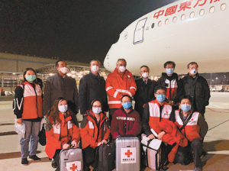
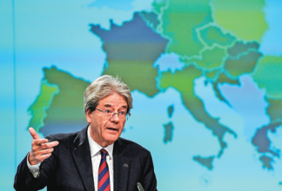
Visual images of EU (2020)
A group photo of Chinese experts and Italian personnel in the airport.
People’s Daily, 2020.03.14, p.3
European Economic Commissioner Paolo Gentiloni holds a news conference in Brussels.
China Daily, 2020.05.08,p.12 (EU predicts historic recession for this year )

Slide 36
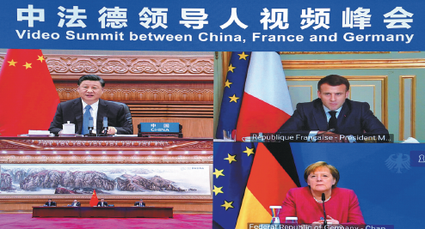

Visual images of EU (2021)
Chinese President Xi Jinping and French President Emmanuel Macron and German Chancellor Angela Merkel take part in a virtual summit on climate issues.
China Daily, 2021.04.18, p.1-2
A gondolier, with his empty boat in Venice on Thursday, will be keen to see tourists.
China Daily, 2021.05.22, p.8

Slide 37
Conclusions
EU has been an important actor in Chinese media.
China’s attention to EU has slightly decreased between 2020 and 2021 (The 14th Five-Year Plan was one of the reasons)
China Daily (English-language daily) has been the most interested in reporting the EU
The shadow of Covid-19 reduced in 2021
Chinese press paid stable and low attention to Brexit and the interest decreased between 2020 and 2021; most reports on Brexit focused on the struggles in post-Brexit negotiations.
EU appeared most frequently in local-context (487), yet, these news stories always featured EU only as a minor actor. The second-most frequent context was EU/Europe-context (484), where EU always featured as a major/secondary actor.
Notes:
2. This decreasing attention to EU has been significant in Liaowang. Reports on the Two Sessions & 14th Five-Year Plan dominated Liaowang.
6. Local: 487, EU+UK: 484, global: 282, 3rd: 118

Slide 38
Conclusions (2)
An increase in extra-EU action was found in 2021; yet there is also a significant increase in negative extra-EU reports, mainly driven by China’s dissatisfaction with the EU’s critics on the Xinjiang and Hong Kong issues.
For intra-EU actions, Chinese press focused on the Covid-hit economy and EU’s lack of quick remedies in 2020. Such lack of quick remedies also led to the perception of a lack of solidarity.
In 2021, the focus shifted to EU’s economic recovery and its uncertainty, which was also reported in a negative tone.
China expressed many and high expectations towards EU in 2020, and the number even increased in 2021.
Notes:
Extra: 2020-113, 2021- 170; intra: 2020 -88, 2021
Expectations: 383 (2020) +424 (2021)

