Slide 1
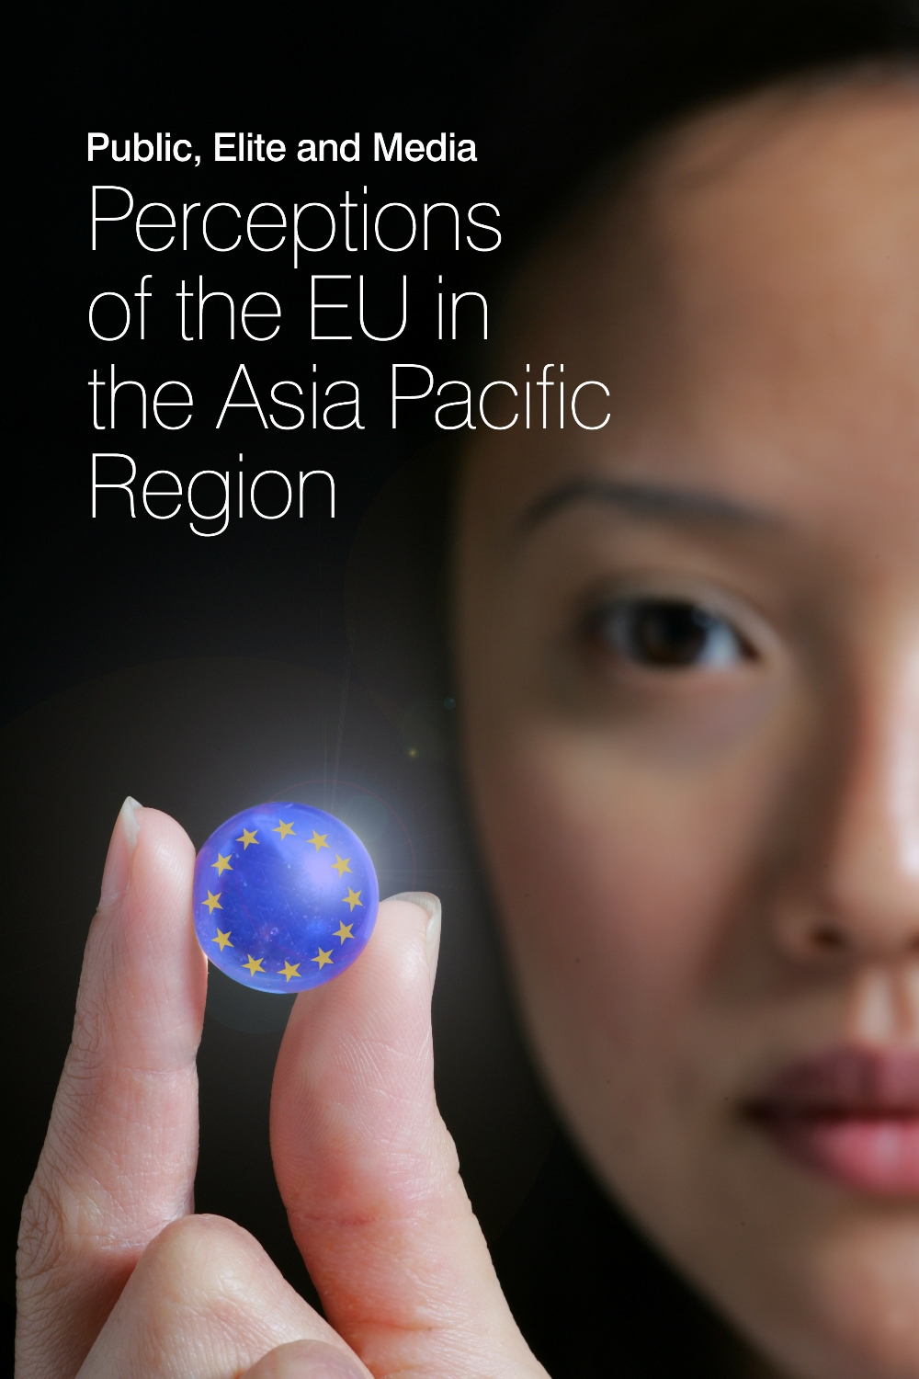
EXPECT: Japan’s Perception and Expectation on the EU
The case of Printed media
SHAO Jingkai
Waseda University
September 21, 2022

Slide 2
Content
1 | Bilateral relations with EU
2 | Monitored outlets
3 | Visibility of EU & Hot issues
4 | Sources of EU news
5 | Centrality
6 | Domesticity
7 | Action frames
8 | Bilateral relations
9 | Evaluation
10 | Expectations
11 | Visual images
12 | Conclusions

Slide 3
1. Bilateral relations with EU
Diplomatic relations was established in | 1959
First bilateral agreement was signed in | 1972 (AGREEMENT BETWEEN THE GOVERNMENT OF JAPAN AND. THE GOVERNMENTS OF THE COUNTRIES OF THE BENE -. LUX ECONOMIC UNION CONCERNING TRADE IN COTTON TEXTILES)
EU Delegation Office opened in | 1974 (Tokyo)
Annul summit began in | 1991 (Hague Declaration)
Strategic partnership was established in | 1998
EU as trade partner | 3rd largest (2021)
EU as investor | 2nd largest (2021)
Problems | Death penalty; trade disputes; agricultural export from Tohoku region

Slide 4
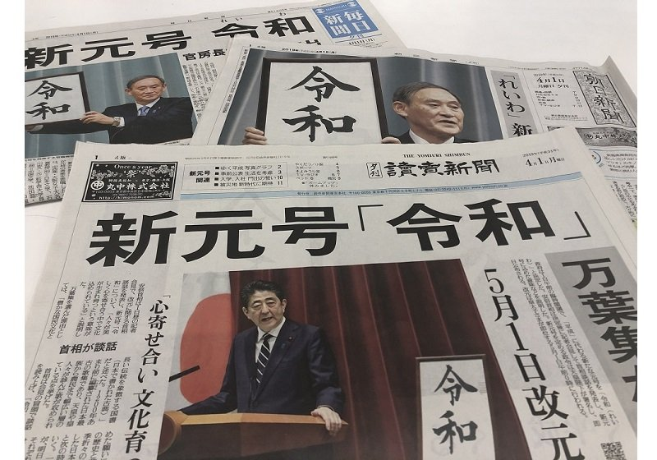
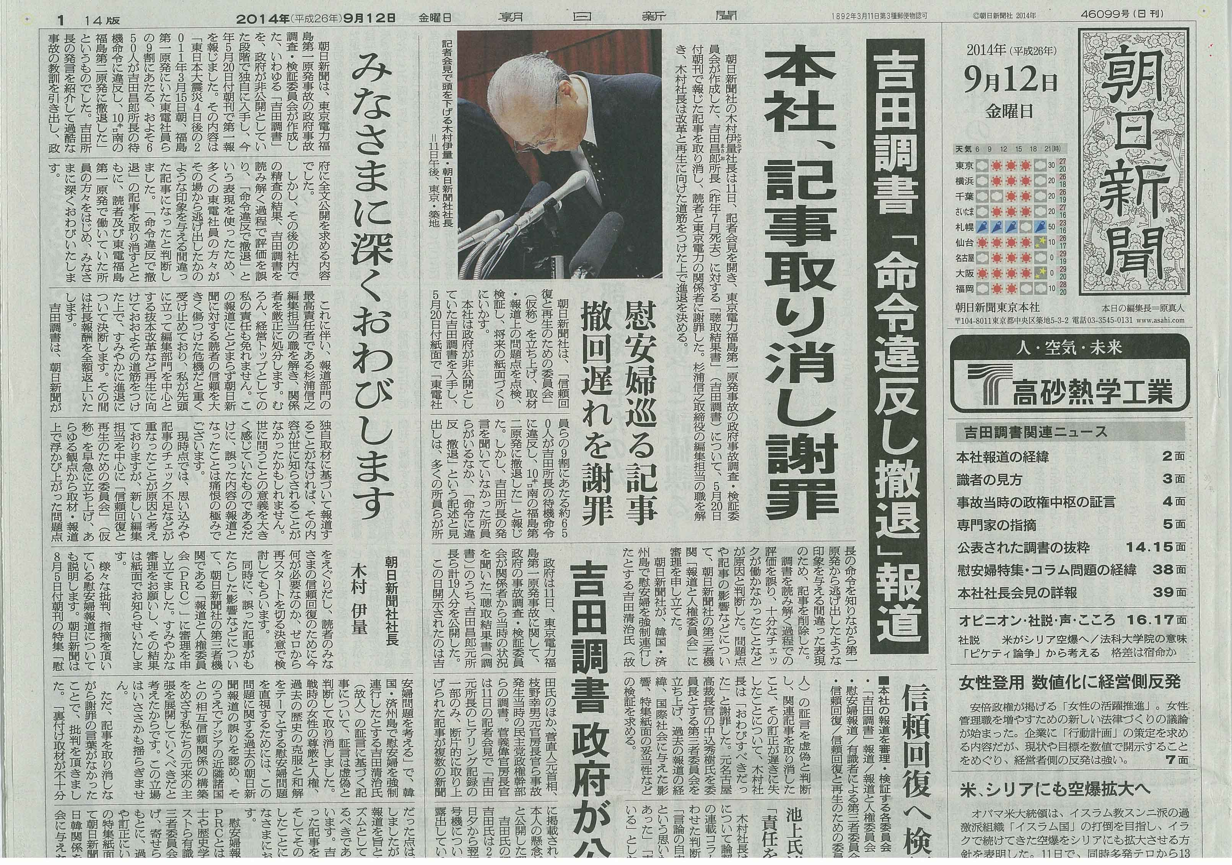
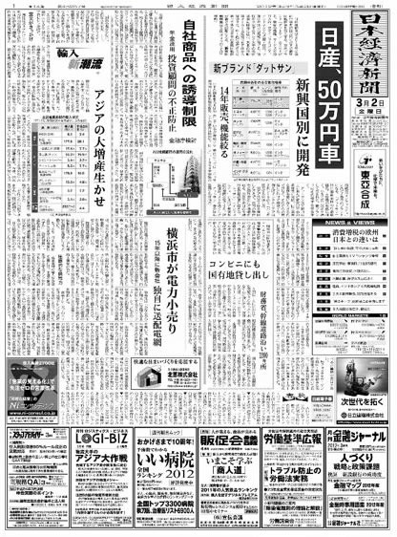
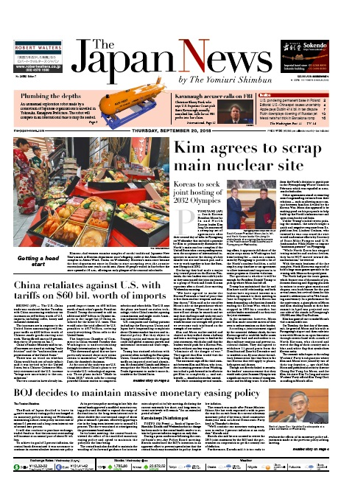
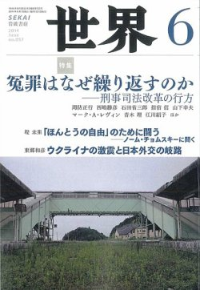
2. Monitored Press in Japan

Slide 5
Type | Selected outlets | Stance | Founding year, online Presence | Circulation
Popular daily | Yomiuri Shimbun | Right-wing, conservative, pro-LDP | 1874 読売新聞オンライン https://www.yomiuri.co.jp/ | 8,099,445 (2020) https://adv.yomiuri.co.jp/download/PDF/mediakit/general/mediadata2020/mediadata2020.pdf
 | Asahi Shimbun | Left-wing, progressive, internationalism, liberalism | 1879 朝日新聞デジタルhttps://www.asahi.com/ | 5,160,355 (2020) https://adv.asahi.com/mb2/other/ad_info/media_kit/DataFile2021.pdf
Business daily | Nihon Keizai Shimbun (Nikkei) | Moderate conservative, (world largest) finance specialized paper | 1876 日本経済新聞 https://www.nikkei.com/ | 2,668,764 (2020) https://www.nikkei.com/topic/20210715.html
English-language daily | The Japan News | Owned by Yomiuri Shimbun | 1955 (Daily Yomiuri, renamed in 2013) The Japan News https://japannews.yomiuri.co.jp/ | 25,274 (2020) https://www.bunkanews.jp/article/221002/ https://www.bunkanews.jp/article/228102/
Monthly | Sekai | Left-wing, progressive | 1945 none | approximately 40,000 (2021) https://www.iwanami.co.jp/ad/sekai/

Slide 6
3. Visibility of the EU (N=2,120)

Slide 7
Visibility of other global players
Notes:
n=1256=646 in 2020 +610 in 2021
The third most important

Slide 8
Visibility of other global players (2)
Notes:
n=1256=646 in 2020 +610 in 2021
The third most important

Slide 9
EU’s appearance on Front Page

Slide 10
Average length of EU-news (major/2nd)

Slide 13
“Indo-Pacific” in EU-related news (N=2,120)

Slide 14
Other hot issues in EU-related news (N=2,120)

Slide 15
4. Sources (N= 2,120)
（Nikkei 2021 not yet included）

Slide 16
Sources of EU news
 | Writers |  | News wires/media
 | 2020 | 2021 | 2020 | 2021
1st | 竹内康雄, Brussels (66, Nikkei) | 竹内康雄, Brussels (79, Nikkei) | Financial Times | Financial Times
2nd | 畠山朋子, Brussels (52, Yomiuri Shimbun) | 畠山朋子, Brussels (76, Yomiuri Shimbun) | The Economist | The Economist
3rd | 中島裕介, London (35, Nikkei) | 中島裕介, London (31, Nikkei) | n/a | Kyodo News
Editorial | 34 | 40 | n/a | Bangkok Post

Slide 17
5. Centrality (N= 2,120)
（Nikkei 2021 not yet included）

Slide 18
6. Domesticity (N= 2,120)
（Nikkei 2021 not included）

Slide 19
Domesticity (Major/2nd, N=869)
（Nikkei 2021 not included）

Slide 20
Centrality of EU in Local news
（Nikkei 2021 not included）

Slide 21
7. EU actions (Main/2nd focus, N=869)

Slide 22
Intra-EU actions (Major/2nd)

Slide 23
Sub-frame of intra-EU actions
(Main/2nd focus)
 | 2020 | 2021
Promoting our European Way of Life | Health
An Economy that Works for People | Economy
EU integration | Solidarity challenged by COVID 19 | Post-Brexit issues

Slide 24
Extra-EU actions (Major/2nd)

Slide 25
Sub-frame of extra-EU actions
(Main/2nd focus)
 | 2020 | 2021
A stronger Europe in the world | CFSP | CFSP
Promoting our European Way of Life | Health
An Economy that Works for People | Trade

Slide 26
8. Bilateral relation (Main/2nd focus)

Slide 27
Bilateral relation with Japan
(Main/2nd focus)
 | 2020 | 2021
Yomiuri Shimbun | COVID-19’s economic impact, Japan-UK trade negotiation | Indo-Pacific Strategy
Asahi Shimbun | COVID-19 travel ban | COVID-19 Vaccine
Nikkei | COVID-19’s economic impact
The Japan News | Japanese beef export | Japan-EU Security Cooperation

Slide 28
9. Evaluation of EU (Major/2nd, N=869)

Slide 29
Evaluation of intra-EU actions

Slide 30
Evaluation of extra-EU actions

Slide 31
10. Expectation on EU
(Main/2nd focus , N=254)
（Nikkei 2021 not included）

Slide 32
Evaluation of EU (Main/2nd focus , N=869)
 |  | Leading +ve Story | Leading -ve Story
2020 | Yomiuri Shimbun | European Green Deal | Economic recession
 | Asahi Shimbun
 | Nikkei
2021 | Yomiuri Shimbun | Decarbonization | Covid-19 vaccine export/patent waiver
 |  | Relaxation of border controls
 | Asahi Shimbun | recovering from Covid19 | Covid vaccine problems & economic downturn
 | Nikkei | n/a | n/a

Slide 33
Japan’s Expectation on EU
（Nikkei 2021 not included）
 | 2020 (46 expectation) | 2021 (18 expectations)
1st | Play a coordinating role among MS to avoid confusions in anti-COVID-19 struggles | Loosen current EU policy of vaccine export approval to Japan
2nd | Relax border controls and travel ban gradually | Strengthen strategic cooperation in the context of Free and Open Indo-Pacific
3rd | Establish a strong recovery fund | Cooperate with Japan to tackle the rise of China

Slide 34
Reported EU’s self-expectation
（Nikkei 2021 not included）
 | 2020 (94 expectations) | 2021 (48 expectations)
1st | Coordinator of EU MS in the Covid-19 pandemic | Protector of EU citizens' health
2nd | Protector of EU economy | Rule-setter of AI regulation
3rd | Global normative power | Partner of Japan against China

Slide 35
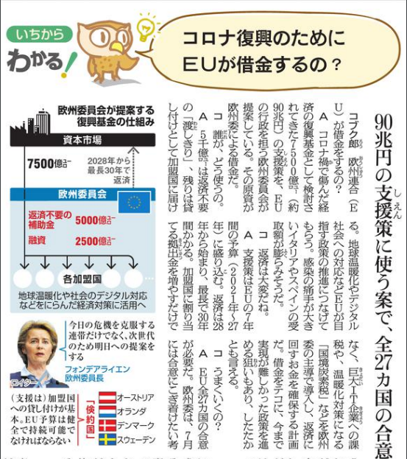
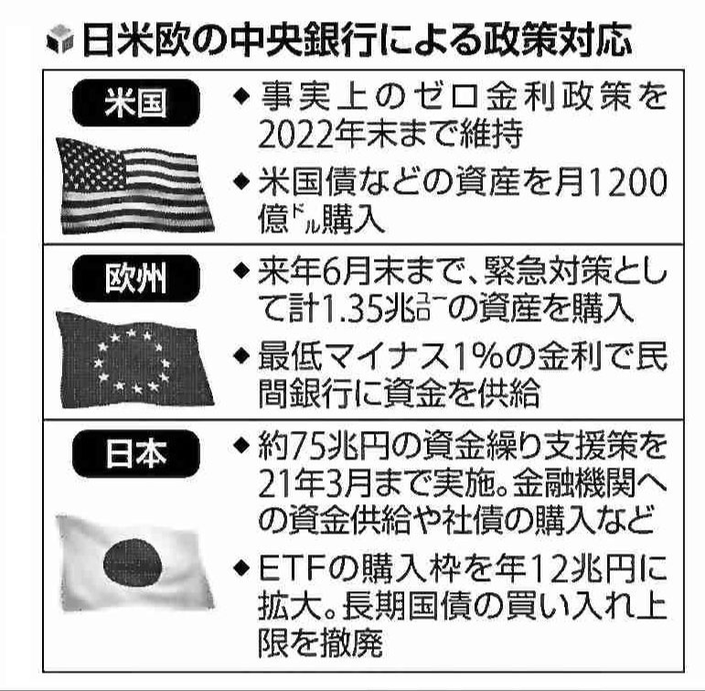
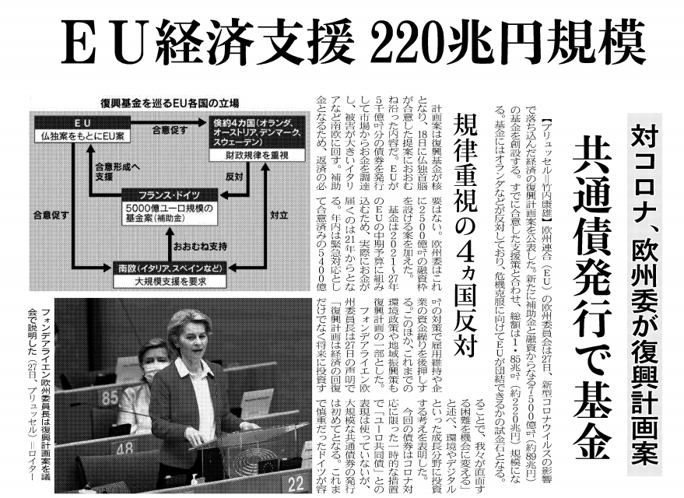
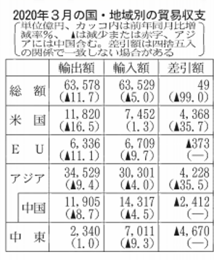
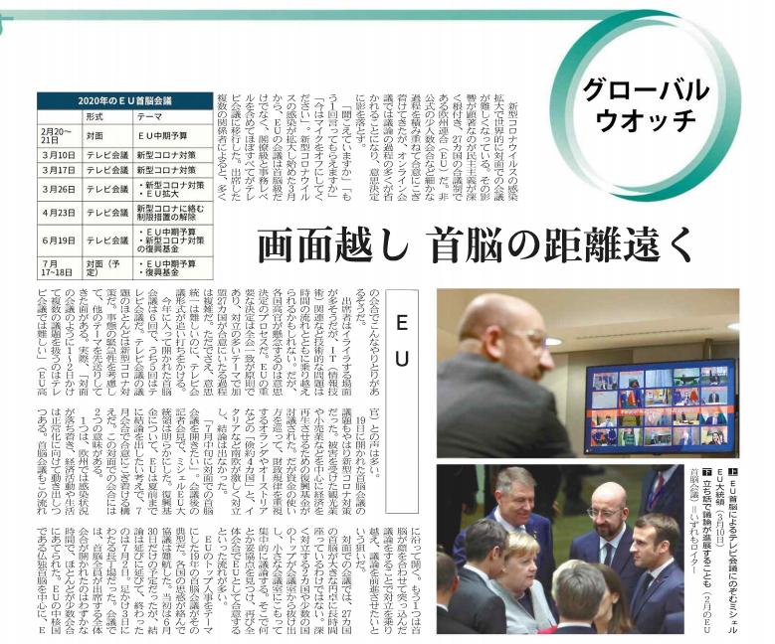
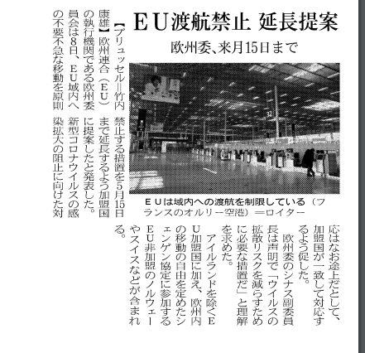
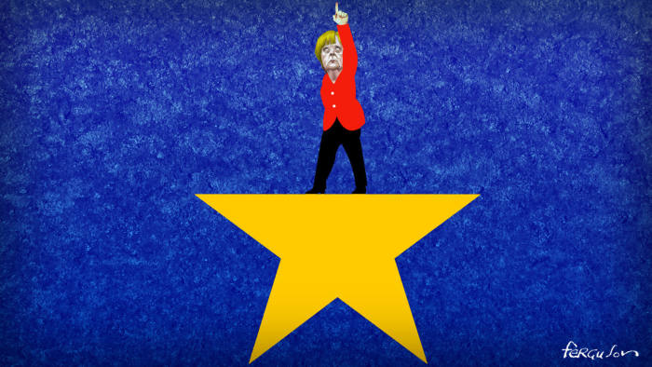
Visual images of EU (2020)

Slide 36
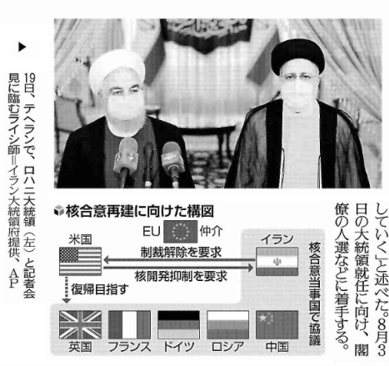
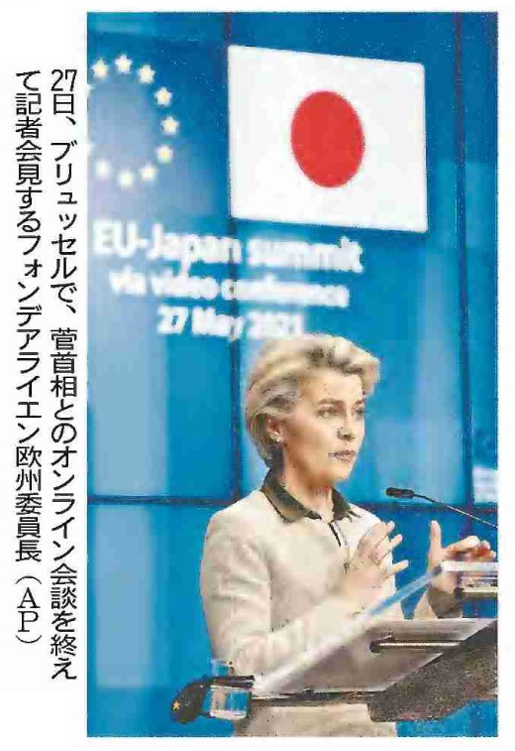
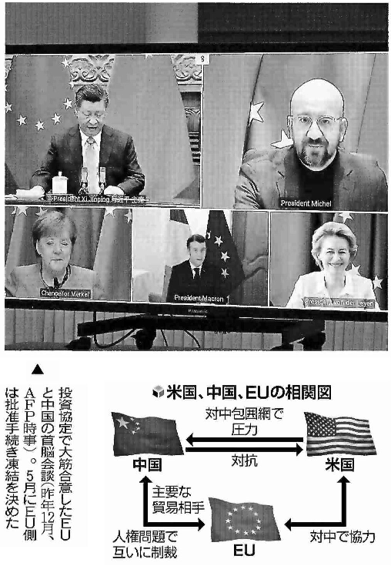
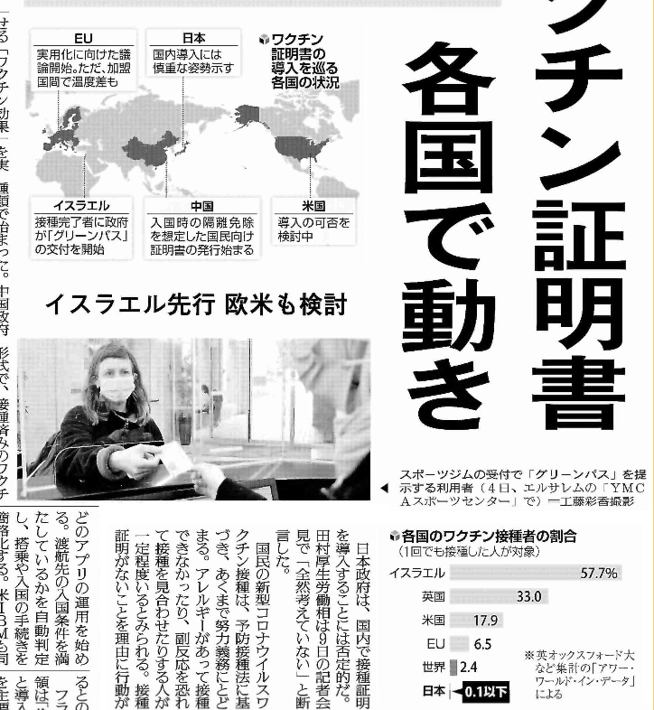
Visual images of EU (2021)

Slide 37
Conclusions
The “normative Europe” perception is salient in Japan’s media discourse; but a “geopolitical Europe” is more expected in 2021
Japan was rather disappointed with EU’s performance in COVID-19 crisis initially but turned increasingly positive after its recovery
Japan regards the EU as a like-minded partner, a defender of liberal international order; and the two sides’ shared values/ identities/ interests are evolving into shared strategies—the Indo-Pacific
A narrowing perception gap—the converging concerns (China, Russia) and rapprochement with the US
Potential cooperation in multiple fields (security, vaccine, supply chains, climate change, etc.)

Slide 38
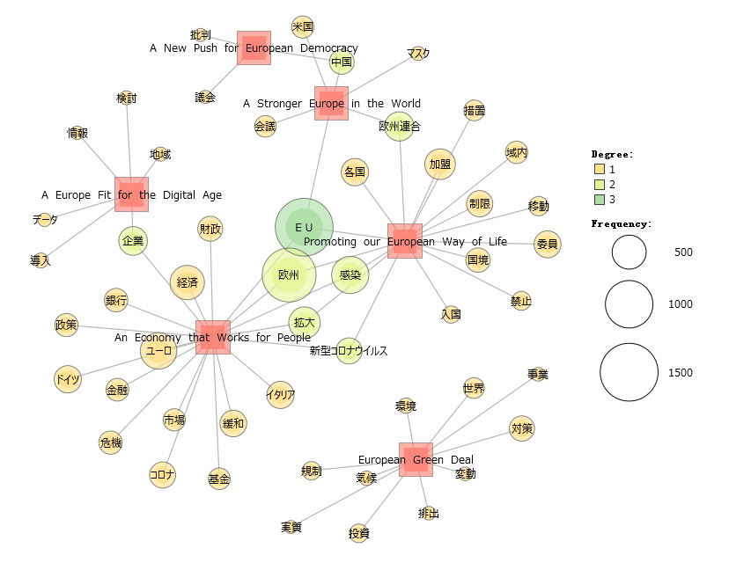
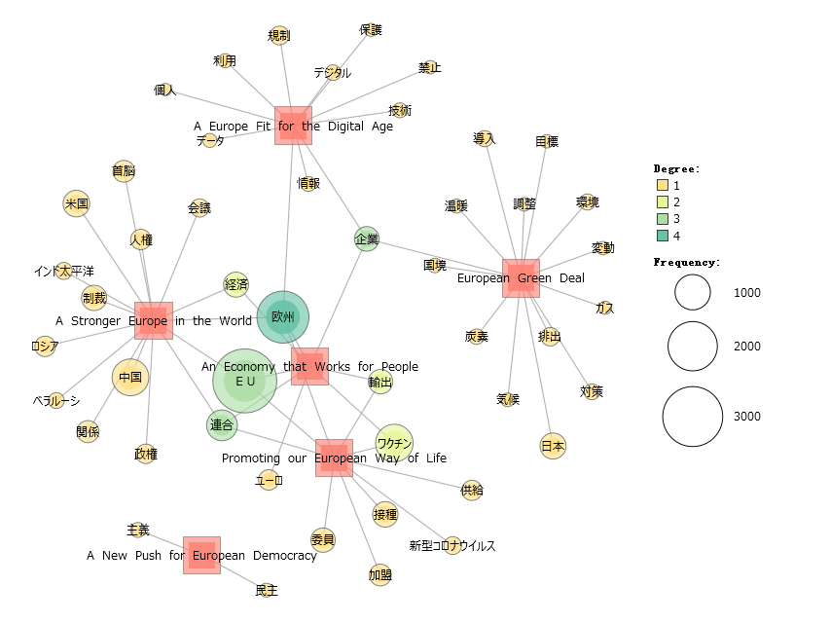
Clusters of “6 Commission priorities for 2019-24” in Japanese media
Semantic network analysis
2020
A European Green Deal
climate change-emission-environment-investment-regulation
A Europe fit for the digital age
data-information-enterprise
An economy that works for people
COVID-19-economy-Italy-crisis-finance-Germany-policy-bank-fund
A stronger Europe in the world
EU-China-US-mask
Promoting our European way of life
COVID-19-infection-spread-border-restrction-movement-prohibit
A new push for European democracy
criticize-China-parliament
2021
A European Green Deal
border-CO2-warm-climate change-Japan-emission-gas-environment-goal-adjustment
A Europe fit for the digital age
enterprise-information-private-data-protection-technology-digital-prohibit-regulation-use
An economy that works for people
euro-export-economy-enterprise
A stronger Europe in the world
Indo-Pacific-China-Belarus-Russia-US-human rights-leader-regime-sanction-economy
Promoting our European way of life
COVID-19-vaccine-vaccination-export-supply
A new push for European democracy
democracy-principle

Slide 39
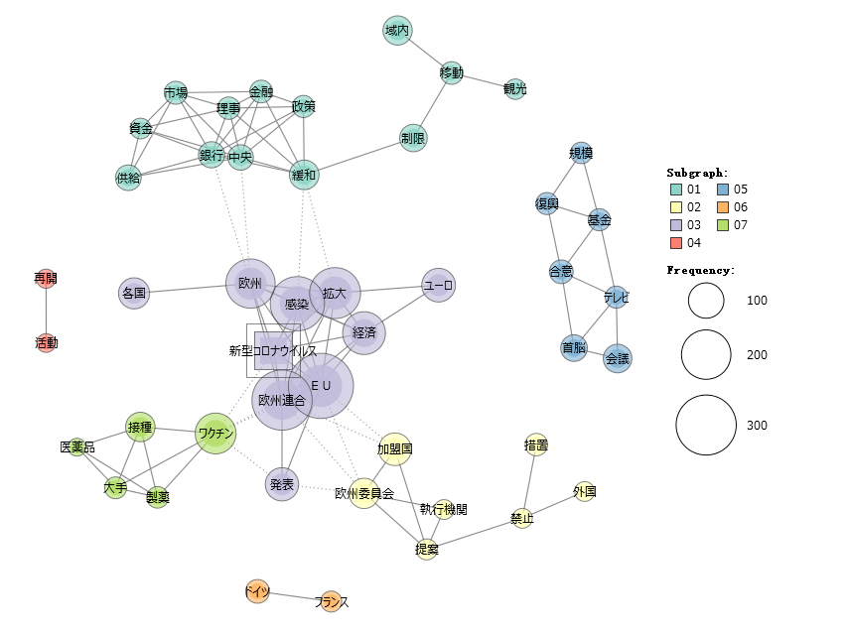
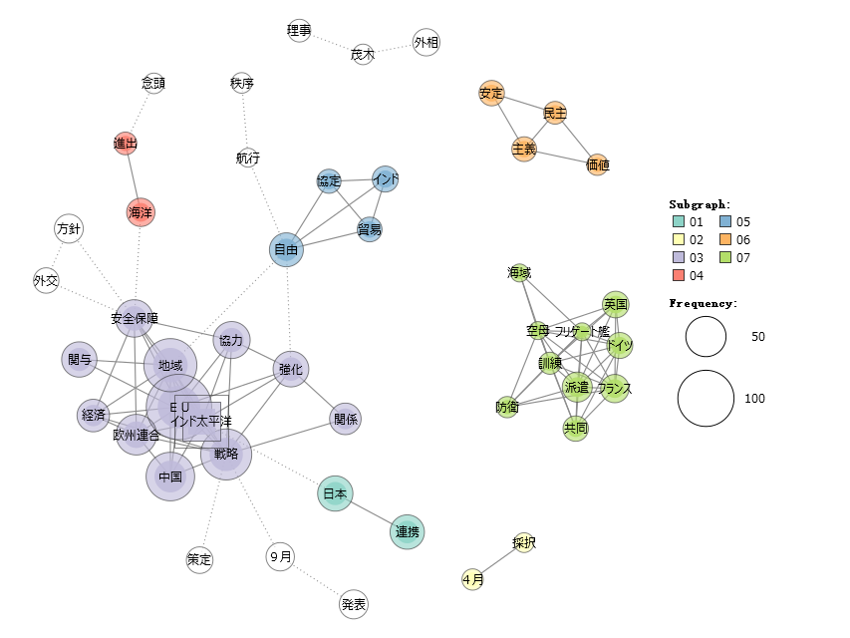
“COVID-19” clusters
“Indo-Pacific” clusters
Cluster 5, 7, 2:
COVID-19-EU-infection-spread-economy-euro-vaccine-vaccination-big-pharmaceutical-European Commission-member states-proposal-prohibition-measure
Cluster 1:
ECB-ease-supply-fund-market-finance-policy-restrction-movement-tourism
Cluster 5:
recovery-fund-consensus-scale-leader-TV-meeting
Cluster 6:
Germany-France
Cluster 4:
resume-activity
Cluster 1, 3, 4:
EU-Indo-Pacific-strategy-China-maritime-expansion-region-economy-engagement-security-cooperation-strenghen-relation-Japan-alignment
Cluster 7:
defense-dispatch-aircraft carrier-frigate-UK-Germany-France-joint-sea area
Cluster 6:
stability-democracy-principle-values
Cluster 5:
free-navigation-order-agreement-trade-India
Cluster 2:
February-adoption

Slide 40
THE END
THANK YOU!

