Slide 1
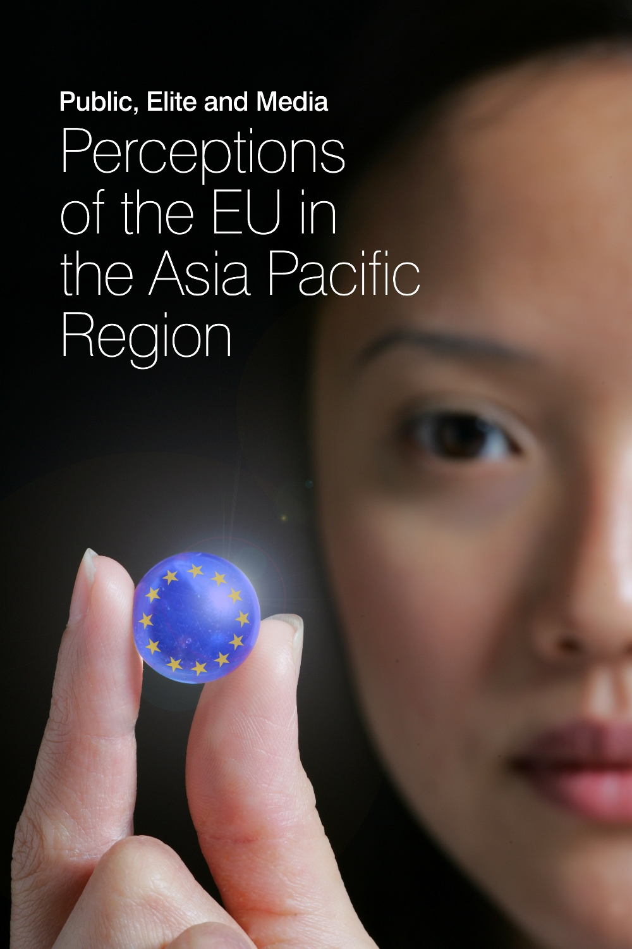
EXPECT: Indonesia’s Perception of and Expectation on EU
The case of Printed media
Nurina Aulia Haris
Universitas Gadjah Mada
September 2022

Slide 2
Content
1 | Bilateral relations with EU
2 | Monitored outlets
3 | Visibility of EU & Hot issues
4 | Sources of EU news
5 | Centrality
6 | Domesticity
7 | Action frames
8 | Bilateral relations
9 | Evaluation
10 | Expectations
11 | Visual images
12 | Conclusions

Slide 3
1. Bilateral relations with EU
Diplomatic relations was established in | 1967 (under EU-ASEAN cooperation,)
First bilateral agreement was signed in | 2009, Partnership and Cooperation Agreement (PCA)
EU Delegation Office opened in | Jakarta, 6 Sept 1988
Annual summit began in | Brussels, 2016 (Joint Committee under PCA)
Strategic partnership was established in | no
EU as trade partner | 3rd
EU as investor | 4th (2019)
Problems | Palm oil disputes, IEU-CEPA long negotiations, Islamophobia, Papua issue
Notes:
Indonesia's main exports to the EU in 2018 were dominated by palm oil products and their derivatives including CPO, fatty acids and biodiesel; other major exports are copper, rubber, sports shoes, footwear and machinery, mainly photocopiers and facsimiles.)
EU is Indonesia's 4th largest source of foreign direct investment after Singapore, China and Japan in 2019 with an investment value of USD 3.44 billion with 4700 programs. Its main investments are in the manufacturing sector (particularly chemical and pharmaceutical/drug products), paper and printing, infrastructure and mining.
https://kemlu.go.id/portal/en/read/149/halaman_list_lainnya/uni-eropa
https://www.eeas.europa.eu/indonesia/who-we-are_en?s=168
https://binus.ac.id/wp-content/uploads/2019/06/20190619-Hubungan-Indonesia-Uni-Eropa-Yuri-O.-Thamrin.pdf
http://repository.umy.ac.id/bitstream/handle/123456789/10985/BAB%20II.pdf?sequence=6&isAllowed=y
https://kemlu.go.id/brussels/id/read/uni-eropa/1669/etc-menu

Slide 4
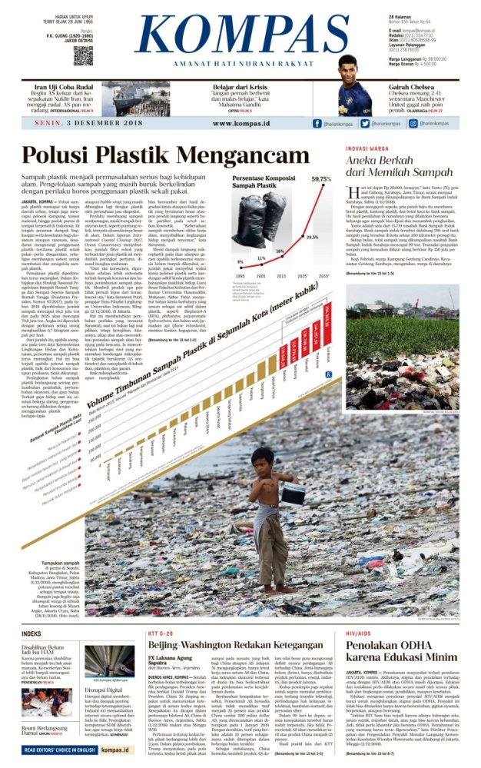

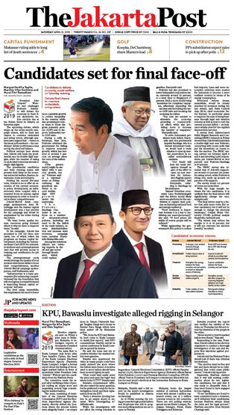
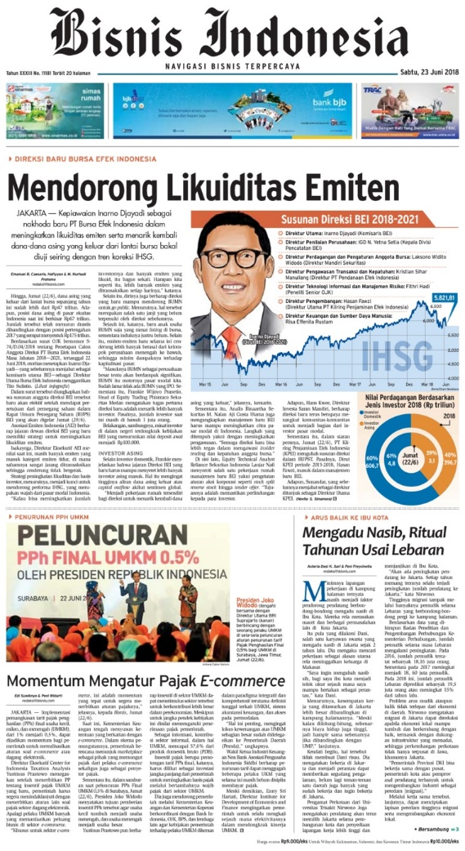
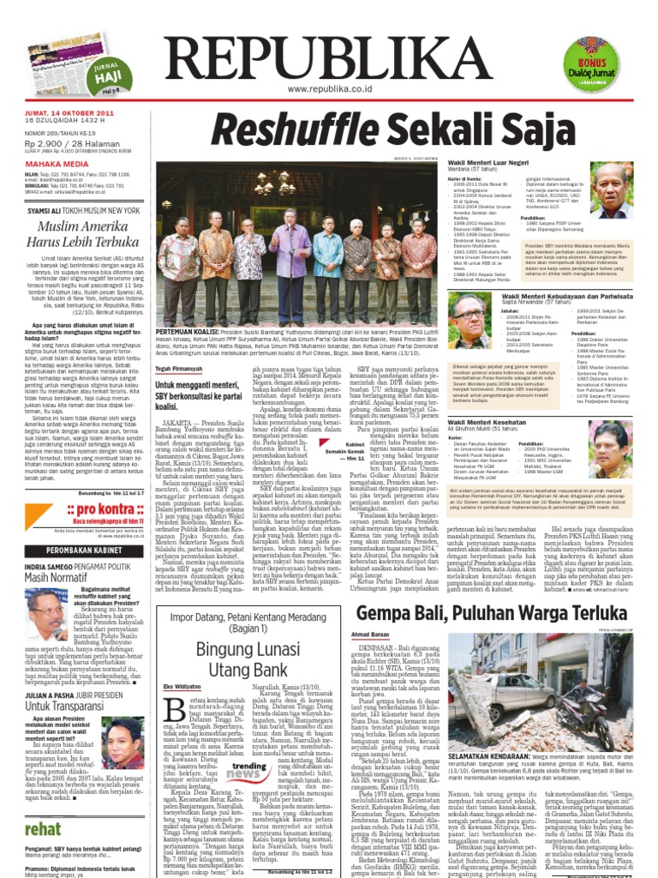
2. Monitored Press in Indonesia

Slide 5
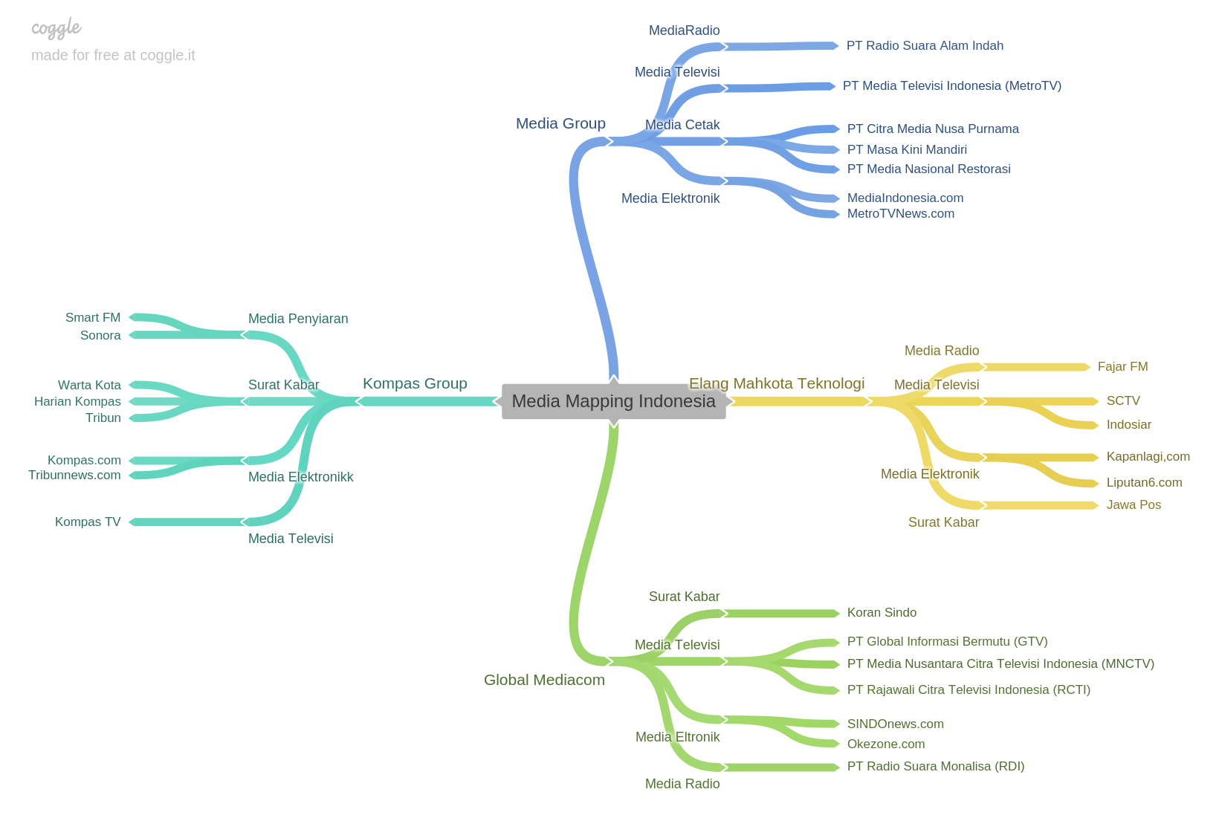

Slide 6
Type | Selected outlets | Ownership | Founding year, online Presence | Circulation
Popular daily | Kompas | PT. Kompas Media Nusantara (Kompas Gramedia) | 28 Juni 1965, Yes Kompas.com 14 Sept 1995 | has 2.5 million readers (Nielsen Q4 2021 CMV Data (Print & ePaper)) with daily circulation of 290.000 copies.
 | Tempo | Operated by: Tempo Media Group (PT Tempo Inti Media) Owned by: PT. Grafiti Pers (24.28%) Yayasan Tempo (17.13%) PT. Jaya Raya Utama (16.28%) Yayasan Jaya Raya (8.54%) Yayasan Karyawan Tempo (8.28%) Public (25.49%) | 2 April 2001, Yes | Daily: 100,000 copies; Stopped publishing on December 31, 2020, referring to changes in the behavior of newspaper readers and the increasing number of subscribers to the digital version of Koran Tempo.
 | Republika | Parent company: PT. Abdi Bangsa (operated under PT. Republika Media Mandiri) | 4 Januari 1993, Yes (17 Agustus 1995) | an average circulation of 80,000 copies per day.
Notes:
Republika: http://repository.fe.unj.ac.id/8752/1/Laporan%20PKL%20sabrina%20maulia%20jannatin%208215164855.pdf
Kompas:
https://korporasi.kompas.id/produk/iklan/#:~:text=Harian%20Kompas%20memiliki%20sirkulasi%20harian,rata%2Drata%20diatas%20290.000%20eksemplar.
Tempo Daily:
https://dapobas.kemdikbud.go.id/home?show=isidata&id=1464

Slide 7
Type | Selected outlets | Ownership | Founding year, online Presence | Circulation
Business daily | BI | Bisnis Indonesia Group, under: PT. Jurnalindo Aksara Grafika | 14 Desember 1985, Yes Bisnis.com (1996) | 121.000 readers/day 97% subscribed
English-language daily | JP | PT Bina Media Tenggara (founded and privately owned by: Suara Karya, Kompas, Sinar Harapan and Tempo) | 25 April 1983, Yes 1st web: 2016 Subscriptions applied in 2018 | 40.000 copies (targeted for Indonesian business people, educated Indonesians, and foreigners.)
Weekly | Tempo | Operated by: Tempo Media Group (PT Tempo Inti Media) Owned by: PT. Grafiti Pers (24.28%) Yayasan Tempo (17.13%) PT. Jaya Raya Utama (16.28%) Yayasan Jaya Raya (8.54%) Yayasan Karyawan Tempo (8.28%) Public (25.49%) | 6 March 1971, Yes Tempo.co (1995, rebranding 2008) | 180.000 copies/week
Notes:
BI:
https://www.bisnisindonesiagroup.com/big-media/11/bisnis-Indonesia
JP:
https://themediavantage.com/media-partners/the-jakarta-post/
Tempo Weekly:
http://e-journal.uajy.ac.id/5739/3/KOM202902.pdf

Slide 8
2. Visibility of the EU (n=944)
Notes:
2020= 248 articles
2021= 696 articles

Slide 9
EU’s appearance on Front Page (n=57)
Notes:
2020=15
2021=42

Slide 10
Average length of EU-news (major/2nd)

Slide 11
EU’s Visibility under Covid-19 Shadow

Slide 12
Notes:
2020:
March→ Kompas 1; Republika 2
April→ Rep 1; Tempo 1
May→ -
June→ Kompas 1; Rep 1; BI 4
2021:
March→ Rep 1; BI 2; JP 16
April→ Kompas 1; JP 13
May→ Kompas 3; BI 2; JP 15
June→ Kompas 2; Republika 1; BI 2; JP 19

Slide 13
Other hot issues in EU-related news (n=944)

Slide 14
3. Sources (n=944)

Slide 15
Sources of EU news
 | Writers |  | News wires
 | 2020 | 2021 | 2020 | 2021
1st | RENI LESTARI (39-BI) | Reni Lestari (32) | Reuters (68) | AFP (187)
2nd | SUKMA LOPPIES (17-Tempo) | RAZ/Kris Mada (21) | AP (35) | AP (43)
3rd | BEN/Benny Koestanto (15-Kompas) | Lintar Satria (16-Republika) | AFP (30) | Reuters (200)
Editorial | 13 | 20 | - | -
Notes:
Kris Mada is also using RAZ as his initial
Benny Koestanto is also using BEN as his initials

Slide 16
4. Centrality (n=944)

Slide 17
5. Domesticity (n=944)

Slide 18
Domesticity (Major/2nd, n= 320)

Slide 19
Centrality of EU in Local news

Slide 20
6. EU actions (Main/2nd focus, n=320)

Slide 21
Intra-EU actions (Major/2nd)

Slide 22
Sub-frame of intra-EU actions
(Main/2nd focus)
 | 2020 | 2021
Promoting our European Way of Life | Health care
An Economy that Works for People | Economic (crisis)
EU integration | Solidarity Challenged | EU membership (Crisis)

Slide 23
Extra-EU actions (Major/2nd)

Slide 24
Sub-frame of extra-EU actions
(Main/2nd focus)
 | 2020 | 2021
A stronger Europe in the world | CFSP | CFSP
Promoting our European Way of Life | Health care
An Economy that Works for People | Trade | Trade

Slide 25
7. Bilateral relation (Main/2nd focus)

Slide 26
Bilateral relation with Indonesia
(Main/2nd focus)
 | 2020 | 2021
KOMPAS | Trade relationship (export commodity) | Trade cooperation
REPUBLIKA | Islamophobia in Europe, Palm Oil Industry | COVID-19 Vaccines; Palm Oil issues
JakPost | - | Palm Oil issues, Covid-19, Regional Security
Bisnis Indonesia | Trade relationship (Palm oil) | Palm Oil
TEMPO | the Forest Law Enforcement Governance and Trade-Voluntary Partnership Agreement (FLEGT-VPA) | -

Slide 27
8. Evaluation of EU (Major/2nd, n=320)

Slide 28
Evaluation of intra-EU actions

Slide 29
Evaluation of extra-EU actions

Slide 30
9. Expectation on EU
(Main/2nd focus , n=320)

Slide 31
Evaluation of EU (Main/2nd focus , n=350)
‘ |  | Leading +ve Story | Leading -ve Story
2020 | KOMPAS | aid to fight Covid-19, Trade cooperation | Covid 19 problems and Turkey’s Refugee crisis
 | REPUBLIKA | fundraising for Covid19 vaccine | Covid 19 problems; Israel/Palestine crisis; Islamophobia; Palm oil
 | BI |  | Covid-hit economy; division among EU MS; Refugee crisis
 | TEMPO daily | an EU solution to Covid-hit economy | Covid-hit economy & division among EU MS
2021 | KOMPAS | aid to fight Covid-19; Refugee crisis; Trade cooperation; Indo-pacific cooperation | Covid 19 Vaccine Problems & Myanmar Crisis
 | REPUBLIKA | authorize the use of vaccines for children 12-15 years old | Ban/limitation on exports of Covid-19 vaccines (Vaccine Distribution)
 | BI | US-EU Trade tariffs; carbon floor price; inflation rate; Covid 19 | Covid vaccine problems & economic downturn
 | TEMPO weekly | EU data protection | -
 | Jakarta Post | recovering from Covid19; Carbon market; economic growth | Covid 19 Vaccine Problems

Slide 32
Indonesia’s Expectation on EU
 | 2020 (6 expectation) | 2021 (24 expectations)
1st | to end the trading disputes | to treat Indonesian palm oil fairly
2nd | Covid 19 aid | a reduction in regulatory and other barriers
3rd | tackling Islamophobia in Europe | comprehensive review of vegetable oils within the framework of the Sustainable Development Goals (SDGs)

Slide 33
Reported EU’s self-expectation
 | 2020 (56 expectations) | 2021 (100 expectations)
1st | EU MS should help each other in economic crisis | Strengthening the EU's presence in the World
2nd | to decrease the burden of EU health system | To protect EU economy
3rd | committed to human rights and the rule of law (Palestine/Israel disputes) | to accelerate vaccine distribution

Slide 34
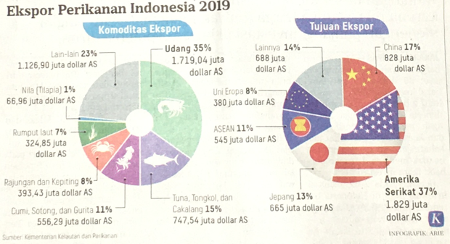
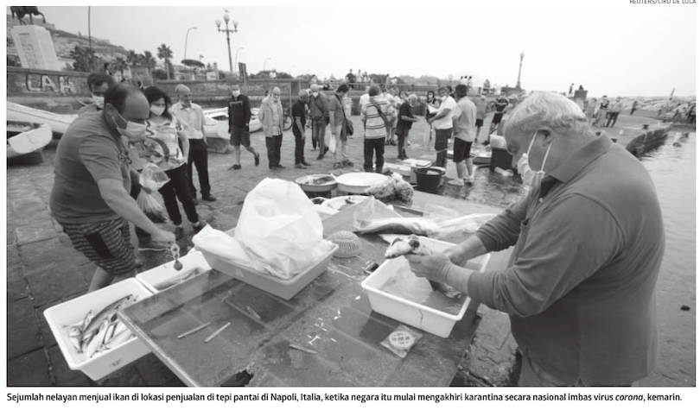
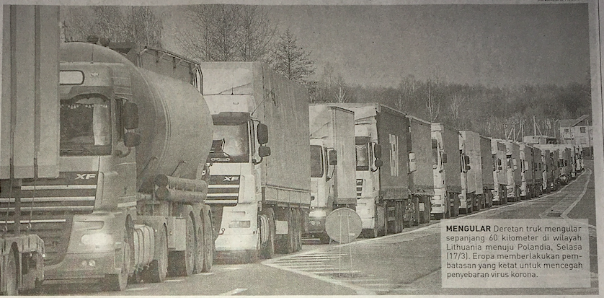
Visual images of EU (2020)

Slide 35
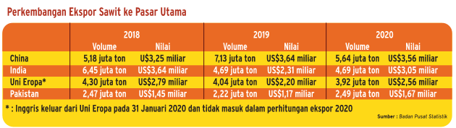
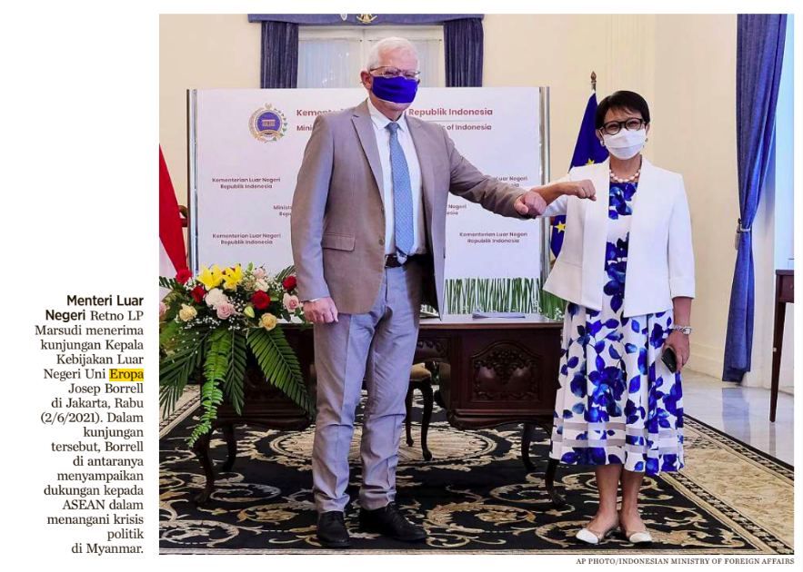
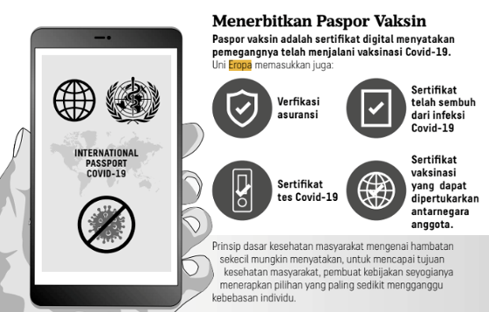
Visual images of EU (2021)

Slide 36
Conclusions
EU has been a visible actor, but not prominent
Indonesia’s attention on EU has grown between 2020 and 2021 but not significant
The Jakarta Post has been the most interested in reporting the EU
Shadow of Covid19 raised significant from 2020 to 2021
The Indonesian press is NOT interested in Brexit.
EU appeared rarely in local-context, and these news stories always featured EU only as a minor actor, among which the most concerned issue was Indonesian palm oil export to Europe.

Slide 37
Conclusions (2)
Extra-EU action was found more in 2021 compared to 2020, but the raise is not significant.
For intra-EU actions, Indonesian press focused on the Covid-hit economy and the health care issues especially vaccines. These reportage was mostly in negative tones. In 2021, the focus shifted to measures related to Covid recovery and economic measures.
For extra-EU actions, stories circulated in Covid vaccine aid, EU political actions globally, and trade agreements. These were mostly reported in neutral tone.
Indonesia's expectations of the EU tend to be low in both years, focusing on bilateral EU-Indonesia relations

