Slide 1
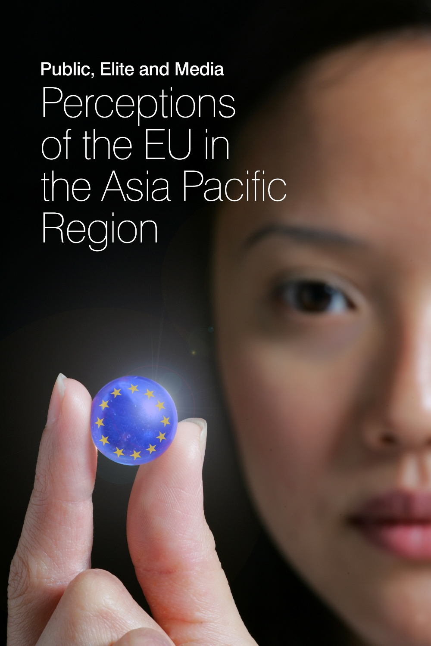
EXPECT: ASEAN’s Perception and Expectations of EU
The case of Social Media
NURINA AULIA HARIS
UNIVERSITAS GADJAH MADA
SEPTEMBER 2022

Slide 2
Content
1 | Monitored platform and accounts
2 | Activeness of EU & Hot issues
3 | Sources
4 | Centrality
5 | Level of focus/ Domesticity
6 | Action & themes
7 | Bilateral relations
8 | Evaluation & netizens’ reactions
9 | Self-image and Asia’s expectations
10 | Visual images
11 | Conclusions

Slide 3
1. Popularity of social media platforms
Indonesia’s total population was 275+ million in early 2022 (Indonesian statistical center)
There were 204.7 million internet users in Indonesia in January 2022 (datareportal)
 | Platforms | Market size
1st | Youtube | 139.0 million (50.0 percent of Indonesia’s total population)
2nd | Facebook | 129.9 million (46.8 percent of the total population)
3rd | Instagram | 99.15 million (35.7 percent of the total population)
7th | Twitter | 18.45 million (6.6 percent of the total population)
https://datareportal.com/reports/digital-2022-indonesia

Slide 4
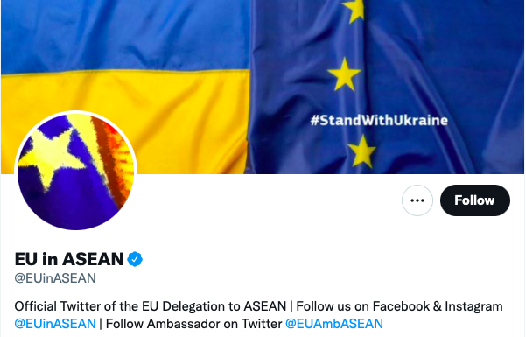
Monitored Social Media accounts for ASEAN
Notes:
Note: As of 2022, ASEAN mission to EU did not run any twitter or social media account.

Slide 5
2. Activeness of accounts (n=475)

Slide 8
Other hot issues in EUD account

Slide 9
3. Sources (n=475)

Slide 10
Sources of reposts
 | EUD
 | 2020 | 2021
1st | European External Action Service @eu_eeas | Igor Driesmans @EUAmbASEAN
2nd | EuropeAid @europeaid | Josep Borrell Fontelles @JosepBorrellF
3rd | European Commission (@EU_Commission) | European External Action Service - EEAS @eu_eeas

Slide 11
4. Centrality of EU (n=475)

Slide 12
5. EUD’s Level of Focus (all posts)

Slide 13
6. EU actions (Main/2nd focus, n=450)

Slide 14
Leading #hashtag (Major/2nd)
2020 | 2021
Covid 19 | EU in ASEAN
Europe Day | Covid 19
EU in ASEAN/ EU&ASEAN | Europe Day

Slide 15
Intra-EU actions (Major/2nd)

Slide 16
Sub-frame of intra-EU actions
(Main/2nd focus)
2020
Promoting our European Way of Life | Health Care
European Green Deal | Environment
A Europe fit for digital age | Disinformation
2021
EU integration | Europe Day Celebration
European Green Deal | Environment
Promoting our European Way of Life | Health Care

Slide 17
Extra-EU actions (Major/2nd)

Slide 18
Sub-frame of extra-EU actions
(Main/2nd focus)
2020
A stronger Europe in the world | CFSP
Promoting our European Way of Life | Health Care
European Green Deal | Environment
2021
A stronger Europe in the world | CFSP/International Partnership
Promoting Our European Way of Life | Research & Education
European Green Deal | Environment

Slide 19
7. Bilateral relation (Main/2nd focus)

Slide 20
Bilateral relation with ASEAN
(Main/2nd focus)
 | 2020 | 2021
1st | EU-ASEAN cooperation (education) | EU-ASEAN cooperation in environment
2nd | Celebrate Europe Day | EU's response to Covid19
3rd | EU's response to Covid19 | Celebrate Europe Day

Slide 21
8. Evaluation of EU (Major/2nd, n=450)

Slide 22
Evaluation of intra-EU actions

Slide 23
Evaluation of intra-EU action (Main/2nd focus)
 | Leading +ve Story | Leading -ve Story
2020 | EU's response to Covid19 | -
2021 | Celebrating Europe Day | -

Slide 24
Most popular posts of intra-EU story
 | Most liked | Most commented | Most shared
2020 | Europe Day Celebration (13) | - | Europe Day Celebration (6)
2021 | Europe Day Celebration (14) | - | Europe Day Celebration (7)

Slide 25
Evaluation of extra-EU actions

Slide 26
Evaluation of extra-EU action (Main/2nd focus)
 | Leading +ve Story | Leading -ve Story
2020 | EU's response to Covid19 | US Travel Ban/US decision in suspending WHO fund
2021 | EU-ASEAN environment cooperation | -

Slide 27
Most popular posts of extra-EU story
 | Most liked | Most commented | Most shared
2020 | Celebrate Europe Day (34) | EU-Indonesia cooperation (researcher exchange) (2) | EU's response to Covid19 (€350 million to assist the ASEAN) (26)
2021 | EU-ASEAN diplomatic relations (EU HRVP Borrell' attended a meeting with Permanment representatives to ASEAN) (86 likes, 12 comments, 46 shared) | (12) | (46)

Slide 28
9. Self-image built by EUD (Main/2nd)
 | 2020 | 2021
1st | Partner of ASEAN | Partner of ASEAN
2nd | Green Europe | Green Europe
3rd | Protector of EU | Promoter of values

Slide 29
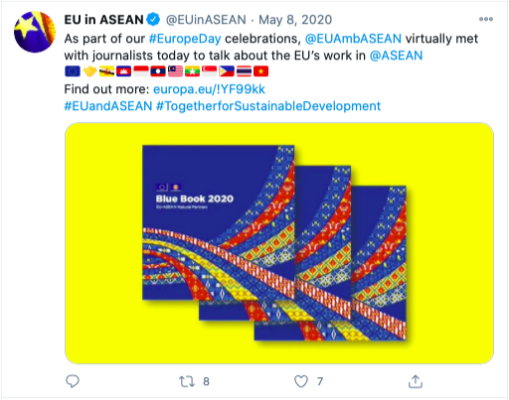
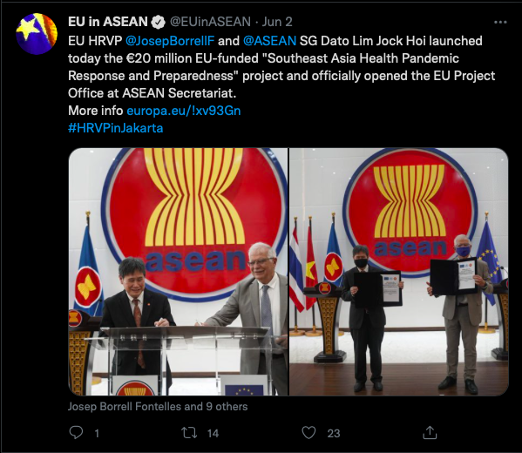
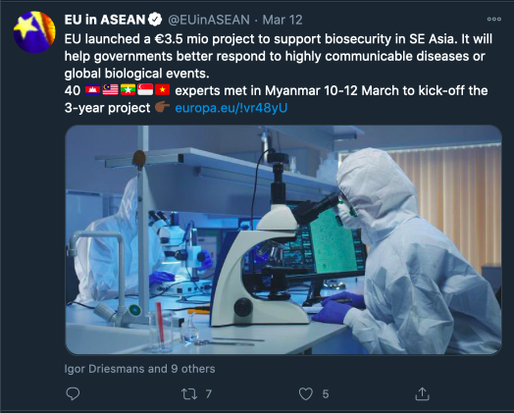
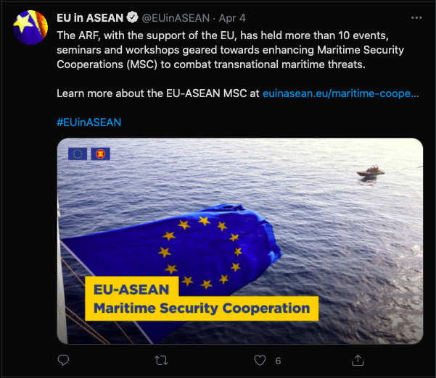
10. Pictures in EUD (2020 versus 2021)
2020
2021

Slide 30
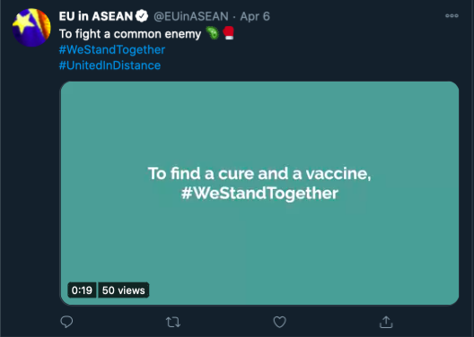
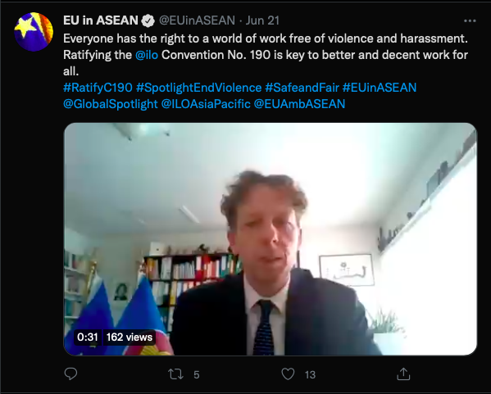
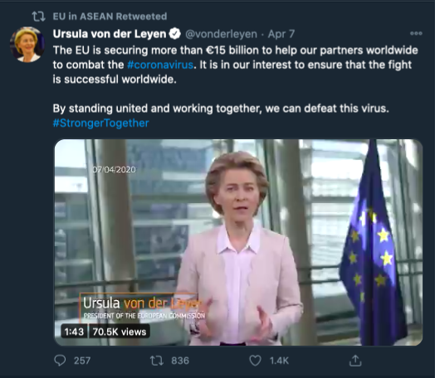
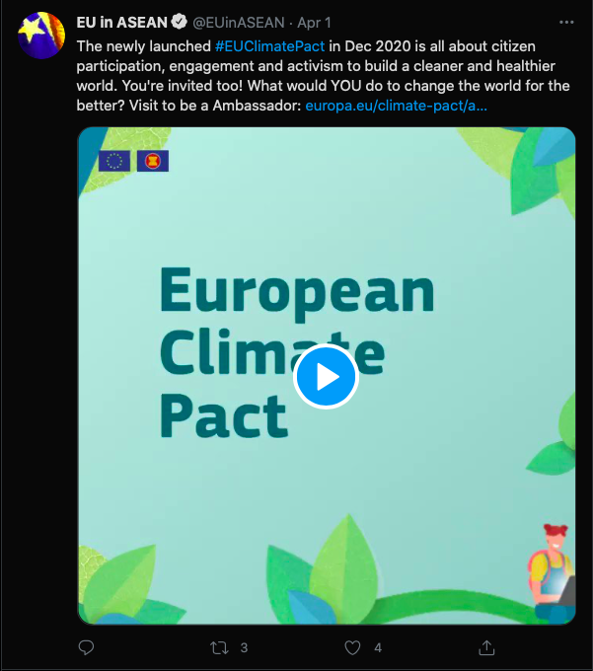
Videos in EUD (2020 versus 2021)
2020
2021

Slide 31
Conclusions
Activeness of the EUinASEAN account doubled in 2021, most were original posts.
In 2020 the trend on Covid-19 fluctuated following the number of posts, while in 2021 the trend decreased across time and had a vast gap with the number of posts.
No Brexit related post were found in both year
The Green Deal was the most discussed issue in both years, especially in 2021 (number has almost tripled).
The sources of reposts in 2020 are led by European institutions while in 2021 by its leaders.
Both years focus on regional issues which by 2021 almost quadrupled.
Promotion for Europe Day is one of the key events for both year.

Slide 32
Conclusions (2)
For the intra-and extra-EU actions in 2020, Health Care and Environment sub-frame topped the list, while 2021 was more varied.
Posts on bilateral relation tripled in 2021 with EU-ASEAN cooperation in education dominating 2020 and environment leading in 2021.
Positive posts dominate both years. The EU’s response to Covid-19 lead the positive story in 2020 while 2021 are European Day and Environmental cooperation.
The negative story only exists in 2020 which related to US travel ban and US decision to suspend WHO fund.
For both years, EU’s institutions post lead the popular Intra-EU stories while EU’s figures dominating extra-EU stories.
In both years, the 1st and 2nd most common image EU wanted to build were to be the Partner of ASEAN and showing its concern in Green Europe. While the 3rd most common image in 2020 was as Protector of EU and in 2021 was as the Promoter of Values.

