Slide 1
EXPECT: China’s Perception and Expectations of EU The case of Social Media
WANG Yuhuan (Yvonne)
Tsinghua University
22 September 2022

Slide 2
Content
1 | Monitored platform and accounts
2 | Activeness of EU & Hot issues
3 | Sources
4 | Centrality
5 | Level of focus/ Domesticity
6 | Action & themes
7 | Intra/Extra EU posts
8 | Bilateral relations
9 | Evaluation
10 | Self-image and Asia’s expectations
11 | Pictures and videos
12 | Conclusions

Slide 3
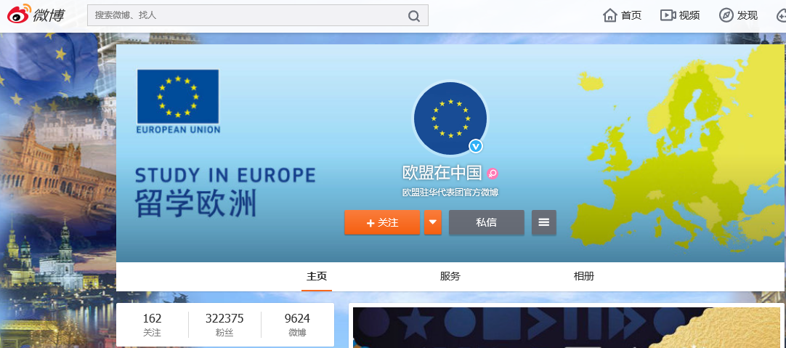
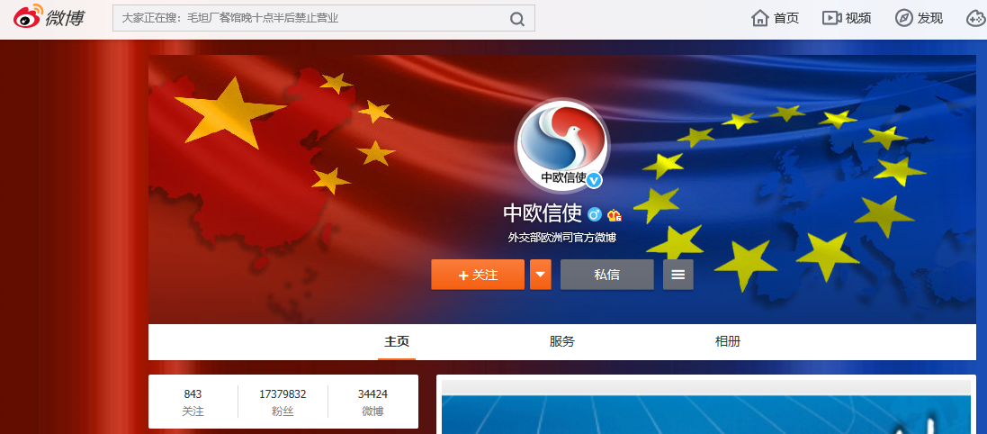
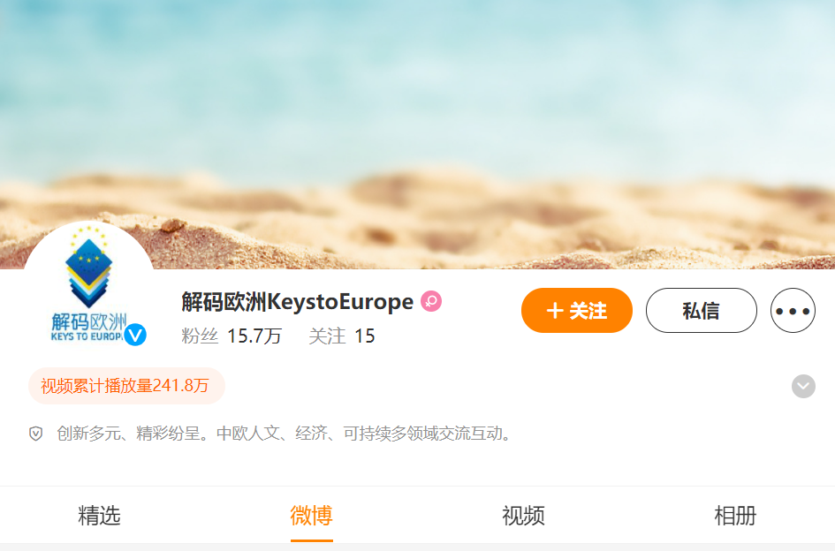
1. Monitored Social Media accounts in China
2020 | EU Delegation EU in China
 | Chinese MFA China-Europe Messenger
2021 | EU Delegation EU in China
 | Entrusted by EU Delegation KeystoEurope
 | Chinese MFA China-Europe Messenger

Slide 4
2. Activeness of Monitored Accounts
KeystoEurope
EU in China

Slide 5
Activeness of across time, EUD

Slide 6
Activeness across time, China-EU Messenger

Slide 7
Hot issues
2020 |  | 2021
EUD | MFA | EUD | MFA
Covid19 |  | Covid19 | Xinjiang, Covid19

Slide 8
Social media Activity on Covid-19
Proportion of posts on Covid-19 from 2020 to 2021
EUD

Slide 9
Social media Activity on Covid-19
Proportion of posts on Covid-19 from 2020 to 2021
MFA

Slide 10
Other hot issues in EUD accounts

Slide 11
Sources of EU posts

Slide 12
4. Centrality of EU (n=876)

Slide 13
Level of Focus in EUD (Main/2nd focus)
*Project did not code “personal” in 2020
**Some posts have more than one level of focus.

Slide 14
Domesticity in MFA (Main/2nd focus)
*Some posts have more than one domesticity.

Slide 15
6. EU actions (Main/2nd focus, n= 285)
Some posts contained both intra-EU and extra-EU actions.

Slide 16
Leading #hashtag (Major/2nd)
 |  | 2020 | 2021
EUD | 1st | #Covid19 | #BeautyInDiversity
 | 2nd | #MuseEurope | #LoveHasNoBorder
 | 3rd | #EUTogether | #DecodeEurope
MFA | 1st | #ChinaEUCooperation
MFA | 2nd | #PandemicFightWithoutBorder | #ChinaEuropeRelations
 | 3rd | - | Bilateral collaboration

Slide 17
Intra-EU actions (Major/2nd)

Slide 18
Sub-frame of intra-EU actions (Main/2nd focus)
2020
 | EUD | MFA | MFA
EU integration | Solidarity
Promoting our European Way of Life | Health care
European Green Deal | Environment | -
2021
 | EUD
Promoting our European Way of Life | Health care
European Green Deal | Environment

Slide 19
Extra-EU actions (Major/2nd)

Slide 20
Sub-frame of extra-EU actions (Main/2nd focus)
2020
 | EUD | MFA
A stronger Europe in the world | CFSP
Promoting our European Way of Life | Health care
European Green Deal | Environment | -
2021
 | EUD | MFA
A stronger Europe in the world | CFSP
Promoting our European Way of Life | Values | -
European Green Deal | Environment | Climate change

Slide 21
7. Bilateral relation (Main/2nd focus)

Slide 22
Bilateral relation with China (Main/2nd focus)
 |  | 2020 | 2021
EUD | 1st | EU-China Bilateral political and diplomatic relations | Bilateral economic and trade relations
 | 2nd | EU-China bilateral cooperation | Bilateral collaboration
 | 3rd | EU's reaction of Covid-19 | Special days celebrations
MFA | 1st | EU-China Bilateral Political and diplomatic relations | Bilateral Political and diplomatic relations
MFA | 2nd | Bilateral relations with European state | Bilateral economic and trade relations
 | 3rd | China's reaction of Covid-19 | -

Slide 23
8. Evaluation of EU (Major/2nd, n= 285)

Slide 24
Evaluation of EU action (Main/2nd focus)
 |  | Leading +ve Story | Leading -ve Story
EUD | 2020 | EU's reaction of Covid-19 | EU solidarity challenged
 | 2021 | EU promotes rights for LGBTI | -
MFA | 2020 | Bilateral diplomatic and political relations | -
 | 2021 | Bilateral cooperation | Covid vaccine problems & economic downturn

Slide 25
Most popular posts of intra-EU story
 |  | Most liked | Most commented | Most shared
EUD | 2020 | European Environmental Issues | Covid-19 | Europe Day
 | 2021 | EU efforts on environmental protection | European products (GI products) | EU efforts on environmental protection
MFA | 2020 | Covid-19 | Public life during outbreak of Covid-19
 | 2021 | - | - | -
Red: Most visible comments are negative
Orange: Most visible comments are not related to what EUD posted
*Some comments are invisible due to the block mechanism of the platform

Slide 26
Most popular posts of extra-EU story
 |  | Most liked | Most commented |  | Most shared
EUD | 2020 | International Day Against Homophobia | International Day Against Homophobia |  | Bilateral Political and Economic Relations
 | 2021 | Sanctions against human right violation | Sanctions against human right violation |  | Bilateral Political and Economic Relations
MFA | 2020 | Bilateral Political and diplomatic relations |  | China's reaction to Covid-19&Bilateral collaboration (public health) | Bilateral Diplomatic Relations
 | 2021 | Bilateral relations with European MS (Hungary) | - | Bilateral Political and diplomatic relations
Red: Most visible comments are negative
*Some comments are invisible due to the block mechanism of the platform

Slide 27
9. Self-image built by EUD (Main/2nd)
 | 2020 | 2021
1 | Protector of Public Health | Promoter of values
2 | A Union of Solidarity | Partner of China
3 | Norm setter | Protector of environment

Slide 28
Expectation in MFA account (Main/2nd)

Slide 29
China’s Expectation on EU
 | 2020 (53 expectation) | 2021 (17expectations)
1st | Strengthen bilateral cooperation in pandemic | Focus on positive side of China-EU relations
2nd | Cooperate with China in global problems | Strengthen bilateral cooperation with China
3rd | Conclude EU-China investment and trade deals at early time | Increase strategic autonomy

Slide 30
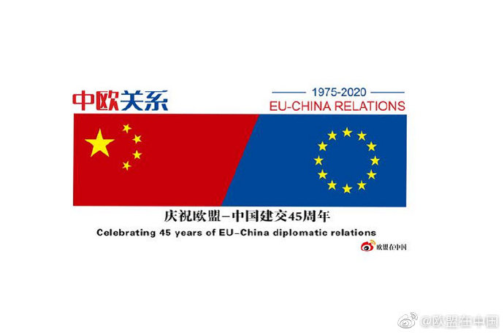
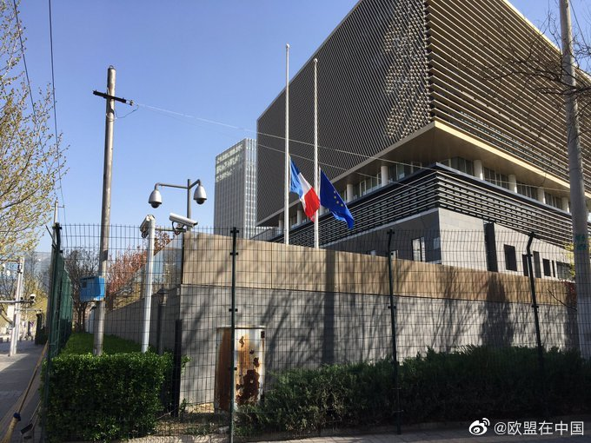
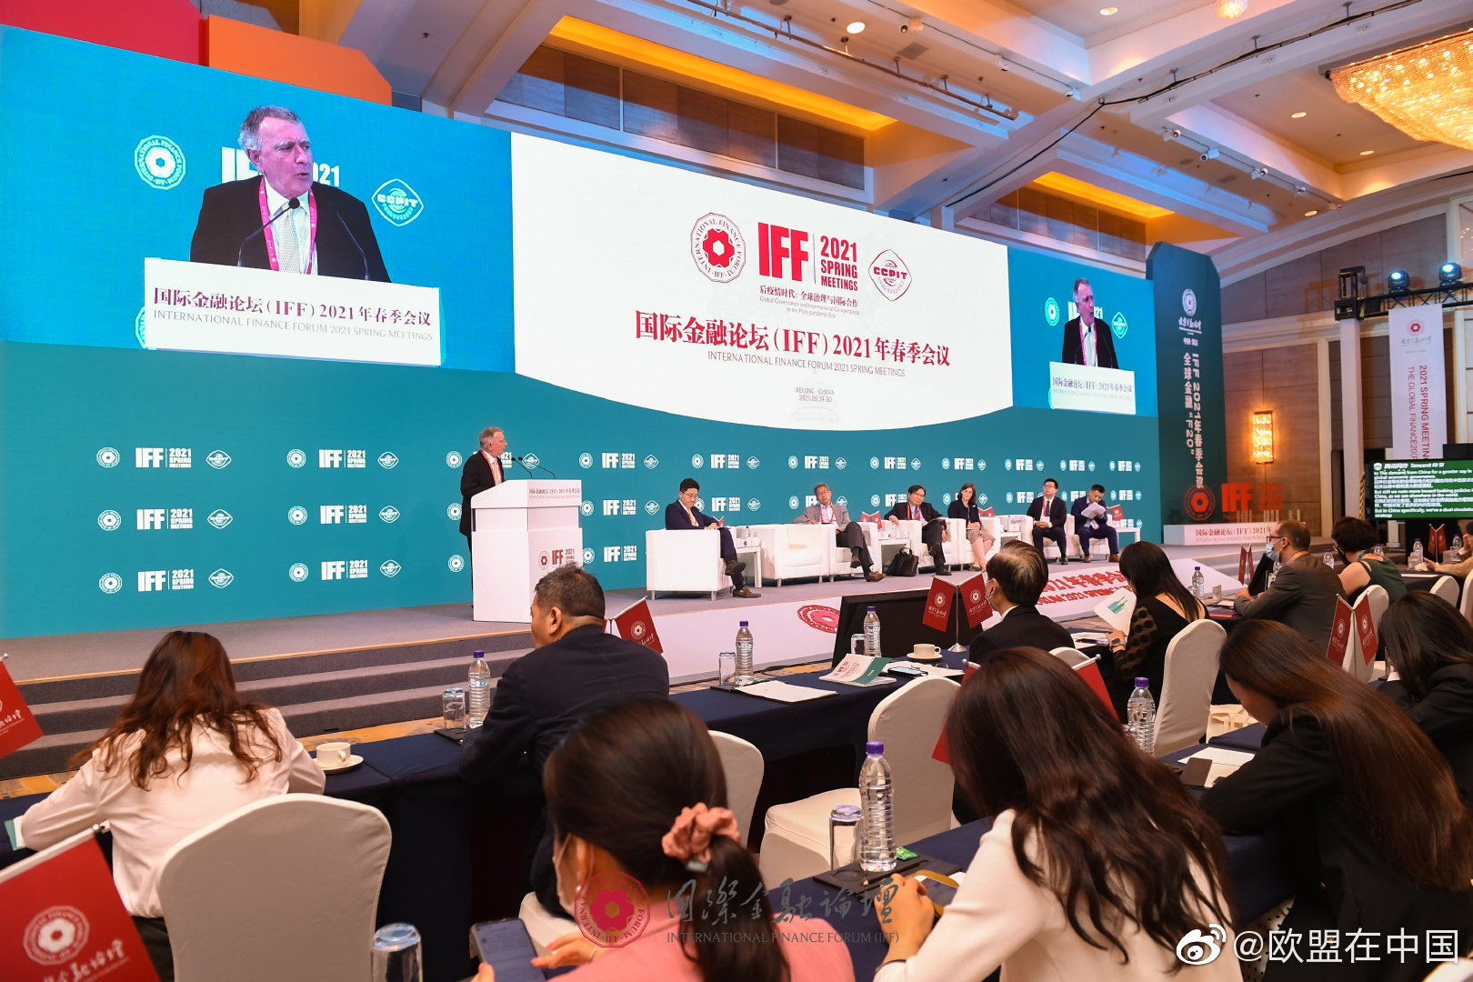
Pictures in social media EUD 2020 versus 2021

Slide 31
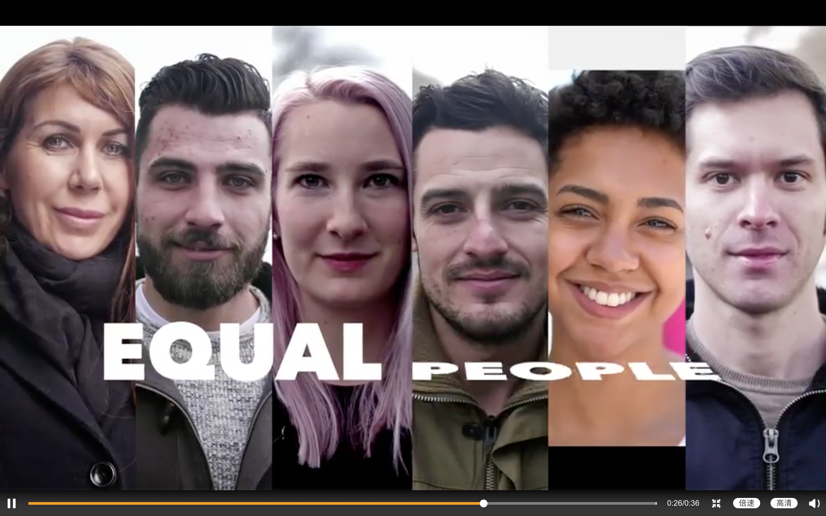
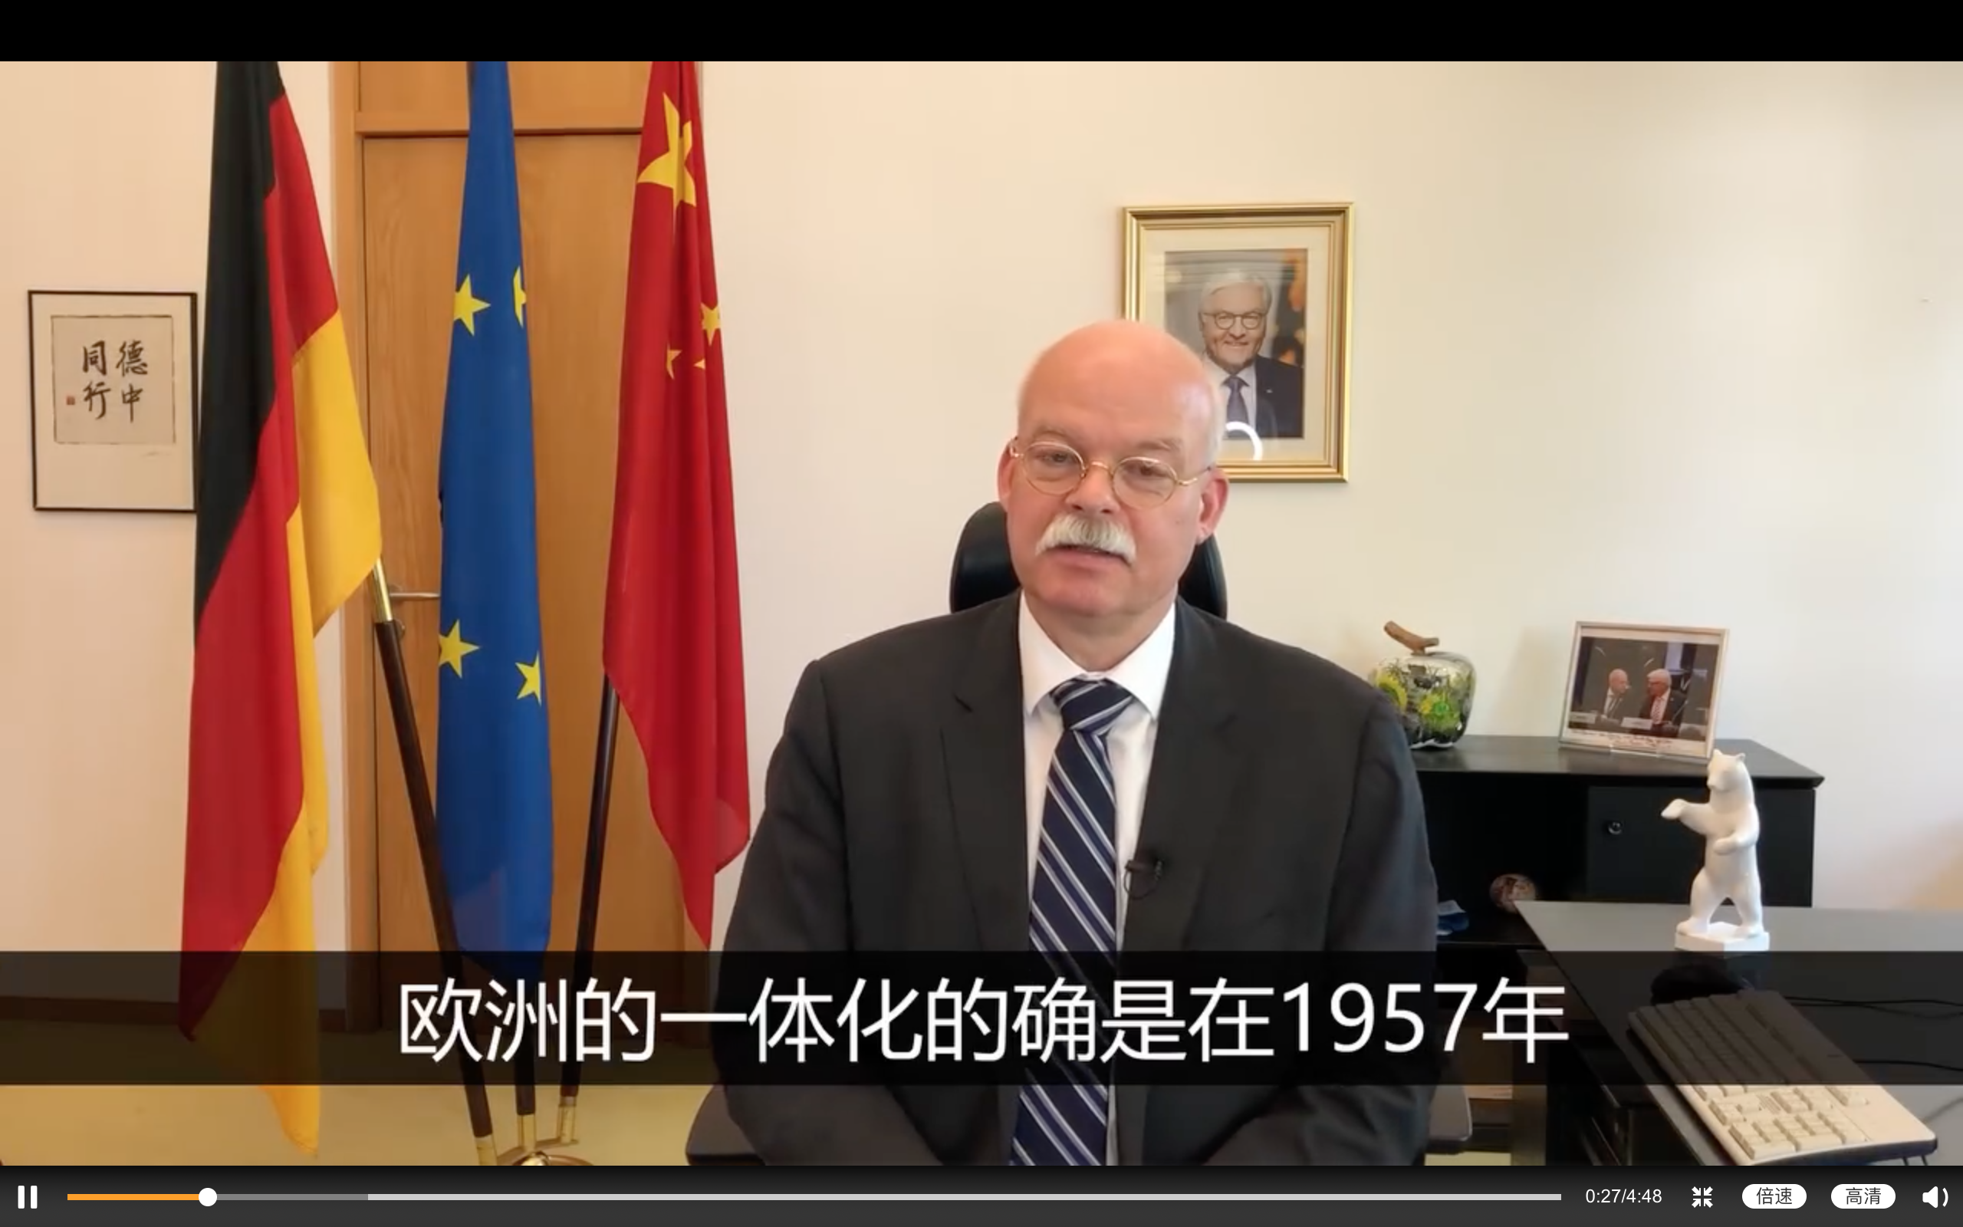
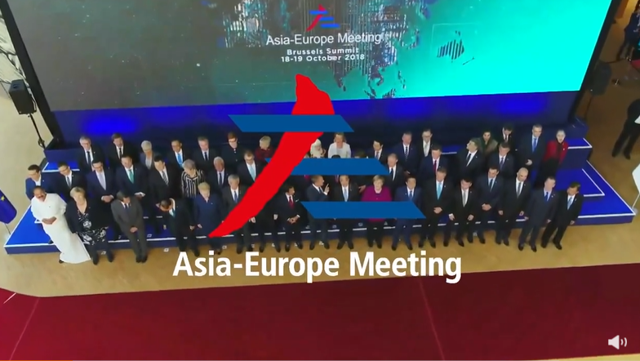
Videos in social media EUD 2020 versus 2021

Slide 32
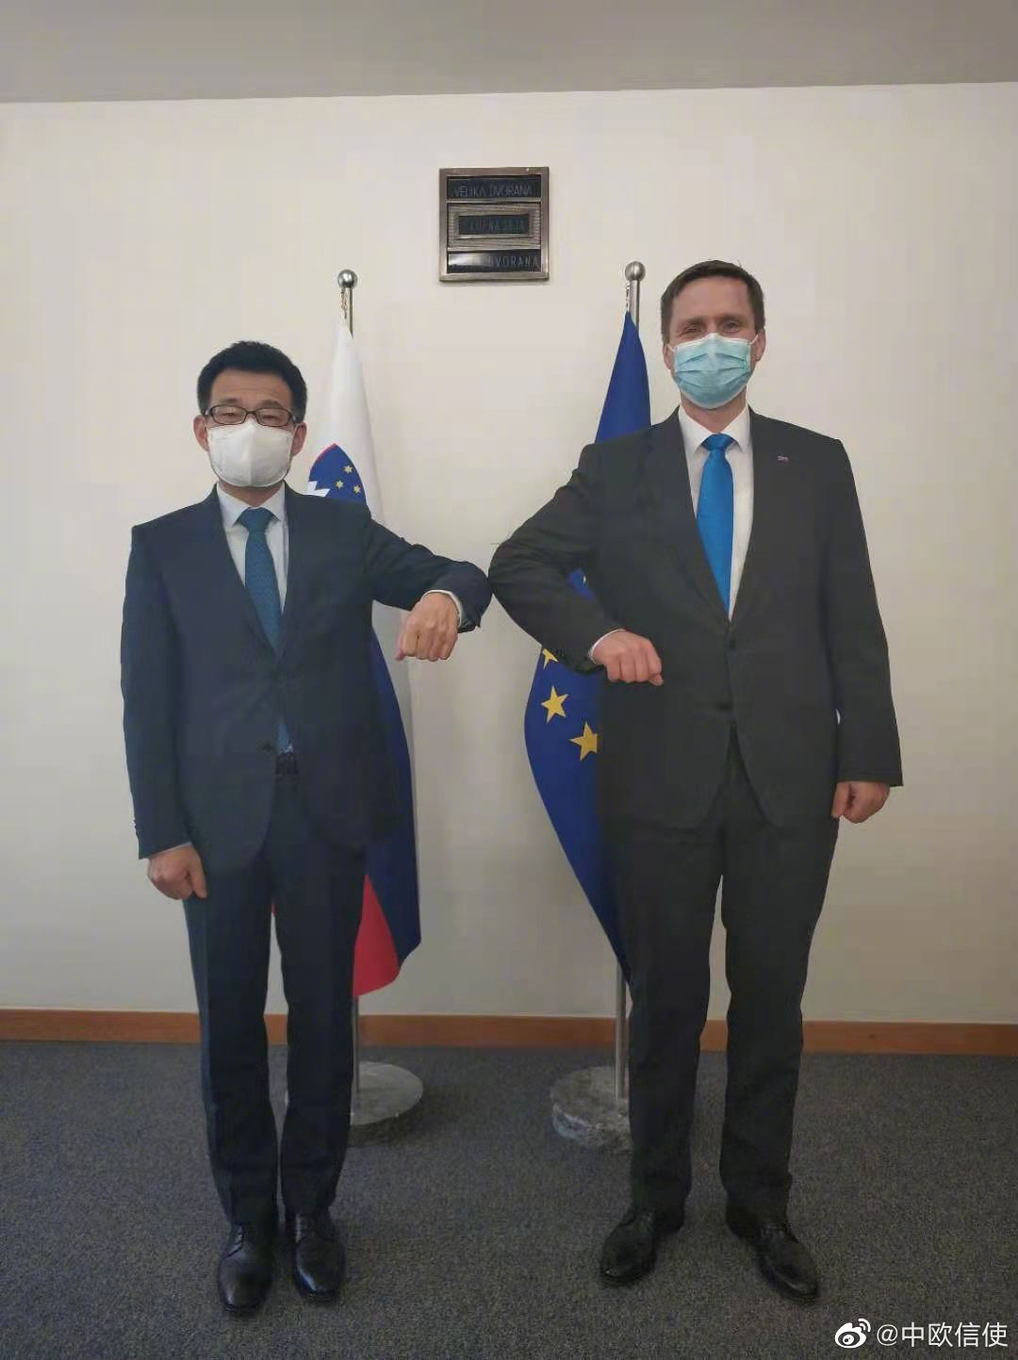
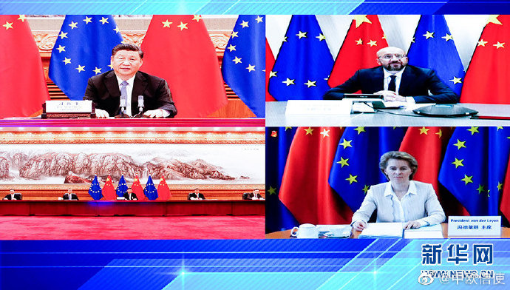
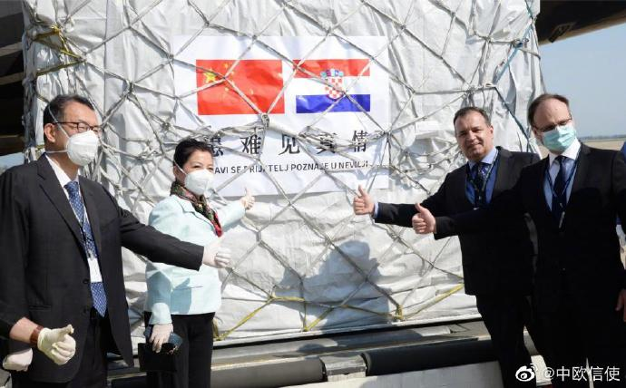
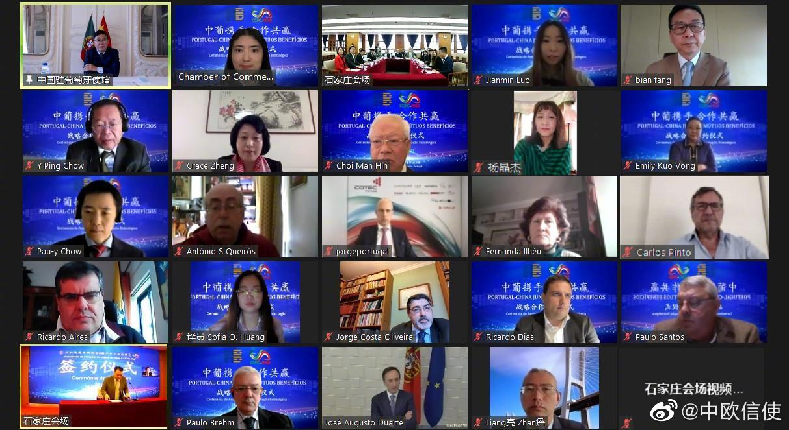
Pictures in social media Chinese MFA 2020 versus 2021

Slide 33
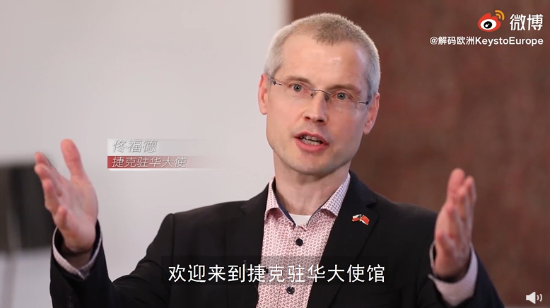
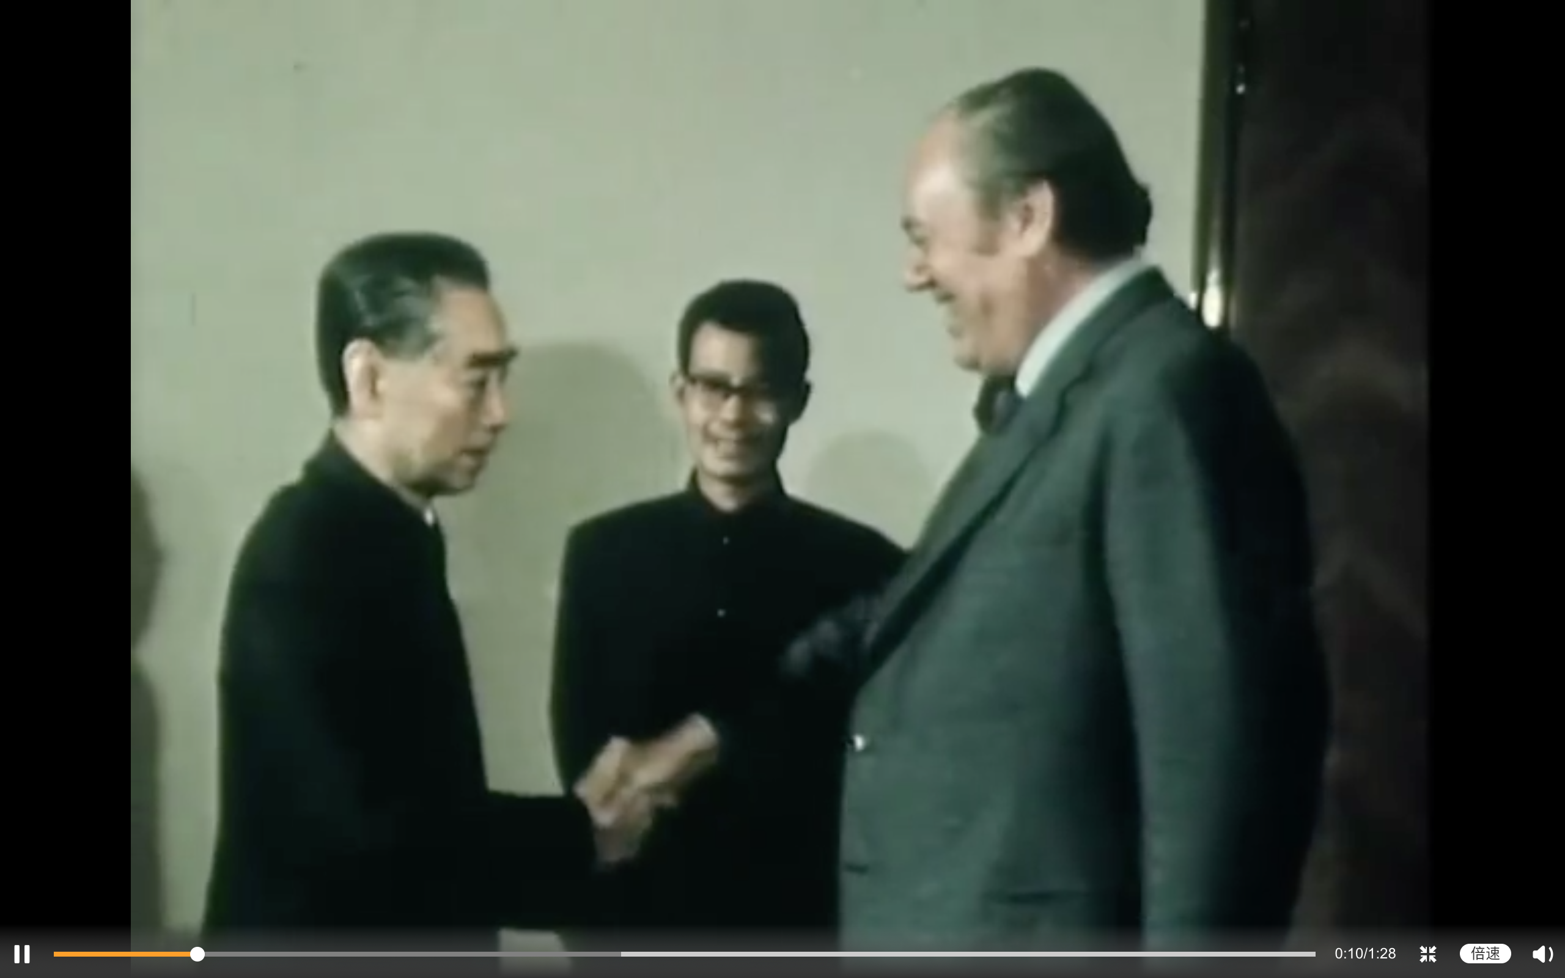
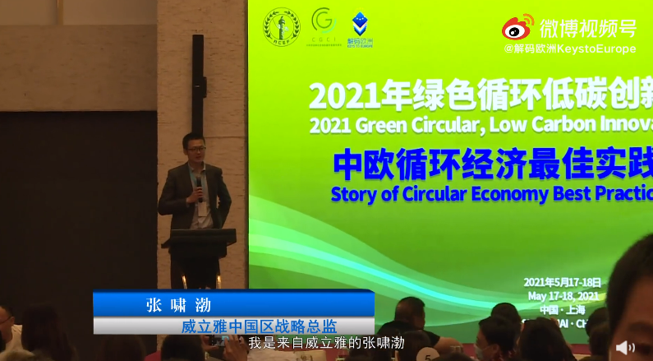
Videos in social media Chinese MFA 2020 versus 2021
Notes:
China's former president Zhou Enlai met with Soames, vice chairman of European Economic Community on May 6th, 1975, the day China and EU establish diplomatic relationships

Slide 34
Conclusions
Both EUD and MFA are less active on Weibo in 2021, and the change of EUD is more pronounced despite two accounts were monitored in 2021.
Hot issue(covid19) in 2020 was quite consistent between EUD and MFA, but in 2021 MFA concerned more on political issues while EUD posted more on environmental sustainability.
MFA posts received less shares or comments in 2021 when compared to 2020.
Member states, rather than EU, are more frequently posted in MFA account in 2021, and bilateral relations between countries are more concerned.
Adding KeystoEurope in 2021, proportion of EUD personal posts increased, as it’s not a government official account and aims at promoting the “soft” image of EU.
Notes:
Two accounts in 2021

Slide 35
Conclusions(2)
Chinese MFA posted only EU extra actions in 2021, focusing mostly on bilateral relations. MFA concentrated more on global cooperation rather than EU internal news.
No negative news posted by MFA despite conflicts in 2021, but more neutral posts-Chinese official social media account tries to be objective and convincing by expressing less emotion.
Many posts by EUD did not receive positive comments. Instead, lots of comments were negative or even irrelevant. –many netizens stick to their previous opinions no matter what has been posted.
Developing partnership and politically as well as economically cooperation dominated China’s expectation on EU’s global role, while EU stressed on promoting norms, although sometimes being criticized by Chinese netizens due to value conflicts.
Notes:
Two accounts in 2021

Slide 36
Thanks!

