Slide 1

How innovative are you?

Slide 2
What is Marketing
& Branding

Slide 3

What is Marketing?
Advertising
Sales
Producing Products
Consumption (Over)
Pricing
Etc.
Notes:
These are the common ideas that you receive when you ask the average person what marketing is
However, while these ideas encompass elements of marketing, they do not capture what marketing really is.

Slide 4
Marketing Defined
Marketing is the exchange which takes place between consumer groups and supplying groups. Alderson, 1957,
An activity, set of institutions and processes for creating, communicating, delivering and exchanging offering that have value for customers, clients, partners and society at large. Solomon et al, 2012
Notes:
Here are several definitions of marketing:
Alderson gives us one of the first definitions from the 50’s and a more recent definition from Stanton
Notice the common themes that begin to emerge
needs and wants
value
exchange

Slide 5
Marketing is Exchange
Currency
Producer
Consumer
Products
What’s driving the exchange?
Notes:
Exchange is the defining concept underlying marketing.
Exchange is the act of obtaining a desired product from someone by offering something in return.
Let’s look at the concept of exchange more thoroughly

Slide 6
Marketing is Exchange
Currency
(Cash, Debt, Time, Votes, Behaviour)
Producer
(Profits, goals)
Consumer
(Wants & Needs)
Products
(Goods, Services, Ideas, People, Places, Organisations)
Solutions to Problems
Benefits = Health, Safety, Comfort, Beauty, . . .
Notes:
Manufacturers often make the mistake of paying more attention to the physical products than what it is these products provide.
They see themselves as selling a product rather than providing a solution to a need.
Consumers are not buying physical products , what they are buying is solutions to problems they have
They are purchasing the benefits these product can provide.
So when a woman buys makeup, she is buying hope
A carpenter isn’t buying a drill, be is buying a hole
A middle age man who buys a sports car, is buying sex appeal
The mktrs’s job then is to sell the benefits built into physical product rather than just their physical features
* Sellers who concentrate their thinking on the physical product instead of on the benefits are said to suffer from Marketing Myopia

Slide 7
Benefits Create Demand
Benefit
The outcome sought by a consumer that motivates buying behaviour – that satisfies a need or want
Demand
Consumers’ desire for products coupled with the resources to obtain them

Slide 8
Marketing is Exchange
A successful marketing exchange involves:
two or more parties, each with something of value desired by the other party
all parties must benefit from the transaction
the exchange must meet both parties’ expectations (e.g. quality, price)
Free to accept or reject the offer.
Notes:
To be considered a successful marketing exchange, the transaction must satisfy the following conditions.
Two or more parties must participate, each with something of value desired by the other party.
All parties must benefit from the transaction.
The exchange must meet both parties’ expectations (e.g. quality, price).
Once again, exchange can occur for all different types of organisations: large and small, for-profit and not-for-profit, and private and public.

Slide 9
Exchange provides Value
(Value = Economic Utility)
Utility: the benefits or value gained by users of a product/service.
Form Utility - creation of product
Place Utility - accessibility
Time Utility - availability when needed
Possession Utility - transfer of ownership, use
Image Utility - emotional or psychological
Notes:
So the exchange process provides value to both parties. Value can also be thought of as economic Utility
The Values or Utilities that marketing provides include the following.
So Marketing provides ...
FORM -When timber is made into furniture, form utility is created
PLACE - is created when the product is made readily accessible to customers
TIME - is created when the product is made available When customers want to buy it.
POSSESSION - is created when a customer buys the product or ownership is transferred
IMAGE - more subjective - it involves the emotional or psychological value that a person attaches to a product or brand

Slide 10
6 Main Tasks of a Marketer…
Identify customer needs
Design goods/services that meet those needs
Communicate information about those goods/services to prospective buyers
Make goods/services available at times and places that meet customer needs
Price goods and services to reflect costs, competition, and consumers’ ability to buy
Provide the necessary service and follow up care to ensure customer satisfaction after the purchase
Notes:
Identify customer needs
Design goods/services that meet those needs
Communicate information about those goods/services to prospective buyers
Make goods/services available at times and places that meet customer needs
Price goods and services to reflect costs, competition, and consumers’ ability to buy
Provide the necessary service and follow up care to ensure customer satisfaction after the purchase

Slide 11
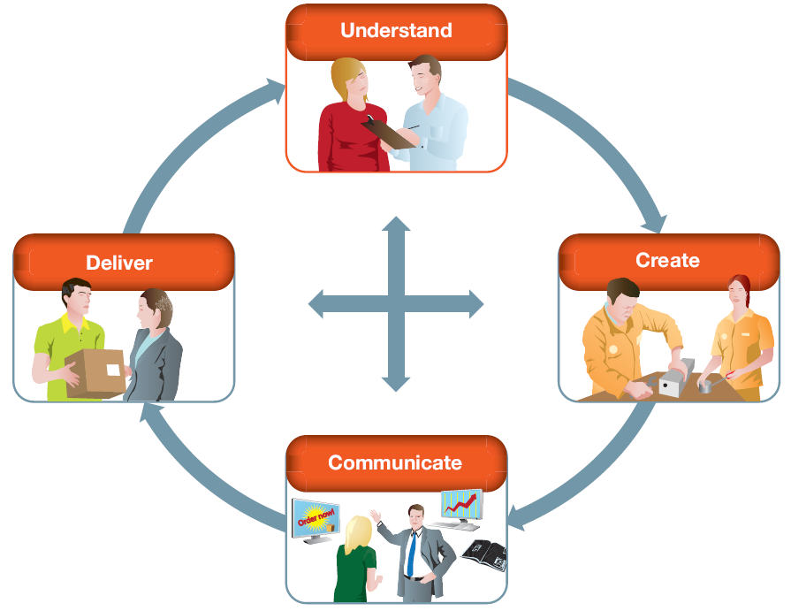
6 Main Tasks of a Marketer…
Notes:
Identify customer needs
Design goods/services that meet those needs
Communicate information about those goods/services to prospective buyers
Make goods/services available at times and places that meet customer needs
Price goods and services to reflect costs, competition, and consumers’ ability to buy
Provide the necessary service and follow up care to ensure customer satisfaction after the purchase

Slide 12
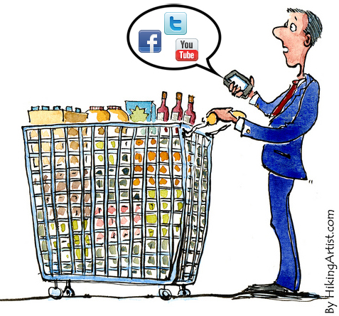
Marketing Mix
Product strategies
Place strategies
Price strategies
Promotion strategies

Slide 13
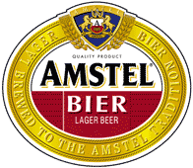
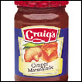



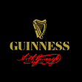
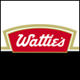






Slide 14

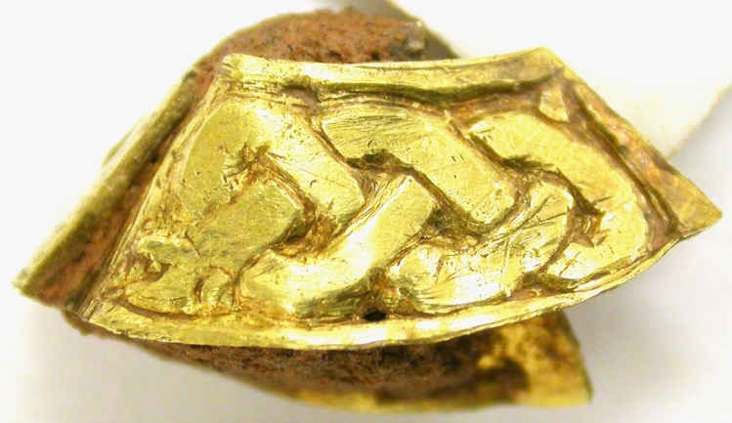

Branding
Brand
  A collection of symbols such as a name, logo, slogan and design intended to create an image in the customer’s mind that differentiates a product from competitors’ products.
Brand image
  The set of beliefs that a consumer has regarding a particular brand.
Notes:
Brand refers to a collection of symbols, such as the name, logo, slogan and design, intended to create an image in the customer’s mind that differentiates a product from competitors’ products. A brand can identify one item, a family of items, or all the items of a seller. Brands play a particularly important role in high involvement purchase decisions. Most consumers will prefer a well-known, reputed brand over a cheaper, unknown brand when making high-involvement purchases. For consumers, the brand helps speed up consumer purchases by identifying specific preferred products. The brand can provide a form of self-expression and status, as well as denote product quality. It can also arouse a collection of images in the customer’s mind.
Brand image is the set of beliefs that a consumer has regarding a particular brand. People can have a positive or negative brand image for a given brand, depending on things like past experience or word-of-mouth, which can substantially influence whether they would be willing to buy the product or not. When marketers make decisions about products, the decisions must relate to the product’s brand and brand image.

Slide 15
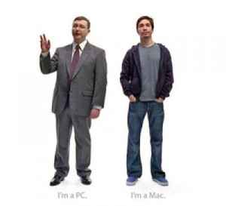
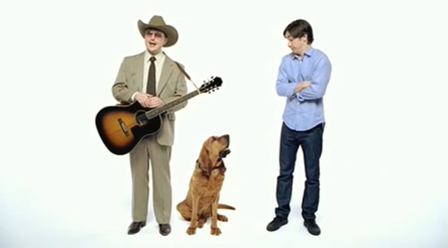

Slide 16
Why Brand?
Identify (know the producer)
Make consumers’ shopping easier
  Reduce risk
  Assure quality and reliability
  Brand image
As a Competitive Barrier
  Reduce price comparisons
  Coordinate channel behaviour
  Product extensions

Slide 17

Characteristics of a good brand name
Distinctive (Prolog vs. Red Stag)
Suggestive (Huggies, Sunkist, Head & Shoulders)
Easy to remember (Apple, Tide, Surf)
Adaptable to new products
Able to be protected
Notes:
) It should be distinctive: The market is filled with over-worked names and over-used symbols. A unique and distinctive symbol is not only easy to remember but also a distinguishing feature. “Northstar” shoes have a distinct name.2) It should be suggestive: A well-chosen name or symbol should be suggestive of quality, or may be associated with superiority or a great personality. The name VIP Classic for travelers is suggestive of a superior quality for a distinct class of people. Promise is suggestive of an assurance of tooth health.
3) It should be appropriate: Many products are surrounded by a certain mystique in the minds of the consumers. Carefree is an appropriate brand name of a sanitary towel.
4) It should be easy to remember: It should be easy to read, pronounce and spell. Tide, Surf, Gold Spot are examples of such brand names.
5) It should be adaptable to new products: Videocon is was good brand name for TVs and VCRs but when it is extended to refrigerators and washing machines, some of the sales appeal is lost. Hotline was a good name for gas stoves, but definitely not a suitable name for TVs.
6) It should be registerable under the Indian laws of Trade Marks and Copyrights.

Slide 18
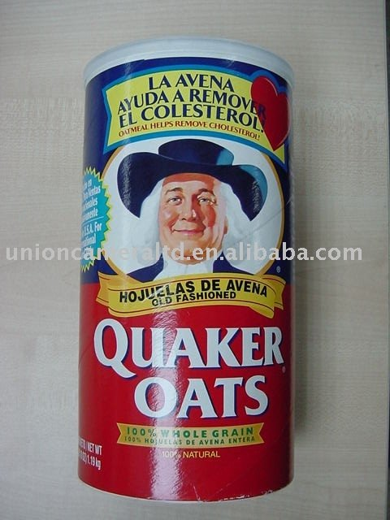
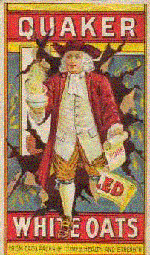
Packaging - Quaker Oats
“a delicacy for the epicure, a nutritious dainty for the invalid, a delight to the children.”
Notes:
Relationship with the product (brand, packaging, and advertising...)
When packaging, branding, and advertising began to be used together, the impact was greater than the sum of the parts. Branding is the manufacturer’s assertion of standardization and quality. Packaging is both a physical protection that enable the manufacturer to maintain control over the contents, and thus assure its standards. But it is also an expression of identity. Advertising lets people know about the manufacturer’s promise and makes them familiar with the package. TRUST THE PACKAGE!
Perhaps one of the first products to be packaged and marketed in a way that we can recognize as wholly modern was the unpretentious, uncharismatic--oatmeal. What began in 1870 as a food for horses and a few stray Scots, became known in two short decades as “a delicacy for the epicure, a nutritious dainty for the invalid, a delight to the children.” (QUAKER OATS CEREAL--throw handsfuls)
A base substance had been put in a small box, invested with a personality, outfitted with recipes that increased its usefulness, and turned into a profitable brand. The Quaker image was a stout friendly Quaker carrying a scroll that said pure.
When powerful brand names are combined with distinctive packages and backed by promotion, this can be a strong combination.
VI. PACKAGING: There is an intimate relationship. Packaging innovation made branding possible. Branding did not arise until technological innovations in packaging occurred (the folded box), that affected tranport, and made printing on the box possible. 125 years later, it is just as important.

Slide 19
Packaging
Designed to attract the consumer’s attention
Helps quickly communicate the product benefits
Provides easy brand recognition
Designed to physically protect the product
May provide additional benefits, such as a special lid
May help augment the product with information, recipes, warranties

Slide 20
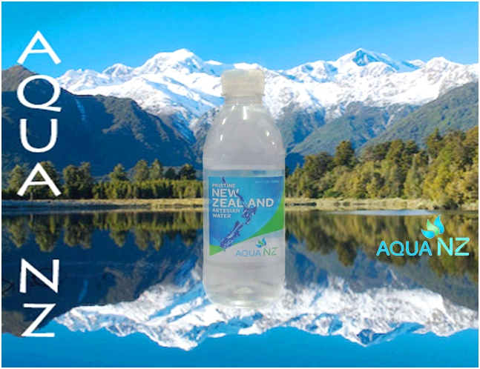
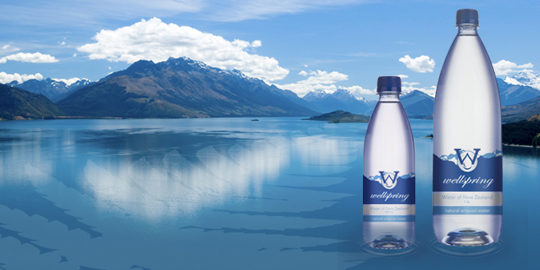
Bottled Water Exercise
Notes:
Could you do a lesson on branding?
Comparing NZ bottled water brands (pure, fresh, clean, green) versus Asian brands (health oriented e.g. with herbal extracts, company brands e.g. Watsons water in Hong Kong, foreign brands e.g. Evian). How marketing influences consumers?
As these students are from overseas, we could get them to talk about marketing NZ products internationally. Then they actually come up with a brand/logo/label to promote NZ bottled water in their home country. I could get some adhesive label sheets, felt pens, scissors, so they have some fun, labelling their bottles. Then we get them to present or do a “commercial”. I could invite Laura and David from International Business to be the judges and we have prizes for best product and presentation.

Slide 21
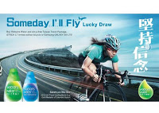
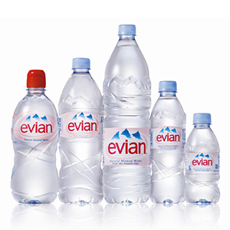
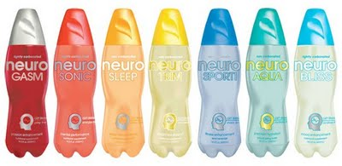
Bottled Water Exercise
Notes:
(health oriented e.g. with herbal extracts, company brands e.g. Watsons water in Hong Kong, foreign brands e.g. Evian
Watsons in Hong Kong (store brand or retail brand)
Watson's (Your Personal Store) or Watson's is part of the Health and Beauty retail and consumer division of the Hong Kong-based A.S. Watson Group, which in turn is part of the world wide conglomerate Hutchison Whampoa Ltd. The Company operates over 2,200 stores in Asia and Europe, and has for the second year running been voted the No. 1 in retail - Pharmacy and Drugstore category of Asia's top 1,000 brands.
Cyclist Sarah Lee Wai-sze, (李慧詩) became the face of Watsons Water last year after winning a bronze medal at the London Olympics.

Slide 22
Bottled Water Exercise
How would you market New Zealand bottled water in Asia?
  Choose a country
  Choose a Target Market
  Would you vary the product?
  Develop a brand image/position
  Come up with a brand name/slogan
  Design a label
Notes:
Break into groups of three

