Slide 2
Survivor Aotearoa
A resource provided by Science Outreach at the University of Canterbury with support from Dr Melanie Massaro and the University of Canterbury, School of Biological Sciences.
Funding was provided by the Canterbury Community Trust and the Brian Mason Scientific and Technical Trust.
www.outreach,canterbury.ac.nz

Slide 3
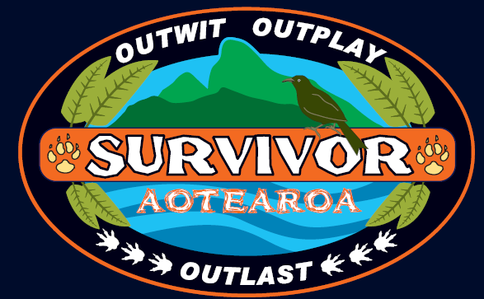

Slide 4

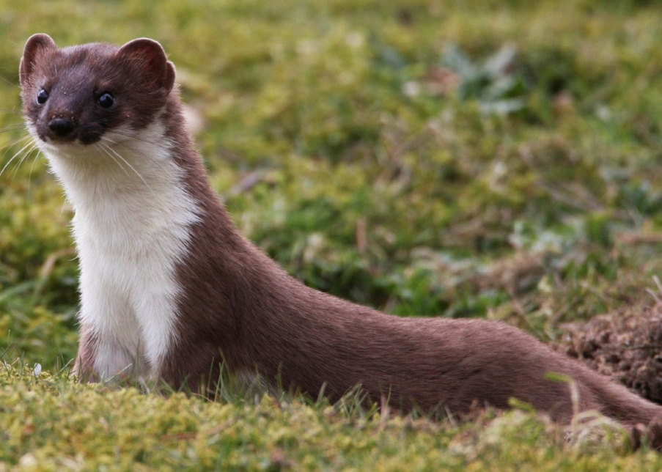
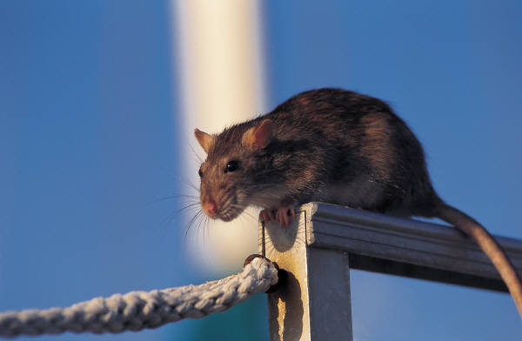
THE TRIBES...
The exotic predator tribe (introduced to NZ)

Slide 5
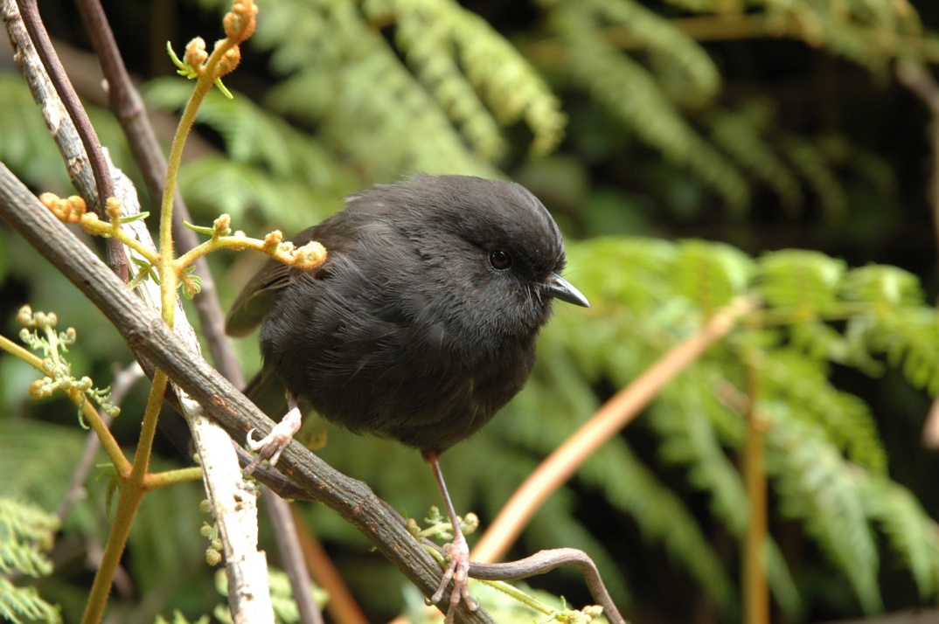
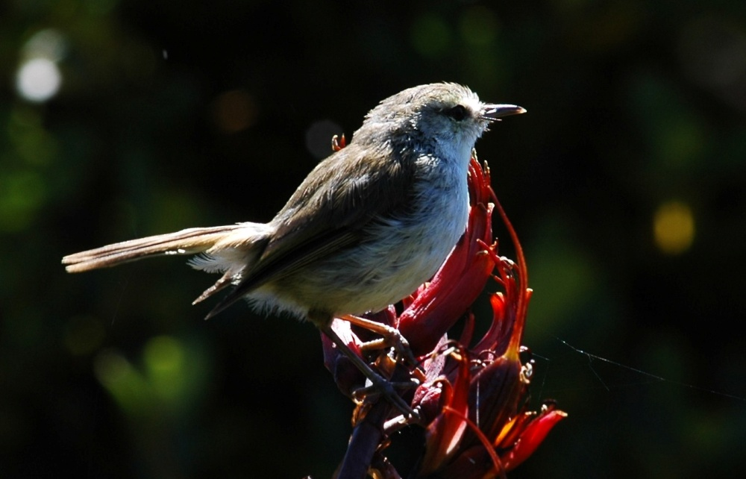
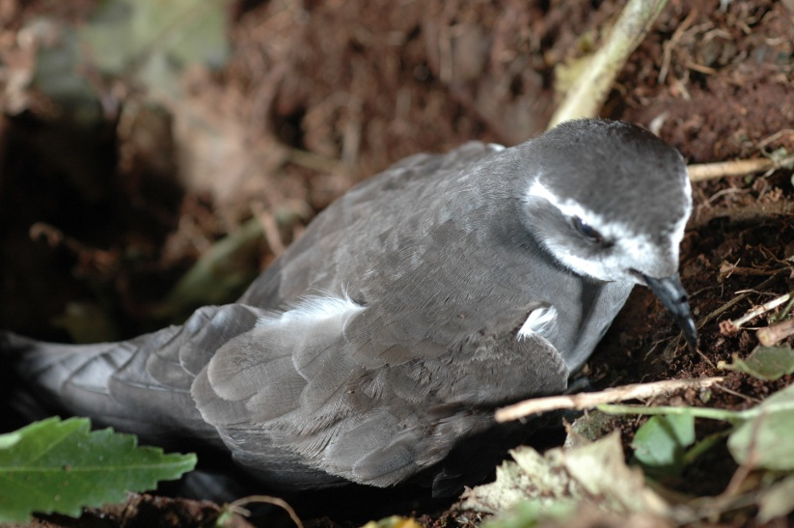
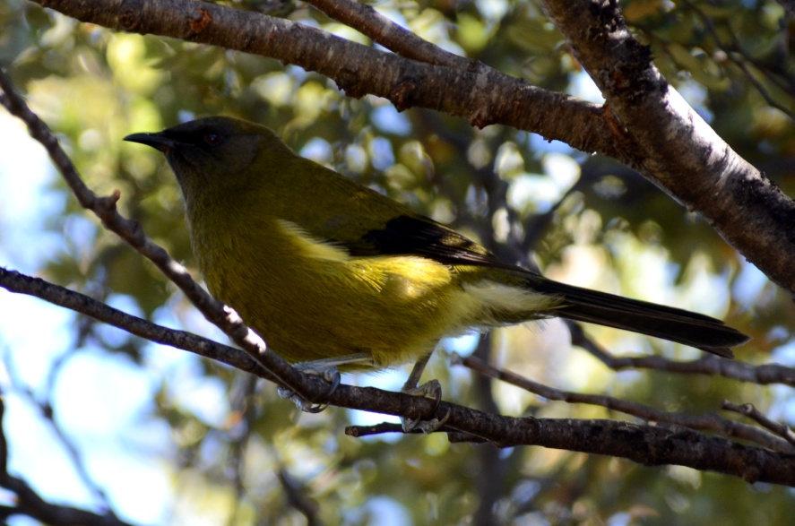
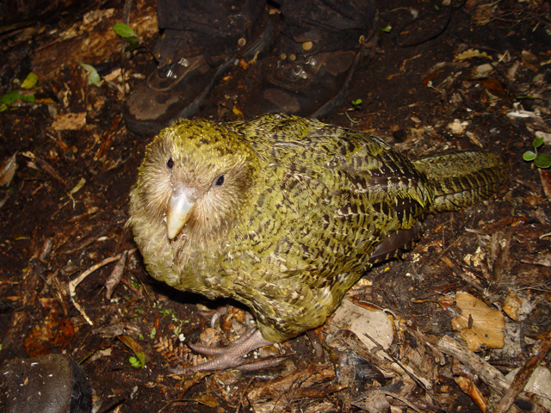
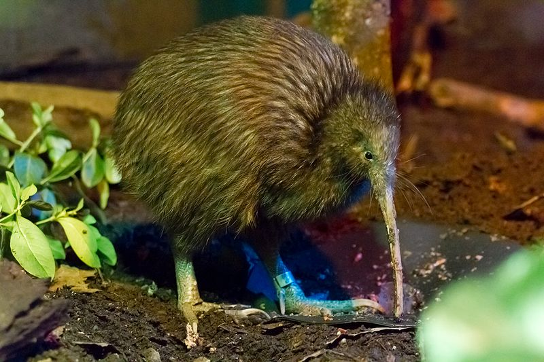
THE TRIBES...
The native NZ bird tribe

Slide 6
The native NZ bird tribe
Native NZ birds like the Kakapo evolved without predators. They are large, timid and flightless. They are vulnerable to predators.

Slide 7
The native NZ bird tribe
Are native NZ birds trapped by their evolutionary history?
Native NZ birds like the Kakapo evolved without predators. They are large, timid and flightless. They are vulnerable to predators.

Slide 8
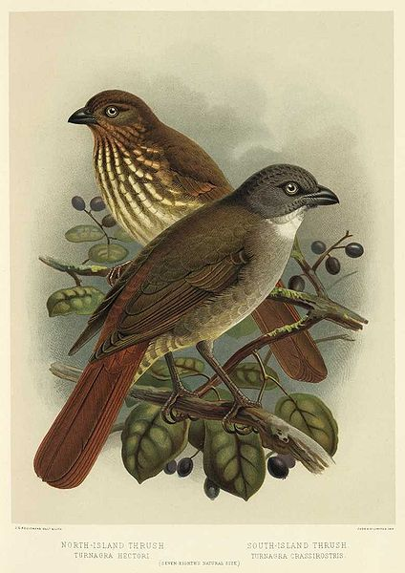
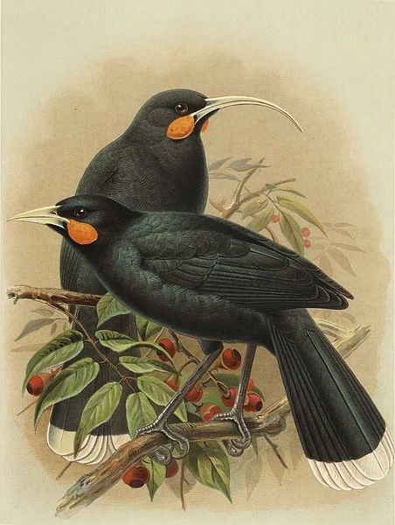
The native NZ bird tribe
Huia
Piopio

Slide 9
EXTINCT
EXTINCT
Huia
Piopio

Slide 10
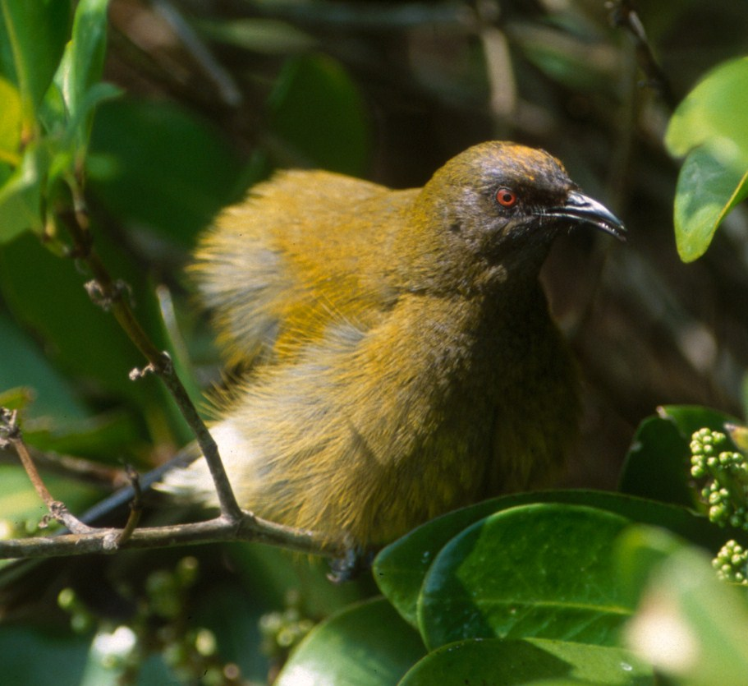
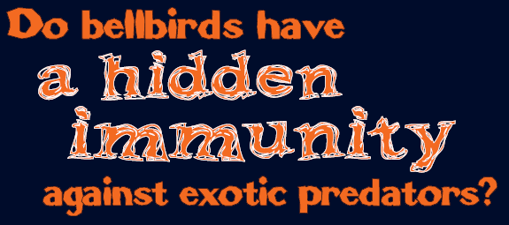

Slide 11
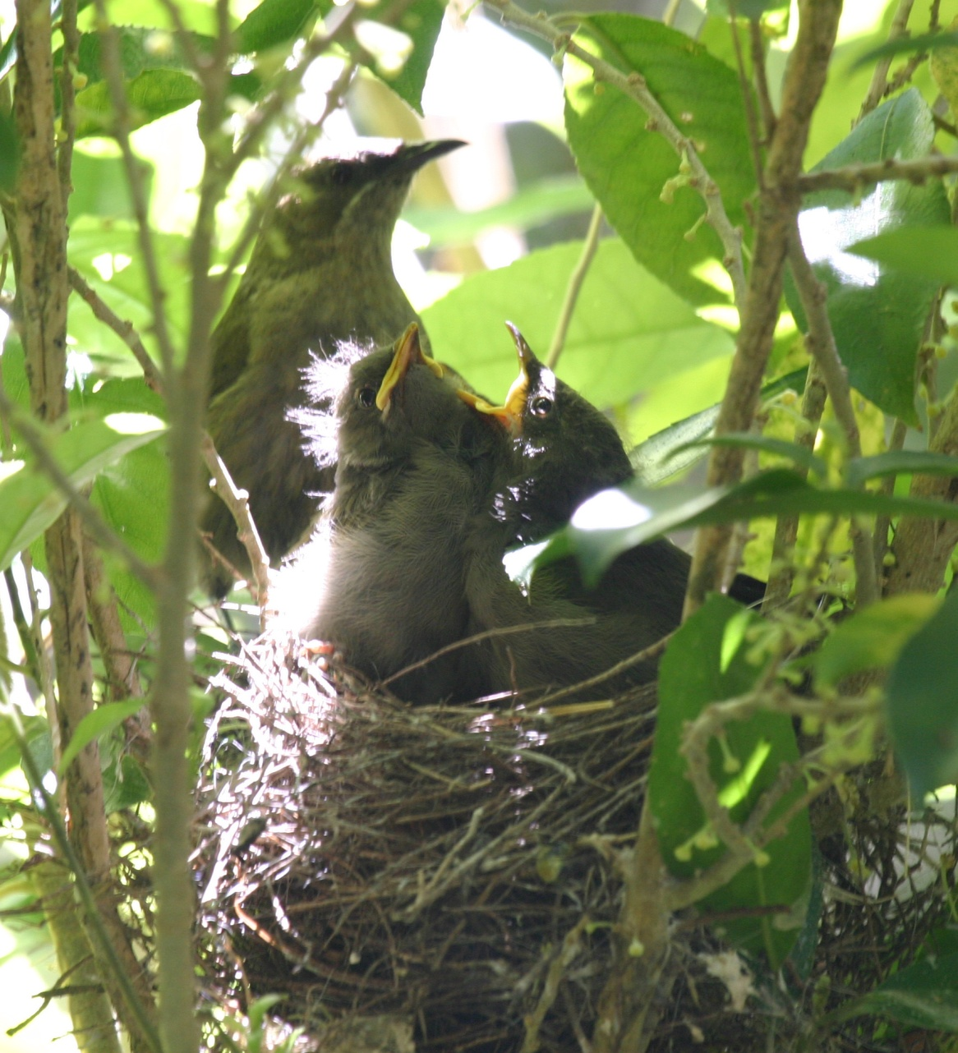
Can bellbirds rapidly adjust their behaviour or evolve in response to exotic predators?

Slide 12
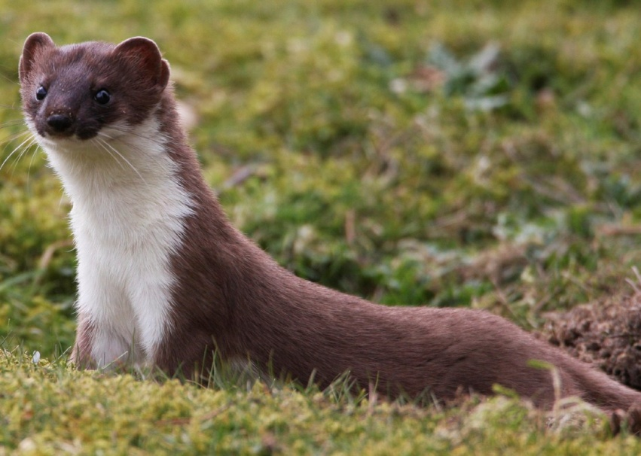
THE TRIBES for this
SURVIVOR challenge
Bellbird tribe vs Predator tribe

Slide 13

Bellbirds were studied at 3 sites
1. A permanent low risk site an offshore island
where exotic predators have never been introduced
(Aorangi Island)
2. A recent low risk site on the mainland where
exotic predators were experimentally removed
(Waimangarara Bush)
3. A high risk site on the mainland with exotic
predators present (Kowhai Bush)

Slide 14

Hidden cameras were used to film parental behaviour of Bellbirds at their nests.

Slide 15
The following data was collected:
The number of parental visits to the nest per hour
The length of time a female sat on the nest
(on-bout)
The length of time females spent foraging away from
the nest (off-bout)

Slide 16
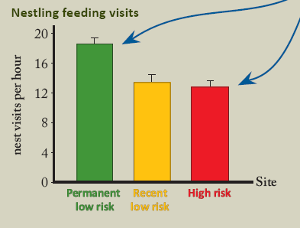
The birds at the
high risk site visit their nest less frequently compared to the recent low risk site and the permanent low risk site.
THE RESULTS

Slide 17
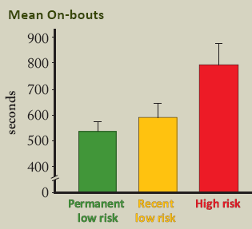
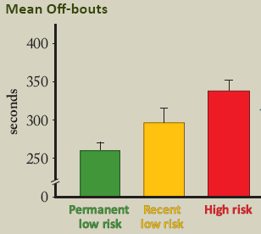
The birds at the high risk site visit their nests for longer periods (on-bouts) and forage away from the nests for longer periods (off-bouts)

Slide 18
1. Why do you think this would be an advantage for Bellbirds in the high risk site?

Slide 19
2. When there is no risk from predators – why do you think Bellbirds visit their nests and forage more often?

Slide 20
3. What does this trend tell us about the Bellbirds?

Slide 21
4. What is the conclusion of this study?
How could it be useful to conservationists?

Slide 22
DISCUSSION
Look at the graphs and answer the questions.

Slide 23
Answers........

Slide 24
Activity is minimised at the nests in the higher risk sites and reduces the risk of being spotted by a predator.
This will increase the survival of the chicks.
Bellbirds are small, with a high metabolism, and therefore need to feed often. This is possible when there is no risk of predation.

Slide 25
3. It seems that Bellbirds can assess the level of predation and adapt accordingly.

Slide 27
Final TRIBAL Council
Bellbirds have “a hidden immunity” against exotic predators.
Bellbirds, and perhaps other native NZ birds, are not necessarily trapped by their evolutionary history. They outwit predators by changing their nesting behaviour.

Slide 28
Final TRIBAL Council
We can use this information to improve conservation efforts for the long-term survival of threatened native birds.

Slide 29
Acknowledgements
Dr Melanie Massaro and
the University of Canterbury, School of Biological Sciences and Science Outreach
Kakapo photo by :Markus Nolf
Kiwi photo by: Rohit Saxena

