Slide 1

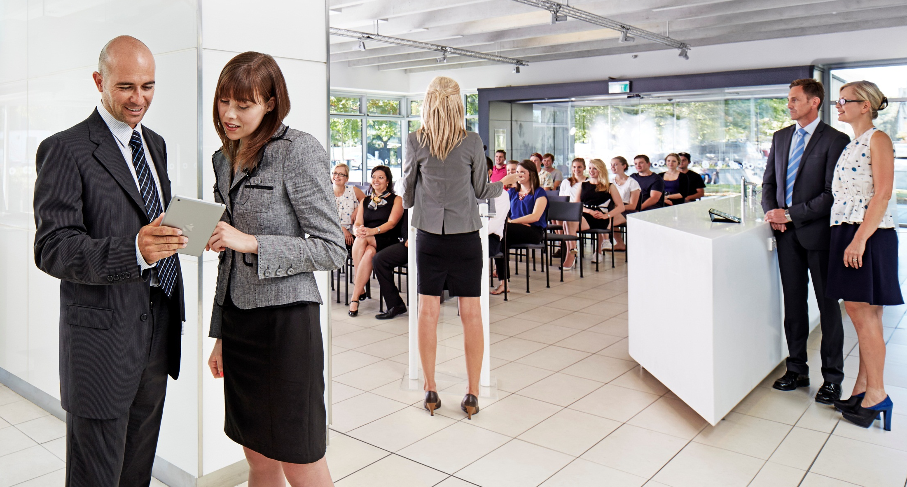

Slide 2
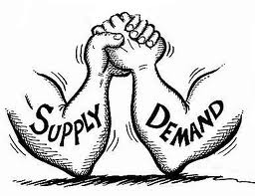
Markets – what are they and how do they work?
What is a market?
How is the price of avocado / iPhone determined?
How do sellers and buyers who don’t know each other manage to get to an equilibrium where supply equals demand, where all transactions that make buyers and sellers better off are made?

Slide 3

Markets – what are they and how do they work?
In our experiment today, we will split into many seller and buyer groups to create a market.
Let’s see if our trading leads to an equilibrium even though none of us really know what the supply and demand are.
Let’s see if we can get the “invisible hand” working!

Slide 4
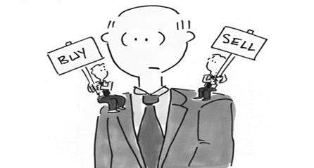
Markets in action! - Groups
We will need to split into 12 groups
Each group will get a “lollipop”
If you have a green lollipop you are a buyer.
If you have a red lollipop you are a seller.

Slide 5
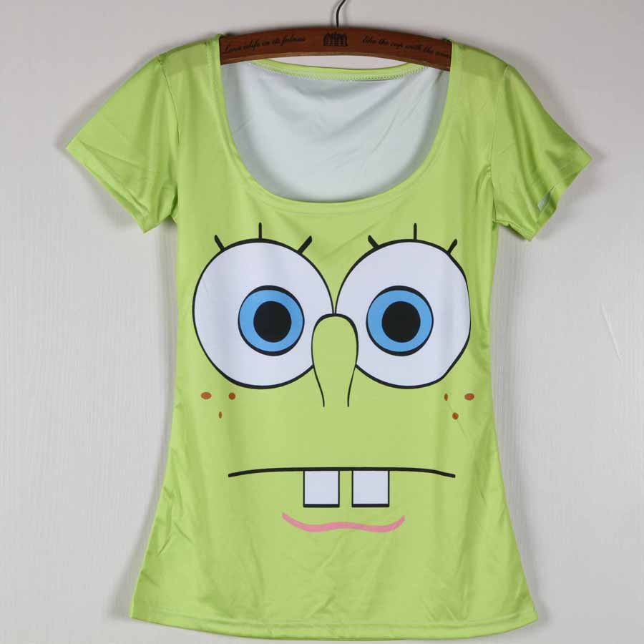
Buying and selling
Today we will buy (bid) or sell (ask) imaginary t-shits
If you are a selling team, you will be given information about how much each t-shirt costs you to make. These costs are specific to you.
If you are a buying team, you will be given information about how much each t-shirt is worth to you. These values are specific to you.
Once everyone knows their own values, we can trade
Trading here today is a bit like trading in the stock market – sellers yell out asks (the price you are happy to sell the t-shirt for) and buyers yell out bids (the price you are happy to buy the t-shirt for)
We will be moderated by Sam who picks the team whose lollipop she thinks was up first to make the next bid or ask

Slide 6
Buying and selling – first t-shirt
Once a round opens, anyone can put their lollipop up and, if called, make a bid to buy (only buyers can buy) or make an ask to sell (only sellers can sell)
Assume that the first group to be called is a seller group that asks $18 for the t-shirt.
The next buyer group called can either accept the ask or place their own bid. For example, they could say they want to buy the t-shirt for $10.
The next seller group called can either accept this bid or place their own ask. Say the place an ask of $13.
Assume that the next buyer group called accepts this ask.

Slide 7
Next t-shirt goes on the market
The first t-shirt is sold for $13 and we start the process of selling the next one by opening the bidding to all sellers and buyers who still have t-shirts to buy or sell (everyone has two per round).
We then continue selling more t-shirts until either all 12 t-shirts are sold and bought or 7 minutes is up, whichever comes first.
After this, round 1 is over and round 2 begins. You will again have two t-shirts to buy or sell, regardless of how many you bought or sold during round 1.
There are three rounds in total after which we hopefully can demonstrate that you have reached the equilibrium in the market and thus that the invisible hand has done its job!

Slide 8
Decision sheets
Each group will get one CONFIDENTIAL decision sheet
It is important that you don’t show your decision sheet to anyone outside your group because on it are your private costs (if you are a seller) or private values (if you are a buyer), and revealing those to others could undermine your position in the market.
You will also record your sale price / purchase price and your resulting earnings on the sheet.
We will use these sheets at the end of the experiment to determine who made the most money – the best seller and buyer teams are the WINNERS who win PRIZES!!!

Slide 9
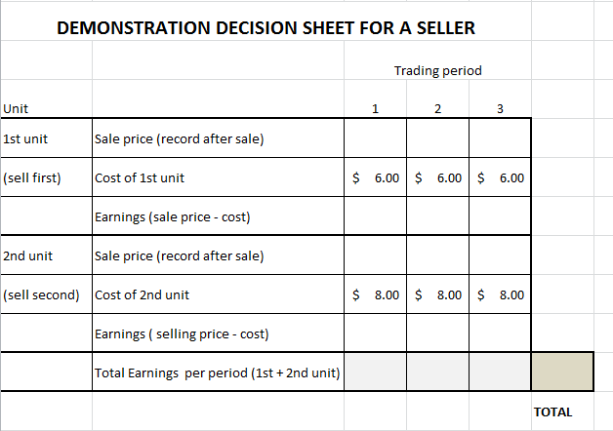
Record your first sale price here
Decision sheet - sellers
If you only sell one unit then the second unit’s earnings equal zero (you don’t have to pay the cost unless you sell).If you sell zero units your total earnings equal zero.
Then calculate your earnings here
Record your second sale price here
Then calculate your earnings here
You can add up your earnings here

Slide 10
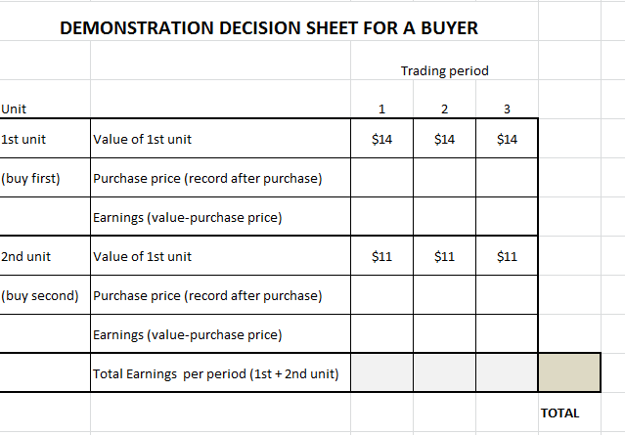
Record your first purchase price here
Decision sheet - buyers
If you only buy one unit then the second unit’s earnings equal zero (you don’t get the value unless you buy).If you buy zero units your total earnings equal zero.
Then calculate your earnings here
Record your second purchase price here
Then calculate your earnings here
You can add up your earnings here

Slide 11
Rules and tips
You must sell or buy the first unit before selling or buying the second unit in each period.
All bids must be higher than the previous bid for the same shirt, and all asks must be lower than the previous ask for the same shirt.
Once the t-shirt is sold, you can ask or bid whatever you want again for the next one.
For the seller, the earnings are the sale price minus the cost of that unit so higher prices are better (if you can sell at that price) and it does not make sense to sell below cost.
For the buyer, the earnings are the value minus the purchase price of that unit so lower prices are better (if you can buy at that price) and it does not make sense to buy above value.

Slide 12
What happens next?
After the three rounds are over, we will collect your decision sheets.
We will enter all the information on the computer to check the earnings for each team.
We will then find the average price and number of units sold in each round.
I will then show you what the demand function looks like (based on the values I gave you) and what the supply function looks like (based on the costs I gave you) and what theory predicts the market clearing price would be.
It will be exciting to see if we get there in round 3!
After that, we can talk through different events that change the market equilibrium to see if we can get good at predicting the price effects.

Slide 13
Results
Let’s see how you did.

