Slide 2
Hatching failure and population bottlenecks
A resource provided by Science Outreach at the University of Canterbury
www.outreach,canterbury.ac.nz

Slide 3
Population bottlenecks in birds and hatching failure

Slide 4
Based on the following study:
Hatching failure increases with severity of population bottlenecks in birds.
by James V. Briskie and Myles Mackintosh

Slide 5
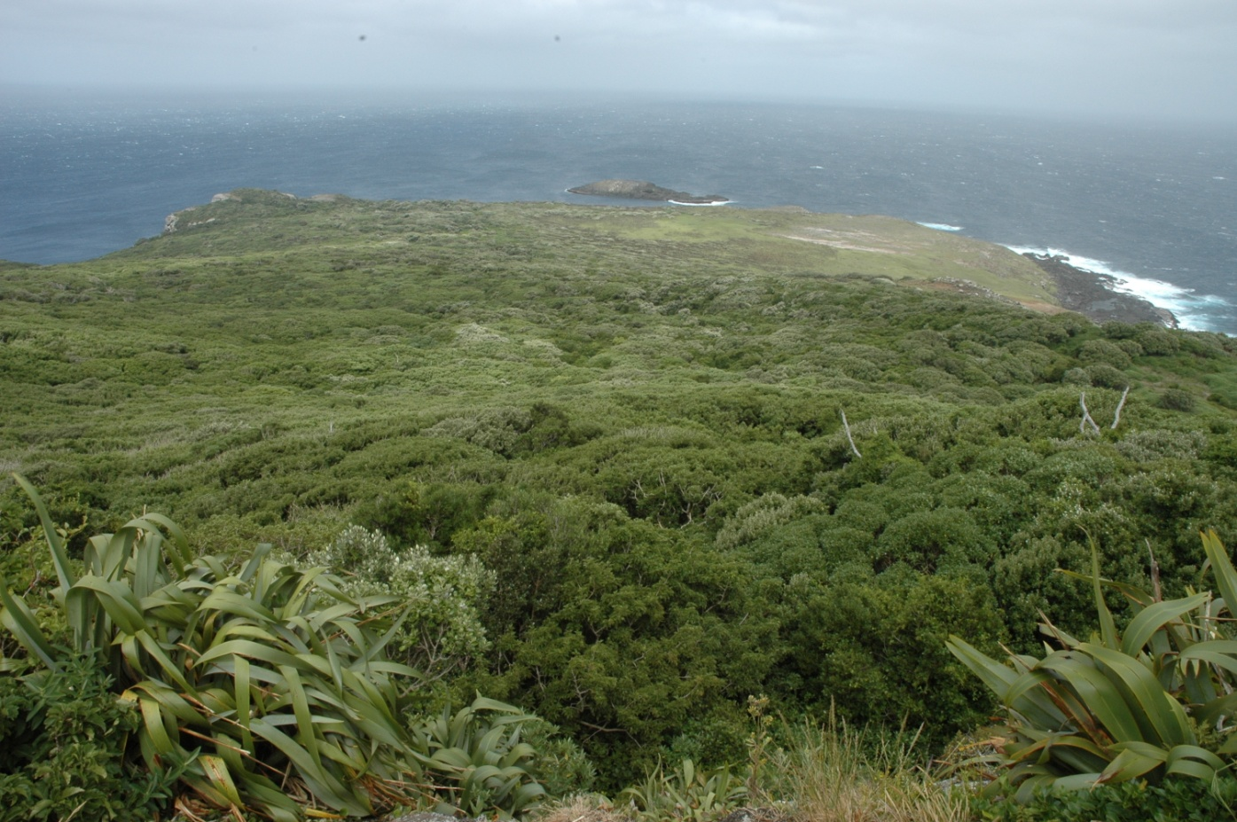
Habitat destruction, exploitation and introduction of exotic predators are causing populations of birds to decrease in number.
One of the unspoilt regions of New Zealand in the Chatham Islands (Rangatira Island)

Slide 6
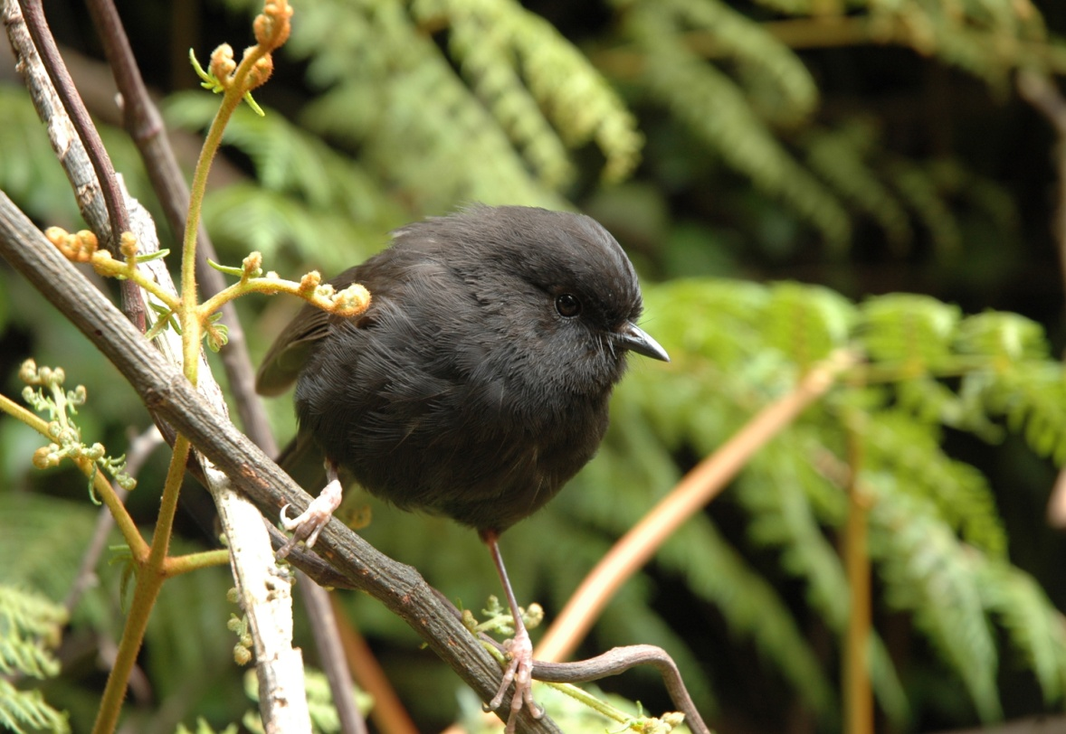
New Zealand Black Robin
(found only in the Chatham Islands)

Slide 7
Before the 1870’s there was a diverse Black Robin population.....

Slide 8
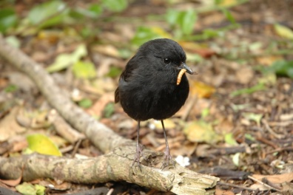
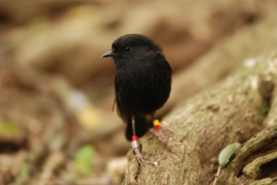
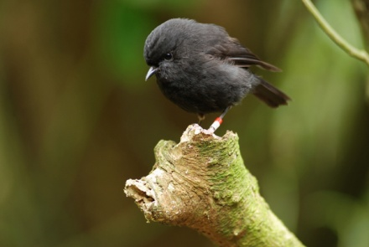
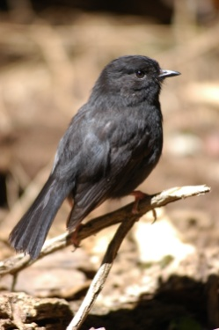
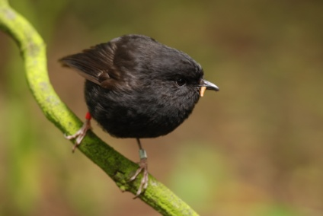
Before the 1870’s there was a diverse Black Robin population.....

Slide 9
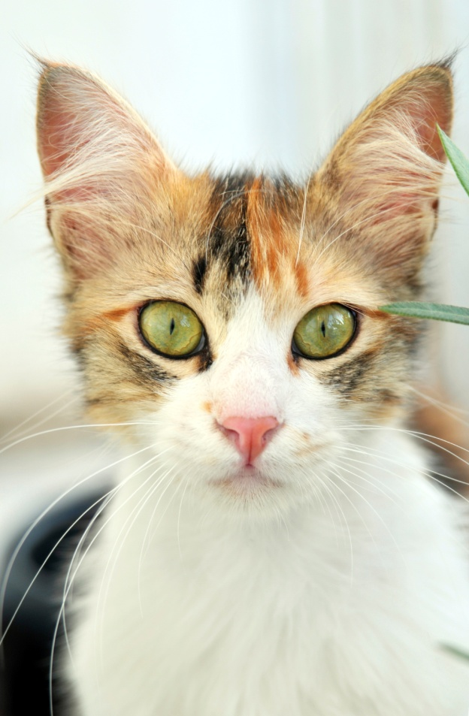
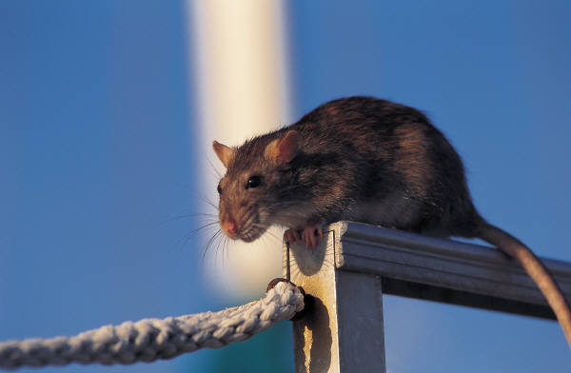
The introduction of rats and cats to New Zealand

Slide 10
The introduction of rats and cats to New Zealand reduced the population of Black Robins to only a few individuals

Slide 11
The introduction of rats and cats to New Zealand reduced the population of Black Robins to only a few individuals – this is a genetic bottleneck

Slide 12
...when the population later recovered, due to conservation efforts, the genetic diversity is reduced.

Slide 13

...when the population later recovered, due to conservation efforts, the genetic diversity is reduced.

Slide 14
As a population decreases in size, a lot of genetic diversity is lost.

Slide 15
As a population decreases in size, a lot of genetic diversity is lost.
time

Slide 16
As a population decreases in size, a lot of genetic diversity is lost.
this is a genetic bottleneck
time

Slide 17
As a population decreases in size, a lot of genetic diversity is lost.
time
..when the population recovers, the population is not as genetically diverse as the original population.

Slide 18
The smaller the size of the genetic bottleneck the more in-breeding occurs, and there is even less genetic diversity in the new population.

Slide 19
The smaller the size of the genetic bottleneck the more in-breeding occurs, and there is even less genetic diversity in the new population.
time

Slide 20
When a group of birds is relocated far from its source population,

Slide 21
When a group of birds is relocated far from its source population, it is similar to a genetic bottleneck.

Slide 22
When a group of birds is relocated far from its source population, it is similar to a genetic bottleneck.
The founder population is not as genetically diverse as the source population.

Slide 23
SOURCE population
When the new population recovers in the new area it is not as genetically diverse as the source population.

Slide 24
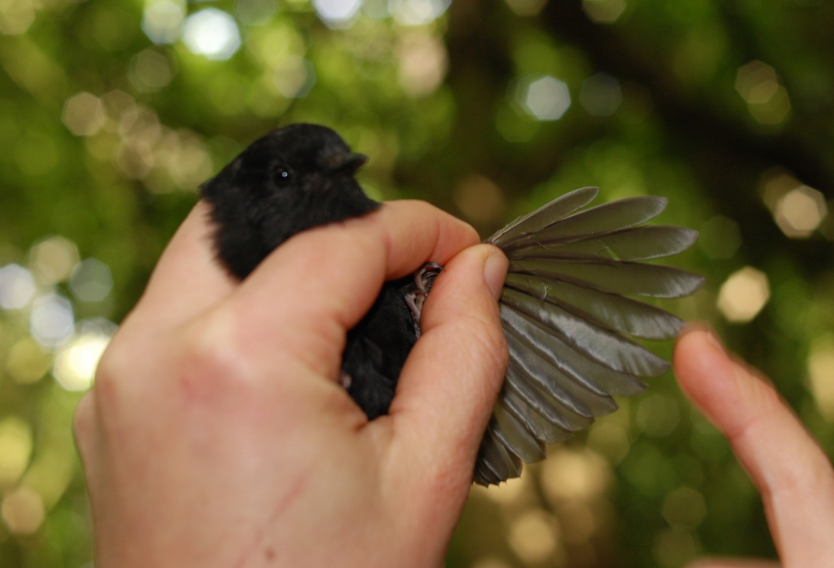
Lower genetic diversity in a population may result in fitness costs and decrease population survival.
Scientists check the fitness of Black Robins on Rangatira Island

Slide 25
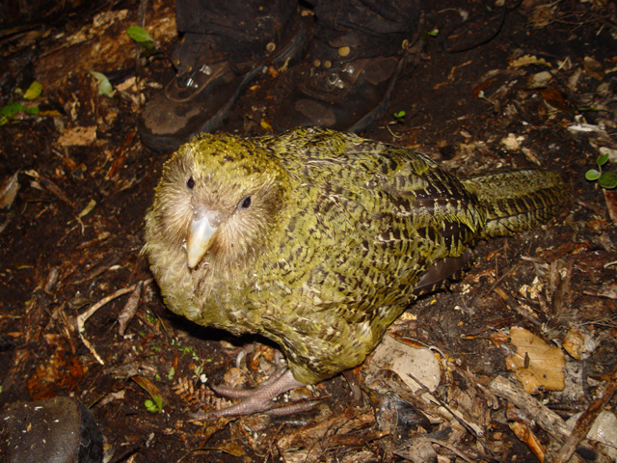
A group of birds, like the Kakapo, are relocated to a predator-free NZ island to increase the numbers of these endangered birds.

Slide 26
A group of birds, like the Kakapo, are relocated to a predator-free NZ island to increase the numbers of these endangered birds.
Only about half the eggs that survive incubation successfully hatch.

Slide 27
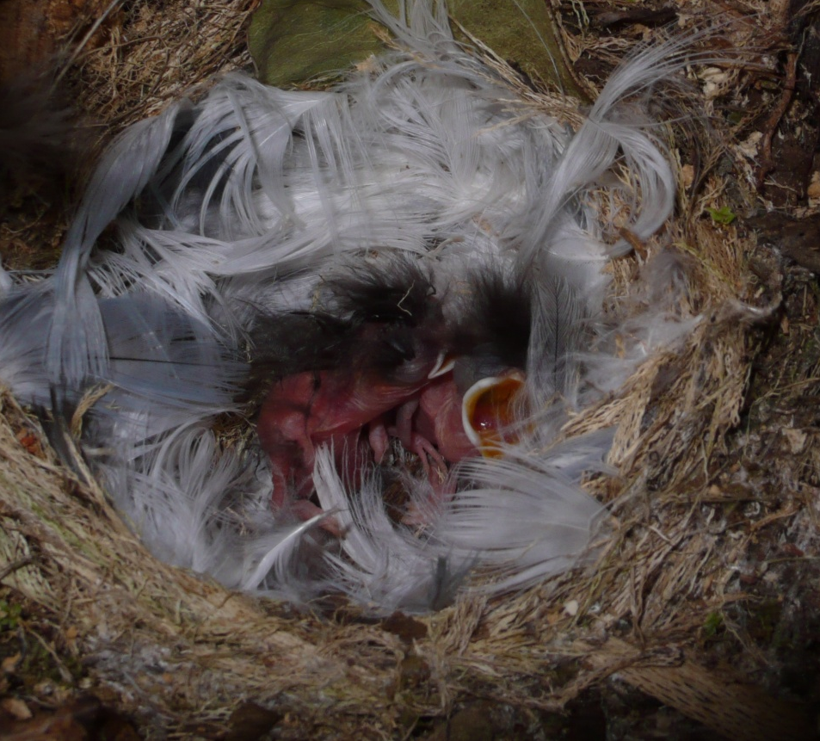
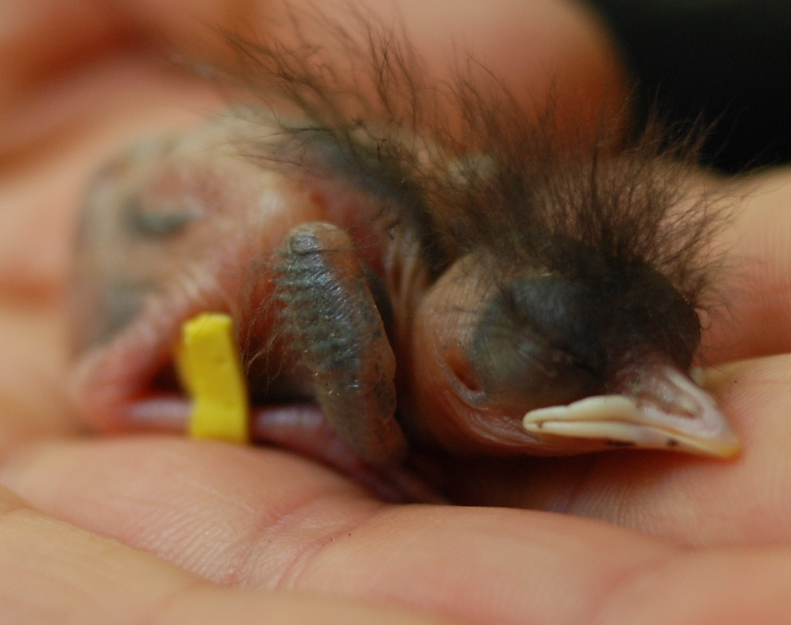
...similar problems have been observed in the Black Robin (the population was reduced to one breeding pair). The Black Robin population is now over 200.
Successfully hatched Black Robin chicks

Slide 28
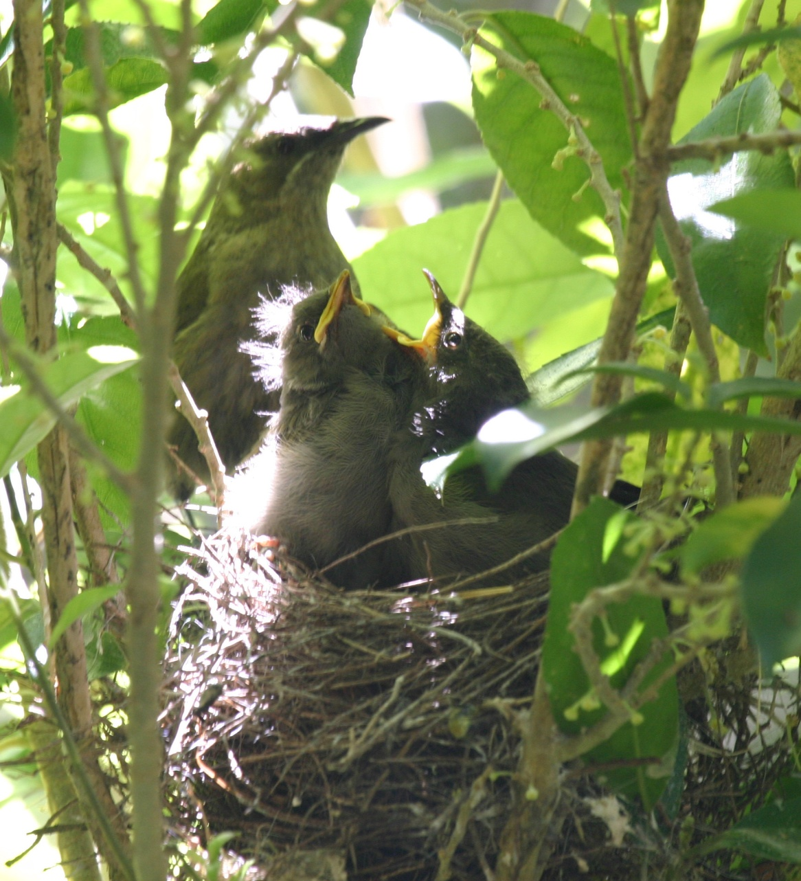

To investigate the effect of genetic bottleneck size on hatching failure in birds, data was collected from a variety of sources and treated with statistics and log transformed.

Slide 29
figure 1
Native New Zealand birds
Increase in hatching failure with increasing severity of population bottleneck in 22 Native New Zealand birds. Open circle shows mean hatching failure in 15 species that did not pass through a bottleneck.

Slide 30
figure 1
Native New Zealand birds
Increase in hatching failure with increasing severity of population bottleneck in 22 Native New Zealand birds. Open circle shows mean hatching failure in 15 species that did not pass through a bottleneck. Hatching failure increased when bottlenecks dropped below 150 individuals.

Slide 31
figure 2
Bird species introduced to NZ
Increase in hatching failure of 15 introduced species with decreased numbers of individuals released by the 19th century New Zealand acclimatization societies. Open circle shows mean hatching failure in the same species in their native range.

Slide 32
figure 3
Bird species introduced to NZ
Increase in differences in rate of hatching failure between each introduced population in New Zealand (postbottleneck) and their source (prebottleneck) for 15 species of introduced birds with data in both localities. Positive values indicate that hatching failure is greater in the introduced populations.

Slide 33
The smaller bottleneck size caused more hatching failure compared to the source population in their native habitat
Positive values indicate that hatching failure is greater in the introduced populations.

Slide 34
Read the information on the worksheet, study the graphs and answer the questions.

Slide 35
1. Explain how the “bottleneck” occurred in the
Black Robin population of New Zealand.
2. Explain the trend shown in figures 1 and 2.
3. Explain the trend shown in figure 3.
4. Why would this study be useful to conservationists
in New Zealand and worldwide?

Slide 36
ANSWERS

Slide 37
Q | Achievement | Achievement with Merit | Achievement with Excellence
1 | Black Robin population decreased due to introduced predators to NZ or the Chatham Islands (or examples such as cats & rats). | (Achieved plus) A smaller population means a smaller or decreased gene pool / less genetic diversity for the future / breeding population/s.

Slide 38
Q | Achievement | Achievement with Merit | Achievement with Excellence
2 | The smaller the bottleneck size or introduced population size, the greater the % hatching failure. OR As the population bottleneck size (in fig. 1) decreases, % hatching failure increases. AND As the size of the introduced population (in fig. 2) decreases, % hatching failure increases. | (Achieved plus) A smaller population bottleneck size in the native birds means there is less genetic diversity / a smaller gene pool available for future generations. AND A smaller population size of introduced birds means a smaller founder population and therefore a smaller gene pool / lower genetic diversity available for future generations. (or similar) | (Merit plus) Bird populations that breed from a small starter population or go through a bottleneck have lower genetic diversity which can result in the expression of unfavourable genes which could result in hatching failure.

Slide 39
Q | Achievement | Achievement with Merit | Achievement with Excellence
3 | The smaller the number of the original introduced population, the greater the difference in hatching failure between the introduced birds and its source population. | (Achieved plus) The smaller introduced population has a smaller gene pool / lower genetic diversity / more inbreeding and therefore greater hatching failure compared to its source population. | (Merit plus) The introduced population of birds are also out of their native habitat / range and have different environmental conditions which may also induce more hatching failure.

Slide 40
Q | Achievement | Achievement with Merit | Achievement with Excellence
4 | When trying to protect bird populations by transferring groups to other areas or islands conservationists can see from this study that a founder population of less than 150 individuals will result in a high percentage of hatching failure. | (Achieved plus) New Zealand conservationists repopulate areas with about 40 individuals which this study shows to be not a big enough group to avoid a high % hatching failure. AND A review of worldwide bird relocations showed that 72% used less than 75 individuals. This will result in high % of hatching failure. | (Merit plus) Conservationists in NZ and worldwide need to change their conservation practises and use larger founder populations (>150) to avoid widespread reproductive failure and possible extinction of endangered bird species.

Slide 41
Acknowledgements
University of Canterbury
Science Outreach and School of Biological Sciences.
Kakapo photo by :Markus Nolf
This resource was made possible through funding from the Canterbury Community Trust and the Brian Mason Scientific and Technical Trust

