Slide 1
University of Canterbury College of Science Outreach Programme
provided by the
Department of Geological Sciences

Slide 2
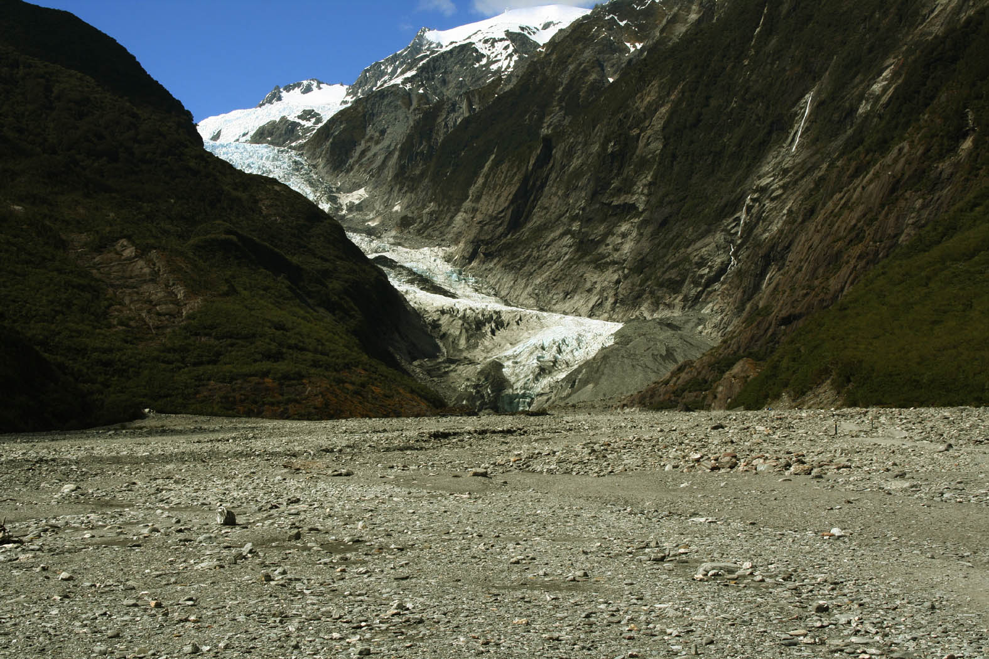
Glaciers change very fast!
(Glacier variations and their causes)
Presentation in 38 slides
(includes questions for discussion)
Franz Josef Glacier
Dr. Stefan Winkler
Department of Geological Sciences
University of Canterbnury
Notes:
OK

Slide 3
Glacier change very fast!
- an example from the past 20 years -
or
Understand glacier variations and what causes them!

Slide 4
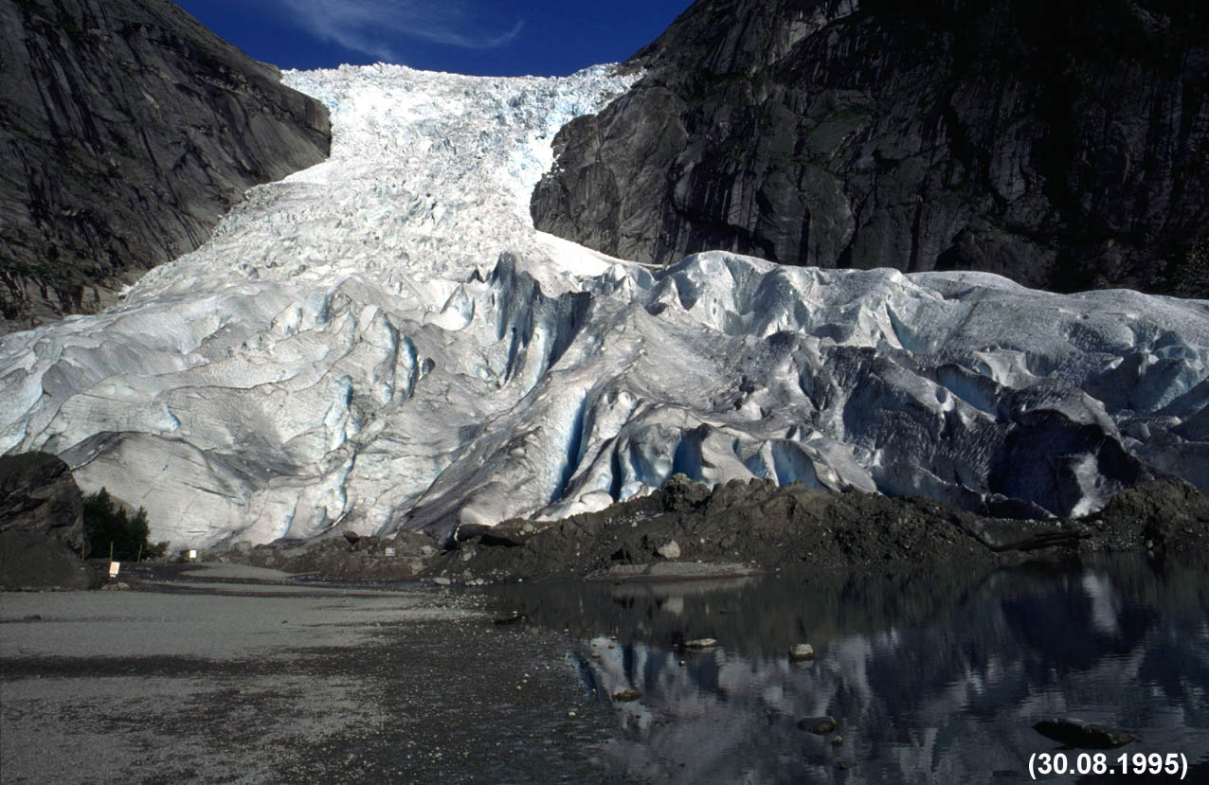
Our example today:
Briksdalsbreen in West Norway
First, let‘s get some background information about the glacier!

Slide 5
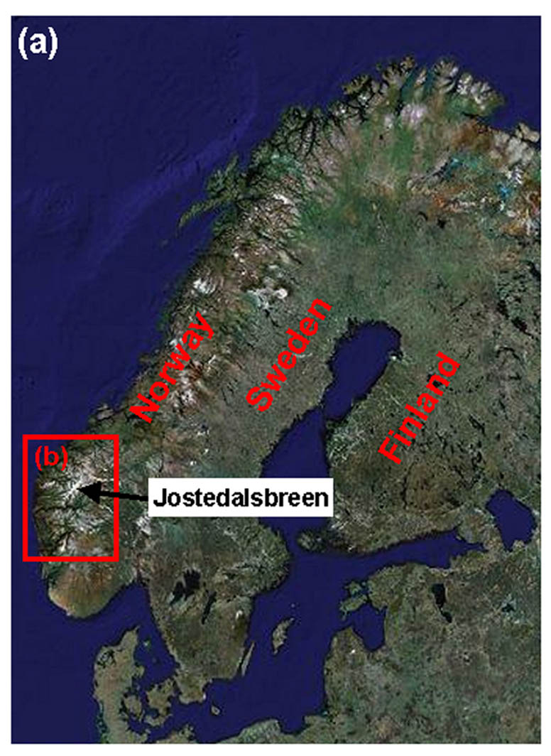
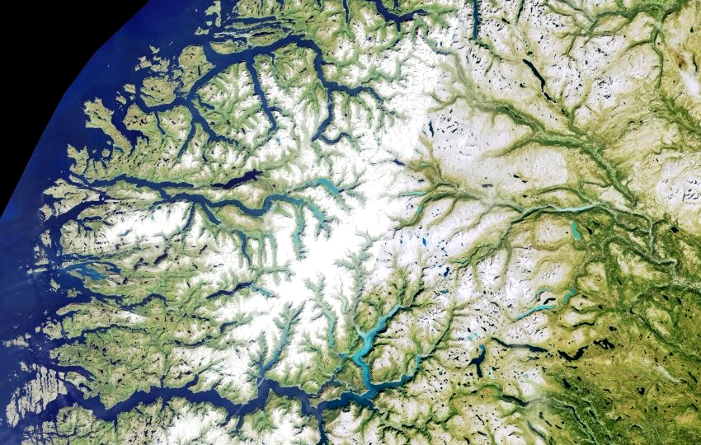
Satellite image of West Norway
(b)
Jostedalsbreen
www.googlemaps.com
www.norgeibilder.no
Between the deep fjords of West Norway, there are some high-lying plateaus. On on of these, a large ice cap (named Jostedalsbreen) is located.

Slide 6
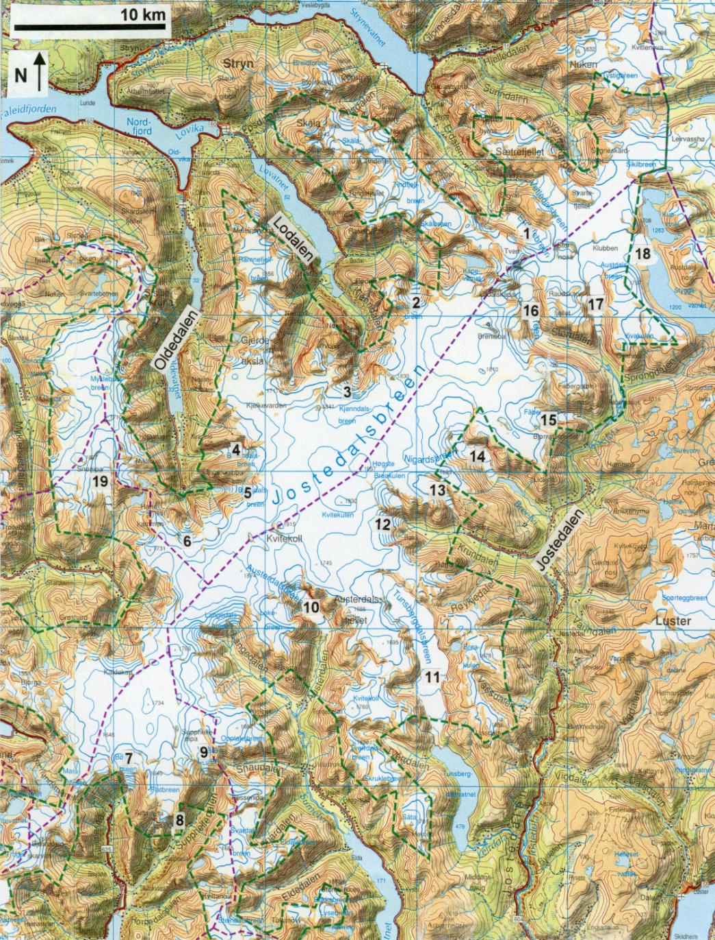
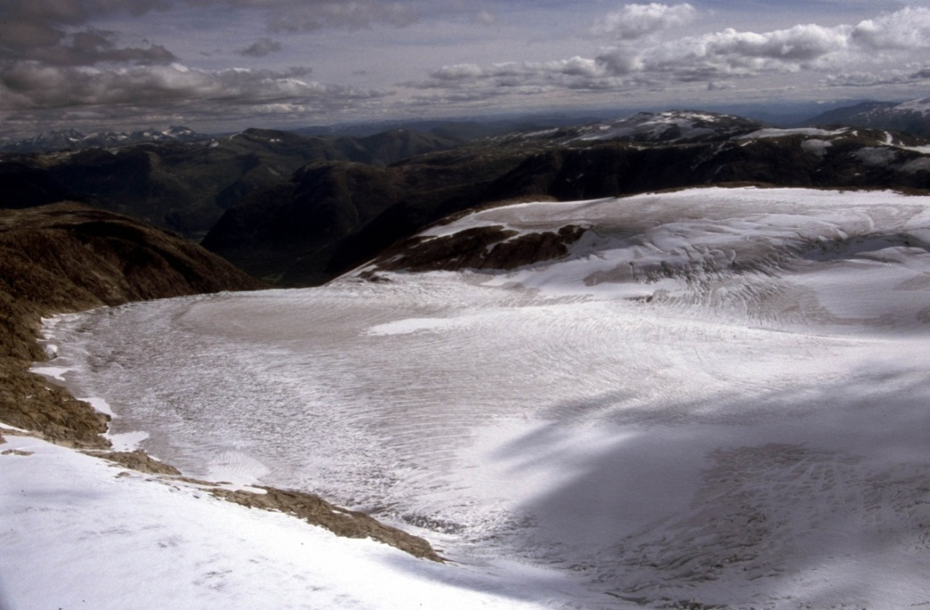
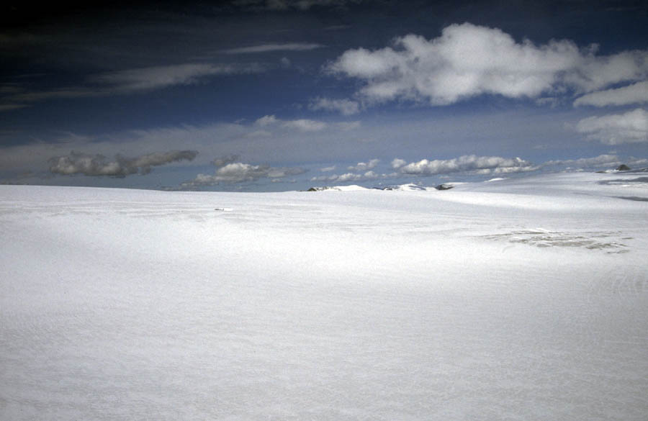
Map and photos of the ice cap (Jostedalsbreen)
Briksdalsbreen
Statens kartverk
glacier area: c. 500 km²
ice thickness: 50 – 600 m
plateau: 1,700 – 2,000 m a.s.l.

Slide 7
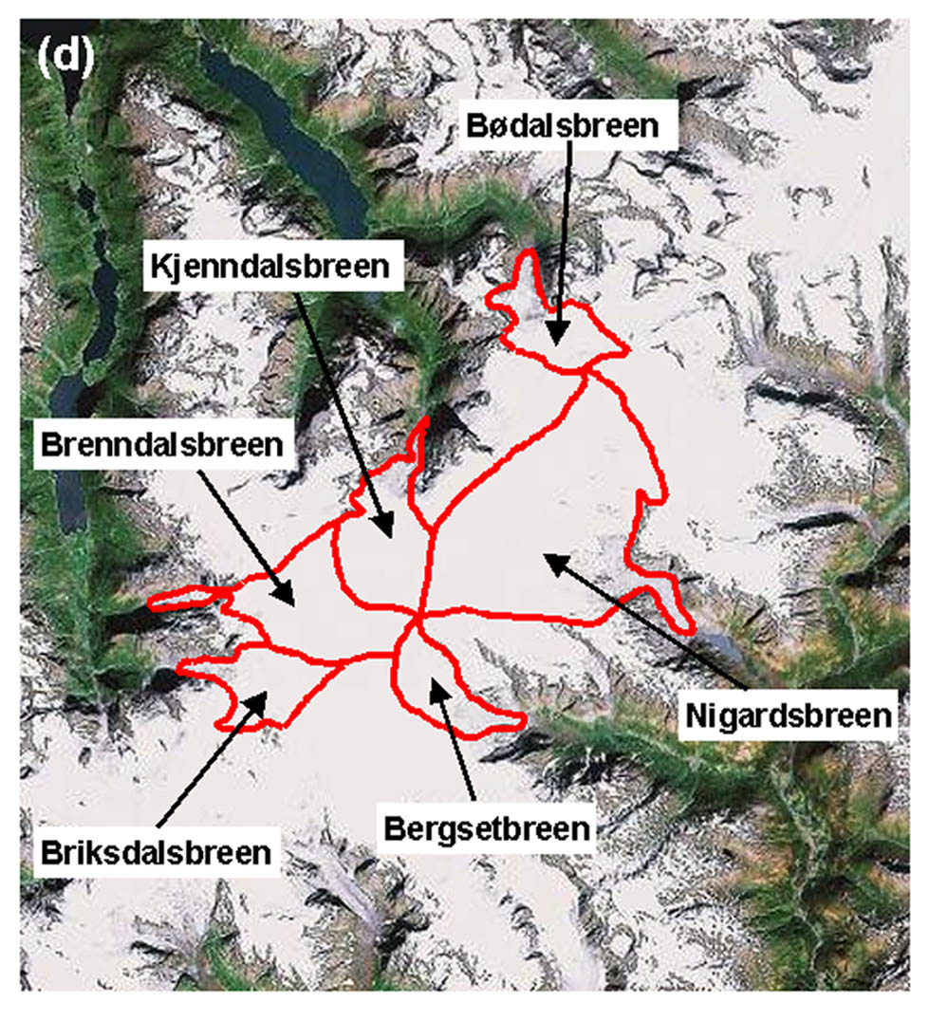
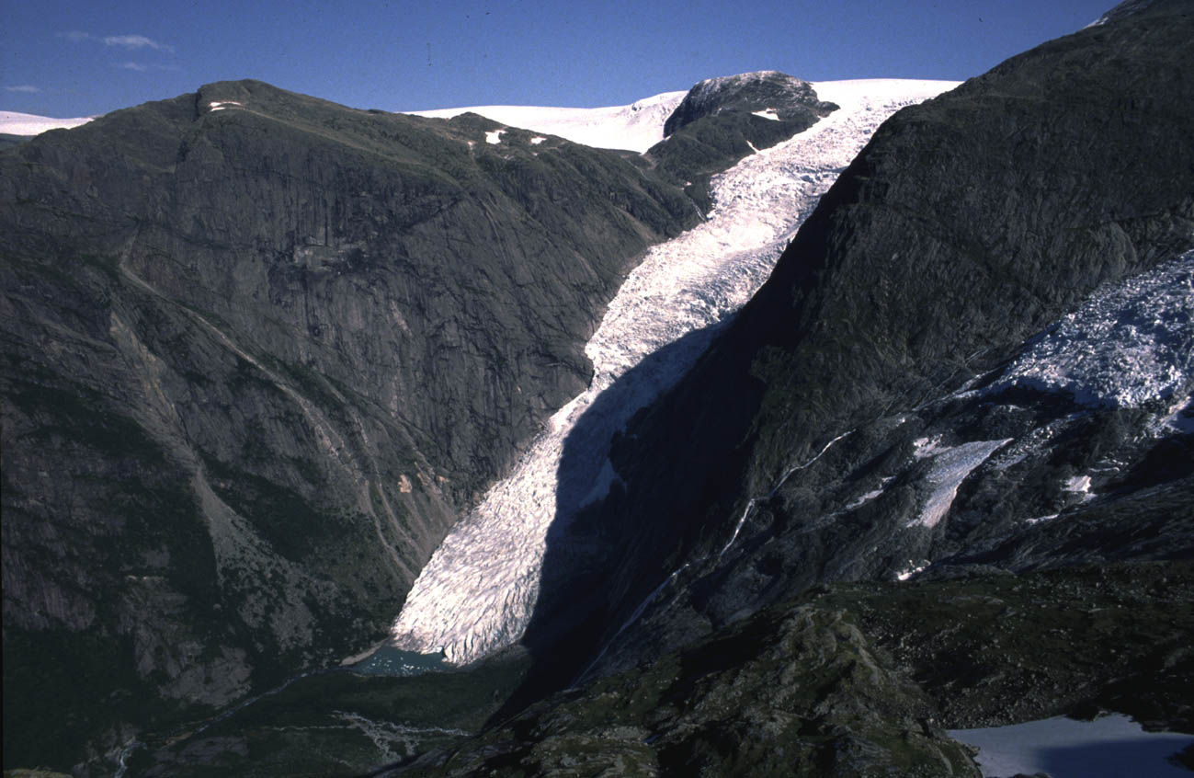
Briksdalsbreen
Briksdalsbreen is one of many glacier arm flowing down from the ice plateau into the surrounding valleys

Slide 8
But now let‘s see how the glacier (the glacier tongue of Briksdalsbreen) changed during the past 20 years since 1989!

Slide 9
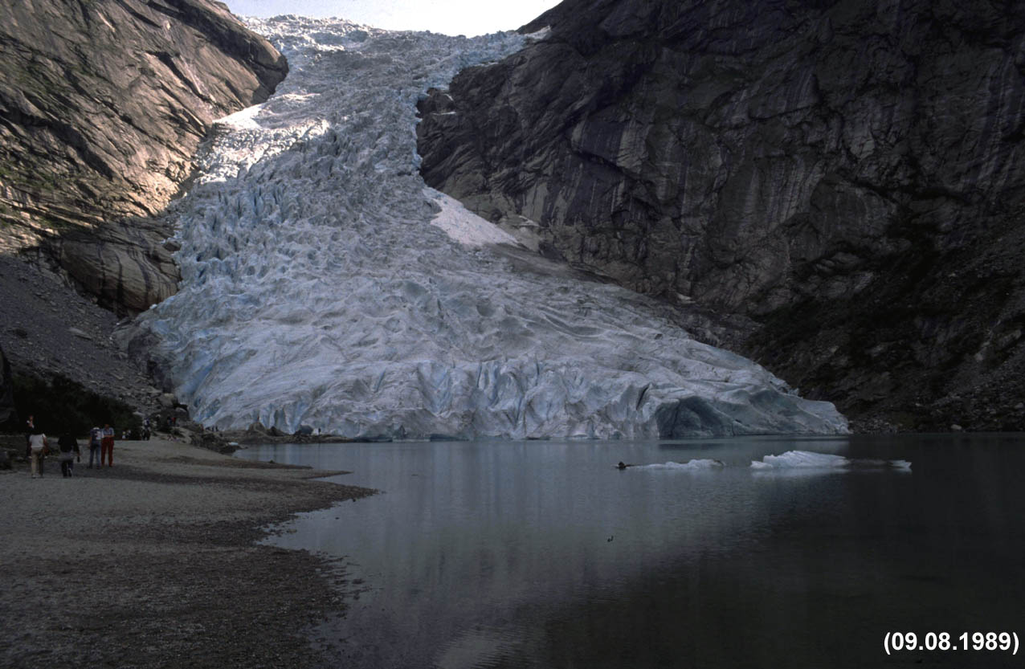
1989
1989

Slide 10
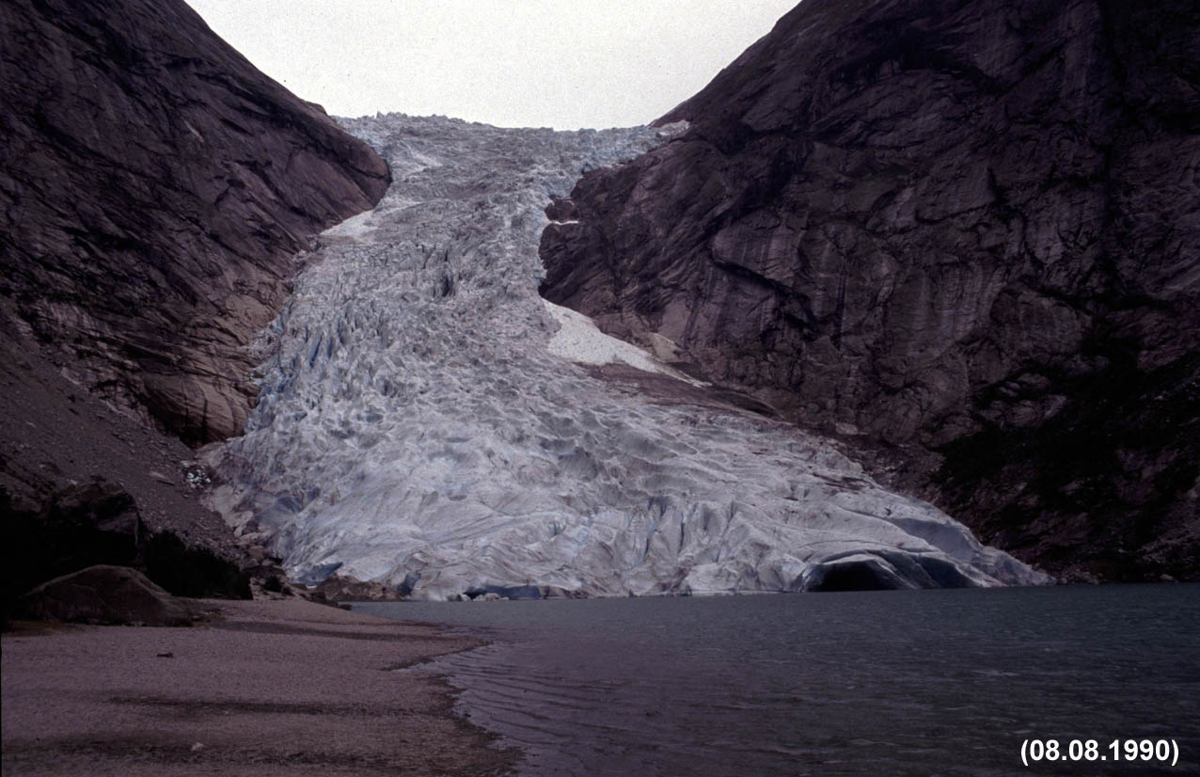
1990
1989
1990

Slide 11
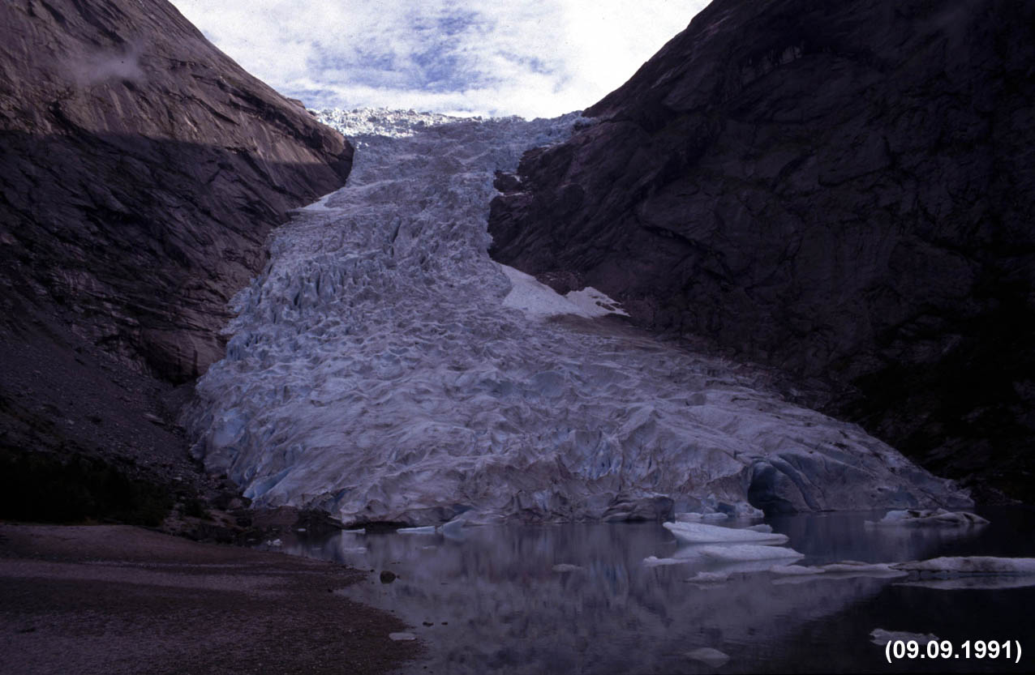
1991
1989
1990
1991

Slide 12
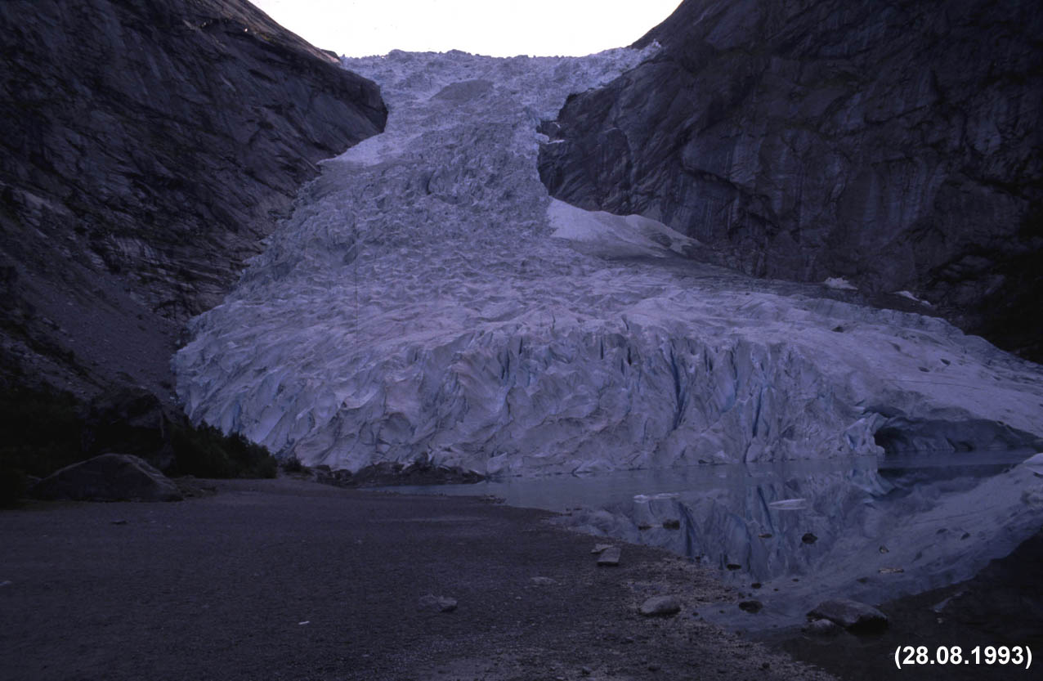
1993
1989
1990
1991
1993

Slide 13
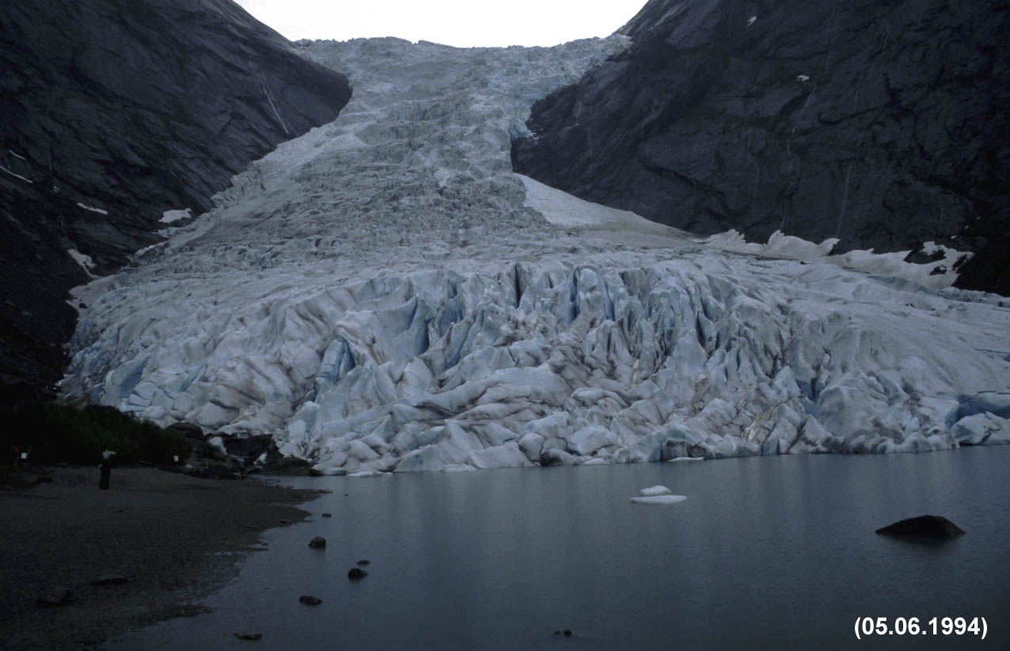
1994 (1)
1989
1990
1991
1993
1994

Slide 14
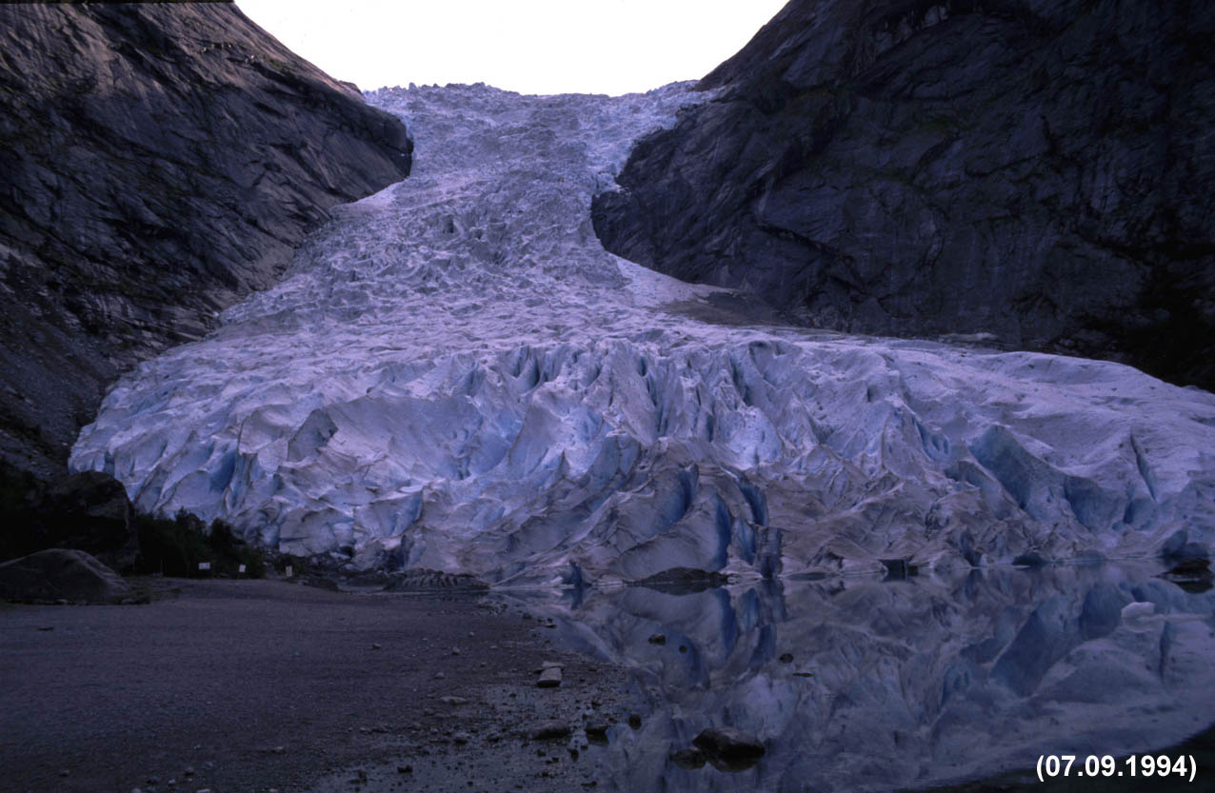
1994 (2)
1989
1990
1991
1993
1994

Slide 15
1995
1989
1990
1991
1993
1994
1995

Slide 16
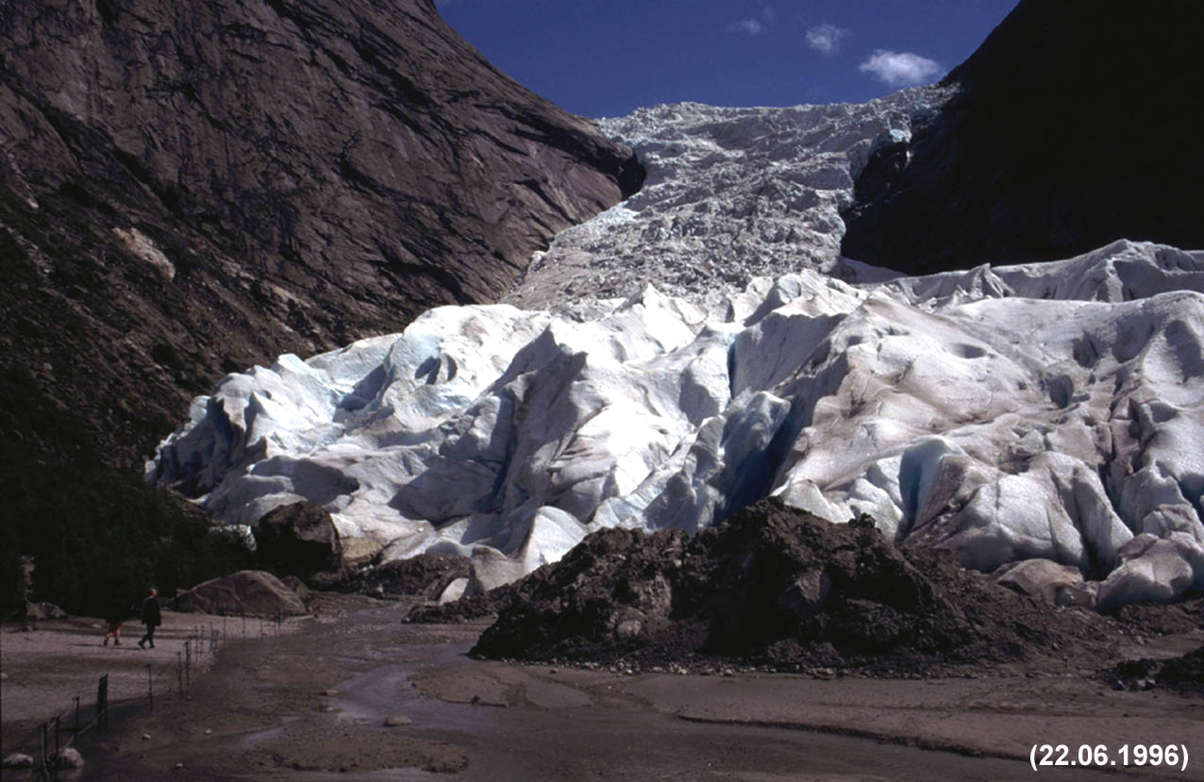
1996 (1)
1989
1990
1991
1993
1994
1995
1996

Slide 17
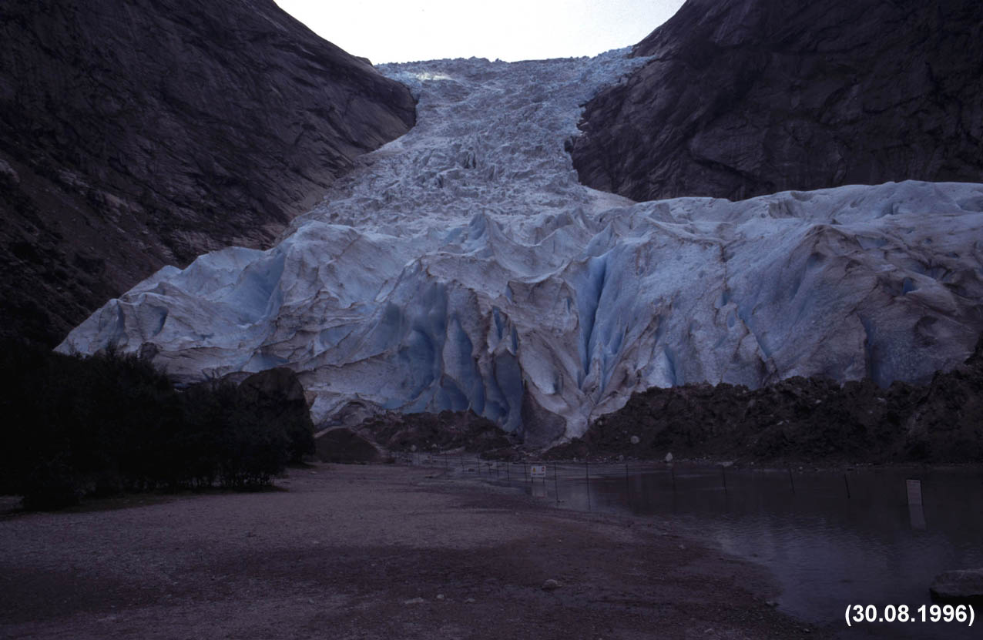
1996 (2)
1989
1990
1991
1993
1994
1995
1996

Slide 18
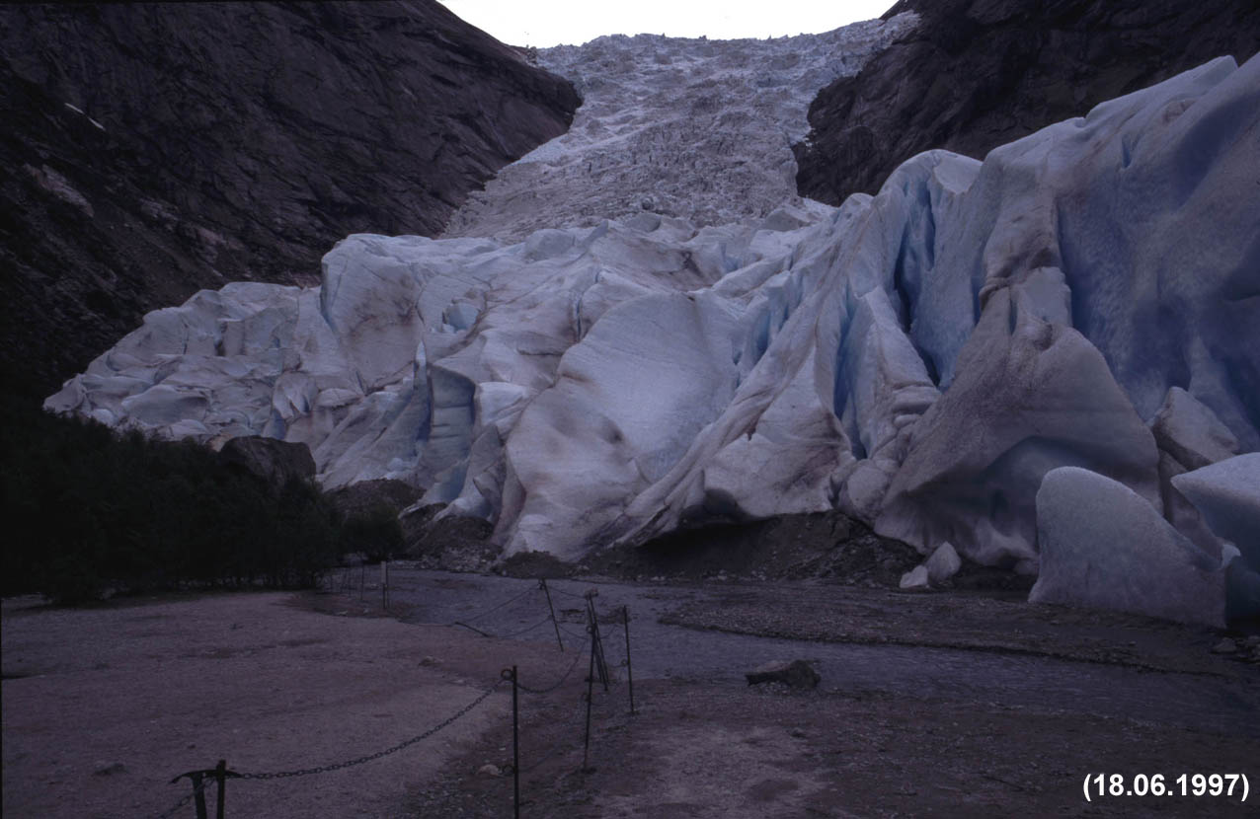
1997
1989
1990
1991
1993
1994
1995
1996
1997

Slide 19
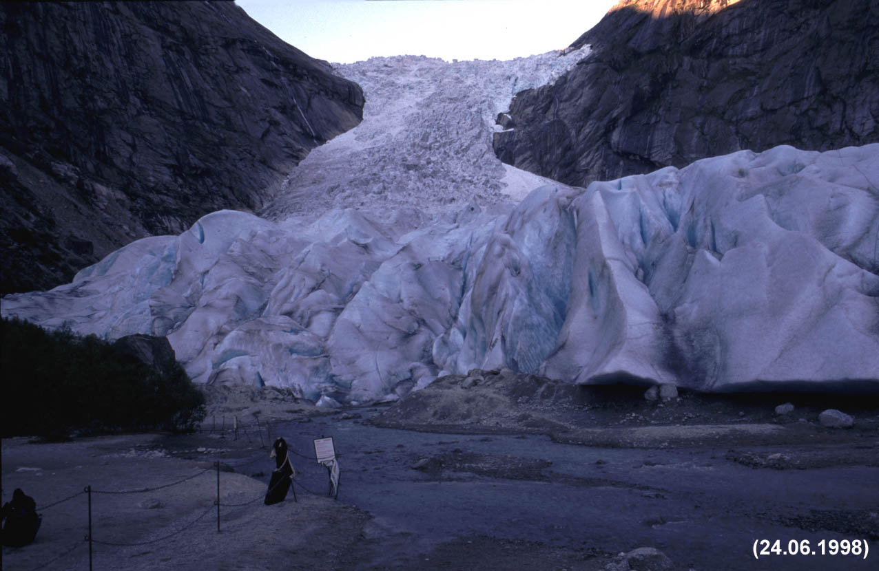
1998 (1)
1989
1990
1991
1993
1994
1995
1996
1997
1998

Slide 20
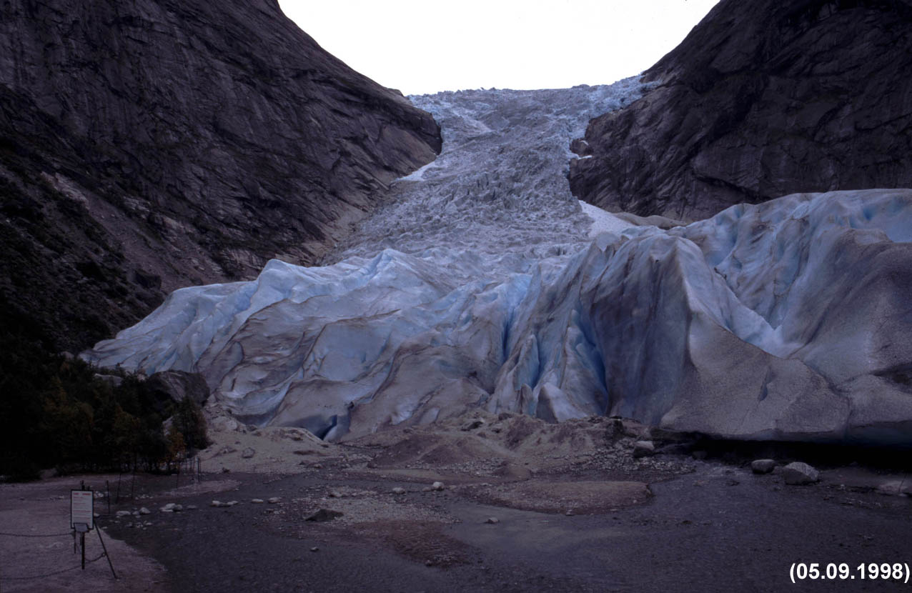
1998 (2)
1989
1990
1991
1993
1994
1995
1996
1997
1998

Slide 21
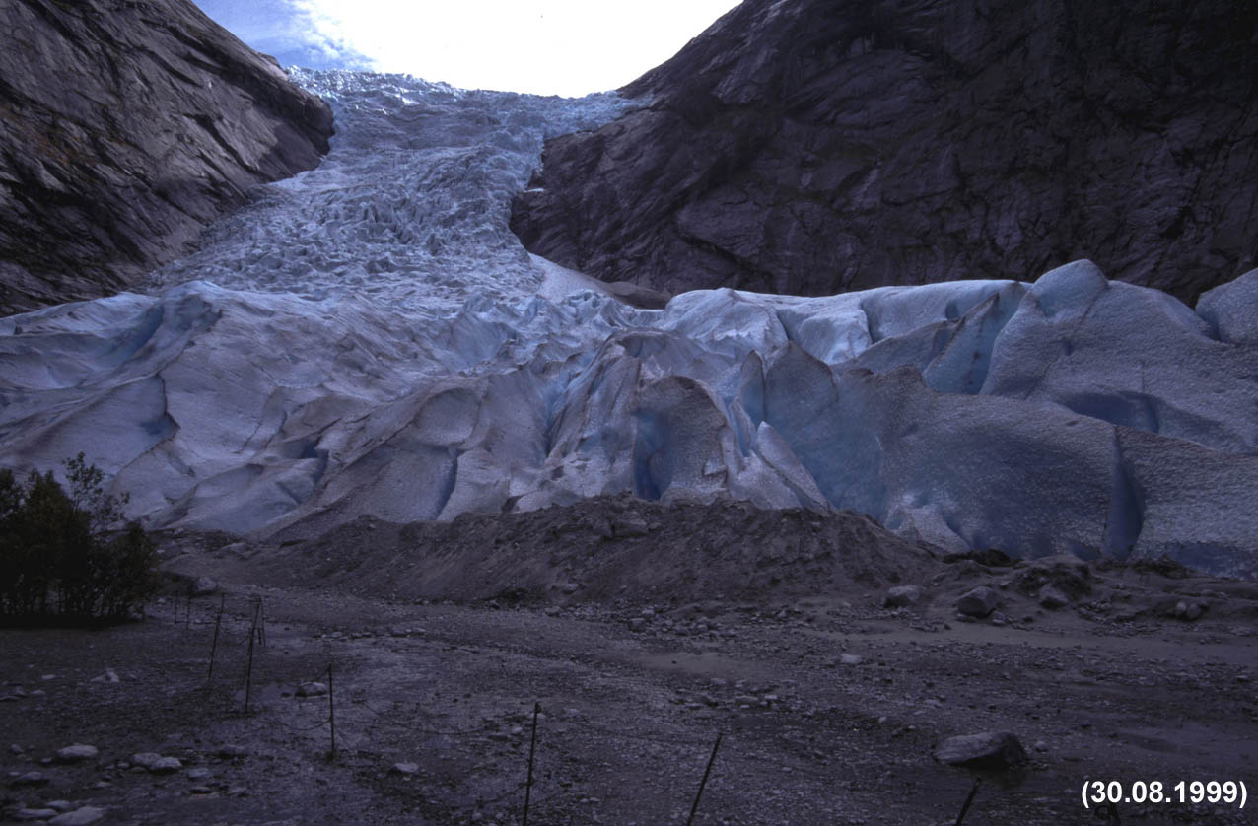
1999
1989
1990
1991
1993
1994
1995
1996
1997
1998
1999

Slide 22
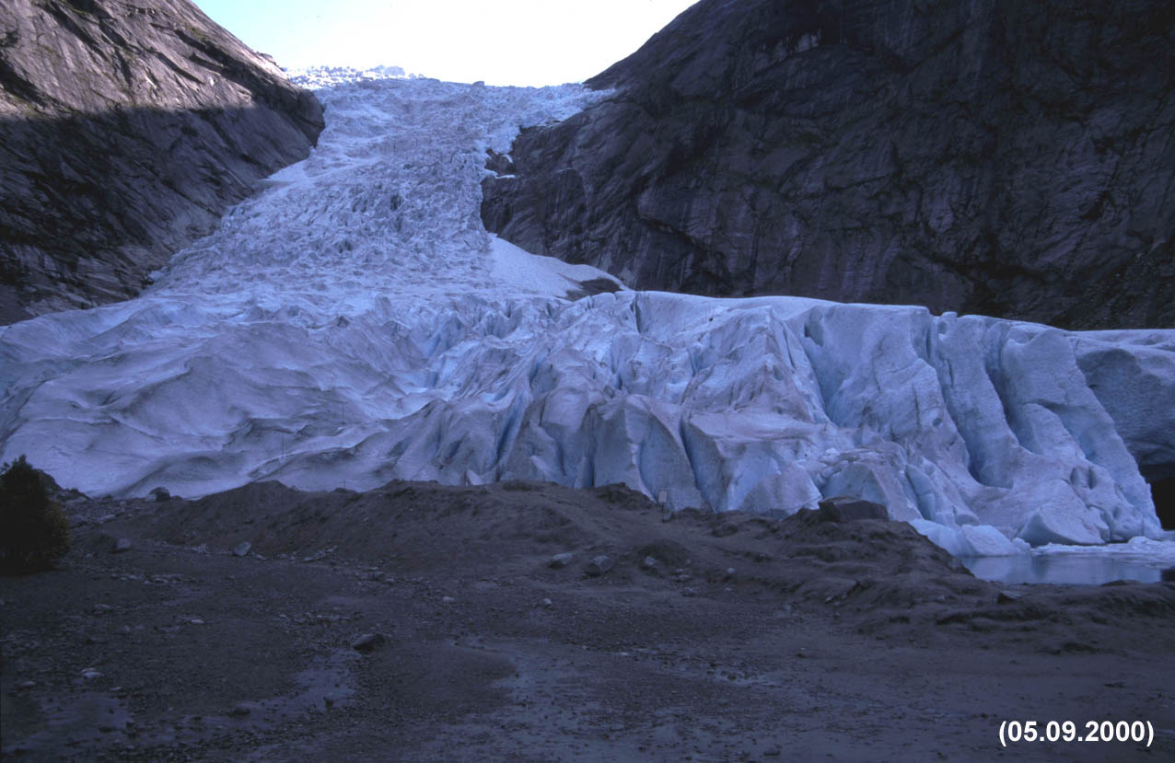
2000
1989
1990
1991
1993
1994
1995
1996
1997
1998
1999
2000

Slide 23
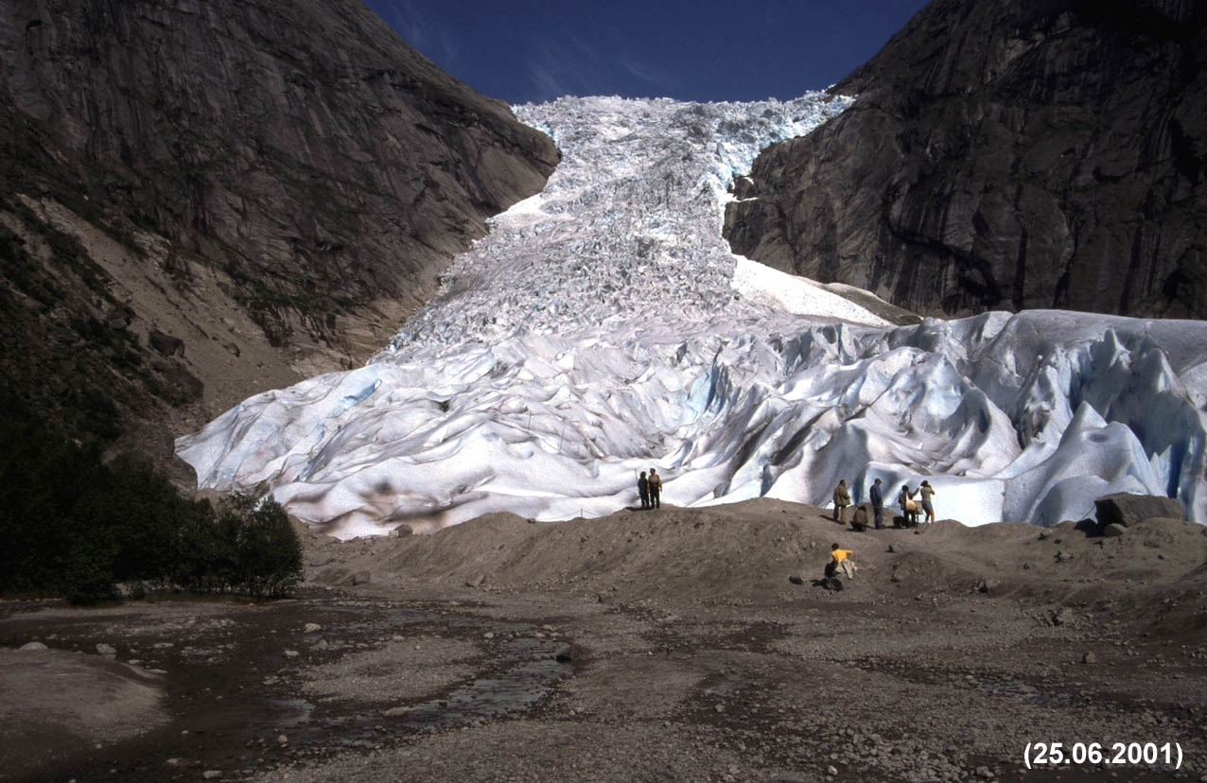
2001 (1)
1989
1990
1991
1993
1994
1995
1996
1997
1998
1999
2000
2001

Slide 24
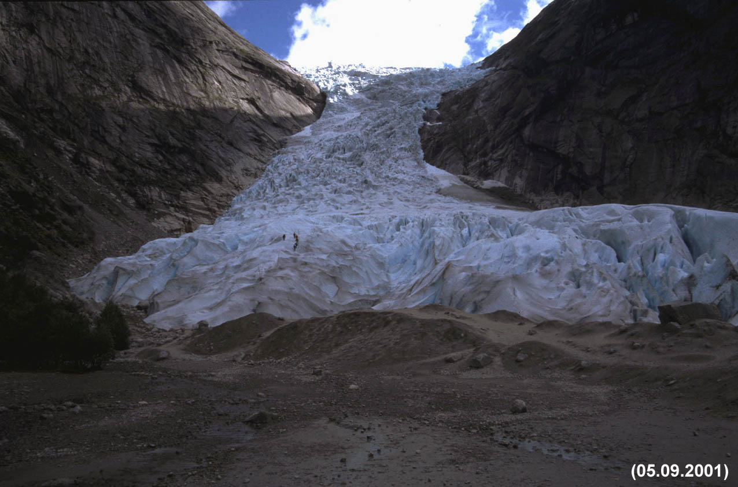
2001 (2)
1989
1990
1991
1993
1994
1995
1996
1997
1998
1999
2000
2001

Slide 25
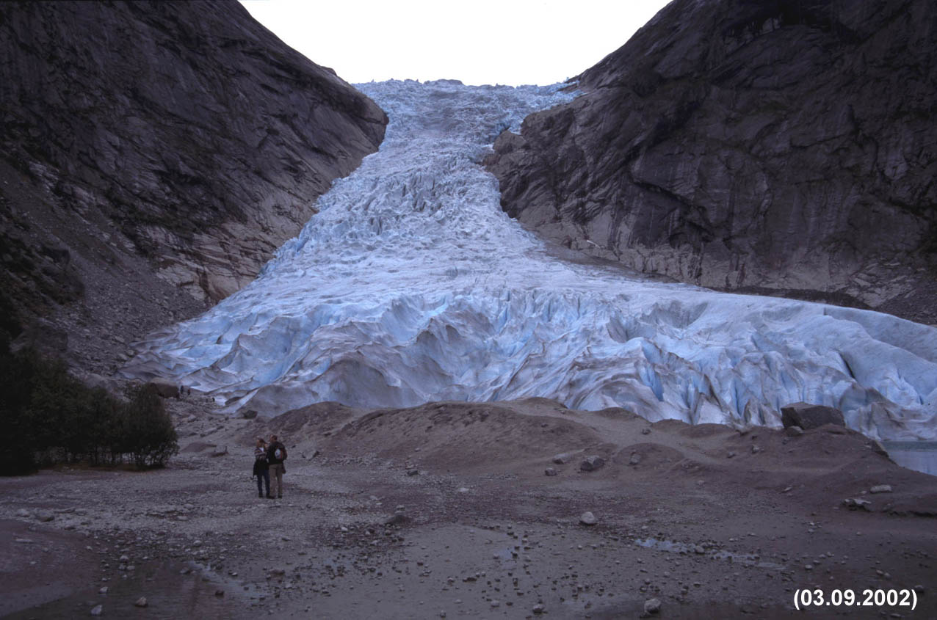
2002
1989
1990
1991
1993
1994
1995
1996
1997
1998
1999
2000
2001
2002

Slide 26
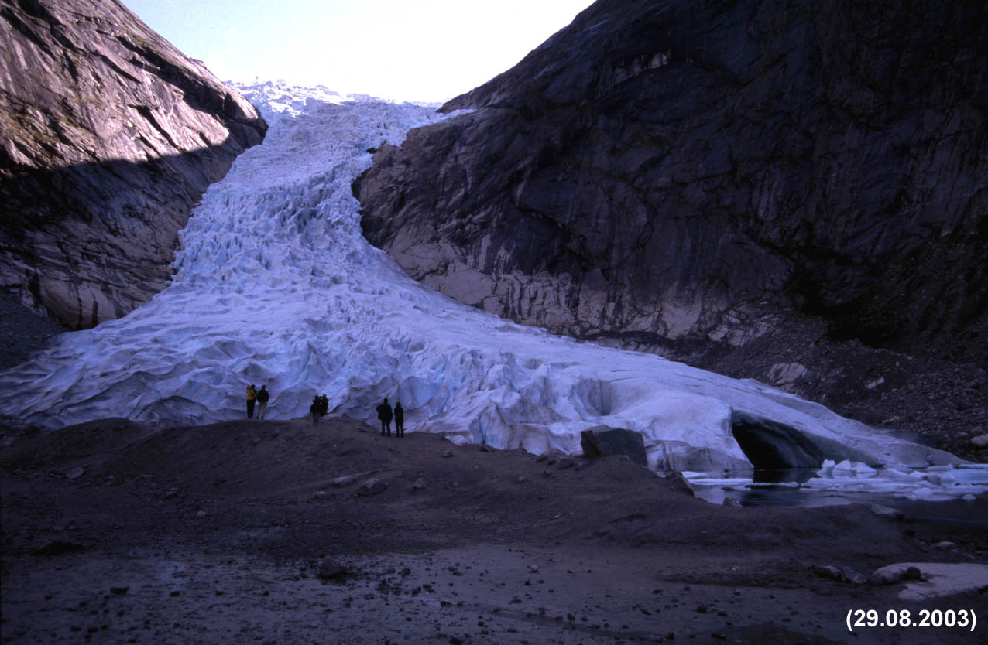
2003
1989
1990
1991
1993
1994
1995
1996
1997
1998
1999
2000
2001
2002
2003

Slide 27
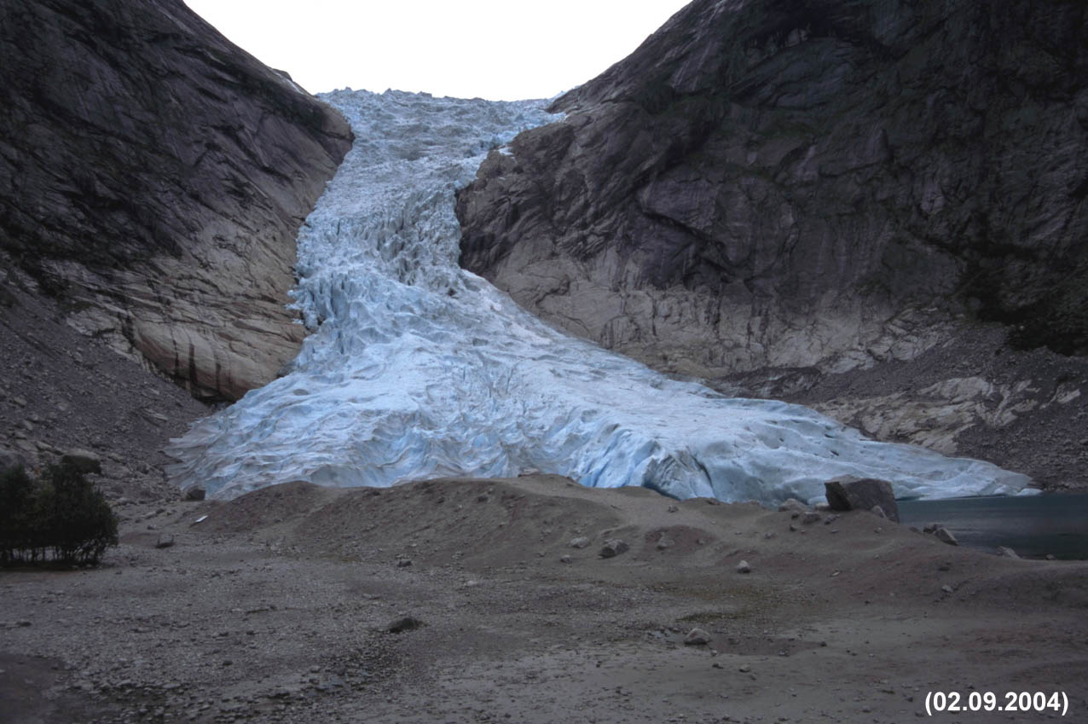
2004
1989
1990
1991
1993
1994
1995
1996
1997
1998
1999
2000
2001
2002
2003
2004

Slide 28
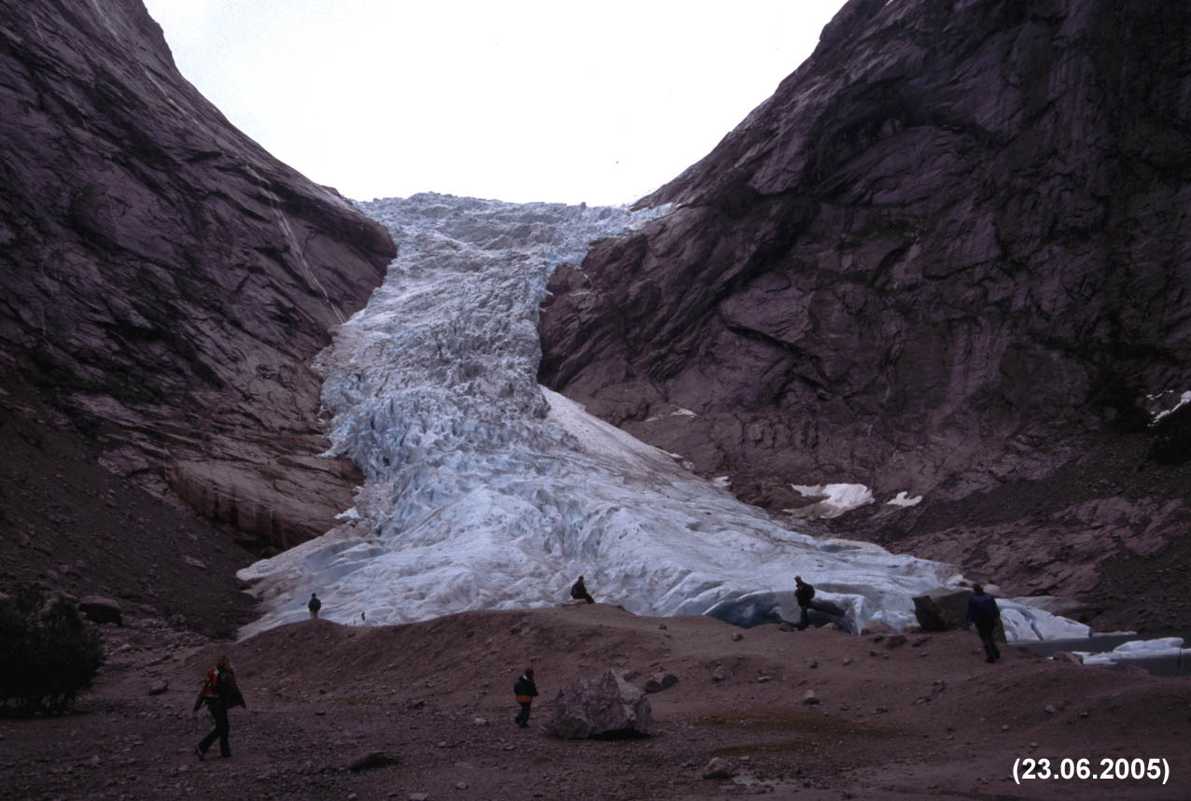
2005 (1)
1989
1990
1991
1993
1994
1995
1996
1997
1998
1999
2000
2001
2002
2003
2004
2005

Slide 29
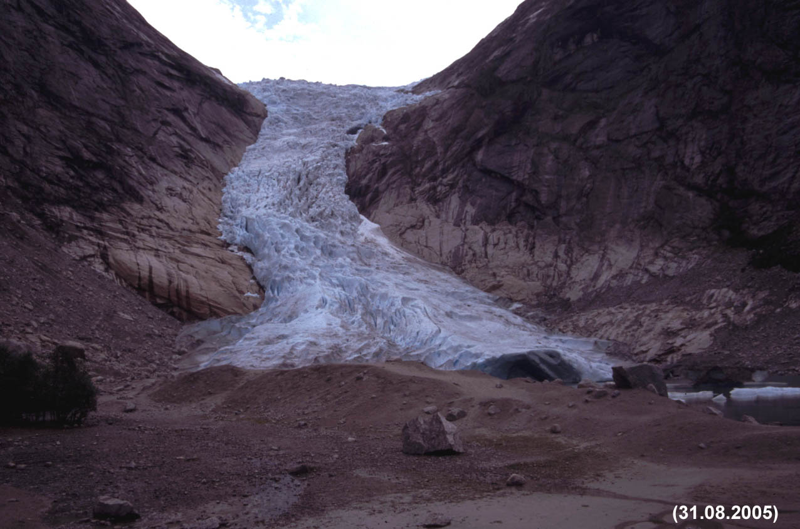
2005 (2)
1989
1990
1991
1993
1994
1995
1996
1997
1998
1999
2000
2001
2002
2003
2004
2005

Slide 30
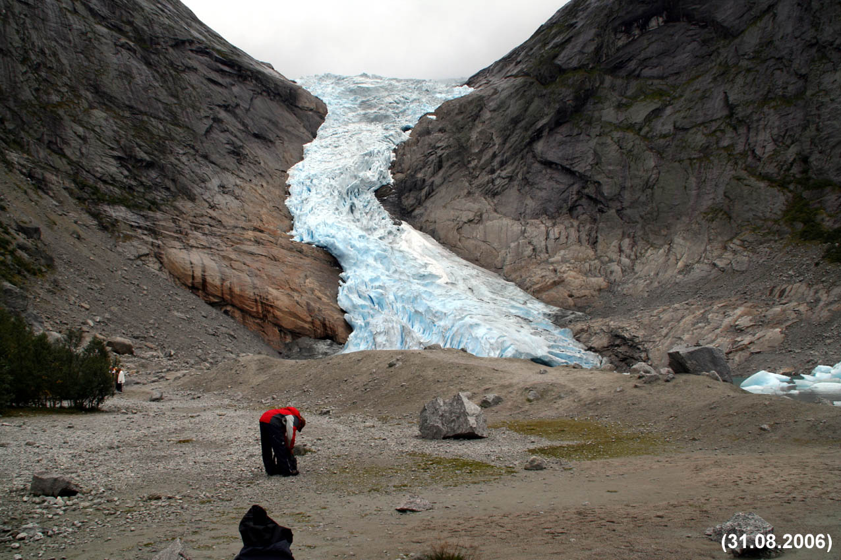
2006
1989
1990
1991
1993
1994
1995
1996
1997
1998
1999
2000
2001
2002
2003
2004
2005
2006

Slide 31
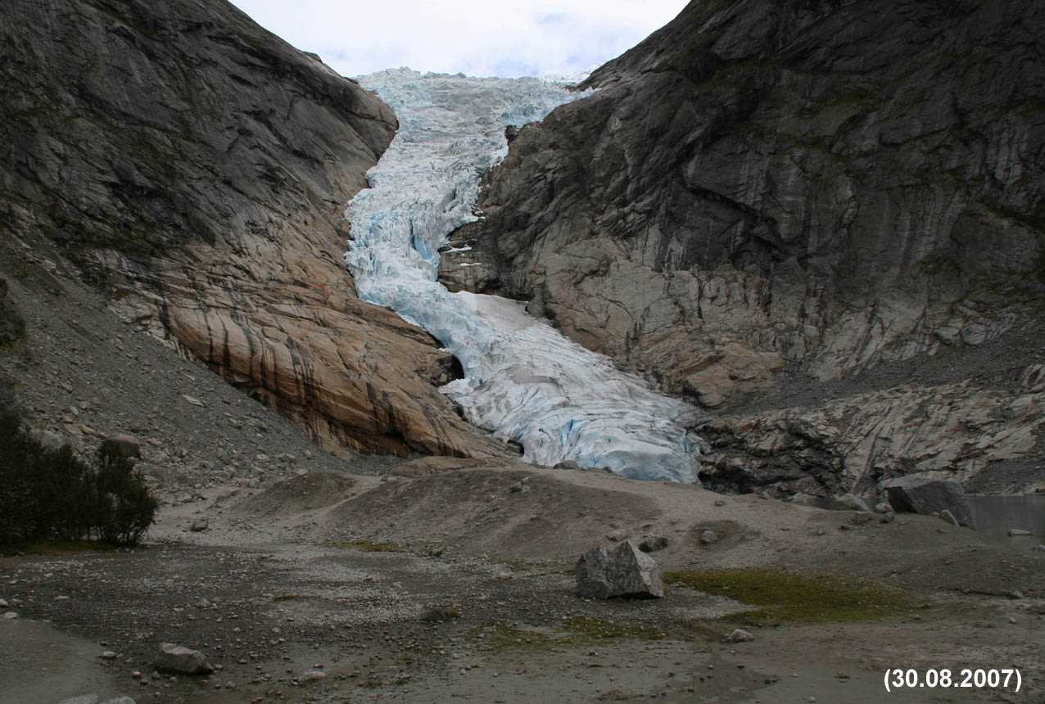
2007
1989
1990
1991
1993
1994
1995
1996
1997
1998
1999
2000
2001
2002
2003
2004
2005
2006
2007

Slide 32
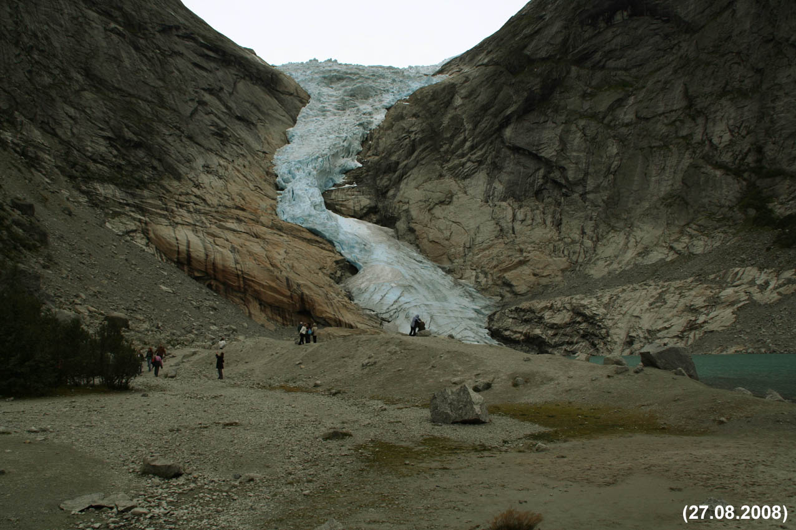
2008
1989
1990
1991
1993
1994
1995
1996
1997
1998
1999
2000
2001
2002
2003
2004
2005
2006
2007
2008

Slide 33
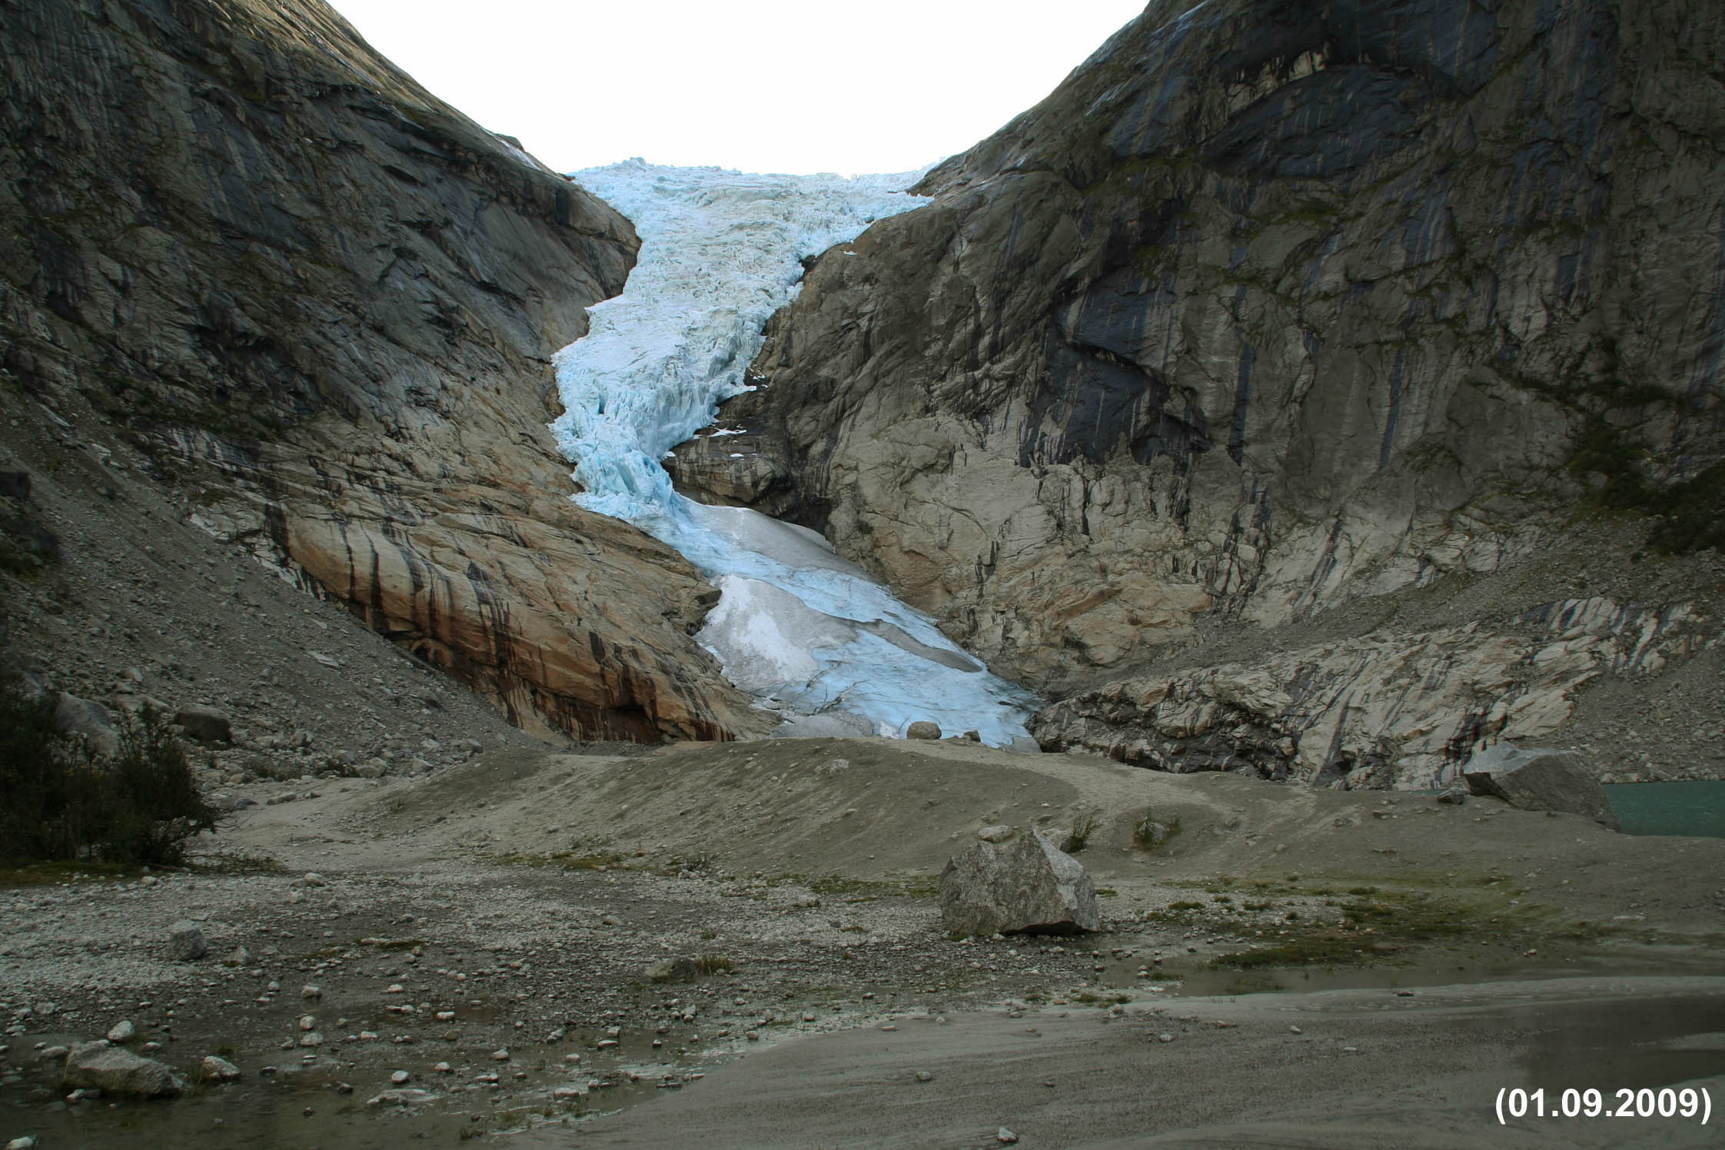
2009
1989
1990
1991
1993
1994
1995
1996
1997
1998
1999
2000
2001
2002
2003
2004
2005
2006
2007
2008
2009

Slide 34
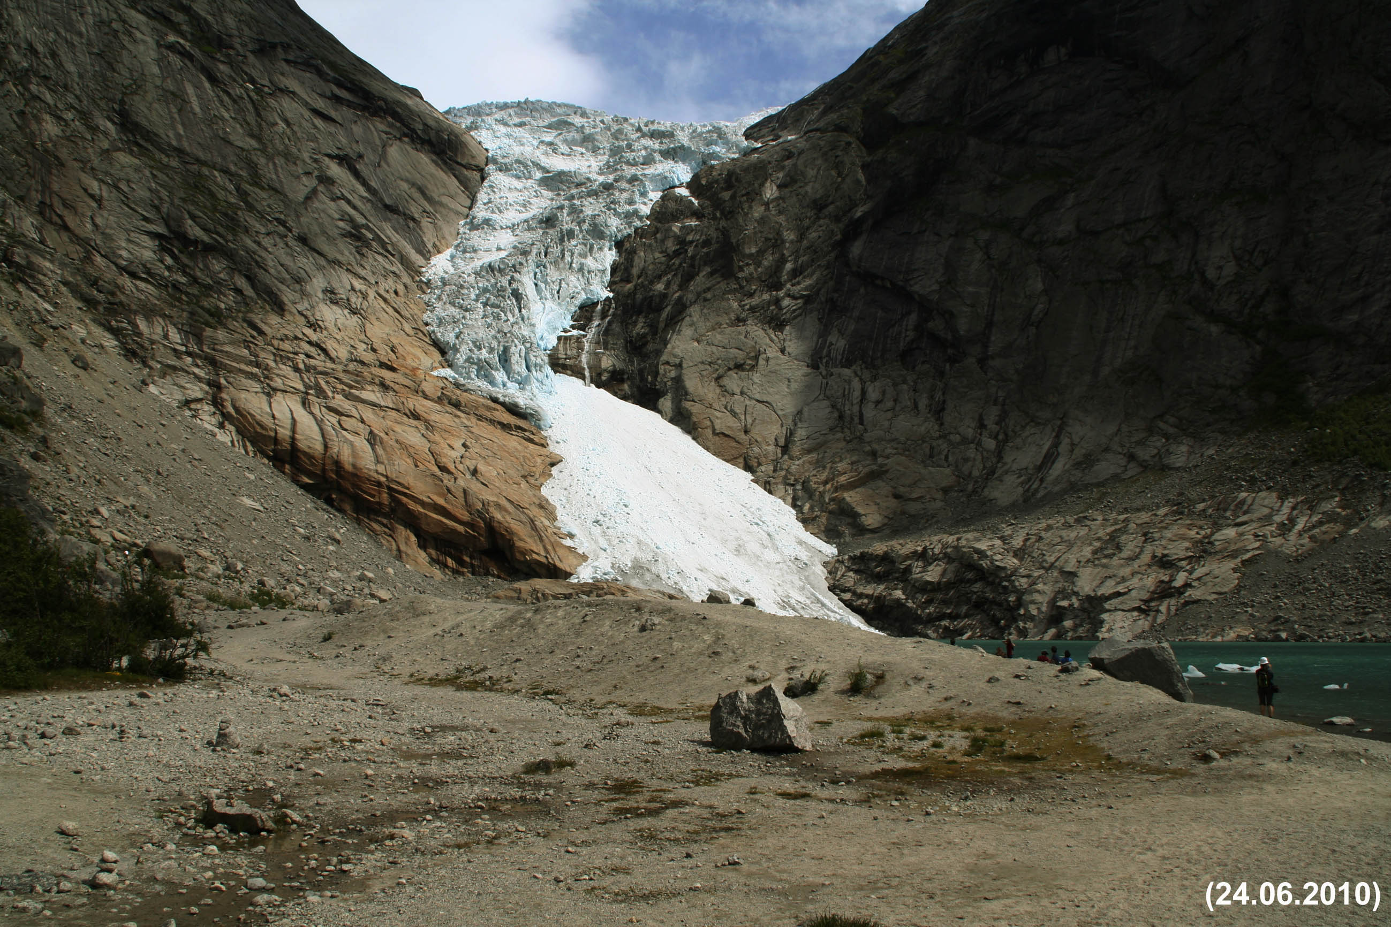
2010
1989
1990
1991
1993
1994
1995
1996
1997
1998
1999
2000
2001
2002
2003
2004
2005
2006
2007
2008
2009
2010

Slide 35
Exercise!
Describe how the glacier tongue has changed from 1989 until 2010!
Describe how the area surrounding the glacier tongue has changed!
Can you split the time period from 1989 until 2010 into different segments, i.e. characterise shorter periods of similar changes?
Here are the answers:

Slide 36
(1) During the period 1989 – 2010 the glacier tongue first was growing and the frontal position was “advancing”.
Later, this advance came to an end and for a few years, the glacier remained almost unchanged (“stationary“).
Then, the glacier tongue started to melt back very fast and the frontal position as “retreating”.
(2) During the advance, the lake in front of the glacier was successively covered by the glacier. Later, it emerged again as the glacier was retreating.
During the advance, a small ridge (called “terminal moraine”) was often visible at the glacier front. It was formed by “bulldozing” of sediments due to the pressure of the ice.
(3) Advance from 1989 until 1996/1997. Stationary period until 2000/2001. Retreat after 2002, increasing around 2005/2006. Last few years (2008 – 2010) only small retreat.

Slide 37
Another exercise!
Think and discuss with your neighbour what might have caused the glacier advance and the subsequent retreat!
What could have been the climatic reasons for this specific behaviour of the glacier tongue?
Here are the answers and some additional information to confirm:

Slide 38
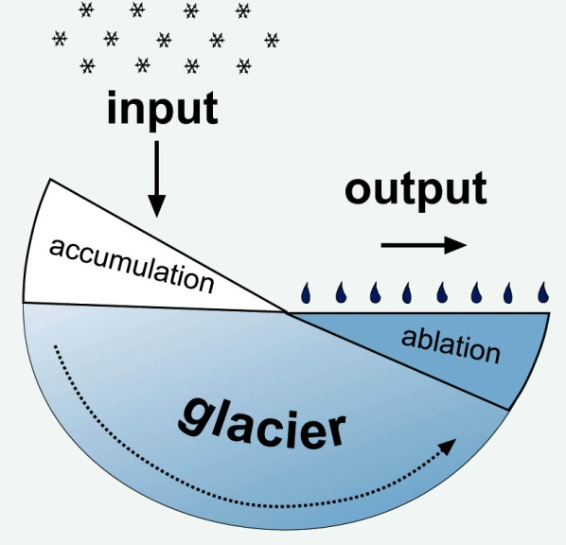
Remember this simple model of a glacier? It helps a lot!
Briksdalsbreen advanced because the glacier was not in an equilibrium state!
Also during the recent retreat, the glacier was in a state of imbalance of his mass.
Briksdalsbreen advanced because the glacier ice mass as grown, i.e. more input than output. The mass surplus was transferred to the lower glacier tongue (and the ice velocity increased). Because the output (melting) could not compensate this surplus, the glacier front advanced.
Briksdalsbreen retreated because the glacier ice mass was reduced, i.e. less input than output. There was more ice lost by melting at the lower glacier tongue than ice was transferred from the higher glacier parts to the tongue to compensate. As a result, the glacier melted back.

Slide 39
If you want to keep it simple, the climate impact on a glacier can be reduced to two major factors at this particular glacier:
Summer air temperature
Winter precipitation
In theory, an advance (ice mass increase) can be caused by:
(1) increased input (more winter precipitation = winter snow)
reduced output (lower summer air temperature = less melting)
both
At Briksdalsbreen, during the ice mass gain and the advance the summer air temperatures were at average levels, melting was normal.
Therefore, increased winter snow fall must be responsible for the glacier advance. In fact, during the 1980s and 1990s, West Norway experienced many mild and moist winters, with heaps of snow.

Slide 40
If you want to keep it simple, the climate impact on a glacier can be reduced to two major factors at this particular glacier:
Summer air temperature
Winter precipitation
In theory, a retreat (ice mass loss) can be caused by:
(1) reduced input (less winter precipitation = winter snow)
Increased output (higher summer air temperature = more melting)
both
At Briksdalsbreen, during the ice mass lost and the retreat the winter precipitation was at average levels, accumulation was normal.
Therefore, increased summer air temperatures and enhanced melting must be responsible for the glacier retreat. In fact, during the late 1990s and since 2000, West Norway experienced many warm summers.

