Slide 1

Gel Electrophoresis
School of Biological Sciences
College of Science, University of Canterbury

Slide 2
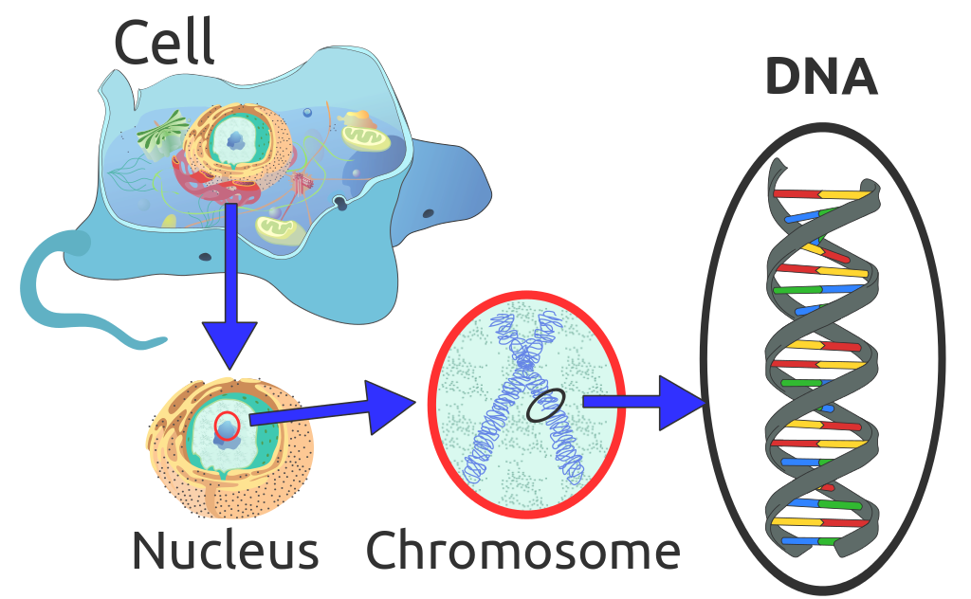
DNA = instructions for life
commons.wikimedia.org/wiki/File:Eukaryote_DNA.svg
Notes:
Today we are going to be working with DNA. DNA is the instruction manual for all life on earth so it is able to tell us a lot about how living things function but also about how they have changed overtime. There are a number of different methods used in research with DNA. Today we are going to be learning about one of these methods that is commonly used by a lot of different areas of DNA research.

Slide 3
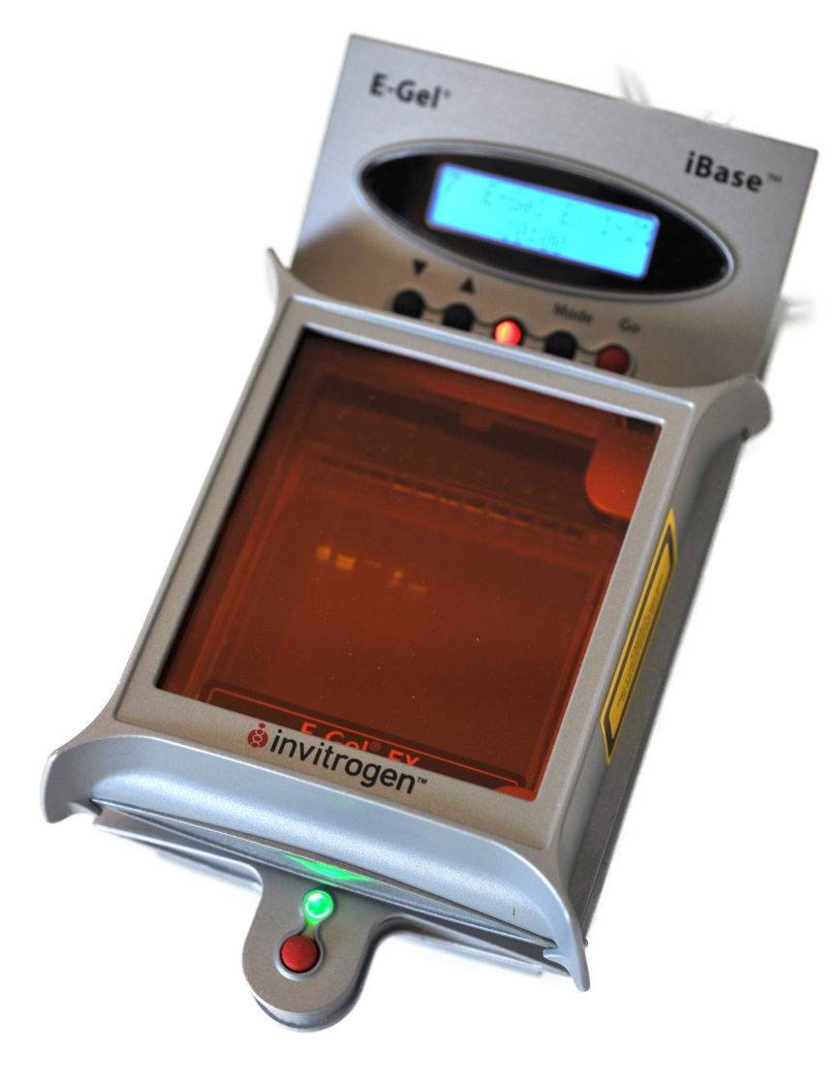
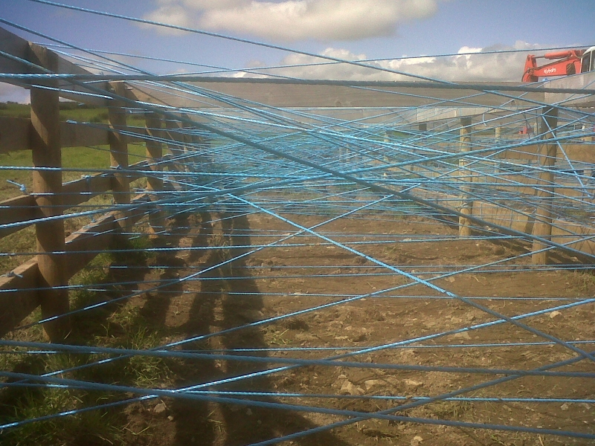
Gel Electrophoresis
Electrophoresis separates DNA fragments according to their size.
DNA samples pipetted into holes (wells) here
Notes:
Gel electrophoresis is an important technique for studying DNA that allows DNA fragments to be separated by size. The gel acts as a kind of web for the DNA to move through. Short fragments can move easily through the gel while long fragments get caught and so don’t move as far through the gel.

Slide 4
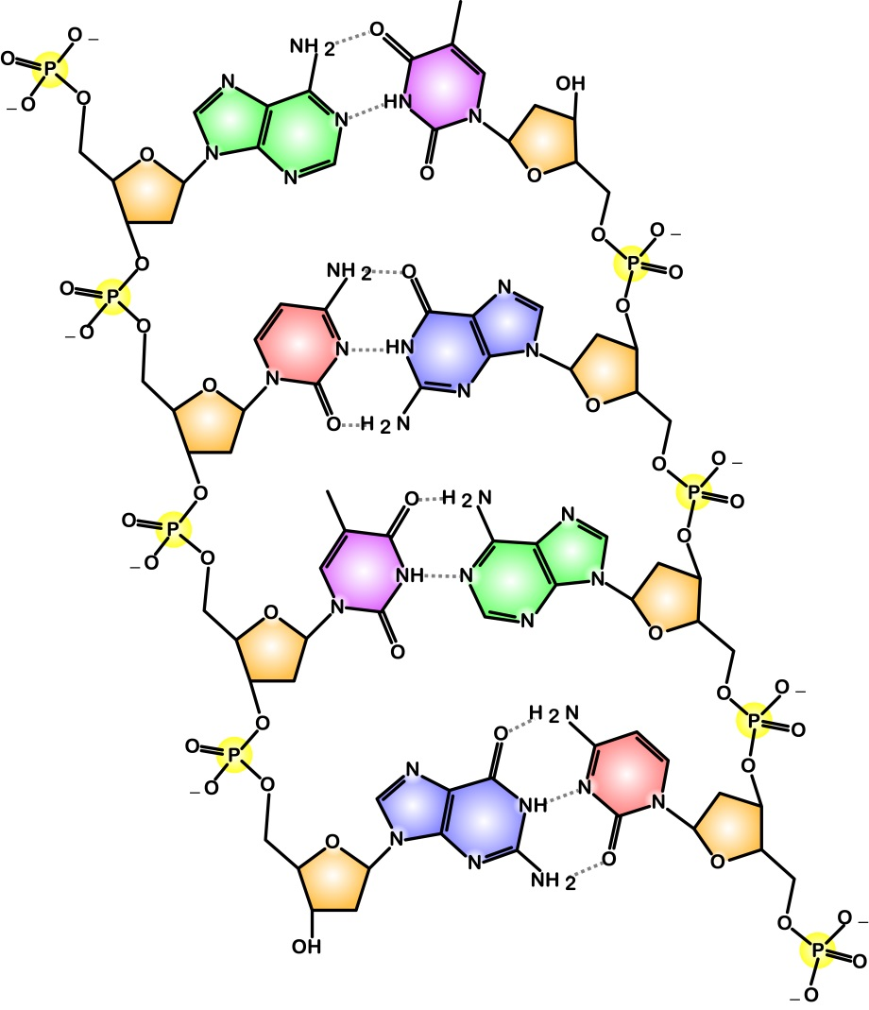
DNA fragments are negatively charged
Opposites attract
Phosphate and sugar backbone
Image: www.boundless.com
Notes:
The DNA is pulled through the gel because it is negatively charged, as a result of its phosphate back bone. The negatively charged DNA is attracted to the positive electrode at the end of the gel and so the DNA is pulled through the web like gel structure.
Image source: Source: Boundless. “Biology: DNA Structure and Replication.” Boundless Physics. Boundless, 26 May. 2016. Retrieved 25 Aug. 2016 from https://www.boundless.com/physics/textbooks/boundless-physics-textbook/electric-charge-and-field-17/applications-of-electrostatics-138/biology-dna-structure-and-replication-494-11195/

Slide 5
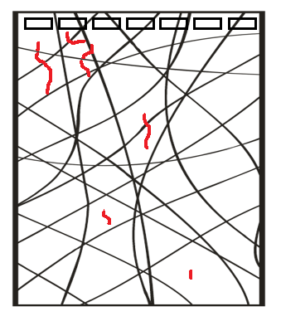
DNA on the move
Separates DNA fragments according to their size
-ve
In the gel polysaccharide strands form microscopic gaps
+ve
Notes:
Here we can see what we expect to happen. The –ve DNA is attracted to the positive electrode with shorter fragments moving more easily and making it further down the gel.

Slide 6
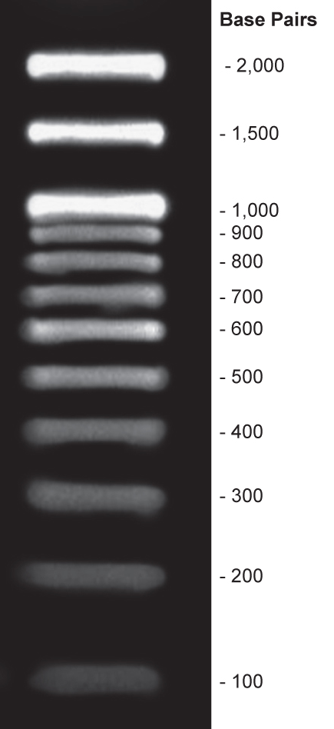
Notes:
Here is an example of what you might see on a gel. In reality we don’t see sing strands because they are very small but we see bands on the gel made of lots of strands of the same size. You can see the longer strands are at the top of the gel, while the shorter strands have moved further down.

Slide 7
Electrophoresis separates DNA fragments according to their size.
DNA samples pipetted into holes (wells) here

Slide 8
Gel Electrophoresis
Separates DNA fragments according to their size
In the gel polysaccharide strands form microscopic gaps

Slide 9
DNA fragments migrate towards the positive electrode.

Slide 10
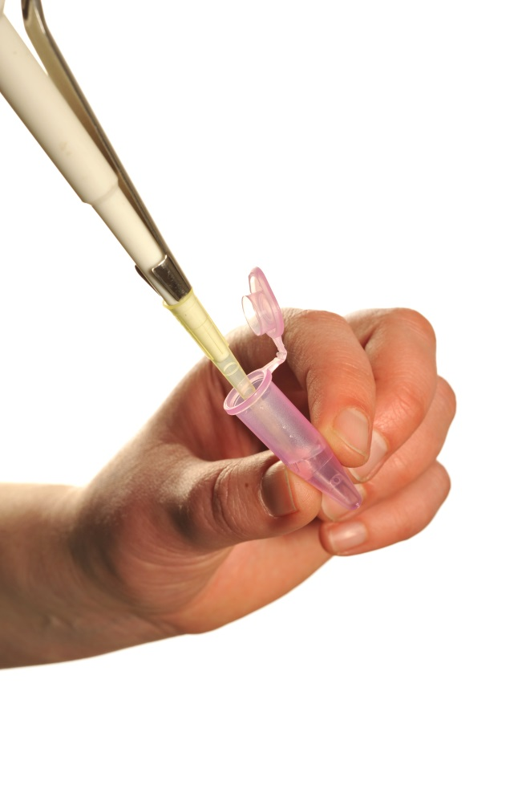
Working with small volumes
micro pipette
Need to be accurate
1000 microlitres (µL) = 1 millilitre (mL)
Eppendorf tube
Notes:
All our chemicals are in these little tubes called eppendorfs. It is important to make sure the solutions are mixed and all at the bottom so you can suck them up. We have done this already using a centrifuge so try not to shake them up.

Slide 11
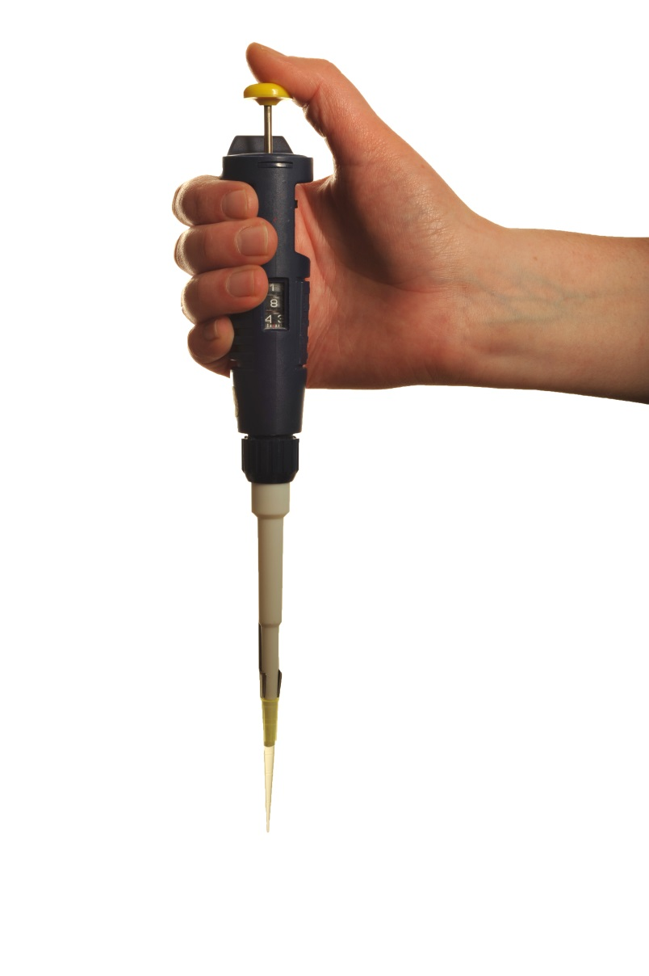
Micropipettes
For measuring small volumes of liquid in microlitres ( µL )
1000 µL = 1 mL
2
20
This pipette can be used for volumes between 2 and 20 µL
Notes:
A micropipette has several parts.
It tells you the volumes it is capable of measuring and on the side tells you what volume it is currently set to. You can adjust this by turning the top of the pipette. It is important not to go beyond the volumes the pipette can manage as this can break it and the pipette will not be accurate.
To suck up a volume we use a pipette tip. We can change this between samples to prevent contamination.
When you use the pipette you will notice it has two “stops”, points of resistance. We push down to the first stop when we want to suck liquid up. Then to make sure we remove all the liquid from the tip we go all the way to the second stop, which pushes extra air out to empty the pipette.
When you are finished with a tip you press this button to eject it into a container.

Slide 12
Practise filling and emptying the pipette with 10 µL of water.
Put the droplets onto the Parafilm – do they look the same size?
Activity
Notes:
Now you are going to have a chance to practise pipetting. You have been given some blue water to practise with and some rubbery plastic called parafilm.

Slide 13
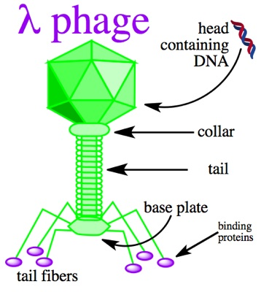
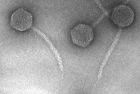
Today: The DNA
DNA from λ bacteriophage or lambda phage
A circular piece of DNA called a plasmid.
Notes:
Today we will be testing this technique using DND from a lambda phage. Lambda phage a virus known as a bacteriophage which means it infects bacteria. As will all viruses the lambda phage is very simple, made up of a protein coat and a simple circular piece of DNA called a plasmid.

Slide 14
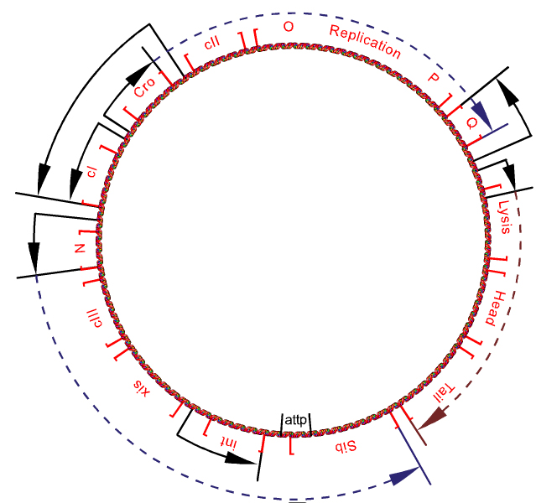
Virus building instructions
Notes:
The plasmid contains all the instructions for making new lambda phages. This virus has been studied extensively and so the sequence and genes are known very well. This means we won’t learn anything new about the virus today but it does make it ideal for testing this method because we know what to expect. The virus can’t make copies of itself so it inserts its DNA into a bacterial cell and turns the cell into a virus making machine.
Image: Richard Wheeler (Zephyris) 2005,
Source: https://commons.wikimedia.org/wiki/File:Bacteriophage_lambda_genome_insertion.png

Slide 15
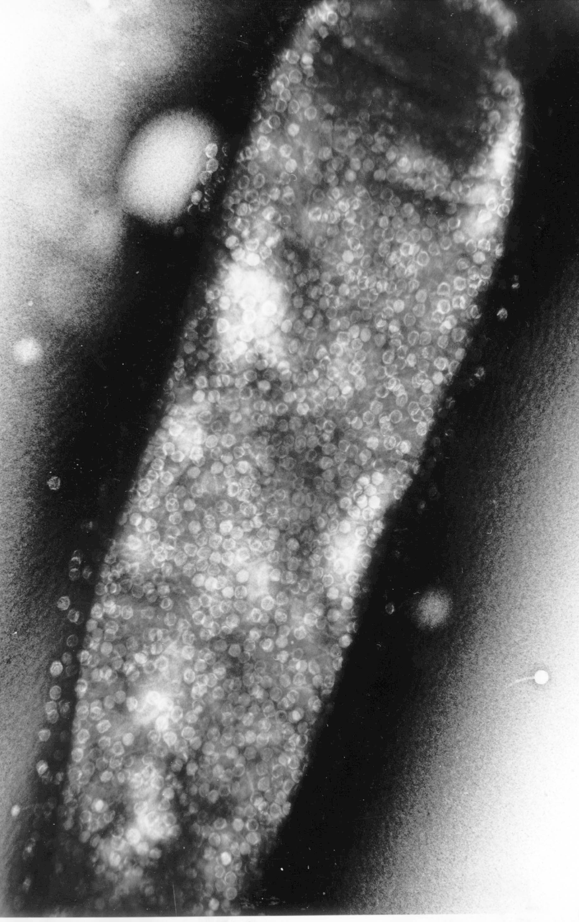

Bacteria fight back!
Restriction enzyme
DNA
plasmid
Restriction enzymes cut at specific DNA sequences.
There are many different restriction enzymes.
Notes:
Bacteria that become virus making machines eventually burst full of viruses. This is less than ideal for the bacteria so over time they have evolved ways to fight against this. These are called restriction enzymes and they work to cut the viral DNA up before it can turn the cell into a virus making machine.

Slide 16


Restriction enzymes
There are many different restriction enzymes.
We will use two:
EcoRI and HindIII
----GAATTC----
----CTTAAG----
----AAGCTT----
----TTCGAA----
Notes:
There are many of these restriction enzymes produced by bacteria and today we are using two of them. Each restriction enzyme has a code of DNA that they are looking for. When they find it they cut the DNA so that it no longer works. We can see this with EcoRI but it works similar for the other restriction enzymes.

Slide 17
EcoRI
----------------GAATTC--------------------
----------------CTTAAG-------------------
Notes:
This is the DNA sequence that EcoRI is searching for

Slide 18
EcoRI
----------------GAATTC--------------------
----------------CTTAAG-------------------
Notes:
When it comes across it, the enzyme makes a cut across these bases.

Slide 19
EcoRI
---------G AATTC--------------
---------CTTAA G--------------
Notes:
The DNA is then cut in two like so.

Slide 20
EcoRI
---------G AATTC--------------
---------CTTAA G--------------
sticky ends
Notes:
The ends of the DNA are called sticky ends because there are bases that are exposed and don’t have another base to pair with. This is very useful for scientists because it means we can stick other pieces of DNA that we design onto the sticky end but we don’t need to worry about that today.

Slide 21
Samples to prepare
The enzyme digestion has been done for you.
All the tubes have 10 µL of DNA in them.
U = uncut plasmid
H = plasmid + HindIII
E = plasmid + EcoR I
D (double) = plasmid + HindIII + EcoR I
L = DNA ladder, known size fragments
Notes:
All this DNA cutting has already been done for you. We have some DNA that has not been cut, some been cut by just EcoRI, some that has been cut by just HindIII and some that cut by both restriction enzymes. In our last tube we have what is called a ladder. In this sample are fragments of known size so we can use it as a kind of ruler to get an idea of what size our fragments in our other samples are.

Slide 22
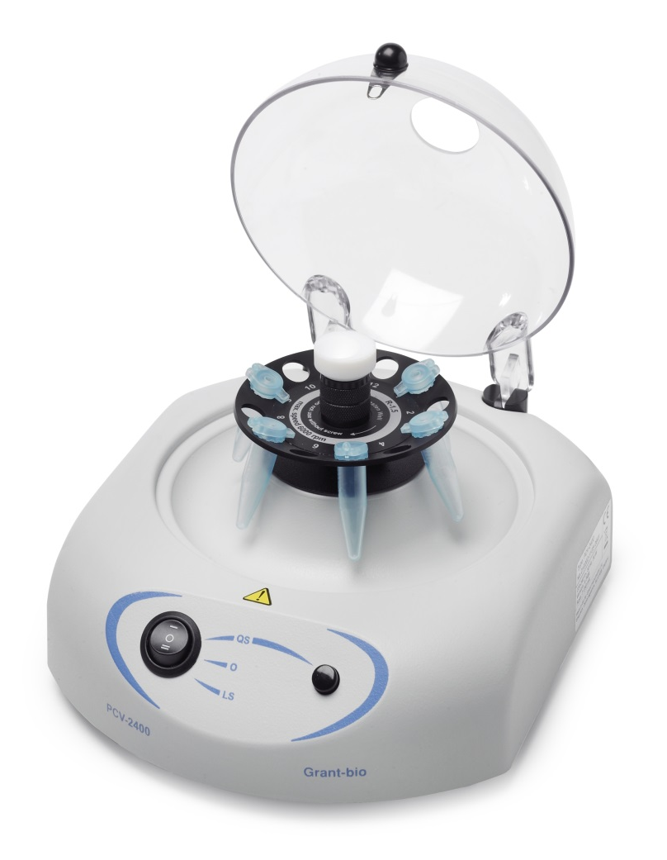
Working with small volumes
Centrifuge the Eppendorf tube or shake it to get all the liquid to the bottom.
Note: The centrifuge must be balanced – place another tube opposite.

Slide 23

Add 10 µL of water to the samples and DNA.
This will make all of the tubes up to 20 µL.

Slide 24
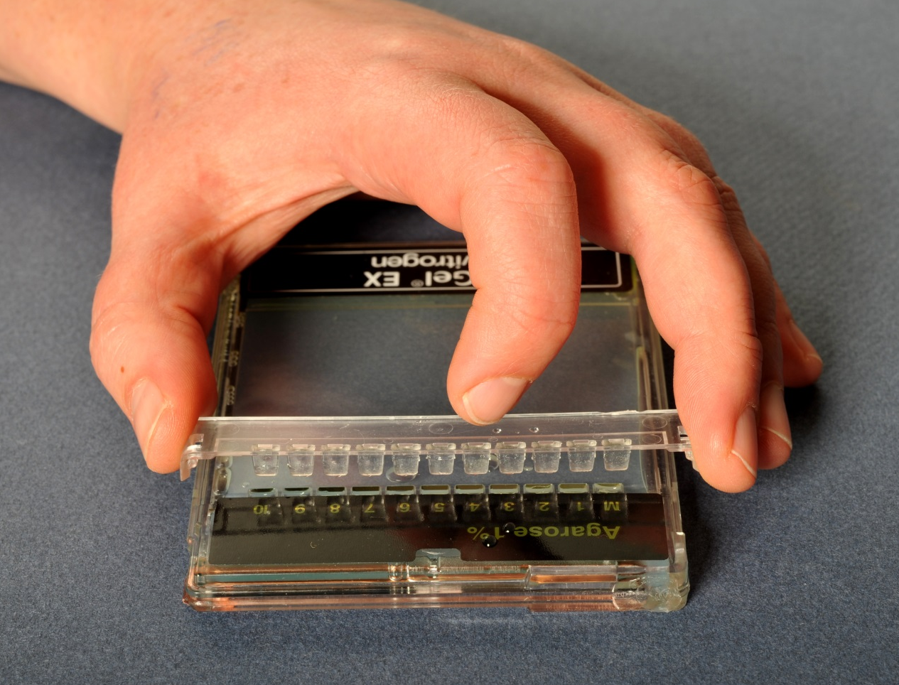
Prepare the gel
Open the packet and then gently lift the comb from the gel.
Notes:
The gel has a “comb” in it. This is used when the gel is being poured so that it will have wells for the DNA to be put in when it sets.

Slide 25
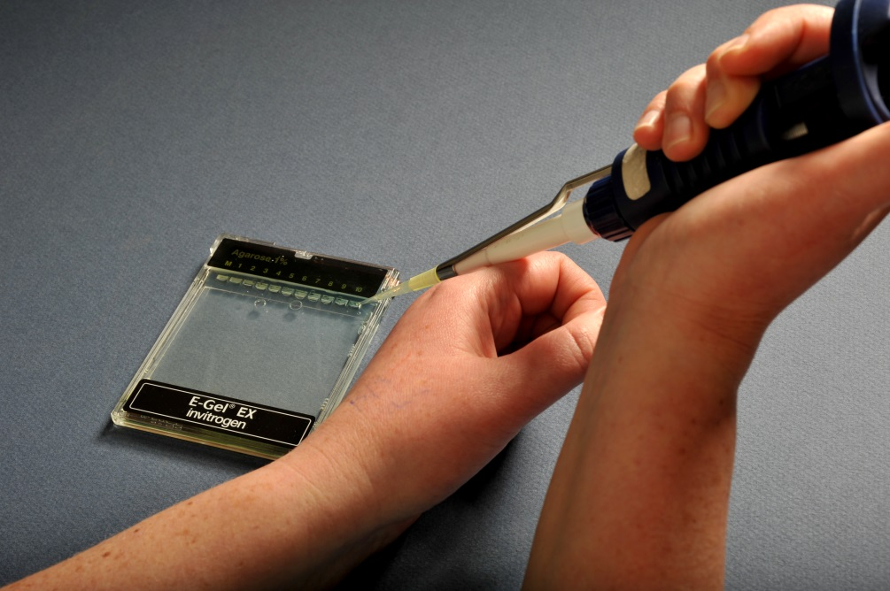
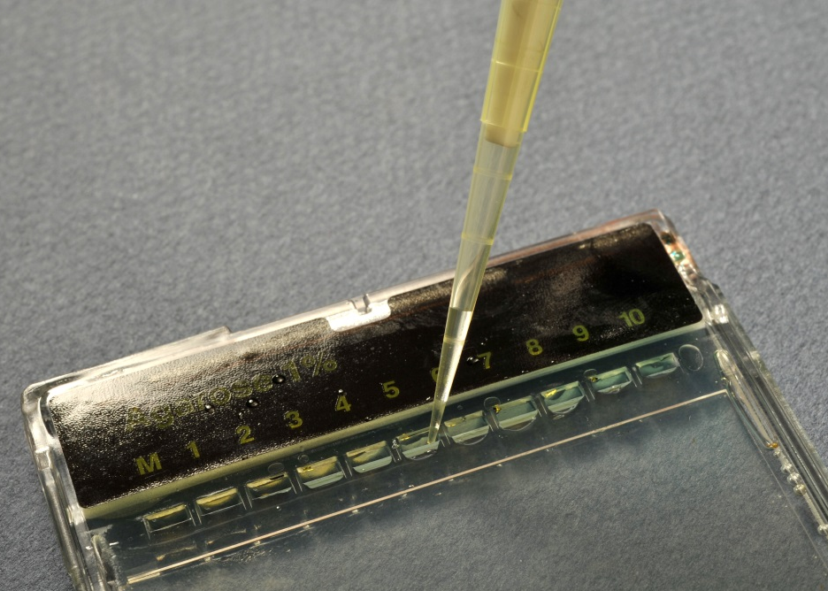
Load the gel
Carefully rest the pipette tip on the inside edge of the well. Add 20µL of each DNA sample into a well of the gel.
Notes:
Make sure not to pierce the gel whilst you are pipetting in the DNA and try not to contaminate one sample with DNA from another well.
Remember to write down which well you put each sample into.

Slide 26
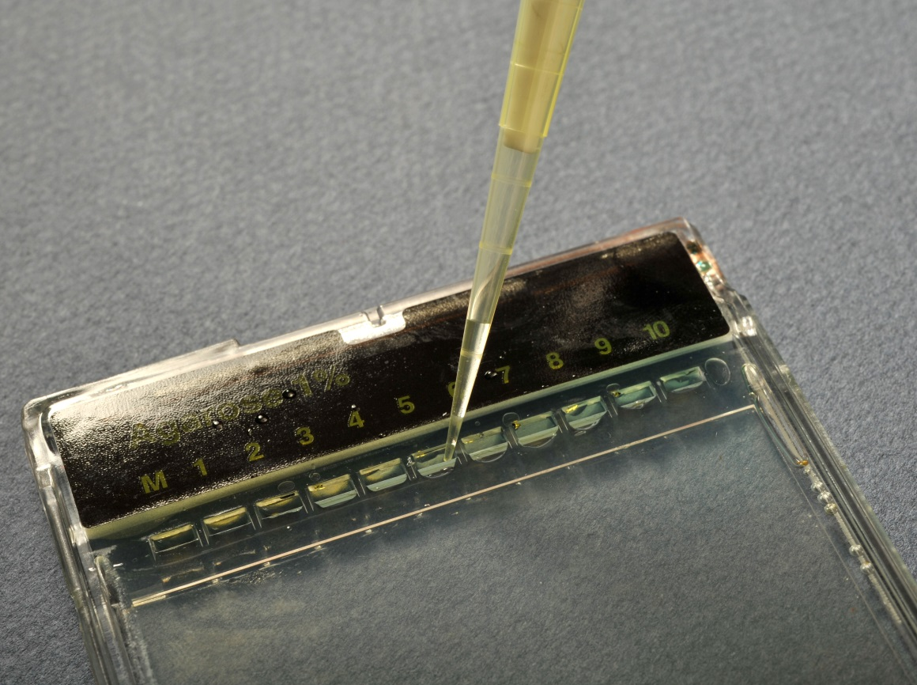
Fill all of the empty wells with 20 µL of water

Slide 27
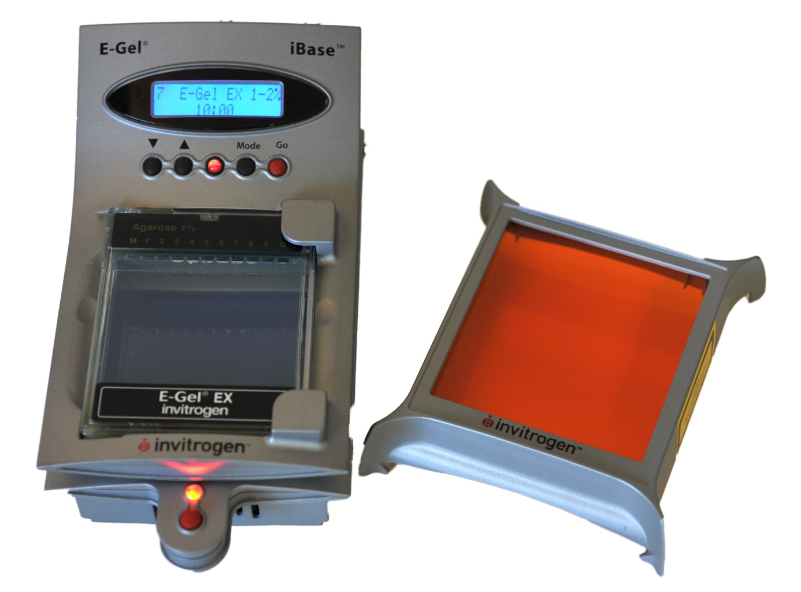
Run the gel
Run the gel for 10 minutes on the E-gel EX programme

Slide 28

View the results
Use the blue light Safe-Imager to view the DNA bands, even while it is running

Slide 29
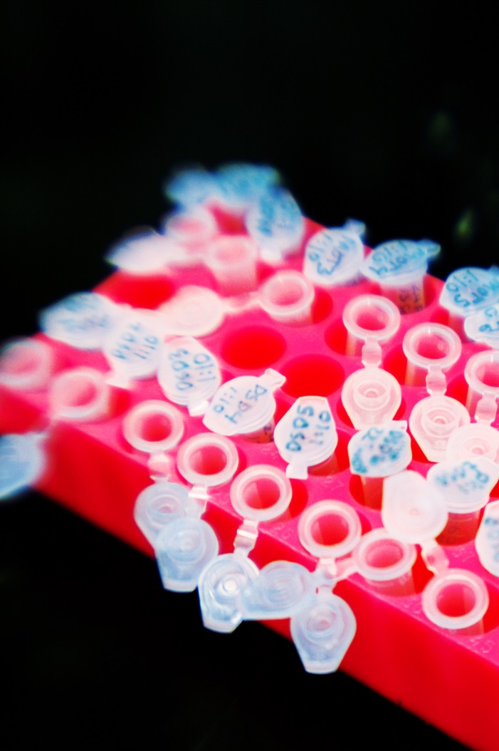
Activity
Using the lab book student work in small groups to calculate:
the number of fragments each enzyme will have produced
the size of each fragment

Slide 30
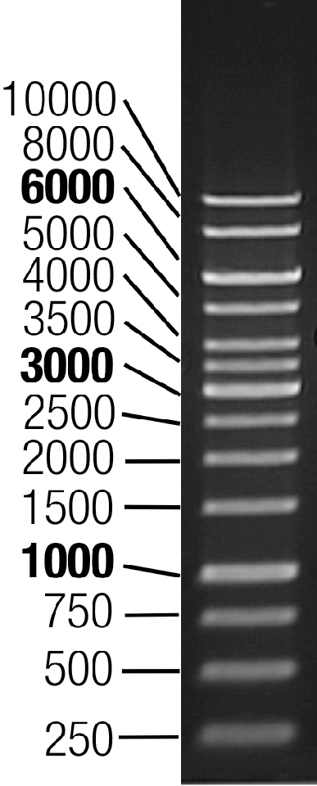
What to expect
Size
(base pairs)
DNA Ladder
This is a standard containing known lengths of DNA.
Notes:
Here is what we expect for our ladder.
(Actual ladder is slightly different – refer to workbook)

Slide 31


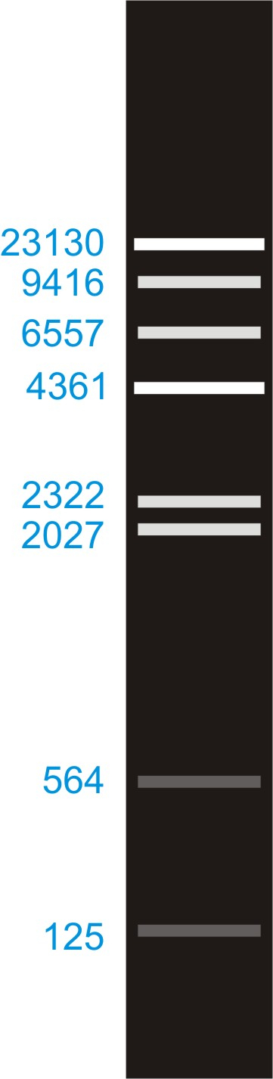
HindIII
EcoRI
Both
Notes:
What we expect to see for each of our samples of DNA cut by the different enzyme combinations.

Slide 32
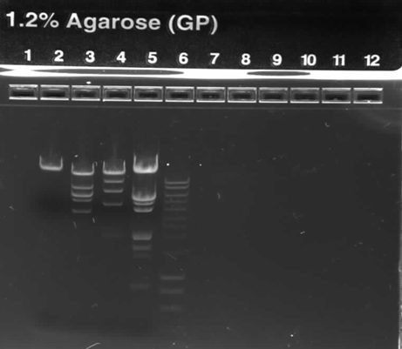
Lane 2:
Uncut Lambda DNA
Lane 3:
Lambda DNA cut with EcoRI
Lane 4:
Lambda DNA cut with HindIII
Lane 5:
Lambda DNA cut with EcoRI and HindIII
Lane 6:
DNA Ladder
Notes:
In reality our bands might not be so clear but here is an example of what we expect to see. The uncut DNA is at the very top of the gel, that is because it is a very large piece and has struggled to make to through the gel very far. The enzymes have cut the DNA into smaller pieces so they have multiple bands and some of them have made it further down the gel. The DNA cut by both enzymes has the most bands and some of them are very far down the gel, which means they must be very small. This makes sense because we have cut this DNA twice, once with each enzyme.

Slide 33
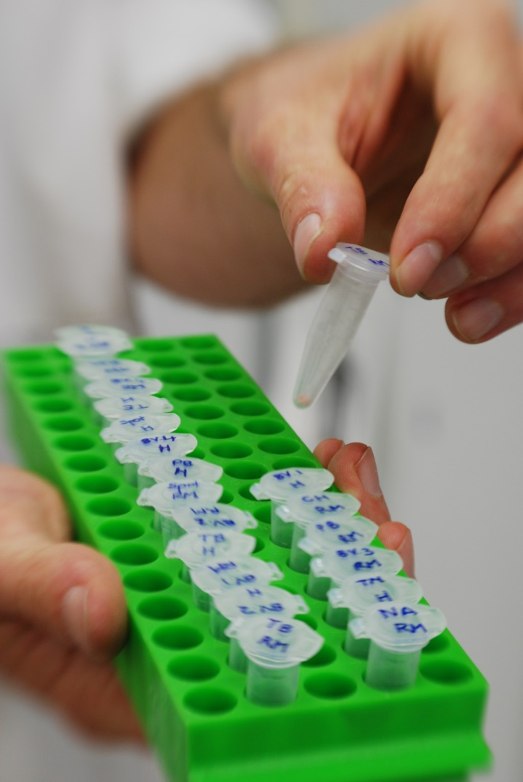
What do you think can we use this technique for?
Question

Slide 34
Paternity cases
DNA fingerprinting
Forensics
Diagnose genetic diseases
Separation and isolation of DNA for drugs and genetic engineering
Conservation and breeding programmes
Evolutionary biology
Research
Notes:
We can use this technique for lots of different things!
You are probably familiar with images of bands from shows like CSI where they are testing to see if the bands match between evidence found at a crime scene and a suspect.
A similar method is used in paternity tests to see if bands from the offspring match bands from each of the parents.
You can also cut out the bands from a gel and clean them to use them for further research.
Lots of research uses these techniques including work done here at the University of Canterbury.

Slide 35
Genetics research at UC
  Genetics underpins much of our research, from ecology to biochemistry:
  Evolution and taxonomy of the Senecioneae in the Sunflower family.
  We are using a combination of field observations, experiments and molecular analyses to investigate species barriers and hybridisation in Dissotis at our Nigerian field station.
  Examining the frozen ‘fossilized’ record of an evolved bacteria.
  Evolving proteins in the laboratory as a powerful means of engineering novel bespoke enzymes for a range of applications.
  comparative genomics and transcriptomics to examine evolution of small RNAs.
  ecological and evolutionary processes that contribute to the formation and maintenance of species boundaries, particularly in threatened shorebirds and seabirds.
Notes:
We cannot easily examine the ‘fossils’ of the protein world, but we have recently gained access to the frozen ‘fossilized’ record of an evolved bacteria. In collaboration with Dr Cooper (University of Houston), this study deciphers (structurally and functionally) the evolution of E. coli pyruvate kinase as the bacterium adapts to various energy limiting environments. Because we can reproduce protein evolution in the laboratory and in real time, implementing the principles of Darwinian evolution to individual genes and enzymes, we can get a glimpse of the evolutionary intermediates, routes, and mechanisms, that may have led the way to the highly proficient enzymes known to us today.
The ability to evolve proteins in the laboratory is also a powerful mean of engineering novel bespoke enzymes for a range of applications, for instance aiding synthetic organic chemistry.
We have been using comparative genomics and transcriptomics to examine evolution of small RNAs. We find that only a few RNAs appear genuinely ancient (i.e. tracing back to the earliest stages of life), with the vast majority appearing to have much shorter evolutionary histories. As part of this, we have pioneered a phylogeny-informed approach to identification of noncoding RNAs.

Slide 36
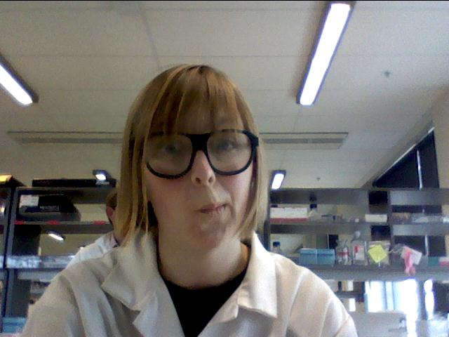
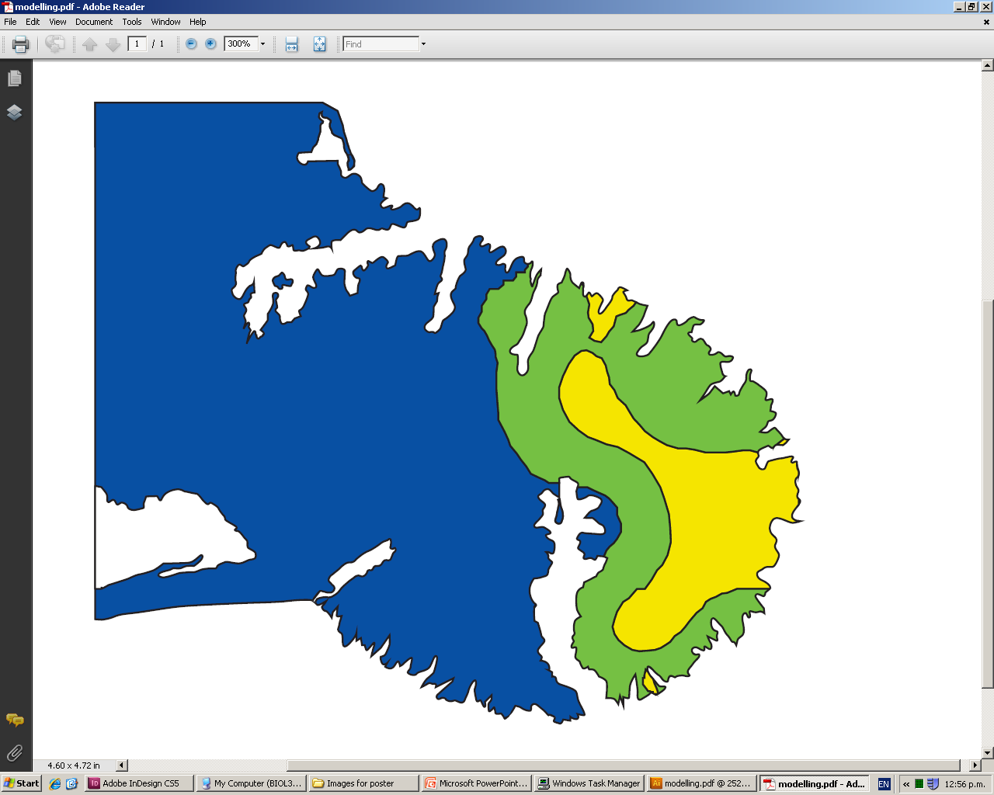
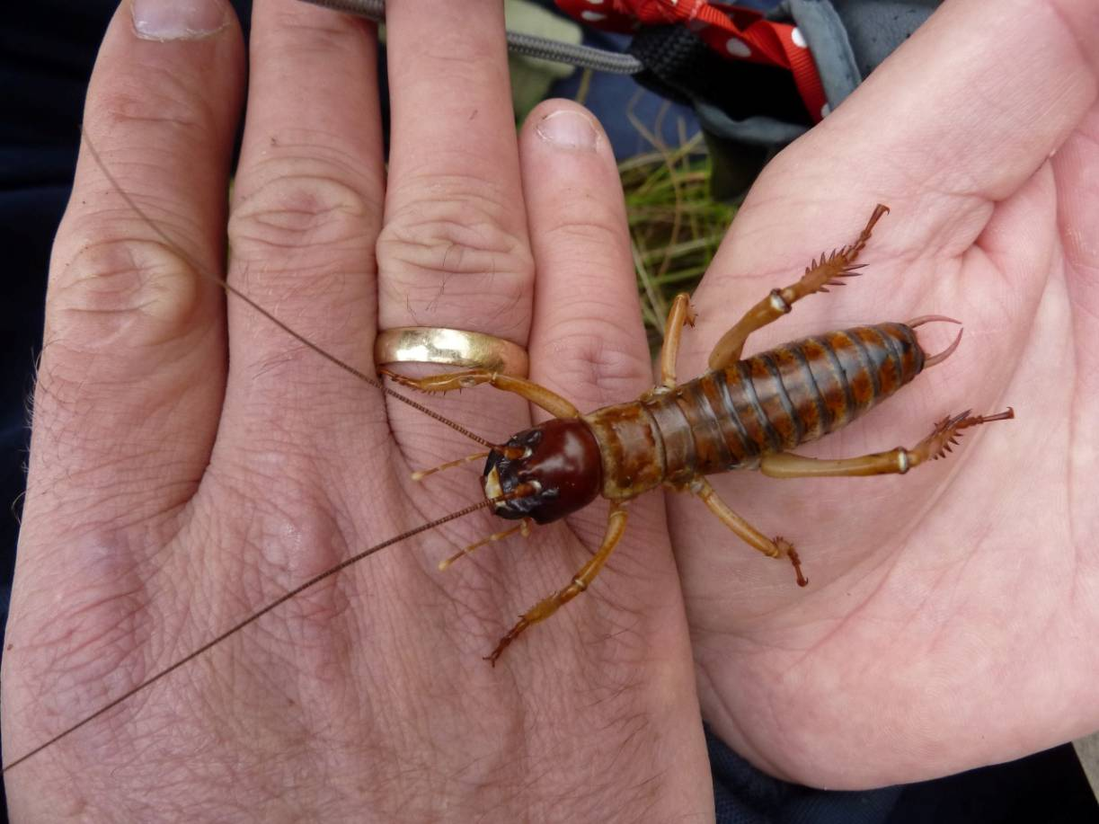
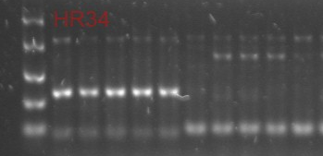
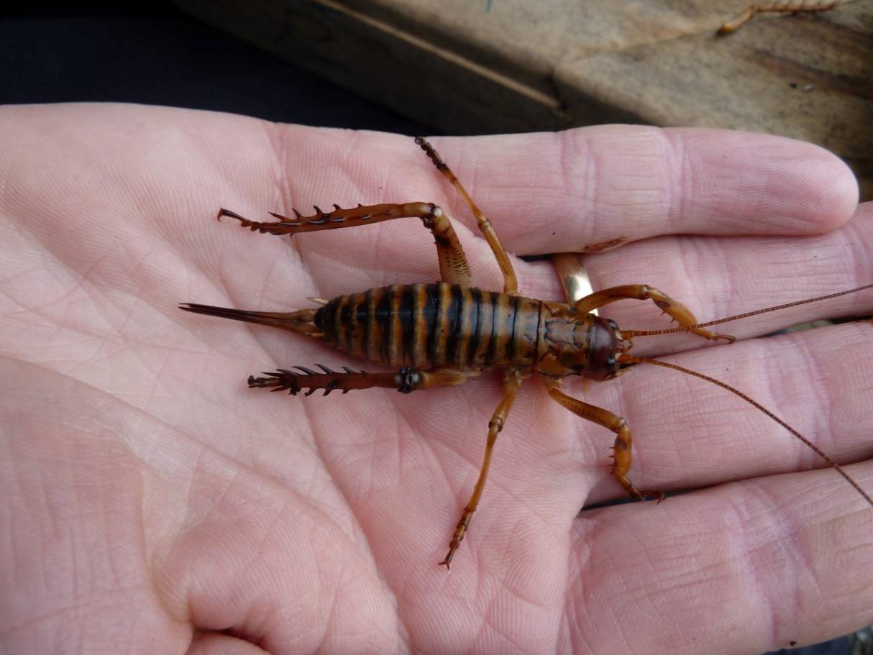

Hybridisation? Rachel van Heugten
?
Notes:
This is some work done by a PhD student at the University. She is studying two species of tree weta found on Banks Peninsula. One of these species, the Banks Peninsula tree weta, is (as its name suggests) only found on the eastern half of Banks Peninsula. It shares some of the areas it lives with another species of tree weta, the Canterbury tree weta, imaginatively named because it is found throughout Canterbury. Previous work found a couple of weta that looked similar to both of these species and conservationists started to worry that the two species might be hybridising. Hybridisation is an important part of the evolutionary process but sometimes human actions can mean it occurs where it normally wouldn’t. Here deforestation is likely to have increased the chances of these two species coming together so hybridisation might not be natural. Furthermore, because the Banks Peninsula weta is rare there is a worry that it might not be able to find a date with members of its own species. It might instead settle for a Canterbury tree weta and overtime genes from the more widespread Canterbury weta might spread throughout the Banks Peninsula weta until there are no pure members of the Banks Peninsula weta left. At this point the Banks Peninsula weta is effectively extinct so we wanted to see if this was likely to happen.
To do this DNA samples were taken from weta from across the Peninsula, in areas where you only find the Canterbury weta as well as areas where you only find the Banks Peninsula tree weta and in areas (here in green) where you are predicted to find both. Looking at the gel you can see that the DNA from each species gives a different banding pattern. Here we have what looks like a hybrid as it has bands expected from both species. I did confirm that the previous study had found a hybrid but after collecting 100s of samples hybridisation appears to be very rare and so doesn’t pose and immediate threat to the Banks Peninsula tree weta.

Slide 37
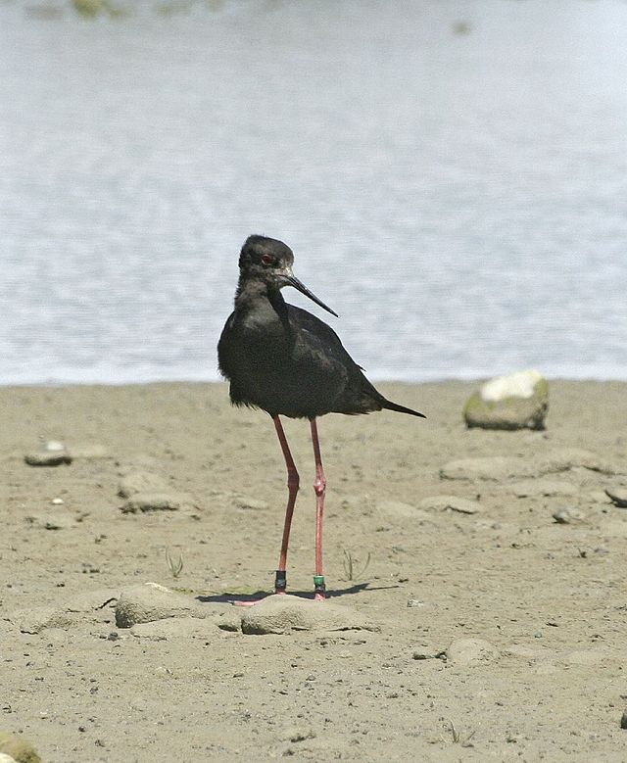

Breeding program
?
ZW
WW
2
bands
1
band
Himantopus-novaezelandiae
by Yang Zhang - originally posted to Flickr as _MG_7499.
Notes:
Another endangered species being studied at Canterbury is the Black Stilt or Kaki. In order to try and boost their numbers there is a breeding program being undertaken. Scientists at Canterbury have been using gel electrophoresis to tell the gender of the birds because it is important to have a mummy bird AND a daddy bird if you want baby birds. For this they use DNA from the sex chromosomes. In birds the female has the sex chromosomes ZW and the male has two Ws. This means that females are going to have two bands on the gel as the gene on their Z chromosome is a different length to the DNA on their W chromosome. As the DNA from both their W chromosomes is the same length, males only show one band on the gel.

Slide 38
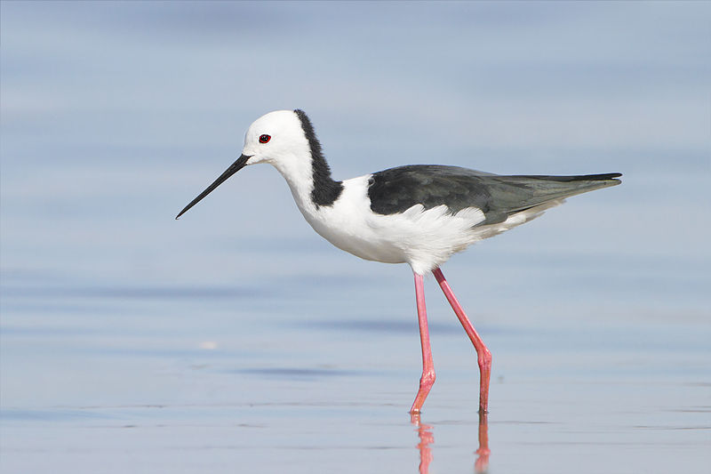
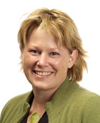
Breeding program
Desperate times...
Dr Tammy Steeves
Himantopus-novaezelandiae
by Yang Zhang
Himantopus himantopus leucocephalus
by JJ Harrison
Notes:
Apart from making sure you are going to get baby Black Stilts the scientists want to see how many males and females they are. Similar to the tree weta, Black Stilts are known to hybridise with Pied Stilts. However, they seem to prefer to mate with other Black Stilts so as long as there are enough males and females to go around with shouldn’t be a problem.

Slide 39
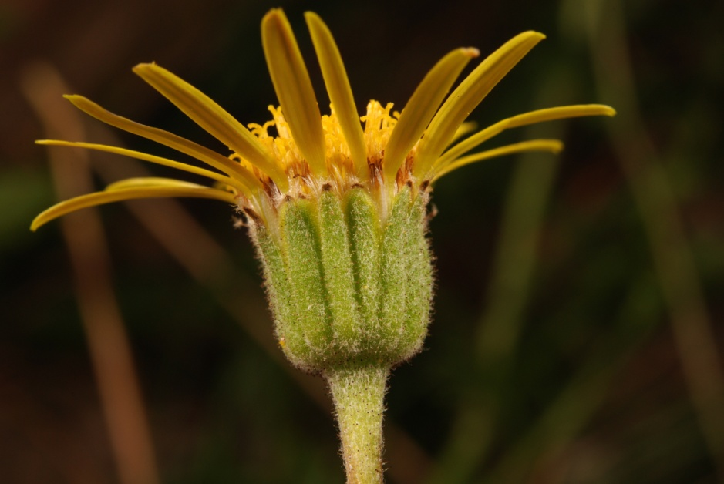
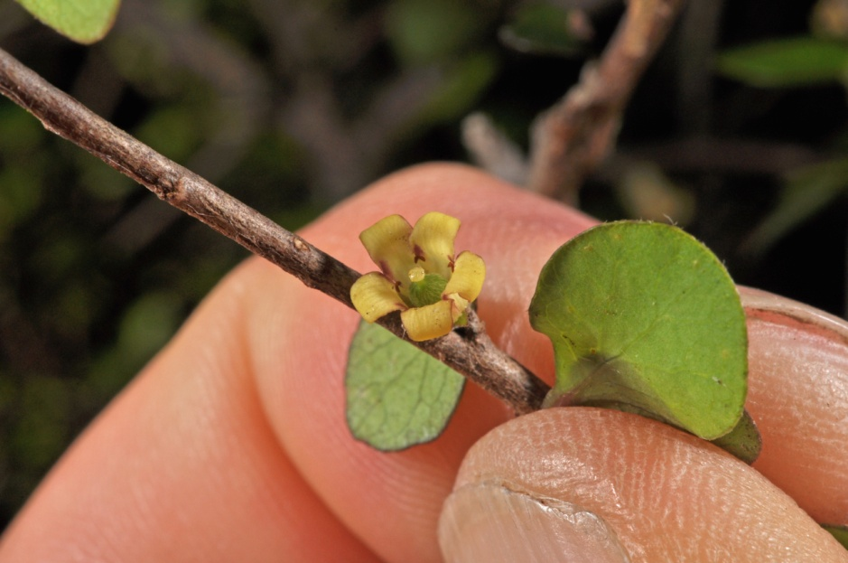
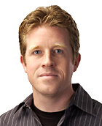
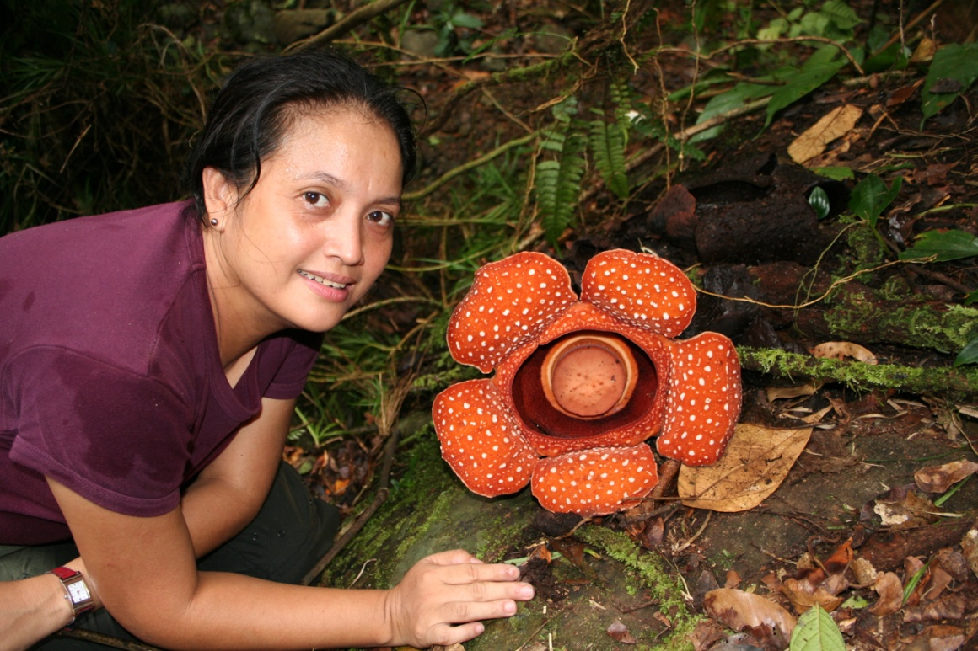
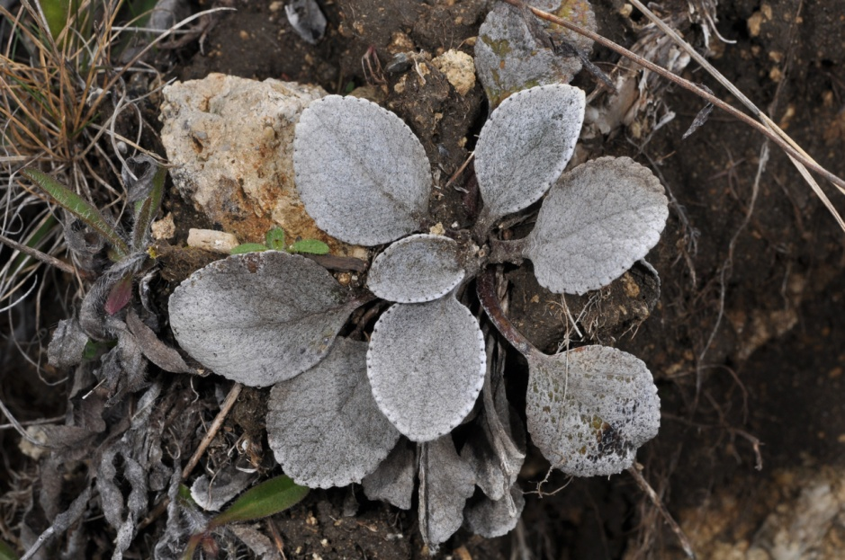
Plant evolution
Dr Pieter Pelser
Notes:
But it isn’t just animals! Pieter Pelser uses gel electrophoresis as one of the steps to test he has the DNA segments he needs and do further work and answer questions such as:
1) Are rare plant species still 'genetically healthy'? Why are they rare?
2) Where, when, and how fast did certain plant groups evolve?
3) Why are there so many species of some plant groups and so few of others?
4) How do parasitic plants evolve and do they have a preference for particular host species?
5) How important is hybridization in plant evolution?
6) What are the more closely related species of a plant group?
He does this with plants here in New Zealand as well as visiting other countries to get samples.

Slide 40
How to we get enough DNA?
Polymerase chain reaction: PCR
Ingredients:
DNA to copy.
DNA primers, select the DNA you want.
Nucleotides, building blocks DNA.
  A=T
  G=C
Taq, enzyme that assembles DNA.
Notes:
After extracting the DNA from a sample, we only have a very small amount. If we want to work with it we need to be able to replicate it. They used to do this by cloning it in cell cultures until it was discovered they could replicate the conditions inside the cell in the lab. The process is known as the polymerase chain reaction or PCR. The process involves a machine that cycles through a number of temperatures like a fancy oven. And like baking in an oven the PCR requires several ingredients. First you need the DNA you wish to copy. Next you need short segments of DNA called primers. The primers bind to the DNA at the ends of the part you wish to copy to they help you to control which bit gets copied. You also need to building blocks of Dna called nucleotides. There are four of these, adenine, guanine, cytosine and thymine. The nucleotides pair in a certain way (A to T, G to C) so in PCR an enzyme can read the code on the piece of DNA you wish to copy and know which nucleotide to add next. The enzyme that does this is called Taq and is a DNA polymerase. You have DNA polymerase in your cells too but this DNA polymerase comes from an organism that lives at very high temperatures. This is useful because it means the enzyme only works when we expose it to high temperatures and we can control when the reaction occurs.

Slide 41
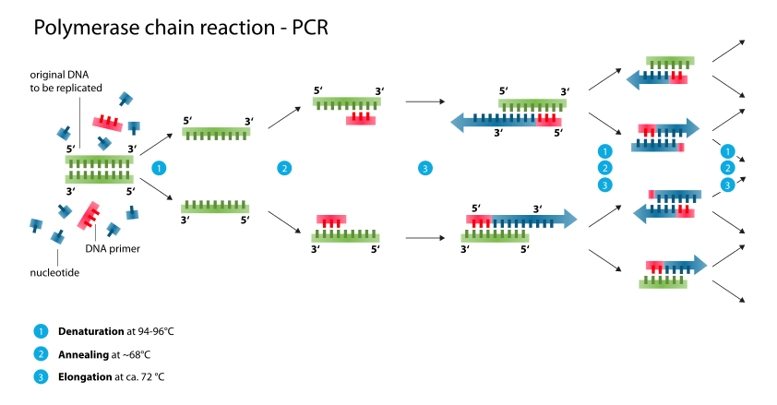
PCR
"Polymerase chain reaction" by Enzoklop - Own work. Licensed under Creative Commons Attribution-Share Alike 3.0 via Wikimedia Commons
Notes:
So here is our PCR reaction.
In green is the segment of DNA we wish to copy. It is called the template DNA because Taq polymerase enzyme is going to use it as a template to copy from.
In red are the primers and the blue bits are the nucleotides, the building blocks the enzyme uses to make the new strand of DNA.
The process starts by heating the DNA to around 95 degrees. This is so hot that the DND breaks open and exposes the code.
The DNA is then cooled so that the primers can attach. Where they attach is determined by their code, the find the part on the template that matches their strand and the DNA between them is what is going to be copied.
The temperature is raised to 72 degrees which is the temperature that Taq polymerase likes and it begins to add the new nucleotides on creating new strands. It adds these to the primers, the primers work as a place for the enzyme to start from. The process then repeats, each time Taq uses the existing strands from the previous cycle to guide the formation of new strands until many many copies of the DNA have been created.

Slide 42
PCR - video
Notes:
We will now look at a video that might explain this more clearly.

Slide 43
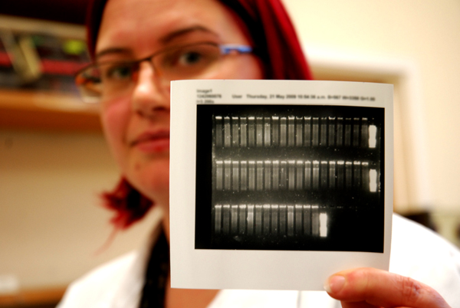
Science at University
Year 12–13
Biology
Chemistry
Physics
Maths
University
Bachelor of Science, 3 yrs
Employment
Postgraduate Study
Honours / Masters, 1-2 yrs
Ph.D. Degree, 4 yrs
Teaching diploma, 1 yr
Other tertiary providers
Polytechnics
Private academies

Slide 44
Sciences at UC
Bachelor of Science majors
Astronomy
Biological Sciences
Biochemistry
Chemistry
Computer Sciences
Geography
Geology
Mathematics
Physics
Psychology
Statistics
Bachelor of Speech and Language Pathology (Hons)
Bachelor of Health Sciences majors
Environmental Health
Health Education
Māori and Indigenous Health
Psychology
Public Health
Society and Policy

