Slide 1
Coastal Processes
Science Outreach

Slide 2
Interacting Elements of the Coastal System
Coast
Ocean
Land
Atmosphere
Human Activity & Structures
Biology

Slide 3
Types of Coastlines in NZ
Rocky shorelines
Form on high energy coasts where the ocean meets mountains or sea cliffs
Sandy beaches
Mainland, pocket and barrier beaches
Coastal wetlands
Swamps, tidal flats, marshes
Rich habitat for wildlife

Slide 4
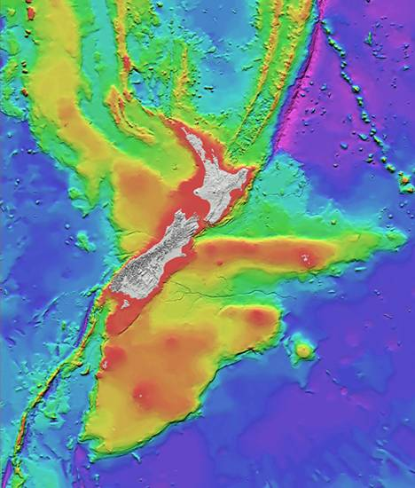
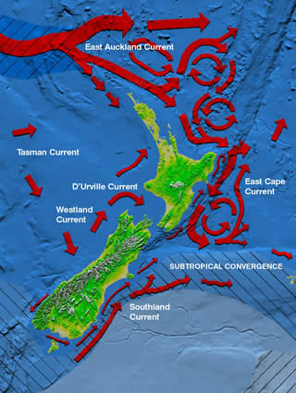
Ocean Currents that influence our coast line:
The Marine Environment that we don’t always see:
Images: NIWA
Notes:
New Zealand a perfect place to study the Coast, after all we are an island surrounded by oceans…on one side we have the Pacific ocean and on the other the Tasman Sea. Emphasises the importance/need to understand what’s going on!
The land mass is heavily influenced by ocean currents which vary from place to place. Very few places are affected the same, and all environments respond differently and seperately…
Can anyone tell me a few of the underwater features seen here in fig 1? (alpine fault, Chatham rise, ocean canyon????……….
Fig 2 shows some of the ocean currents affecting our coastlines

Slide 5
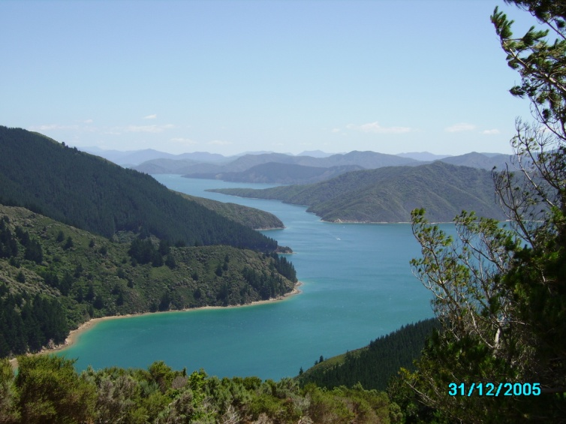
What is the land doing?
Submerging
Drowned valleys (e.g. Marlborough Sounds)
Deep embayments
Emerging
Straight shorelines
Marine cliffs (e.g. Kaikoura Peninsula)
Neutral
Deltaic coasts
Alluvial plains (e.g. Canterbury Plains)
Photograph: C. Kain

Slide 6
Agents of coastal change
Base level change
Tectonics
Sea level change
Sediment supply
Lithology (type of sediment)
Delivery
Human actions
Modify process
Modify morphology
Modify linkages

Slide 7
Coastal processes and timeframes
Geological
Inner continental shelf
Lower shoreface
Tidal Basin
Engineering
Transgressive dune
Inlet-rivermouth
Event
Upper shoreface
Frontal dune
Surfzone bars
Size of feature
Instantaneous
Beachface
Ripple
Time taken for change to occur
Adapted from Cowell and Thom, 1994.
Notes:
The writing in bold is the type of change and the bullet points are the features that change on this particular scale.
Coasts are constantly making adjustments to accommodate variations in energy input and modifications
Change can occur in response to natural processes such as waves, tides and ocean currents, from short term changes associated with local winds which alter the local wave environment, diurnal changes associated with the tides, synoptic conditions which can result in large storm events.
Similarly, change can occur in response to human actions where sand dunes are lowered removing sand from the beach system, building of structures within the active beach zone, and damming of rivers or the building of groynes which change the sediment supply to the beach.

Slide 8
Beaches
What is a beach?
A beach occurs at the MARGIN of a water body where wave action is the principal agent of change.
Why study beaches?
To understand the processes, identify danger and manage hazards
Notes:
Beaches are dynamic and are found at the interface between water and land.
Beaches can be found both at the coast and also on lake shores.
Beaches are also the place were people choose to live and/or visit for recreation.
Beaches can be places of beauty and places of enjoyment but they can also be places of extreme hazard and danger.
We study beaches to find out how they operate - what makes them behave in the ways that they do. With and understanding of the processes operating at beaches we can maximise the potential for enjoyment and safety for all beach users and identify areas of danger.

Slide 9
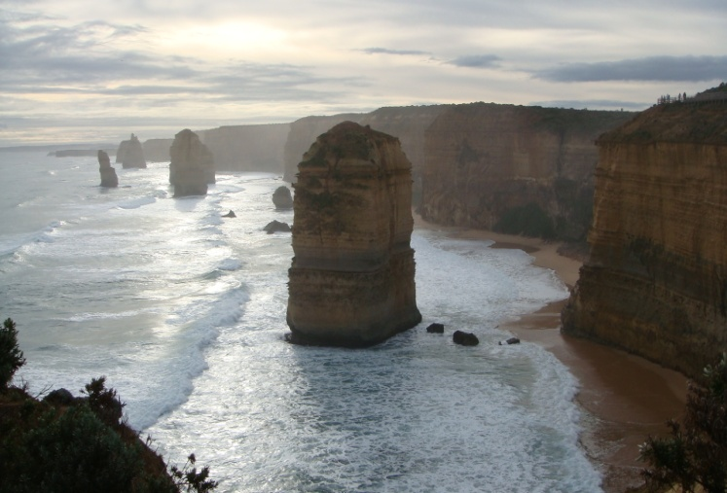
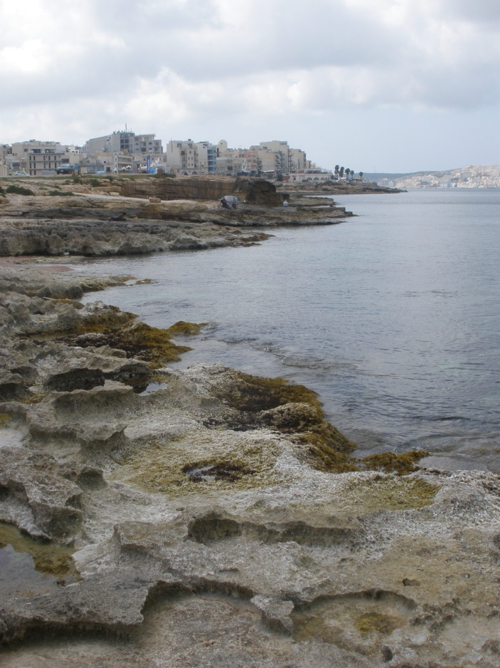
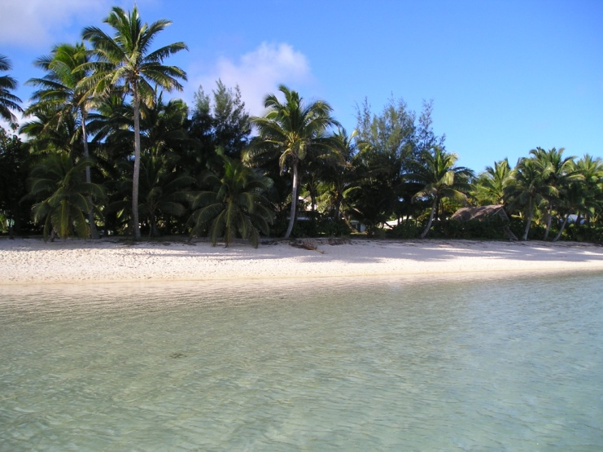
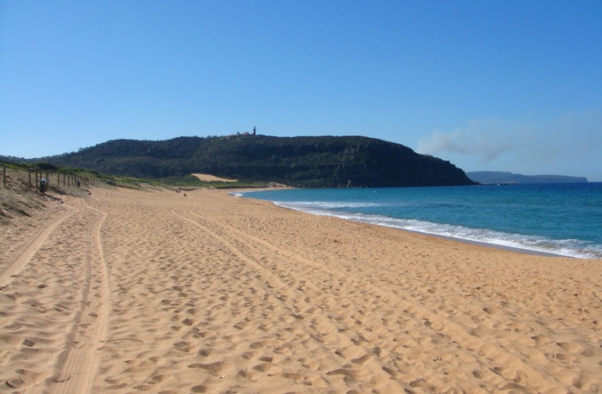
Beaches come in many shapes and sizes
Photographs: C. Kain
Notes:
Beaches come in many forms from sand beaches, to coarser sediments such as gravels to hard shore and platform development.
High energy composite beach – Westland NZ
“12 Apostles” Marine cliffs in Victoria, Australia
White calcareous sand beach in Rarotonga, inside a coral reef lagoon (VERY low energy)
Palm Beach, “Summer Bay of Home and Away”, Sydney
Rock platform, Bugibba, St Paul’s Bay, Malta (Mediterranean Sea)

Slide 10
The Dynamic Beach
Each beach is different
Beaches respond to changes in wave energy (try to reach an equilibrium)
Beaches dissipate energy through the movement of sediment (primarily by waves and wind)
Beaches are natural barriers (they protect us!)
Notes:
Sediment is moved on and off shore to adjust to the energy being applied to the system
It is natural for beaches to erode and deposit
Erosion only becomes a problem when people and their property are effected
Natural barriers e.g. Brighton sand dunes. Debate between council and public between wanting a view vs natural tsunami/surge buffer. Sand dunes are natural, e.g. riccarton…beach front 6500ybp, Linwood cemetery…Raised up on ancient sand dunes
comprised simply of grains of loose sand or shingle.
This enables beaches to adapt their shape very quickly to changes in wave energy, and also dissipate this energy in minor adjustments of the position of each sand or shingle grain.
the beach is able to maintain itself in a dynamic equilibrium with its environment due to the inherent mobility of its sediment.
Beach slope is the result of wave energy-higher=steeper, gentle=less of a slope

Slide 11
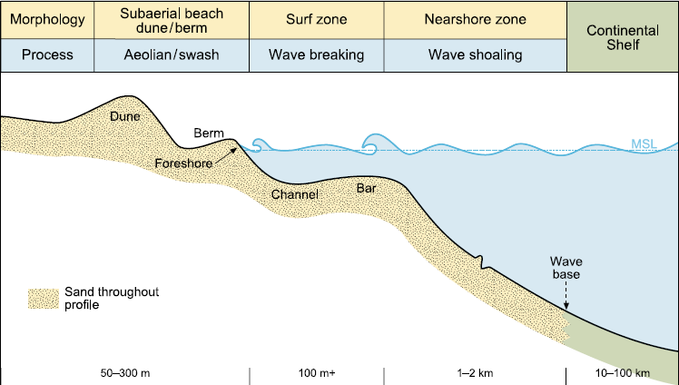
Profile of a sand beach
Source: Hart et al., 2007

Slide 12
During a storm...
Large waves travel a long way up the beach, causing erosion
Sand is removed from the dune and deposited in a bar offshore
The bar helps dissipate wave energy by making waves break further offshore, reducing erosion
Once the storm is over, the sand is slowly brought back to the beach by the waves and deposited on the dunes by wind
Notes:
On a natural beach backed by sand dunes in a storm large waves can travel a long way up the beach. In doing so sand is removed from the dune system and deposited offshore in the form of off-shore bars.
bars in turn enable the to dissipate the wave energy. Additionally, these off-shore bars ensure that the large waves break further off-shore and therefore have less energy to force water up the beach thereby helping to limit further erosion to the backshore and dune system.
Other process erosion(wind) transport(wind) and deposition…dune formation
Once the storm is over and waves return to swell conditions, sand is slowly brought back on shore by the waves. This sand is in turn brought up the beach, allowed to dry and is subsequently blown back into the foredune to rebuild the sand dunes eroded during the previous storm. In effect the sand is returned back into storage ready for the next storm.
You need to understand natural processes before you build a big wall, the beach has a funny way of sorting itself out if left alone!

Slide 13
Human interaction with coasts
We like to live there – coasts are attractive and rich in resources.
Coastal structures that can affect our coasts include:
Ports/harbours
Sea walls and other protection structures
Marine farms
Piers
Boat ramps
Infrastructure (e.g. Stormwater, roads, power poles)

Slide 14
Indirect human effects on the coast
If rivers are dammed, then sediment can’t reach the coast.
If too much water is taken out of the river, its capacity to transport sediment is reduced.
If a river can no longer bring sufficient sediment to the coast - erosion will occur.
If sand dunes are cut down so people can see the sea - there is no longer any coastal protection in times of storm or tsunami.
Structures change the morphology of the beach and affect sediment moving along it (e.g. New Brighton Pier).
Notes:
Remember, the coast is a system that is affected by many connecting variables and a change in any one or a combination of these can have a large impact at the coastline itself.

Slide 15
Coastal hazards
Occur when people and the coast meet. A natural process is not a hazard until people or infrastructure are threatened!
Coastal erosion and coastal flooding are the main coastal hazards.
Affect people and buildings located within the zone of natural shoreline change.
Coastal flooding will increase due to sea level rise caused by global warming
Others include: wind erosion, storms and tsunami

Slide 16
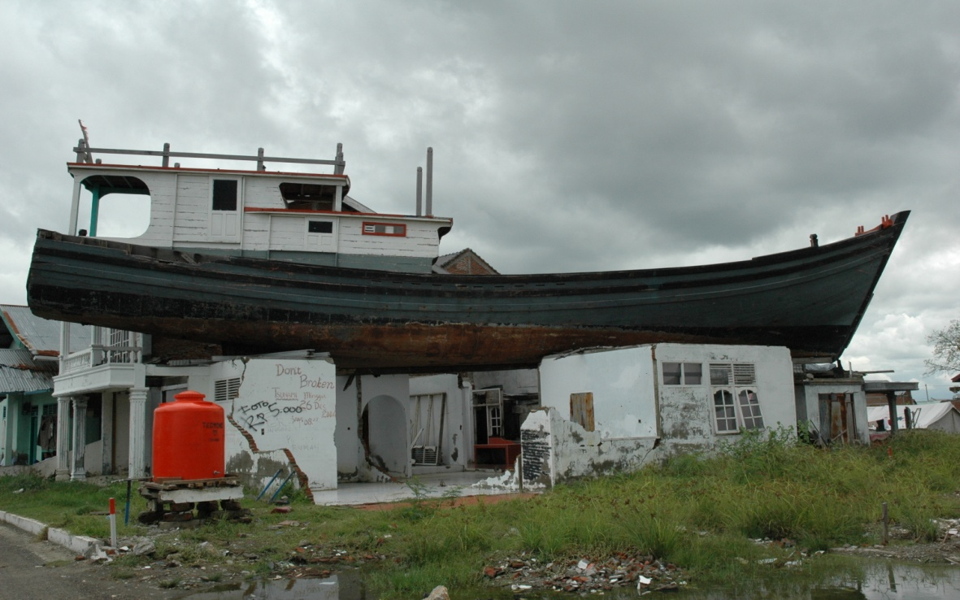
hd
Top: Coastal erosion in the Canterbury Bight (photograph, T. Konlechner)
Right: Boxing Day Tsunami in Banda Aceh, 2004 (photograph, C. Gomez)

Slide 17
Options for erosion management
Do nothing
Works well where coasts are relatively free from development
Avoid
Prevent development in the first place
Accommodate
Change land use, building codes, insurance premiums...
Retreat
Move your house/village – most sustainable option long term
Protect
Use engineered options. This is never a permanent fix. (e.g. Amberley Beach)

Slide 18
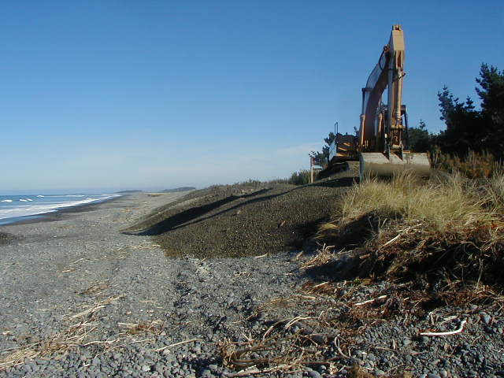
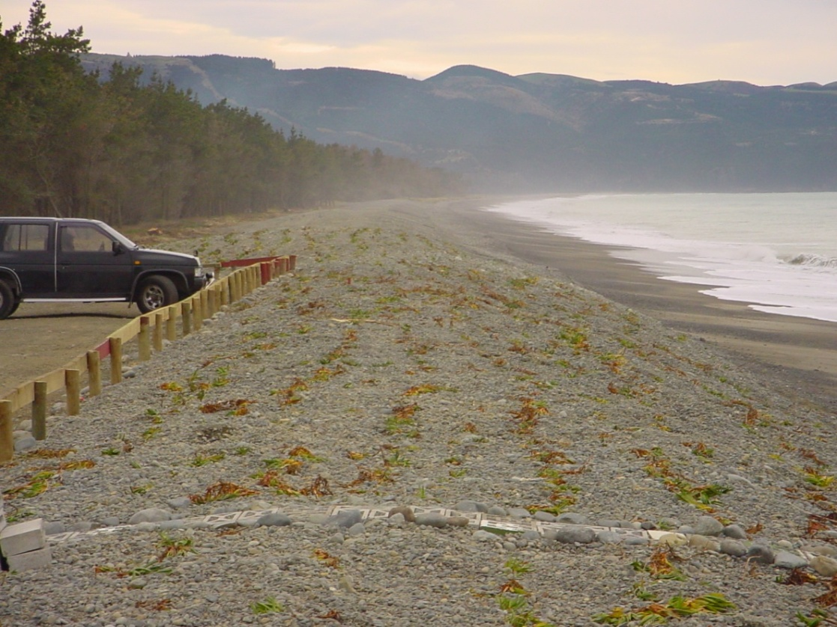
Amberley Beach: Erosion solved??
Top: Amberley Beach in a state of severe erosion, 2002
Top right: Renourishment works, 2004. 10 000 m³ of gravel added to beach
Right: After sediment was added, vegetation was planted to help stabilise the new dunes
Photographs: DTec Consulting Ltd
Notes:
Renourishment was initially undertaken in 2004, with a top up of 6000 cubic metres of sediment added in 2007 after erosion continued to be a problem.

Slide 19
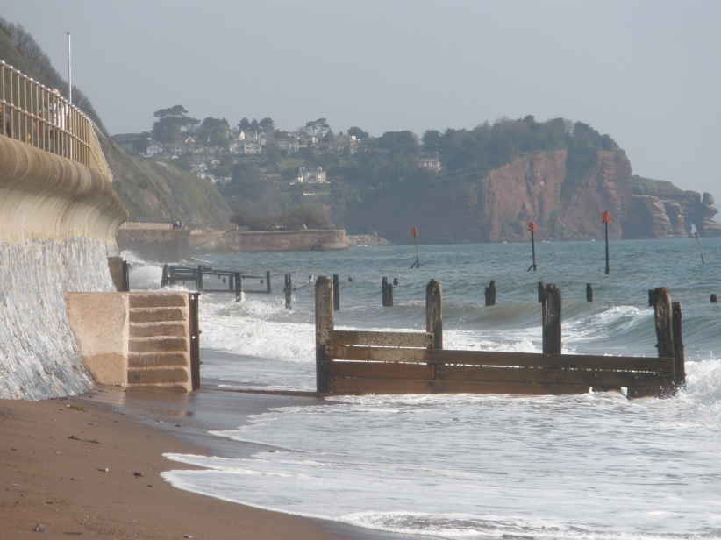
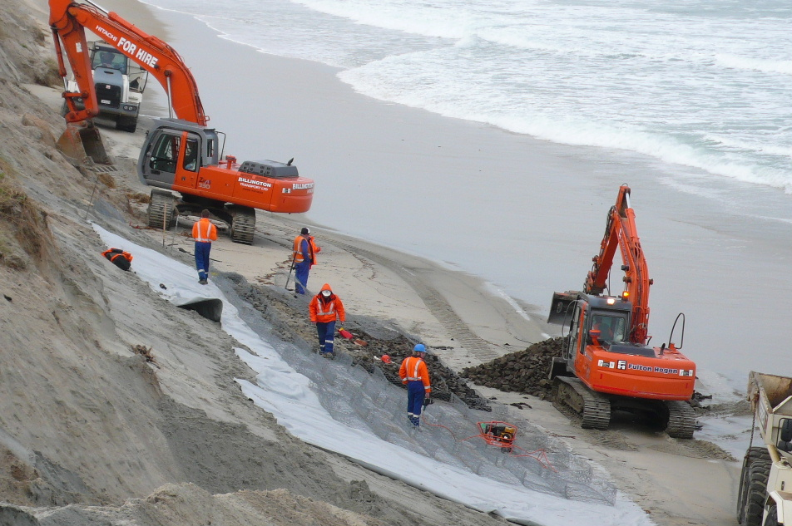
Photograph: C. Kain
Photograph: C. Kain
Top: Sea wall and groyne series, Teignmouth, Devon, England
Top right: Rip-rap revetment, Punakaiki Beach, West Coast
Right: Renourishment works, St. Clair, Dunedin
Photograph: DTec Consulting

Slide 20
The Development-Disaster Cycle
Storm Event
Awareness of risk
Demand for defence
Defence works
Communities/ individuals feel secure
More coastal development
(Modified from Carter et al., 1999)

Slide 21
The future of the world’s coasts
Coastlines have been changing shape since the beginning of time – this is not a new phenomenon!
Sea level rise, increased storminess and changing weather patterns (due to climate change) will cause a lot of change in coming years
This leads to an increase in coastal hazards for us as coastal users

Slide 22
Conclusion
Coasts are dynamic - they are sensitive to changes
Coastal change can result from changes in natural processes, human actions or a mixture of both
Coastal change is ongoing
We must try to understand this change in order to work with it

Slide 23
For more info on available Geography courses at the University of Canterbury:
www.geog.canterbury.ac.nz

