Slide 1
Biosecurity OZ vs NZ 31 March 2023 12:30 - 2:30pm

Slide 2
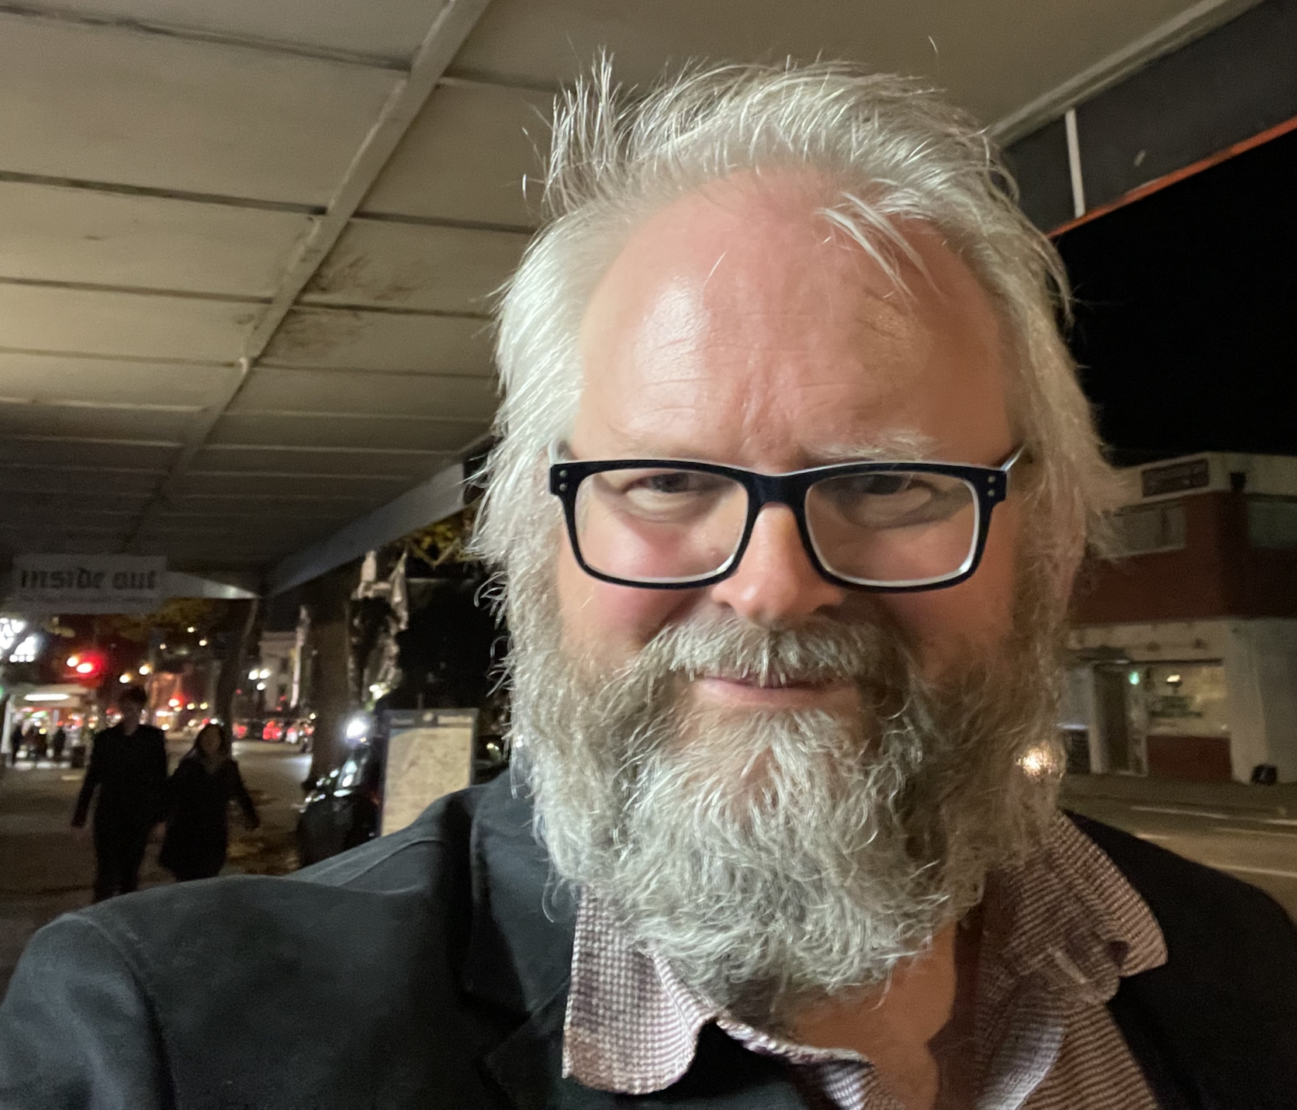
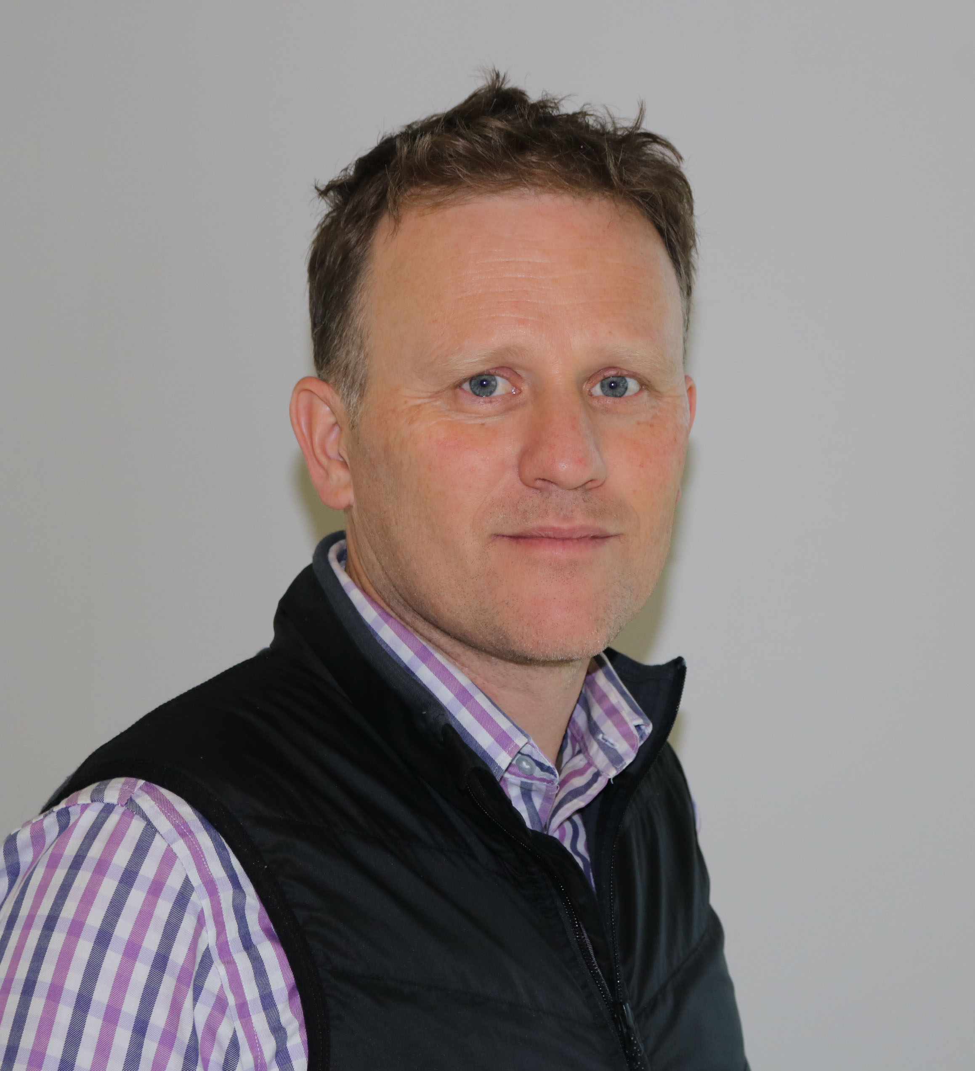
Introductions
Steve Pawson (chair)
Prof. Andrew Robinson
Dr Leigh Tait

Slide 3
Andrew Robinson

Slide 5
Questions

Slide 6
Dr Leigh Tait

Slide 7
Questions

Slide 8
Summary

