Slide 1
EXPECT: South Korea’s Perception of and Expectation on EU The case of Printed media

Slide 2
Content
1 | Bilateral relations with EU
2 | Monitored outlets
3 | Visibility of EU & Hot issues
4 | Sources of EU news
5 | Centrality
6 | Domesticity
7 | Action frames
8 | Bilateral relations
9 | Evaluation
10 | Expectations
11 | Visual images
12 | Conclusions

Slide 3
1. Bilateral relations with EU
Diplomatic relations was established in | 1963
Framework Agreement was signed in | 1997
EU Delegation Office opened in | 1989
Annul summit began in | 2002
Strategic partnership was established in | 2010
EU as trade partner | 9th (export)
EU as investor | 1st
Problems | no

Slide 4
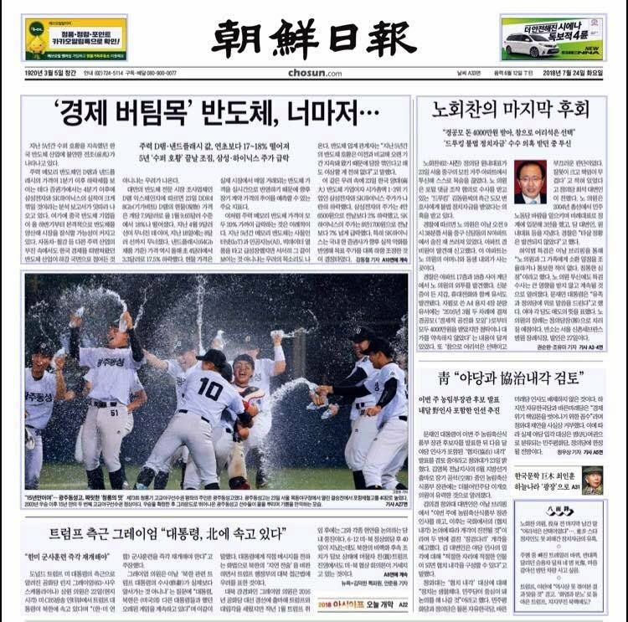
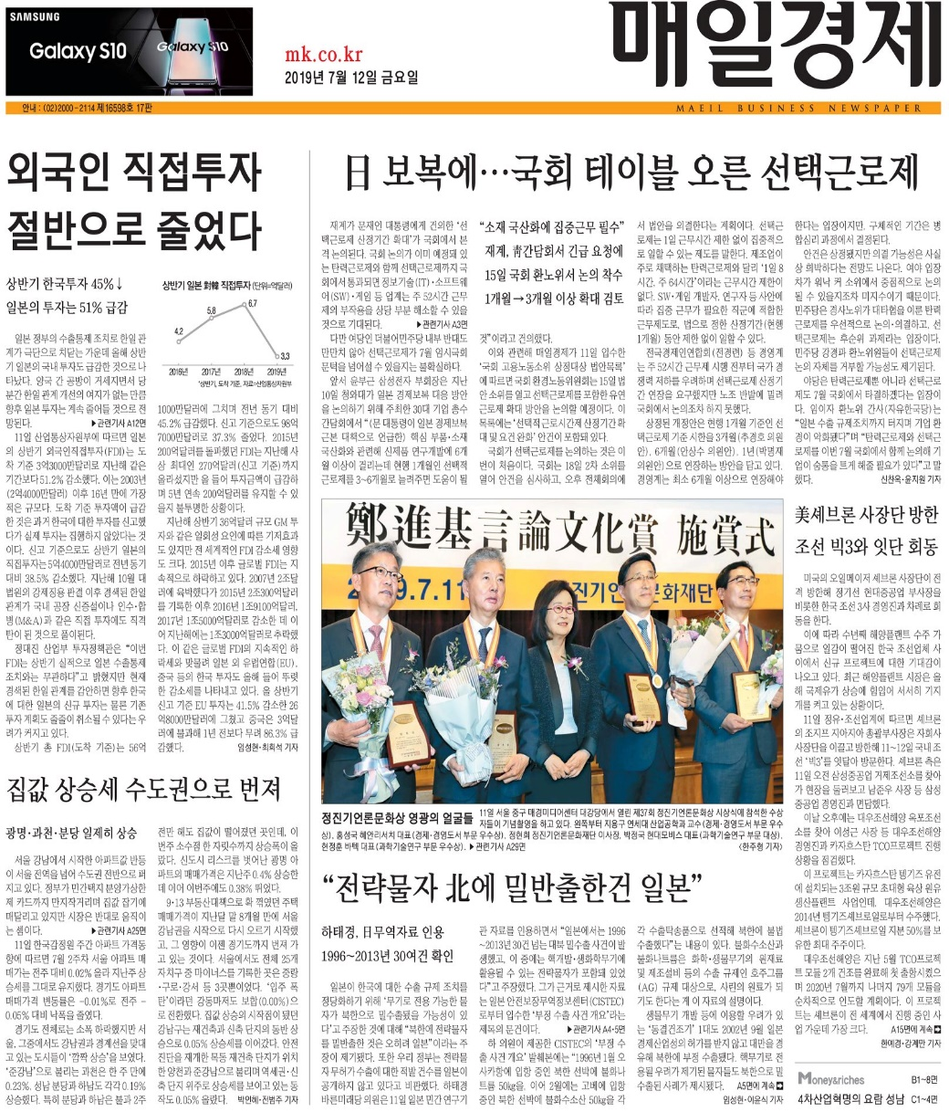
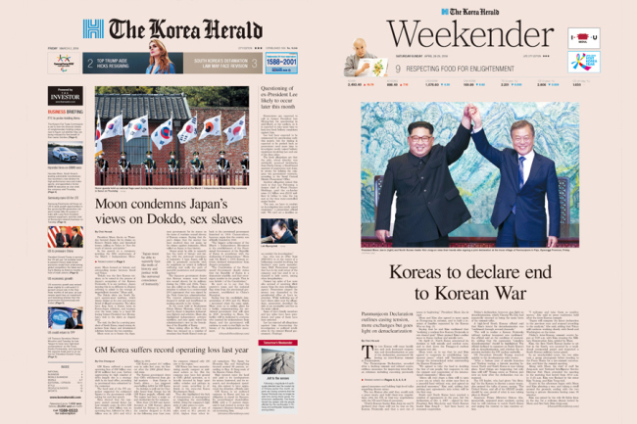
2. Monitored Press in South Korea

Slide 5
Type | Selected outlets | Ownership | Founding year, online Presence | Circulation
Popular daily | Chosun Ilbo | Family | 1919, 1995 (https://about.chosun.com/mobile/pages/company_c02.php) | 1,065,090 (2021)
Business daily | Maeil Business | Non-Profit Cooperation | 1966, 1999 (https://etc.mk.co.kr/company/intro/sub01_2.php) | 554,228 (2020)
English-language daily | Korea Herald | Family | 1953, 1999 (http://company.heraldcorp.com/history.php?lang=kor) | 30,973 (2015)
Weekly | Donga | Family | 1995 (https://damg.recruiter.co.kr/appsite/company/callSubPage?code1=3000&code2=3100&code3=3120) | 60,000

Slide 6
3. Visibility of the EU (n=1072)

Slide 7
EU’s appearance on Front Page

Slide 8
Average length of EU-news (major/2nd)

Slide 11
North Korea in EU-related news (n=1072)

Slide 12
Other hot issues in EU-related news (n=1072)

Slide 13
4. Sources (n=1072)

Slide 14
Sources of EU news
 | Writers |  | News wires
 | 2020 | 2021 | 2020 | 2021
1st | Deokshik KIM (Maeil Kyungje) | Jinseok SON (Chosun Ilbo) | - | Yonhap (Local)
2nd | Jegwan KIM (Maeil Kyungje) | Jegwan KIM (Maeil Kyungje) | - | Reuters (International)
3rd | Jinseok SON (Chosun Ilbo) | Deokshik KIM (Maeil Kyungje) | - | AFP (International)
Editorial | 15 | 8 | - | -

Slide 15
5. Centrality (n=1072)

Slide 16
6. Domesticity (n=1072)

Slide 17
Domesticity (Major/2nd, n=304)

Slide 18
Centrality of EU in Local news

Slide 19
7. EU actions (Main/2nd focus, n=304)

Slide 20
Intra-EU actions (Major/2nd)

Slide 21
Sub-frame of intra-EU actions (Main/2nd focus)
 | 2020 | 2021
Promoting our European Way of Life | Health care
An Economy that Works for People | Economic (crisis)
EU integration | Solidarity challenged by COVID 19 | -

Slide 22
Extra-EU actions (Major/2nd)

Slide 23
Sub-frame of extra-EU actions (Main/2nd focus)
 | 2020 | 2021
A stronger Europe in the world | CFSP | CFSP
Promoting our European Way of Life | Health care
An Economy that Works for People | Economy/Trade | Trade

Slide 24
8. Bilateral relation (Main/2nd focus)

Slide 25
Bilateral relation with South Korea (Main/2nd focus)
 | 2020 | 2021
Chosun Ilbo | - | -
Maeil | - | Korean companies granted access to EU market (after getting certificate/ meeting standard)
Korean Herald | - | EU-Korea cooperation
Weekly Donga | - | -

Slide 26
9. Evaluation of EU (Major/2nd, n=304)

Slide 27
Evaluation of intra-EU actions

Slide 28
Evaluation of extra-EU actions

Slide 29
10. Expectation on EU (Main/2nd focus , n=304)

Slide 30
Evaluation of EU (Main/2nd focus , n=304)
 |  | Leading +ve Story | Leading -ve Story
2020 | Chosun Ilbo | a EU solution to Covid-hit economy | Covid-hit economy & division among EU MS
 | Maeil
2021 | Chosun Ilbo | recovering from Covid19 | Covid vaccine problems & economic downturn
 | Maeil | recovering from Covid19 | Covid vaccine problems & economic downturn
 | Korean Herald | EU-Korea cooperation | -

Slide 31
South Korea’s Expectation on EU
 | 2020 (1 expectation) | 2021 (17 expectations)
1st | EU MS to help each other in economic crisis | To export Covid19 to SK without delay
2nd | - | To support SK in Korean peace process
3rd | - | To cooperate with SK in green transition

Slide 32
Reported EU’s self-expectation
 | 2020 (17 expectations) | 2021 (17 expectations)
1st | EU MS should help each other in economic crisis | To protect public health in EU
2nd | EU MS should spend fiscal expenditure responsibly | To protect EU economy
3rd | To protect EU business (from China) | -

Slide 33
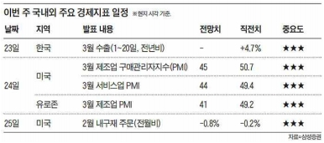
11. Visual images of EU (2020)

Slide 34
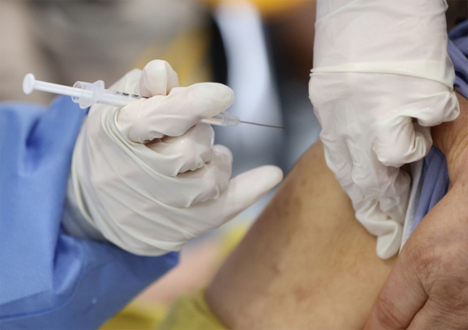
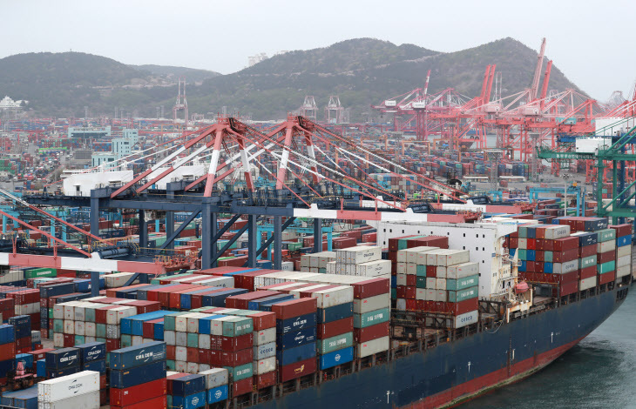
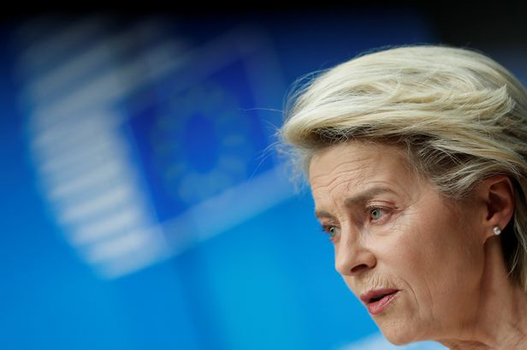
Visual images of EU (2021)

Slide 35
12. Conclusions
EU has been a visible actor, but not important
South Korea’s attention on EU has grown between 2020 and 2021 (EU’s proactive actions on Xinjiang human right issues was one of the reason)
Maeil (business-daily) has been the most interested in reporting the EU
Shadow of Covid19 has reduced between 2020 and 2021
South Korean press is NOT interested in Brexit
EU appeared frequently in local-context, yet, these news stories always featured EU only as a minor actor

Slide 36
Conclusions (2)
A significant rise in extra-EU action was found in 2021 compared to 2020
For intra-EU actions, Korean press focused on the Covid-hit economy and EU’s lack of quick remedies in 2020. These were reported negatively. In 2021, the focus shifted to measures related to recovery, which were reported in a neutral tone.
For extra-EU actions, changes in travel restriction and political actions of EU in various international conflicts boosted the visibility of the EU in Korea. These were reported neutrally and sometimes even positively
South Korea expressed quasi-no expectation towards EU in 2020, and low expectation in 2021
NO Capability-Expectations Gap

